Slide 1
CSCCORE1I Software Engineering 1 Java: Basic Java - Revision
Mark Greenwood
email: greenwm1@hope.ac.uk
Zoom: https://hope.zoom.us/j/4155561823
room: FML202

Slide 2
Overview
Objects and Classes
UML for a class (revision)
Primitives vs References
Static methods, constants and variables
Access Modifiers
Passing objects to methods
Using this

Slide 3
OO Programming Concepts
Object-oriented programming (OOP) involves programming using objects.
An object represents an entity in the real world that can be distinctly identified. For example, a student, a desk, a circle, a button, and even a loan can all be viewed as objects.
An object has a unique identity, state, and behaviors.
The state of an object consists of a set of data fields (also known as properties) with their current values. The behavior of an object is defined by a set of methods.

Slide 4
Objects
An object has both a state and behavior. The state defines the object, and the behavior defines what the object does.

Slide 5
Classes
Classes are constructs (templates) that define objects of the same type.
A java class uses variables to define data fields and methods to define behaviors.
Additionally, a class provides special types of methods known as constructors which are invoked to construct objects from the class.

Slide 6
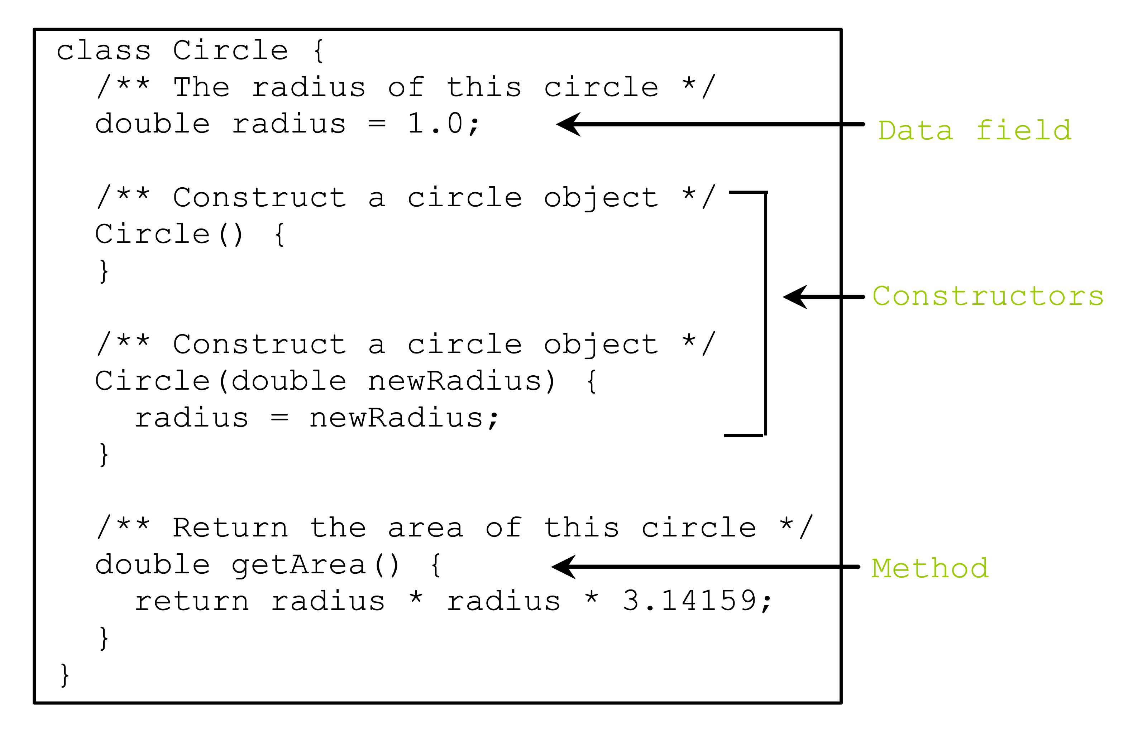
Classes

Slide 7
UML Class Diagram

Slide 8
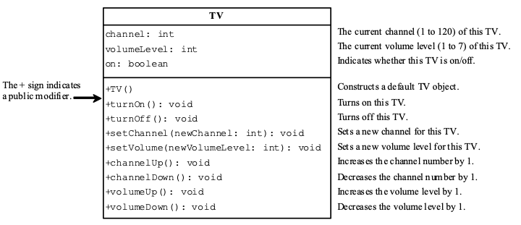
Example: Defining Classes

Slide 9
Constructors
Circle() {
}
Circle(double newRadius) {
radius = newRadius;
}

Slide 10
Constructors
A constructor with no parameters is referred to as a no-arg constructor.
Constructors must have the same name as the class itself.
Constructors do not have a return type—not even void.
Constructors are invoked using the new operator when an object is created. Constructors play the role of initializing objects.

Slide 11
Creating objects using constructors
new ClassName();
Example:
new Circle();
new Circle(5.0);

Slide 12
Default Constructor
A class may be defined without constructors.
In this case, a no-arg constructor with an empty body is implicitly defined in the class.
This constructor, called a default constructor, is provided automatically only if no constructors are explicitly defined in the class.

Slide 13
Reference Variables
To reference an object, assign the object to a reference variable.
To declare a reference variable, use the syntax:
ClassName objectRefVar;
Example:
Circle myCircle;

Slide 14
In one step
ClassName objectRefVar = new ClassName();
Example:
Circle myCircle = new Circle();

Slide 15
Accessing Object’s Members
Referencing the object’s data:
objectRefVar.data
e.g., myCircle.radius
Invoking the object’s method:
objectRefVar.methodName(arguments)
e.g., myCircle.getArea()

Slide 16
Reference Data Fields
The data fields can be of reference types. For example, the following Student class contains a data field name of the String type.
public class Student {
String name; // name has default value null
int age; // age has default value 0
boolean isScienceMajor; // isScienceMajor has default value false
char gender; // c has default value '\u0000'
}

Slide 17
The null Value
If a data field of a reference type does not reference any object, the data field holds a special literal value, null.

Slide 18
Default Values for a Data Field
The default value of a data field is:
null for a reference type,
0 for a numeric type,
false for a boolean type
'\u0000' for a char type.
However, Java assigns no default value to a local variable inside a method.

Slide 19
Example
public class Test {
public static void main(String[] args) {
int x; // x has no default value
String y; // y has no default value
System.out.println("x is " + x);
System.out.println("y is " + y);
}
}
Compile Error!

Slide 20
Primitive and Reference Types

Slide 21
Primitive and Reference Types

Slide 22
Garbage Collection
As shown in the previous slide:,
After the assignment statement c1 = c2, c1 points to the same object referenced by c2.
The object previously referenced by c1 is no longer referenced.
This object is known as garbage. Garbage is automatically collected by JVM.

Slide 23
Garbage Collection
TIP:
If you know that an object is no longer needed, you can explicitly assign null to a reference variable for the object. The JVM will automatically collect the space if the object is not referenced by any variable.
You can use java.lang.System.gc() to hint to the JVM that it’s about time to sweep the heap.

Slide 24
Static Variables, Constants and Methods
Static variables are shared by all the instances of the class.
Static methods are not tied to a specific object.
Static constants are final variables shared by all the instances of the class.
To declare static variables, constants, and methods, use the static modifier.

Slide 25
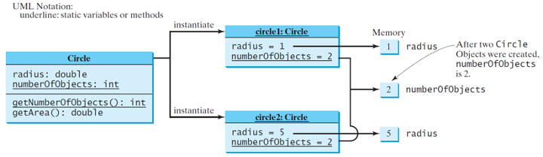
Static Variables, Constants and Methods

Slide 26
Access Modifiers
default (no modifier) – visible withing this package
private – visible ONLY within this class or this .java file
protected – visible in this class and in derived (sub) classes
public – visible everywhere

Slide 27
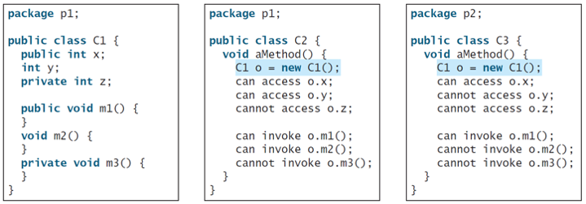
Access Modifiers

Slide 28
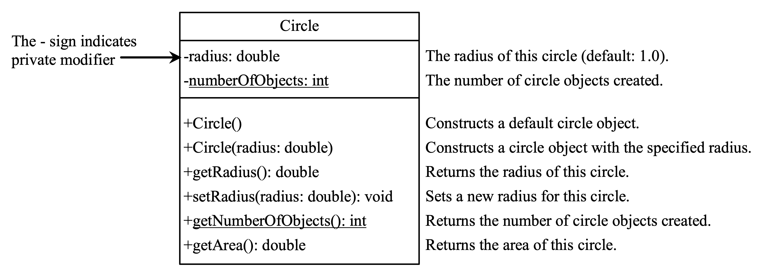
Data Fields Should be Private!
Protects data from bad programmers or habits
Easier to maintain

Slide 29
Passing objects to methods
Passing by value for primitive type value (the value is passed to the parameter)
Passing by value for reference type value (the value is the reference to the object)

Slide 30
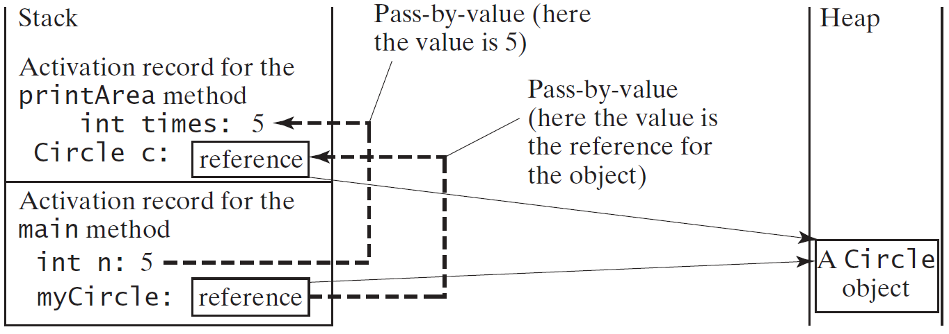
Passing objects to methods

Slide 31
Try this
public static void main(String[] args) {
int a = 0;
addOneToInt(a);
System.out.println("The value of a is : " + a);
List<Integer> intList = new ArrayList<>();
intList.add(1);
addOneToList(intList);
for(Integer i:intList) {
System.out.println("The value is : " + i.intValue());
}
}
public static void addOneToInt(int a) {
a = a + 1;
}
public static void addOneToList(List<Integer> integerList) {
integerList.add(2);
}

Slide 32
Arrays of Objects
Circle[] circleArray = new Circle[10];
An array of objects is actually an array of reference variables.
So; invoking circleArray[1].getArea() involves two levels of referencing as shown in the next slide.
circleArray references to the entire array.
circleArray[1] references to a Circle object.

Slide 33
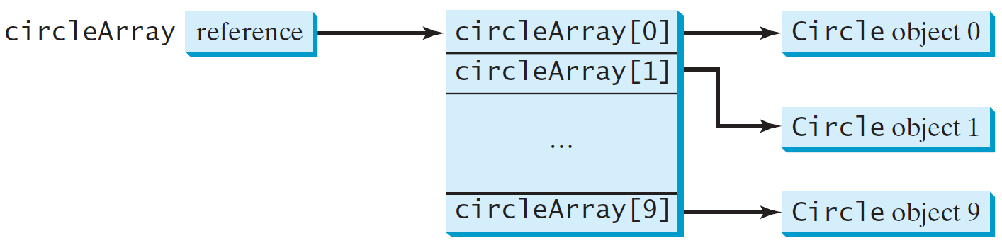
Arrays of Objects
Circle[] circleArray = new Circle[10];

Slide 34
Scope of Variables
The scope of instance and static variables is the entire class. They can be declared anywhere inside a class.
The scope of a local variable starts from its declaration and continues to the end of the block that contains the variable. A local variable must be initialized explicitly before it can be used.

Slide 35
The this keyword
The this keyword is the name of a reference that refers to an object itself. One common use of the this keyword is to reference a class’s hidden data fields.
Another common use of the this keyword to enable a constructor to invoke another constructor of the same class.

Slide 36
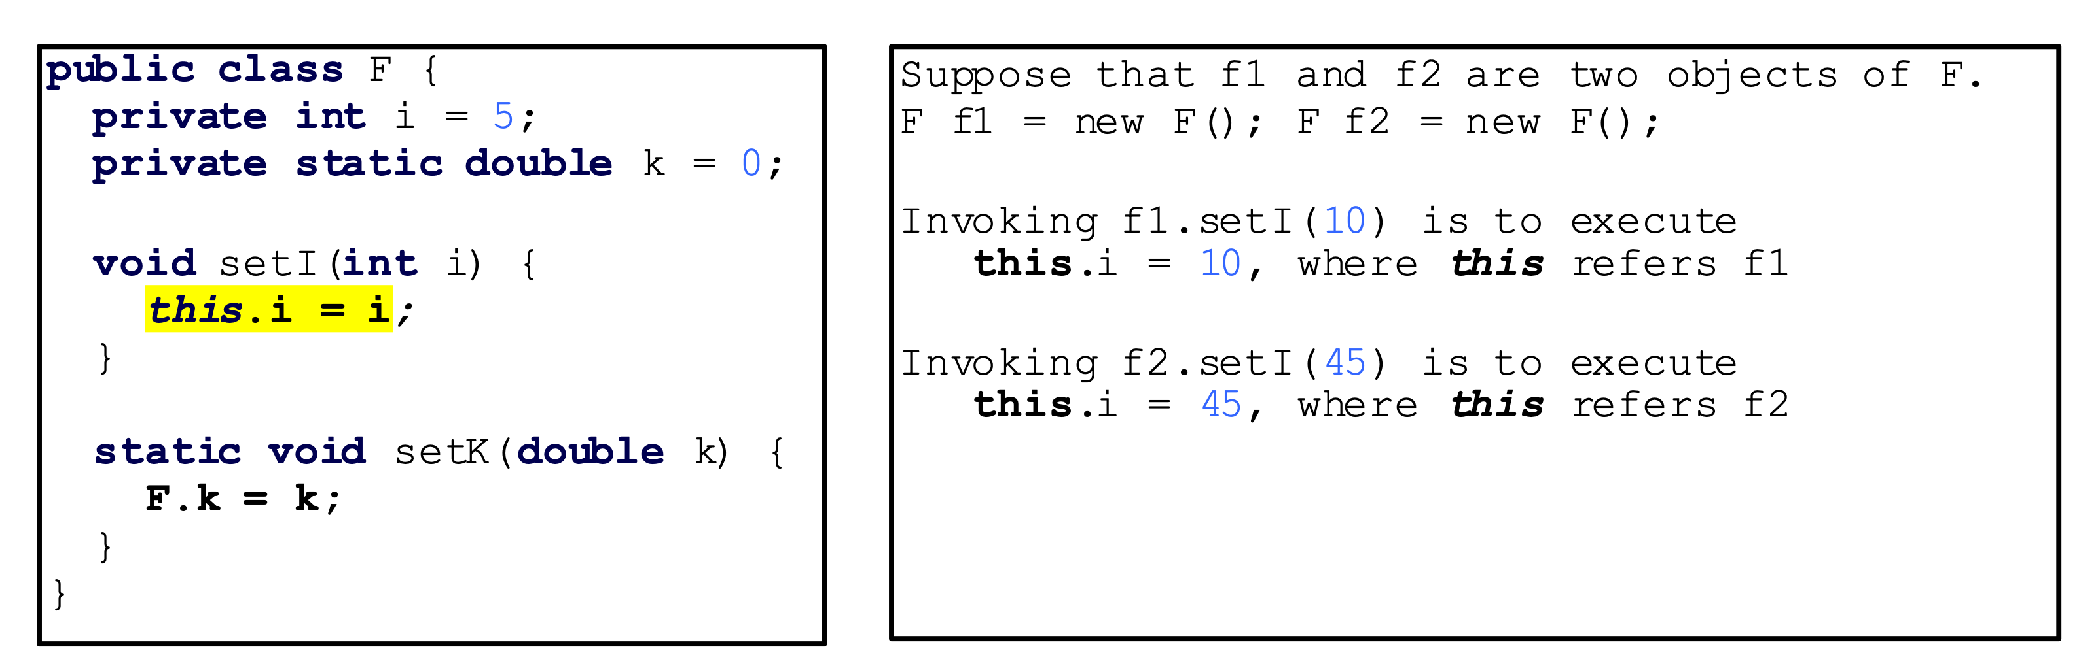
this – reference hidden fields
Adds clarity and aids understanding.

Slide 37
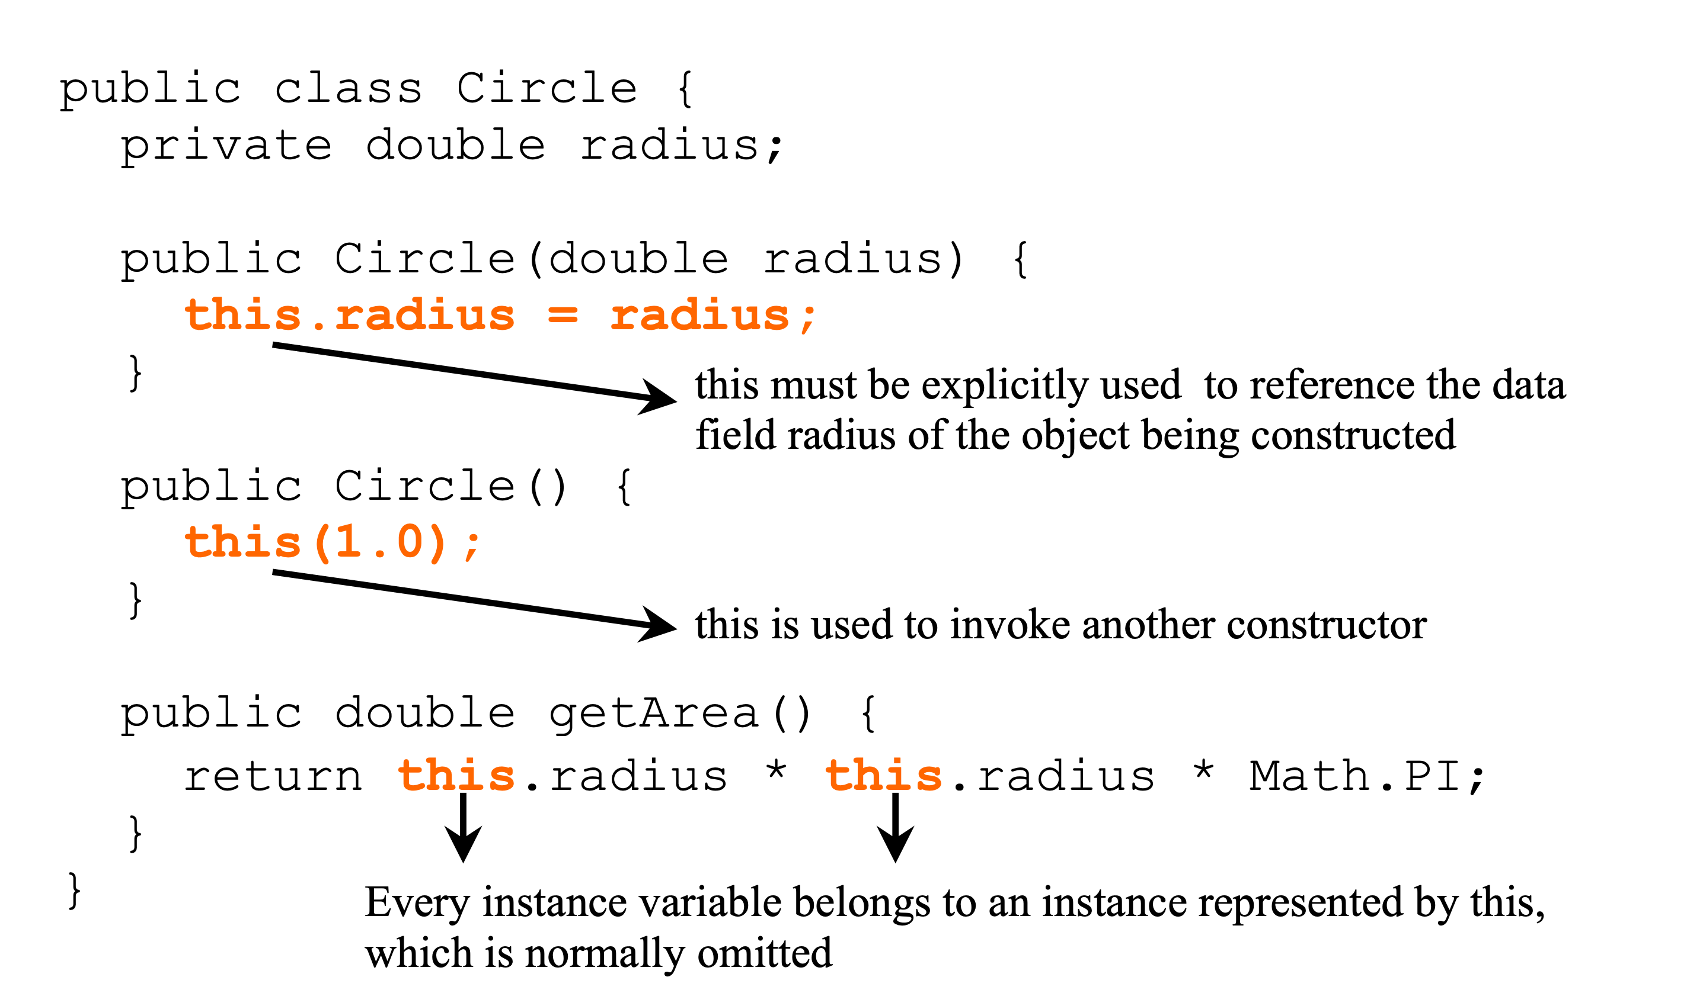
this – an overloaded constructor

Slide 38
Next Week
Thinking in Objects:
How to design software and solve problems using OO constructs

