Slide 1
♛ ♛ ♛
JANSAHAY
AI PUBLIC-SERVICE COPILOT
Navigate government services effortlessly. Our AI copilot
understands your needs, checks eligibility, and guides you
step-by-step through any public-service journey.
TEAM NAME : [Your Team Name]
TEAM MEMBERS : [Member 1, Member 2, Member 3]
JANSAHAY
01 / 07

Slide 2
♛ ♛ ♛
PROBLEM STATEMENT
🔍
Discovery Gap
📄
Document Friction
THE SCALE
Citizens struggle to discover which government schemes they qualify for among thousands of programs across departments.
Manual document verification is slow, error-prone, and creates bottlenecks delaying benefit distribution.
950M+
Indians lack easy access
to government schemes
70%
of eligible beneficiaries
never apply
🌐
Accessibility Barriers
⏱
No Unified Tracking
₹2.7L Cr
in welfare benefits
go unclaimed yearly
Language barriers and low digital literacy exclude the most vulnerable populations from vital services.
No way to track applications across departments — missed deadlines, lost paperwork, repeated visits.
23+
ministries with separate
portals & processes
JANSAHAY
02 / 07

Slide 3
♛ ♛ ♛
SOLUTION
How JANSAHAY transforms public service access
01
02
03
04
💬
📋
🎯
📊
→
→
→
PROACTIVE AI COPILOT
DOCUMENT DOCTOR
SMART MATCHING
JOURNEY TRACKER
Understands user needs in natural language and instantly matches them with relevant government services and schemes.
AI-powered extraction and verification of details from uploaded documents — income certificates, IDs, and more.
Proactively discovers schemes citizens qualify for based on their profile, alerting them to new opportunities.
Unified dashboard to track every application with real-time status updates, reminders, and next-step guidance.
JANSAHAY
03 / 07

Slide 4
♛ ♛ ♛
ARCHITECTURE
FRONTEND
React / Next.js
Tailwind CSS, TypeScript
Responsive Web App
TECH STACK
Frontend
React, Next.js, Tailwind CSS, TypeScript
▼
AI ENGINE
LLM Orchestration
Intent + Entity Extraction
Semantic Matching
AI / ML
LLMs (GPT / Gemini), OCR, NLP Pipelines
Backend
Python FastAPI, Node.js, REST APIs
▼
PROCESSING
OCR / NLP Pipelines
Eligibility Rule Engine
Scheme Database Indexer
Database
PostgreSQL, MongoDB, Redis
DevOps
Docker, Kubernetes, CI/CD, AWS/GCP
▼
DATA LAYER
PostgreSQL / MongoDB
Encrypted Cloud Storage
Redis Cache
Security
OAuth 2.0, AES Encryption, RBAC
JANSAHAY
04 / 07

Slide 5
♛ ♛ ♛
TECHNOLOGY USED
⚛
🧠
⚙
🔒
FRONTEND
AI & INTELLIGENCE
BACKEND & INFRA
TRUST & SECURITY
React / Next.js
Large Language Models
Python (FastAPI)
OAuth 2.0 / JWT
TypeScript
Computer Vision / OCR
Node.js Runtime
AES-256 Encryption
Tailwind CSS
NLP Pipelines
PostgreSQL + MongoDB
RBAC Policies
Framer Motion
Vector Search
Docker & K8s
Audit Logging
JANSAHAY
05 / 07

Slide 6
♛ ♛ ♛
WORKING PROTOTYPE
▶
CLICK TO PLAY DEMO
Attach video link for demo
LIVE DEMO
GITHUB REPO
VIDEO DEMO
[URL]
[URL]
[URL]
JANSAHAY
06 / 07

Slide 7
♛ ♛ ♛
UTILITY / SCALABILITY
10×
90%
24/7
∞
Faster scheme
discovery
Document processing
accuracy
AI assistance
availability
Scalable to any
government scheme
UTILITY
SCALABILITY
Bridges the digital divide for millions of underserved citizens
Reduces processing time from weeks to minutes with AI verification
Eliminates missed opportunities through proactive scheme matching
Supports multi-language interactions for inclusive access
Cloud-native microservices for horizontal scaling
Plug-and-play integration with new government portals
WhatsApp / voice assistant integration for wider reach
Deploy at district, state, or national level
JANSAHAY
07 / 07

Slide 8
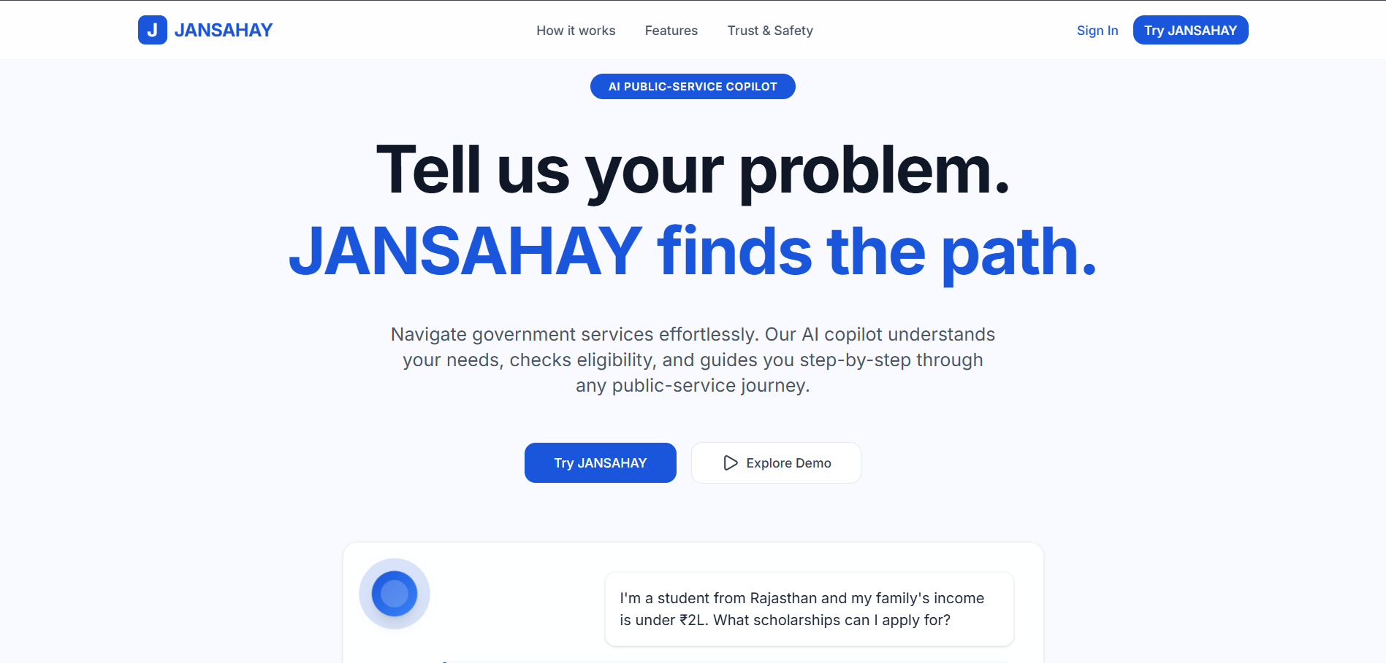
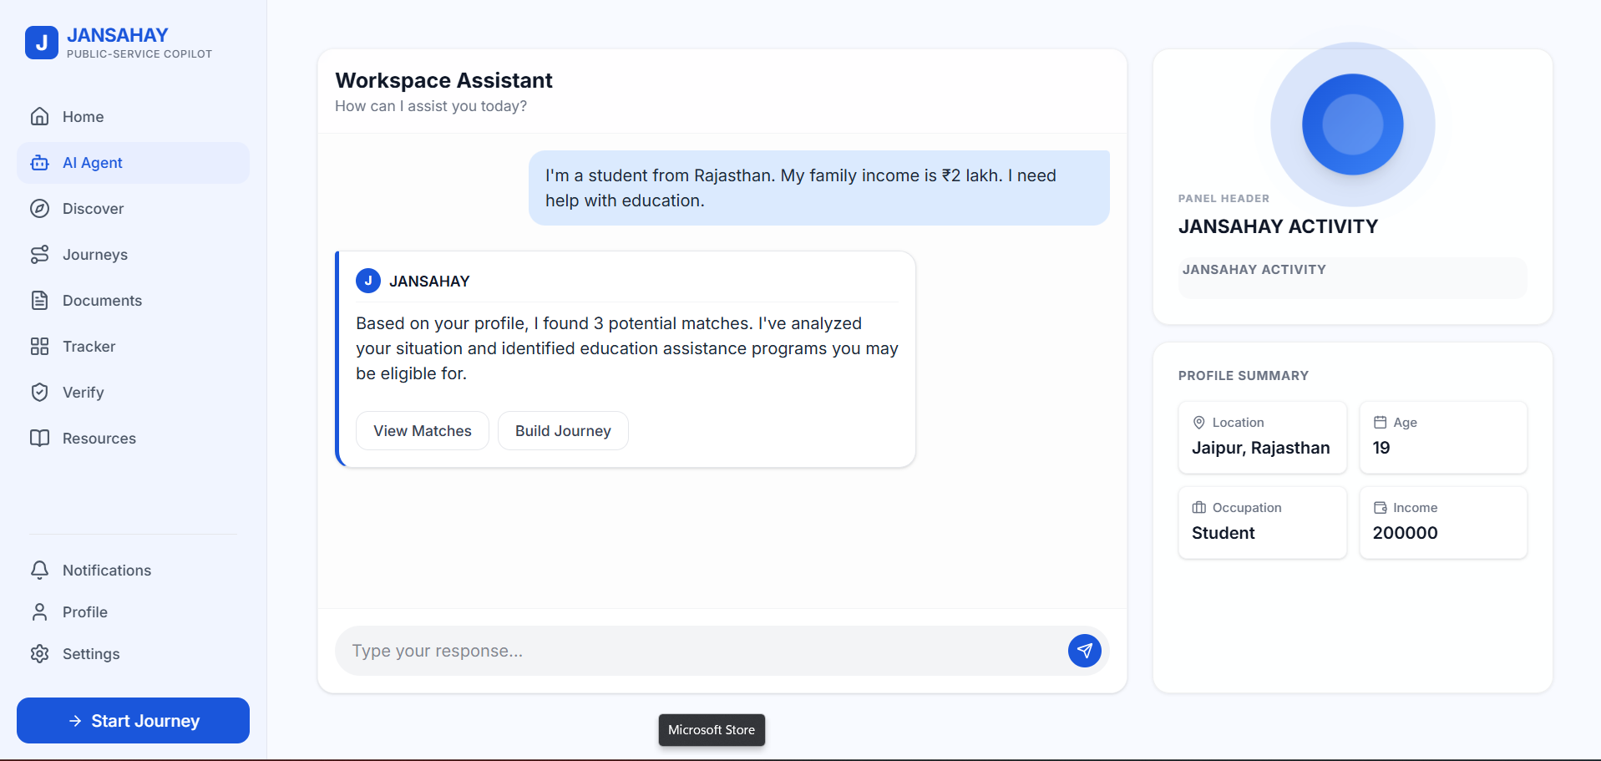
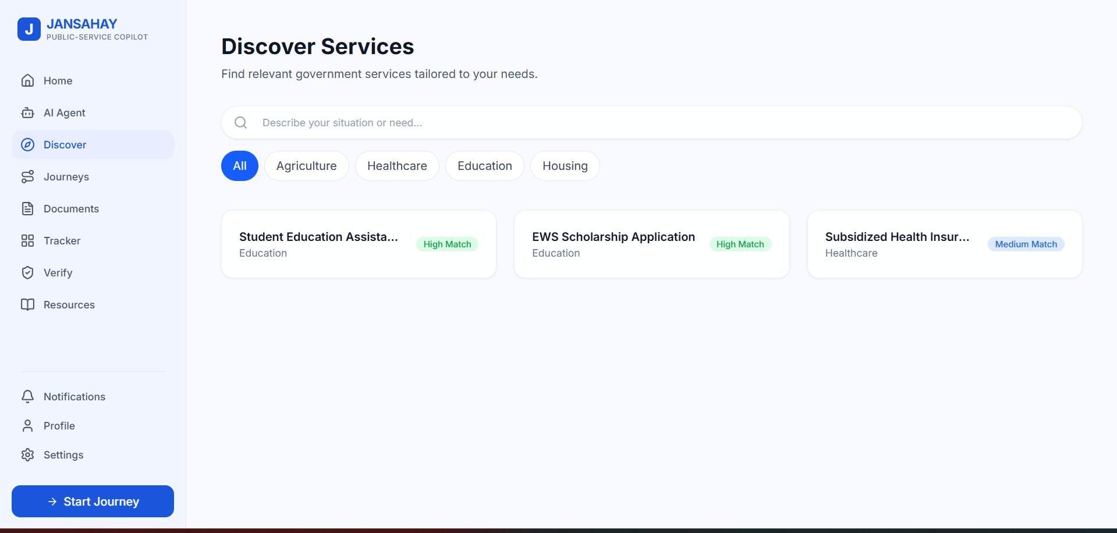
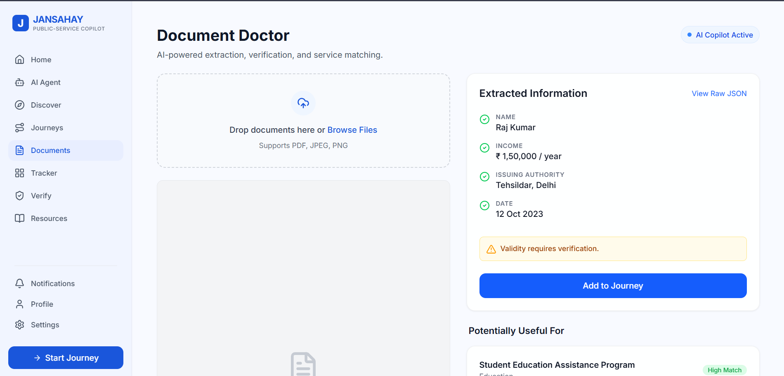
♛ ♛ ♛
THE JANSAHAY EXPERIENCE
Smart Dashboard
AI Workspace Assistant
Personalized home with insights
Natural language copilot
Discover Services
Document Doctor
Filtered scheme discovery
AI extraction & verification
JANSAHAY
0★ / 07

