Slide 1
Hello!! How are you?
I’m fine, thanks! And you?

Slide 2

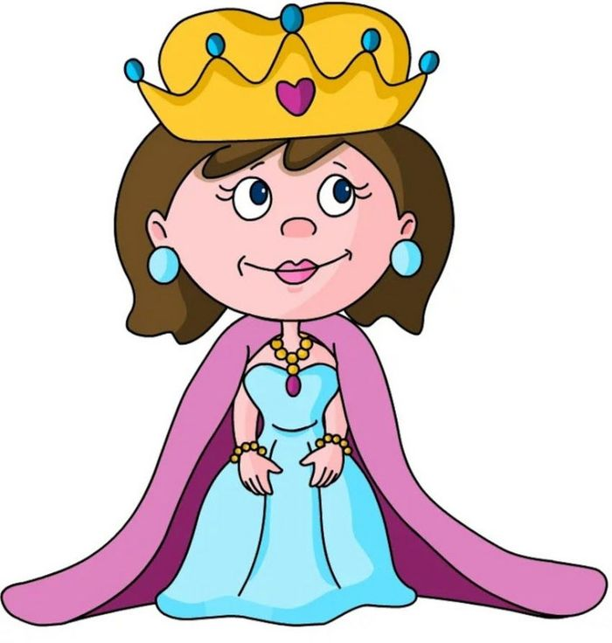
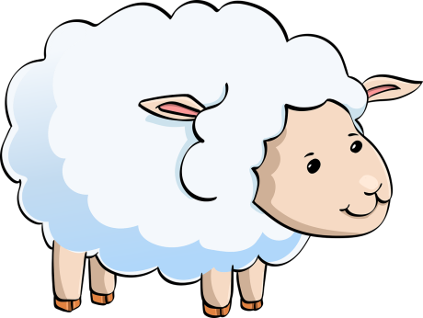
A queen Easterlin and
a sheep Peep sees a green tree.
ee/ea [i:] [и]

Slide 3






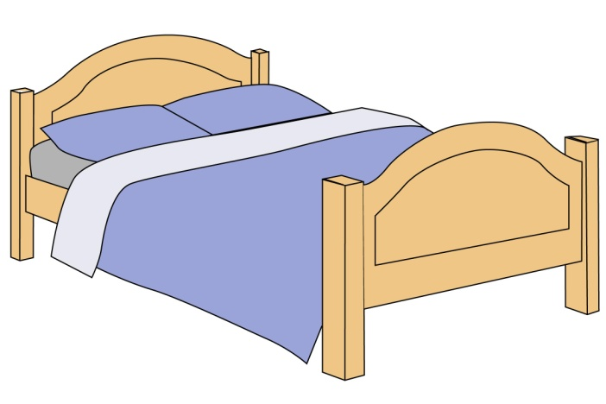
A window
A chair
A table
A tree house
What’s
this?
A radio
A bed
A lamp

Slide 4
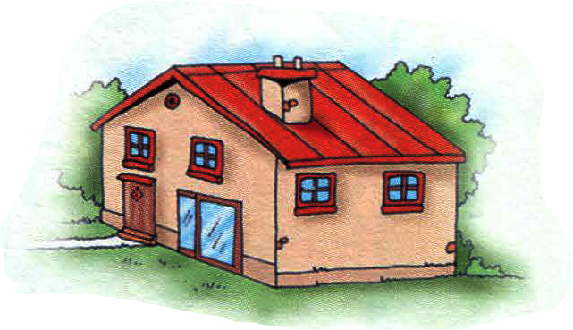
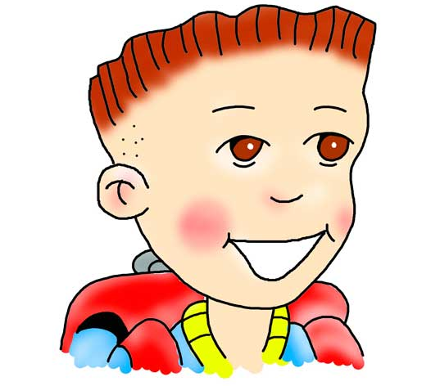
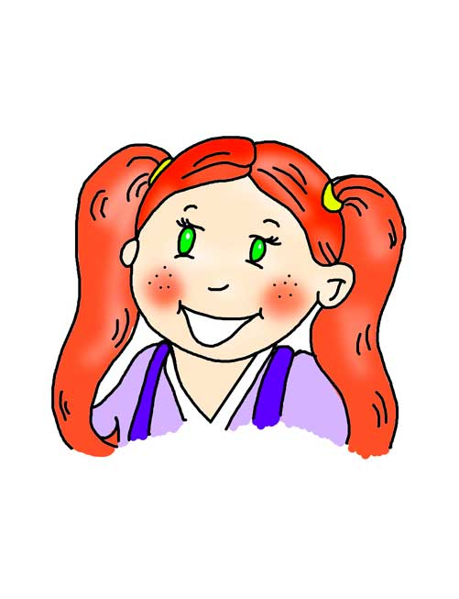
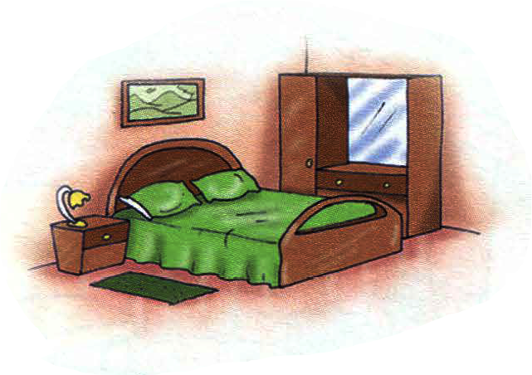
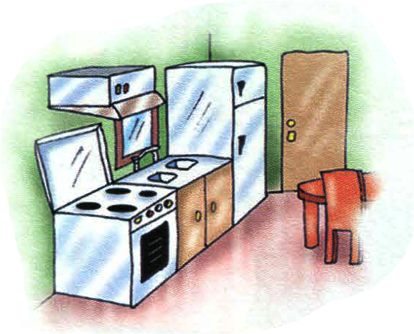
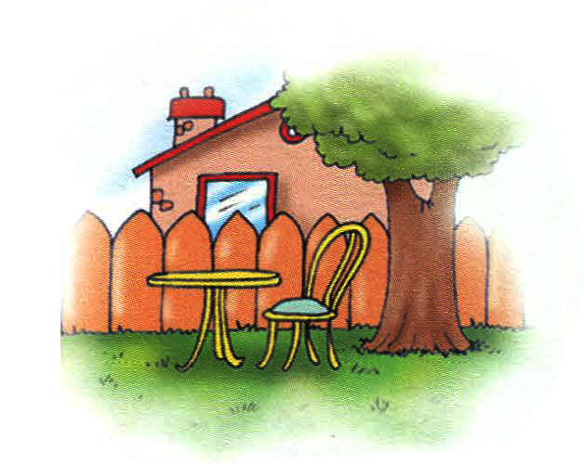
a house
a bedroom
a kitchen
a garden

Slide 5
a house
a bedroom
What’s this?
It’s …..
a garden
a kitchen

Slide 7
a house
a bedroom
a kitchen
a garden

Slide 8
a bedroom
a house
a kitchen
a garden

Slide 9
a house
a bedroom
a kitchen
a garden

Slide 10
a garden
a kitchen
a bedroom
a house

Slide 11
1
4
2
A kitchen
a house
a garden
A bedroom
3

Slide 12
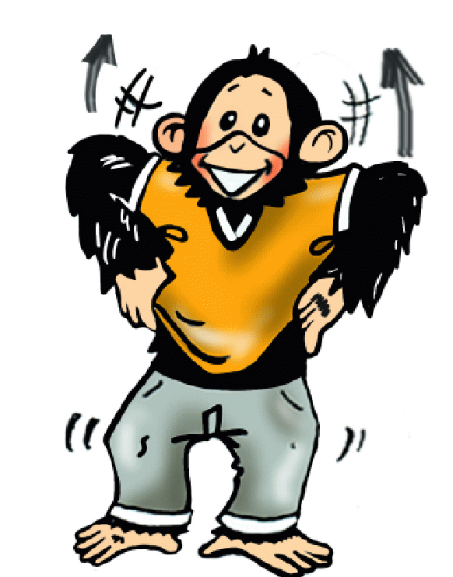
Where’s Chuckles?
He is in the…..
naughty

Slide 13
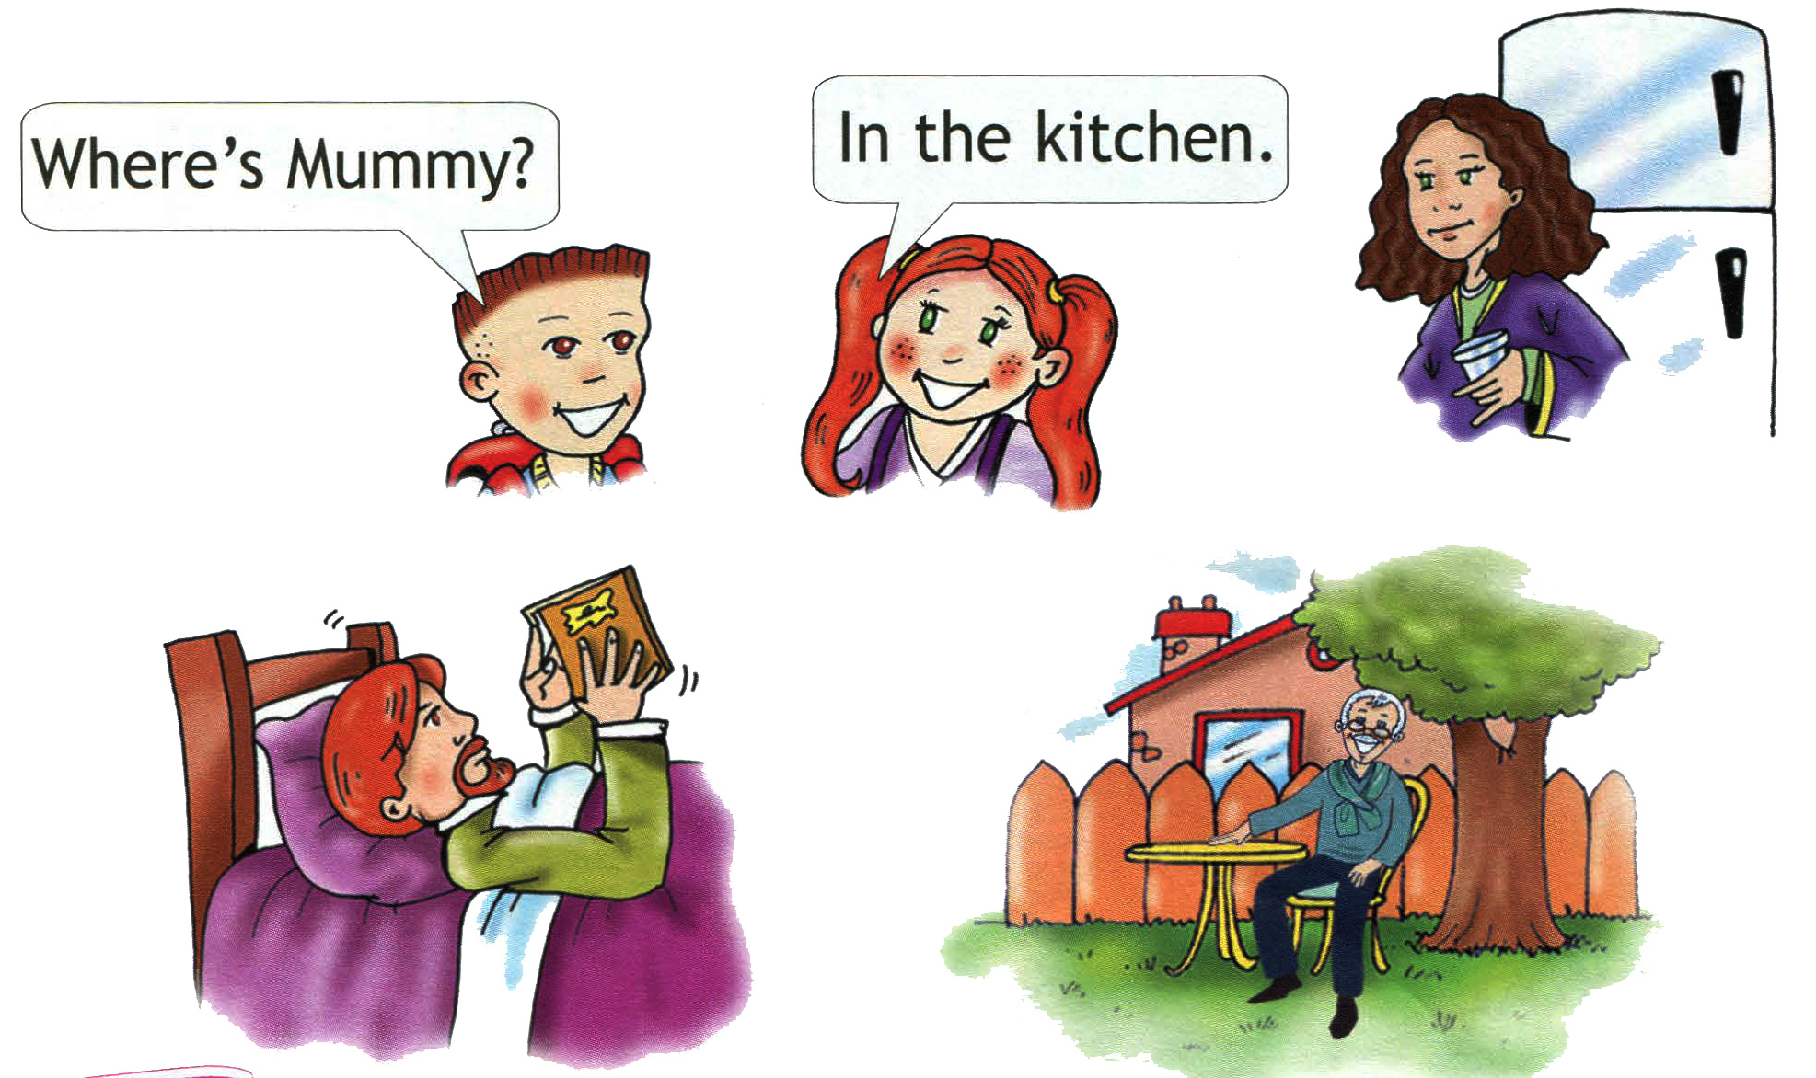
Where’s Daddy?
Where’s Grandpa?
He’s in the bedroom.
He is in the garden.

Slide 14

Where’s Mummy?
She is in the kitchen!
Where’s Daddy?
He is in the
bedroom!
Where’s Grandpa?
He is in
the garden!

