Slide 1







I
We
я
мы
You
You
ты
вы

Slide 2
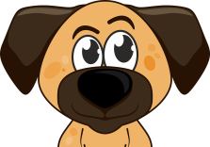
He
It
он
оно
She
They
она
они

Slide 3

am
We
I
are
мы
я
are
You
You
Быть,
находиться,
являться
are
вы
ты

Slide 4
He
It
is
is
он
оно
is
She
are
They
она
они

Slide 5
I am
We are
You are
They are
He is
She is
It is

Slide 6
I am
We are
You are
They are
He is
She is
It is
An ant and a horse
Mum and Dad
A horse
Mummy
An ant
A queen
Daddy
A dog
Larry
Luly
Lulu and Larry
fine!!

