Slide 1
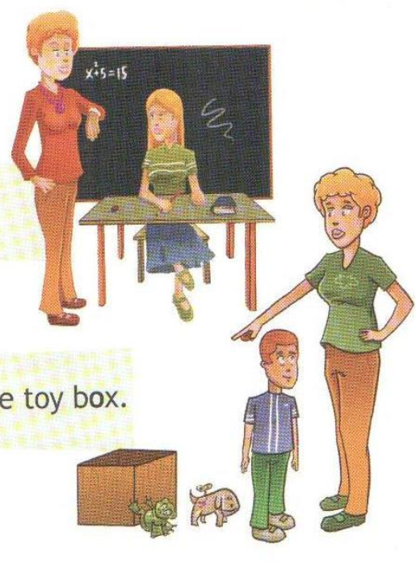
Oo
Rose, close your book and
go home!
[əʊ]
Bob, put the dog and the frog
into your toy box.
[ɒ]

Slide 2
Nose, close, dog, open, hot, box, home, no, frog
[əʊ]
[ɒ]

Slide 3
Чьи это игрушки?
Это игрушки Ани.
Они новые.
Чье это яблоко?
Это яблоко Димы.
Оно красное.
Чей этот портфель?
Это портфель Мэри.
Он маленький.
Whose are these toys?
These are Ann’s toys.
They are new.
Whose is this apple?
This is Dima’s apple.
It’s red.
Whose is this school bag?
This is Marry’s school bag.
It’s little.

Slide 4
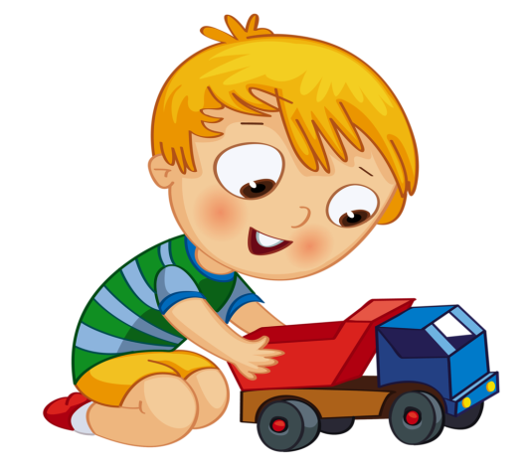

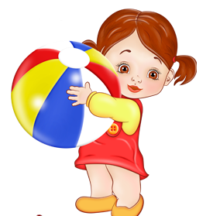
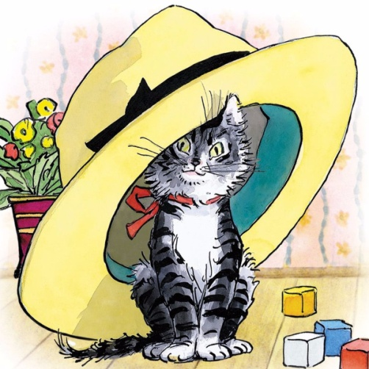
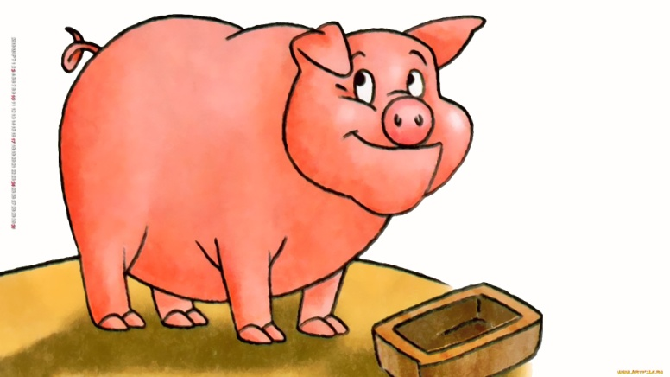
ball

Slide 5
Have got
Has got
Иметь

Slide 6

Short
Big
Small
Hair
Long
Eyes
Fair
Dark
Blue
(green, grey)
Big
A head
Ears
Big
Small
Small
Big
A mouth
A nose
Small
Big
Small
Fat
A body
Fat
A tail
legs
Thin
Short
Thin
Long

