Slide 1


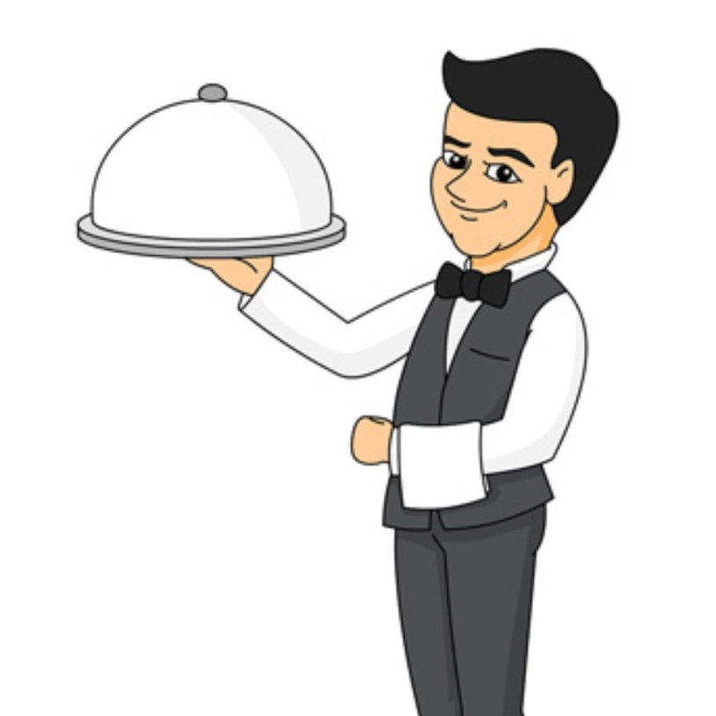

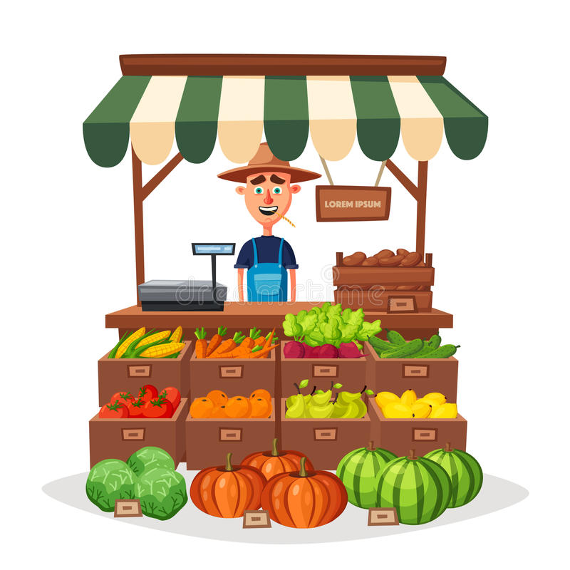
Professions

Slide 2
What are you?
I’m a nurse.
Where do you work?
At a hospital.
Where is it?
It’s in Pine Road.
What do you do?
I help sick people.

Slide 3
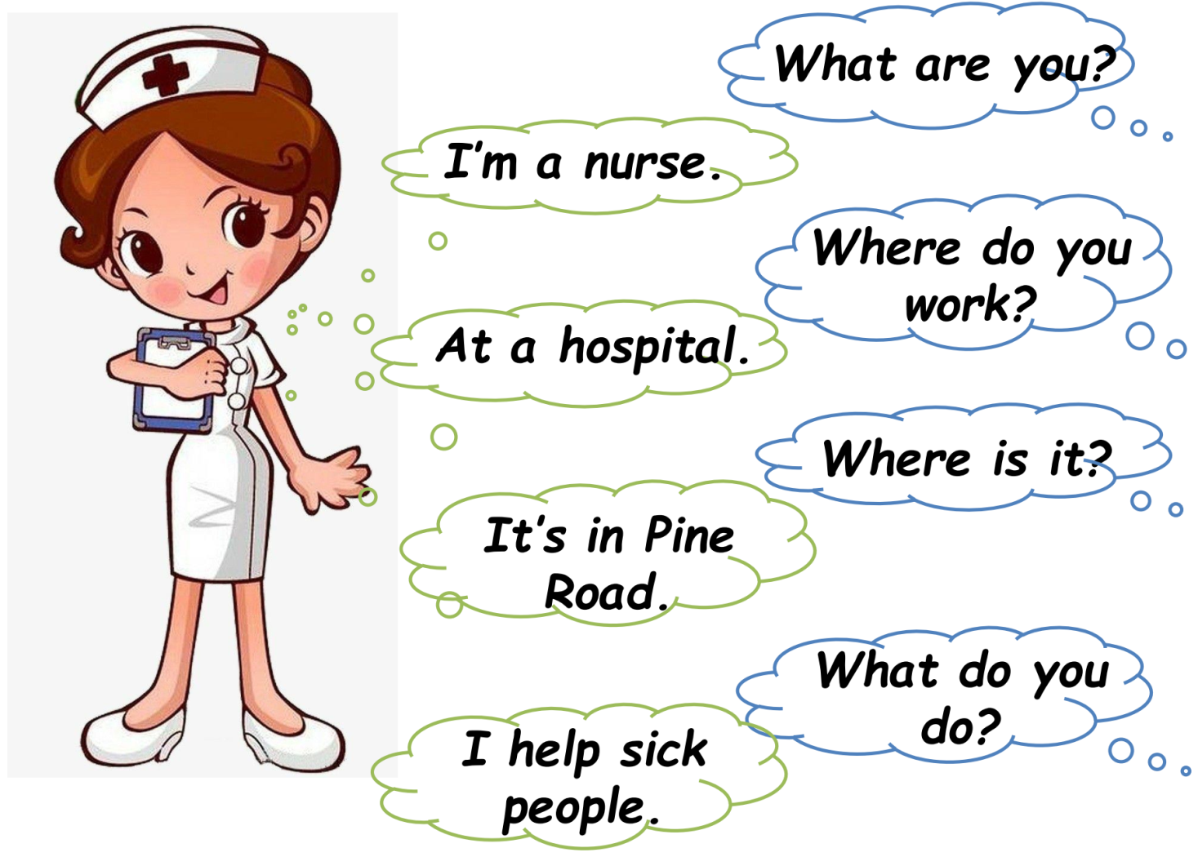
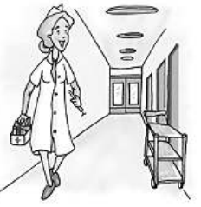
 | She’s a _________. She works at _________. It’s in _________ _________. She _________ sick people.
nurse
hospital
Pine
Road
helps

Slide 4

What ??? you?
I’m a mechanic.
Where ??? you work?
At a garage.
Where ??? it?
It’s in Park Road.
What ??? you do?
I fix cars.

Slide 5
What ??? you?
I’m a postman.
Where do you ????
At a post office.
??? is it?
It’s in Queen
Street.
What do you ????
I carry a big bag. I take letters to people’s houses.

Slide 6

??? are you?
I’m a waiter.
??? do you work?
At a cafe.
??? is it?
It’s in Mount
Street.
??? do you do?
I serve food and drinks.

Slide 7
Кто Вы?
I’m a greengrocer.
Где Вы работаете?
At a greengrocer's.
Где это?
It’s in King Street.
Что Вы делаете?
I sell fruit and vegetables.

Slide 8
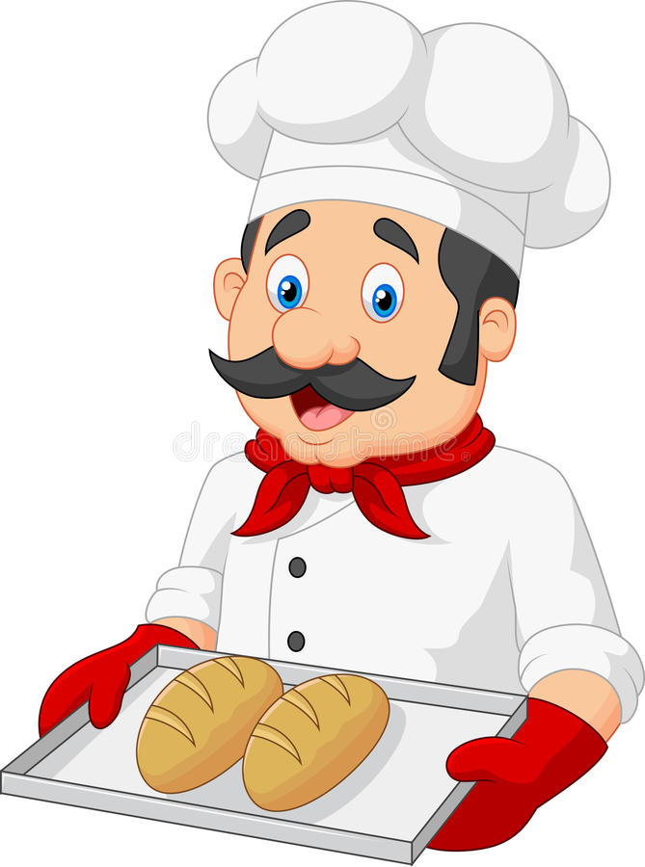
Кто Вы?
I’m a baker.
Где Вы работаете?
At a baker's.
Где это?
It’s in Mill road.
Что Вы делаете?
I bake bread and make cakes.

