Slide 1
Present Simple
Простое настоящее
Употребляем. Когда говорим о действиях которые прoисходят постоянно, регулярно
I go to school every Monday
2 . Когда описываем предмет или человека
I am a teacher.
My name is Tom.
She is a good pupil.

Slide 2
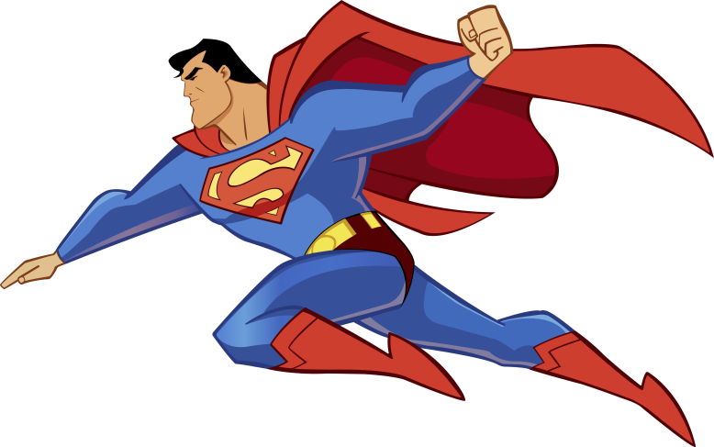
do not
I
We
You
They
runs
jumps
run
does not
He
She
It
jump

Slide 3

Do
I
We
You
They
swings
reads
write
Does
He
She
It
fly

Slide 4
Long form | Short form
Affirmative sentences
I play. We play. You play. He plays. She plays. It plays. They play.
Negative sentences
I do not play. We do not play. You do not play. He does not play. She does not play. It does not play. They do not play. | I don’t play. We don’t play. You don’t play. He doesn’t play. She doesn’t play. It doesn’t play. They don’t play.
Interrogative | Answers
Do I play? Do we play? Do you play? Does he play? Does she play? Does it play? Do they play? | Yes, we do. No, we don’t.

Slide 5
Children
want to run
Do children want to run?
- Yes, they do.
- No, they don’t.
My dog
love swimming
Does my dog love swimming?
Yes, it does.
No, it doesn’t.

Slide 6
to be at home
Children
Are children at home?
-Yes, they are.
-No, they aren’t.

