Slide 1

THE PIRATE CODE

Slide 2

Rule 1: A pirate …………… be brave.
must
mustn’t

Slide 3
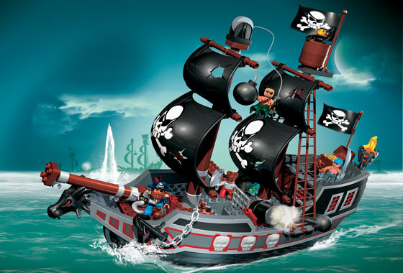
Rule 2: Pirates ……………… have a ship with a flag.
must
mustn’t

Slide 4
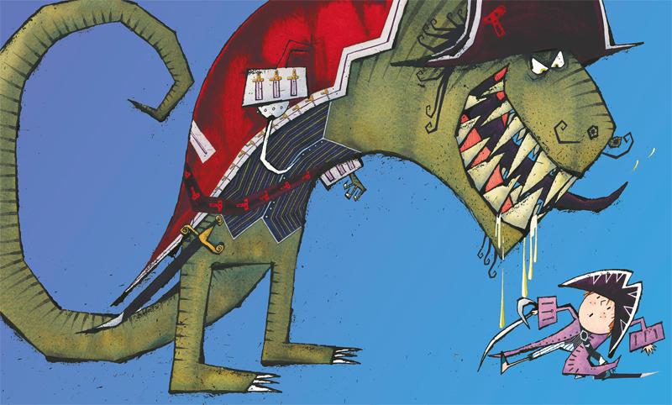
Rule 3: A pirate …..……...… be afraid of monsters.
must
mustn’t

Slide 5

A A
Rule 4: A pirate ………………… listen to the captain.
must
mustn’t

Slide 6
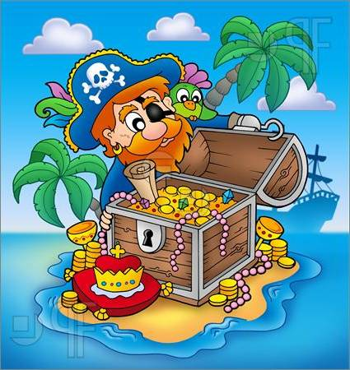
Rule 5: A pirate………... find new treasures.
must
mustn’t

Slide 7
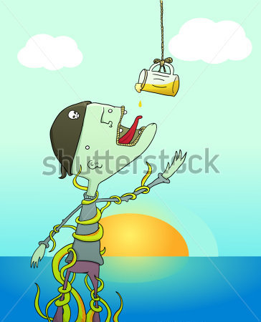
Rule 6: A pirate…………. drink a lot of beers.
must
mustn’t

Slide 8
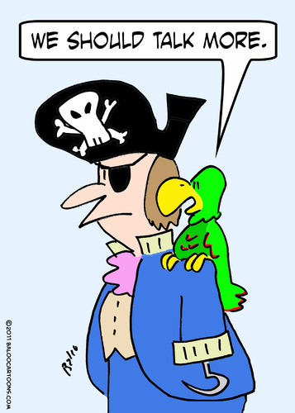
Rule 7: A pirate …………. talk to his parrot.
must
mustn’t

Slide 9
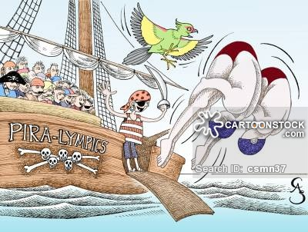
Rule 8: Pirates………….. swim well.
must
mustn’t

Slide 10
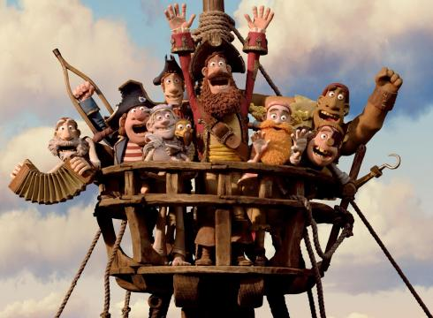
Rule 9: Pirates……….. work together.
must
mustn’t

Slide 11
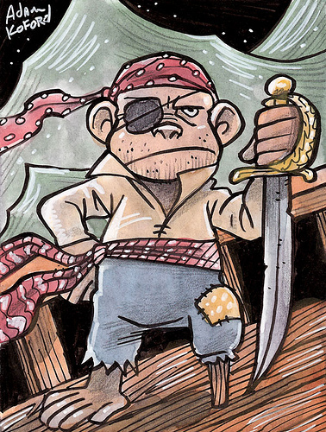
Rule 10: A pirate ……………. wear clean clothes.
must
mustn’t

Slide 12


