Slide 1

RESEARCH LEARNING · 5-MINUTE PITCH
Better cacao.
Measured process.
Shared learning.
CaAPs · Cacao Quality & Traceability
Zamboanga del Norte industry challenge | Presenter: CaAPs Team
CAAPS / 01
15 sec
Notes:
Good day. We are presenting CaAPs, a cacao quality and traceability prototype. Our focus is the post-harvest challenge of smallholder farmers and cooperatives in Zamboanga del Norte: making the process visible enough to review, improve and learn from each batch.

Slide 2
01 · THE INDUSTRY QUESTION
Where does a harvest lose its value?
Inconsistent post-harvest handling
30–40%
Fermentation and drying are difficult to compare
downgraded beans reported on the challenge poster
Quality decisions need a traceable record
Source: user-supplied industry challenge poster. Baseline not independently validated.
CAAPS / 02
30 sec
Notes:
The challenge poster reports that up to thirty to forty percent of beans are downgraded, reducing farmer income. We treat that as the challenge owner’s statement, not as a result measured by CaAPs. Our research question is: how can farmers and cooperatives document post-harvest practices, identify where batches fall short, and use evidence to improve the next batch? The local baseline still needs validation.
Source: user-supplied industry challenge poster. Baseline not independently validated.

Slide 3
02 · WHAT RESEARCH TELLS US
The process matters.
So does the evidence.
ICCO explains the role of fermentation and controlled drying.
DOST-PCAARRD identifies skills, grading and facility-access gaps.
Design implication: combine records with tools, training and review.
Sources: ICCO, Harvesting & Post-harvest; DOST-PCAARRD, Cacao Industry Profile.
CAAPS / 03
30 sec
Notes:
We began with the supplied industry challenge and desk research. ICCO supports the importance of fermentation and careful drying. DOST-PCAARRD identifies post-harvest skills, grading and access to facilities as sector challenges. That led to a design decision: software should support observation and accountability alongside equipment and training. We have not yet completed farmer interviews, tested local adoption or established that this prototype changes bean quality.
Sources: ICCO, Harvesting & Post-harvest; DOST-PCAARRD, Cacao Industry Profile.

Slide 4
03 · THE CAAPS APPROACH
One batch. A history you can follow.
01
02
03
Harvest & allocate
Ferment & turn
Dry & measure
04
05
06
Assess & review
Store & hand over
Sell & learn
Farm provenance stays connected to the post-harvest record.
CAAPS / 04
30 sec
Notes:
CaAPs links a harvest to a batch and follows its stages through fermentation, drying, quality review, storage and sale. Process observations sit beside that history: temperature, turning, moisture and conditions. Cooperative handovers identify the facilities and the person recorded as receiving the batch. This is traceability through recorded events. It is not automatic proof that a physical process happened, and a typed recipient is not a digital signature.

Slide 5
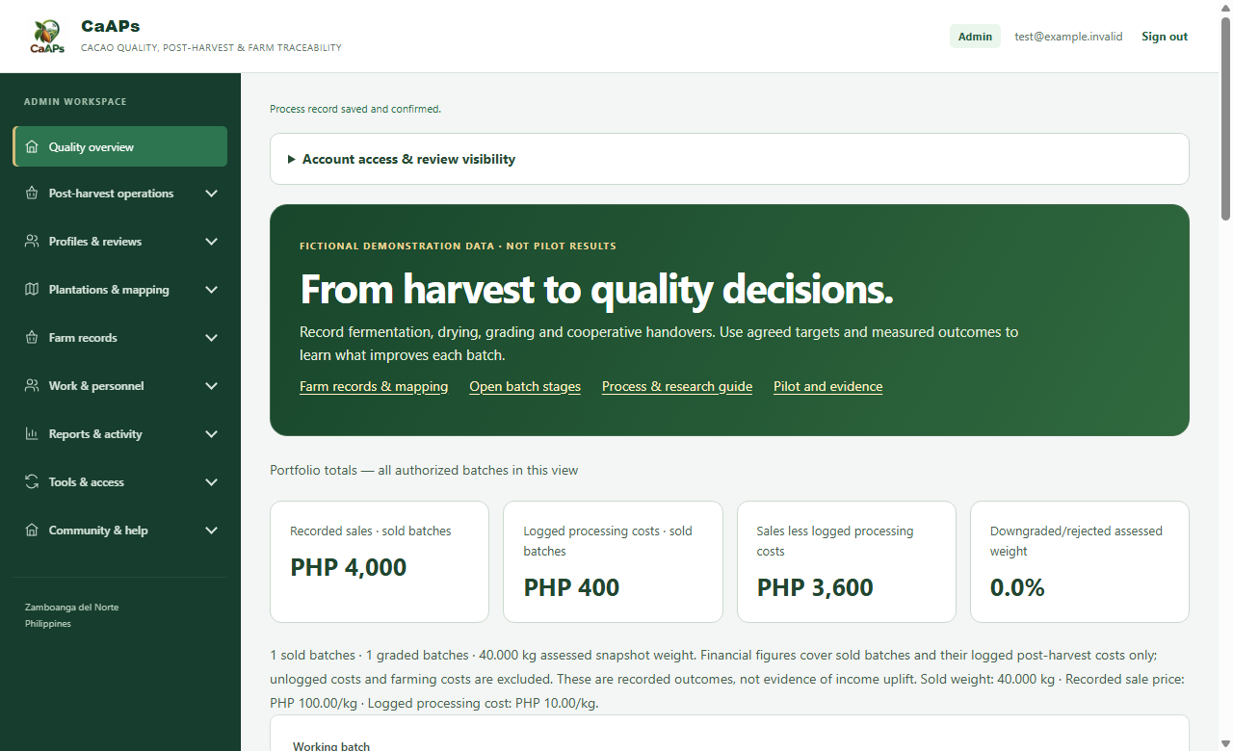
04 · THE WORKING PROTOTYPE
A workspace for observations and decisions.
Buyer/adviser-agreed protocol
Temperature, turning and moisture records
Quality observations and staff-recorded grades
Costs, handovers and correction history
Illustrative screen uses isolated fictional fixtures. No live farmer data.
CAAPS / 05
40 sec
Notes:
This is the prototype workspace using fictional demonstration records. Staff define the agreed protocol and acceptance limits. Farmers can enter process measurements and ungraded quality observations. Assigned staff enter the final grade. A correction retains the original entry while replacing its contribution to the report. Measurements are manual; no sensor or laboratory system is connected. The dashboard distinguishes recorded sales and logged processing costs from total farm profit, and shows unassessed quality as unknown rather than zero.
Illustrative screen uses isolated fictional fixtures. No live farmer data.

Slide 6
05 · QUALITY NEEDS SUPPORTING RECORDS
A pass label is not enough.
Agreed protocol and actual fermentation start
Cut-test sample, moisture and reviewer reference
Recorded results must meet the batch limits before storage
No automatic certification or guaranteed premium price
Access stays scoped to the farmer and assigned staff.
CAAPS / 06
30 sec
Notes:
For storage, the new server guard requires an agreed protocol and a supporting quality assessment. It checks the configured minimum fermentation time, measured moisture, sample defects and recorded grade. These checks use the batch’s agreed limits; we do not prescribe one universal schedule. Access remains limited to the owner and authorized staff. Account permissions identify who recorded a decision, while reviewer competence and buyer acceptance still need to be established outside the software.

Slide 7
06 · HOW WE WOULD TEST IT
A small pilot. Clearly defined measures.
Record completeness and missed checks
3–5
Downgraded/rejected weight share
farmers · 1 cooperative · proposed 6–8 weeks
Recorded selling price per kg
Sales less logged post-harvest costs
Proposed pilot design, not confirmed participation or measured impact.
CAAPS / 07
35 sec
Notes:
We propose a six-to-eight-week pilot with one cooperative and three to five farmers, subject to partner agreement. First, validate the problem and agree the protocol and baseline. Then record comparable batches and review completeness, missed checks, grades, assessed weight, price per kilogram and logged processing costs. Comparisons should account for buyer, variety, season and facility differences. This pilot can reveal feasibility and useful patterns; it does not automatically establish that the app caused an income improvement.
Proposed pilot design, not confirmed participation or measured impact.

Slide 8
07 · WHAT EXISTS AND WHAT DOES NOT
Be precise about readiness.
Built locally: workflow, measurements, reviews and reports
Verified: code tests and isolated browser scenarios
Still needed: staging migrations and live deployment checks
Still needed: trained reviewers, tools and a farmer pilot
No verified income uplift, adoption rate or quality-improvement claim yet.
CAAPS / 08
25 sec
Notes:
The software now has a local prototype for batch records, process observations, staff review, corrections and reporting. Automated and browser checks evaluate software behavior with isolated fixtures. They are not proof that the hosted database, outdoor use or post-harvest outcomes work. Staging migration, deployment verification, training, measurement tools and actual participant testing remain necessary. We are presenting a testable prototype and a learning plan, not a completed impact study.

Slide 9
08 · RESEARCH LEARNING LOOP
Observe. Compare. Reflect. Improve.
Observe actual practice and barriers
Compare records with agreed criteria
Reflect with farmers, staff and buyers
Improve the workflow and test the next batch
Research Learning framing; no additional institutional rubric was supplied.
CAAPS / 09
30 sec
Notes:
Our Research Learning approach is a repeatable loop. Observe what farmers actually do and where recording becomes difficult. Compare the observations with the agreed protocol. Reflect with farmers, staff and buyers on what the records can and cannot explain. Then revise the workflow and test the next batch. We will document failed assumptions as well as useful features. This keeps the project grounded in learning rather than presenting every dashboard number as proof of success.

Slide 10
09 · THE NEXT STEP
Help us test the workflow
where the work happens.
A cooperative and 3–5 farmer participants
A qualified reviewer and buyer-agreed criteria
Access to basic measurement tools and facilities
A baseline review and regular learning sessions
CaAPs turns a process into records people can review together.
CAAPS / 10
35 sec
Notes:
Our next request is a pilot partnership: a cooperative, three to five farmers, a qualified reviewer, buyer-agreed criteria and access to measurement tools and processing facilities. We also need permission to collect a baseline and hold regular learning reviews. We are not promising a specific reduction in downgraded beans or a specific income increase. We are offering a practical way to collect the evidence needed to evaluate those goals. Thank you; we welcome questions and feedback.

Slide 11
APPENDIX · NOT PART OF THE TIMED PITCH
Sources, assumptions and evidence
Industry challenge poster supplied by the user: Zamboanga del Norte cacao sector; 30–40% statement requires local validation.
ICCO: Harvesting & Post-harvest
DOST-PCAARRD: Cacao Industry Profile
TESDA: Cacao Bean Grading Level II
Local software tests use fixtures. Pilot scope and timing are proposals.
https://www.icco.org/harvesting-post-harvest-new/
https://ispweb.pcaarrd.dost.gov.ph/isp-commodities/cacao/
https://www.tesda.gov.ph/Downloadables/CS/CS-%20Cacao%20Bean%20Grading%20Level%20II.pdf
CAAPS / 11
Notes:
Research Learning was the user’s definition of RLE. No institutional marking rubric was provided, so the main slides use a problem-evidence-prototype-learning-pilot structure. Technical capabilities must be checked after staging migration and deployment. No interviews, named partnerships, market-size figures, grant amount, sensor integration or field outcomes were invented.
https://www.icco.org/harvesting-post-harvest-new/
https://ispweb.pcaarrd.dost.gov.ph/isp-commodities/cacao/
https://www.tesda.gov.ph/Downloadables/CS/CS-%20Cacao%20Bean%20Grading%20Level%20II.pdf

