Slide 1
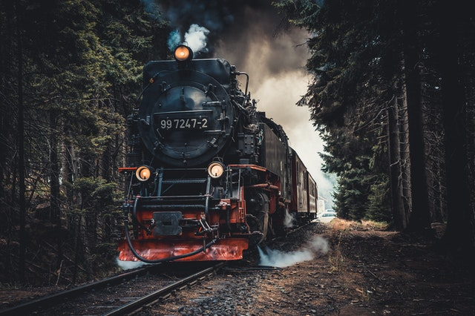
Train Project

Slide 2
Different Classes and there Methods
Generate PNR method builds the PNR as per the business rules and returns the generated PNR.
It should be auto-generated by adding first character of source station, first character of destination station, travel date(yyyy/mm/dd) and a running counter starting from 100. Example: BM_20220121_100
Add Passenger method take passenger details as parameters, creates passenger object and adds the passenger as a key and the calculated passenger fare as the value in Tree Map ‘passengers’.
Generate Ticket method generates the ticket as per the given format and return the ticket in a StringBuilder.
Calc Passenger Fare method takes a passenger object as parameter, calculates the fare for the passenger and returns the ticket fare for that passenger. For age < = 12, fare is 50% of ticket price regardless of gender, For age > = 60, fare is 60% of ticket price regardless of gender For Females, 25% discount on the ticket price.
Calculate Total Ticket Price() method returns the total ticket price by adding up all the passenger fares stored in the Tree Map passengers.
Write Ticket method writes the generated ticket to a File.
Class Train DAO
Find Train method takes trainNo as input and returns a Train object, if train is found, else returns null.

Slide 3
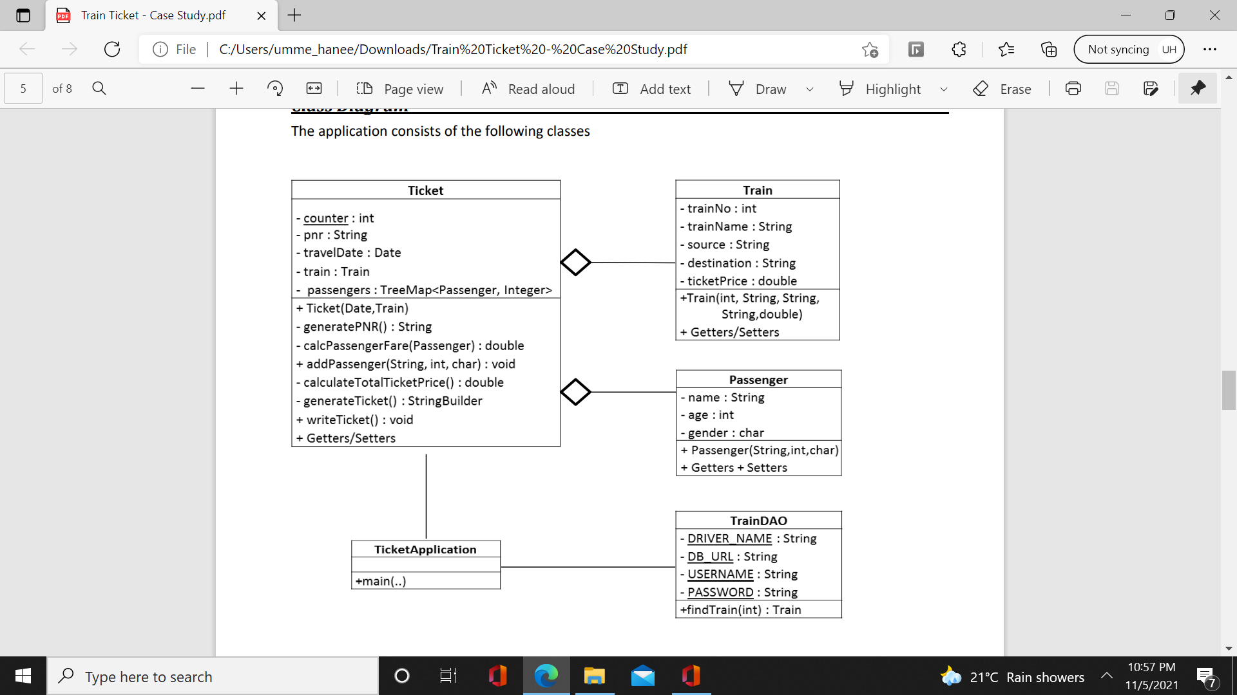
Class Diagram
Class Ticket Application
Contains a main method and is the starting point of Application.
Uses a Scanner to get the train No, travel Date, number of Passengers, and details of each passenger.
Uses Train DAO to find the train. If train is not found, it displays the message “Train with given number does not exist”
Adds passengers to the Ticket.
Writes the ticket to a file.

Slide 4
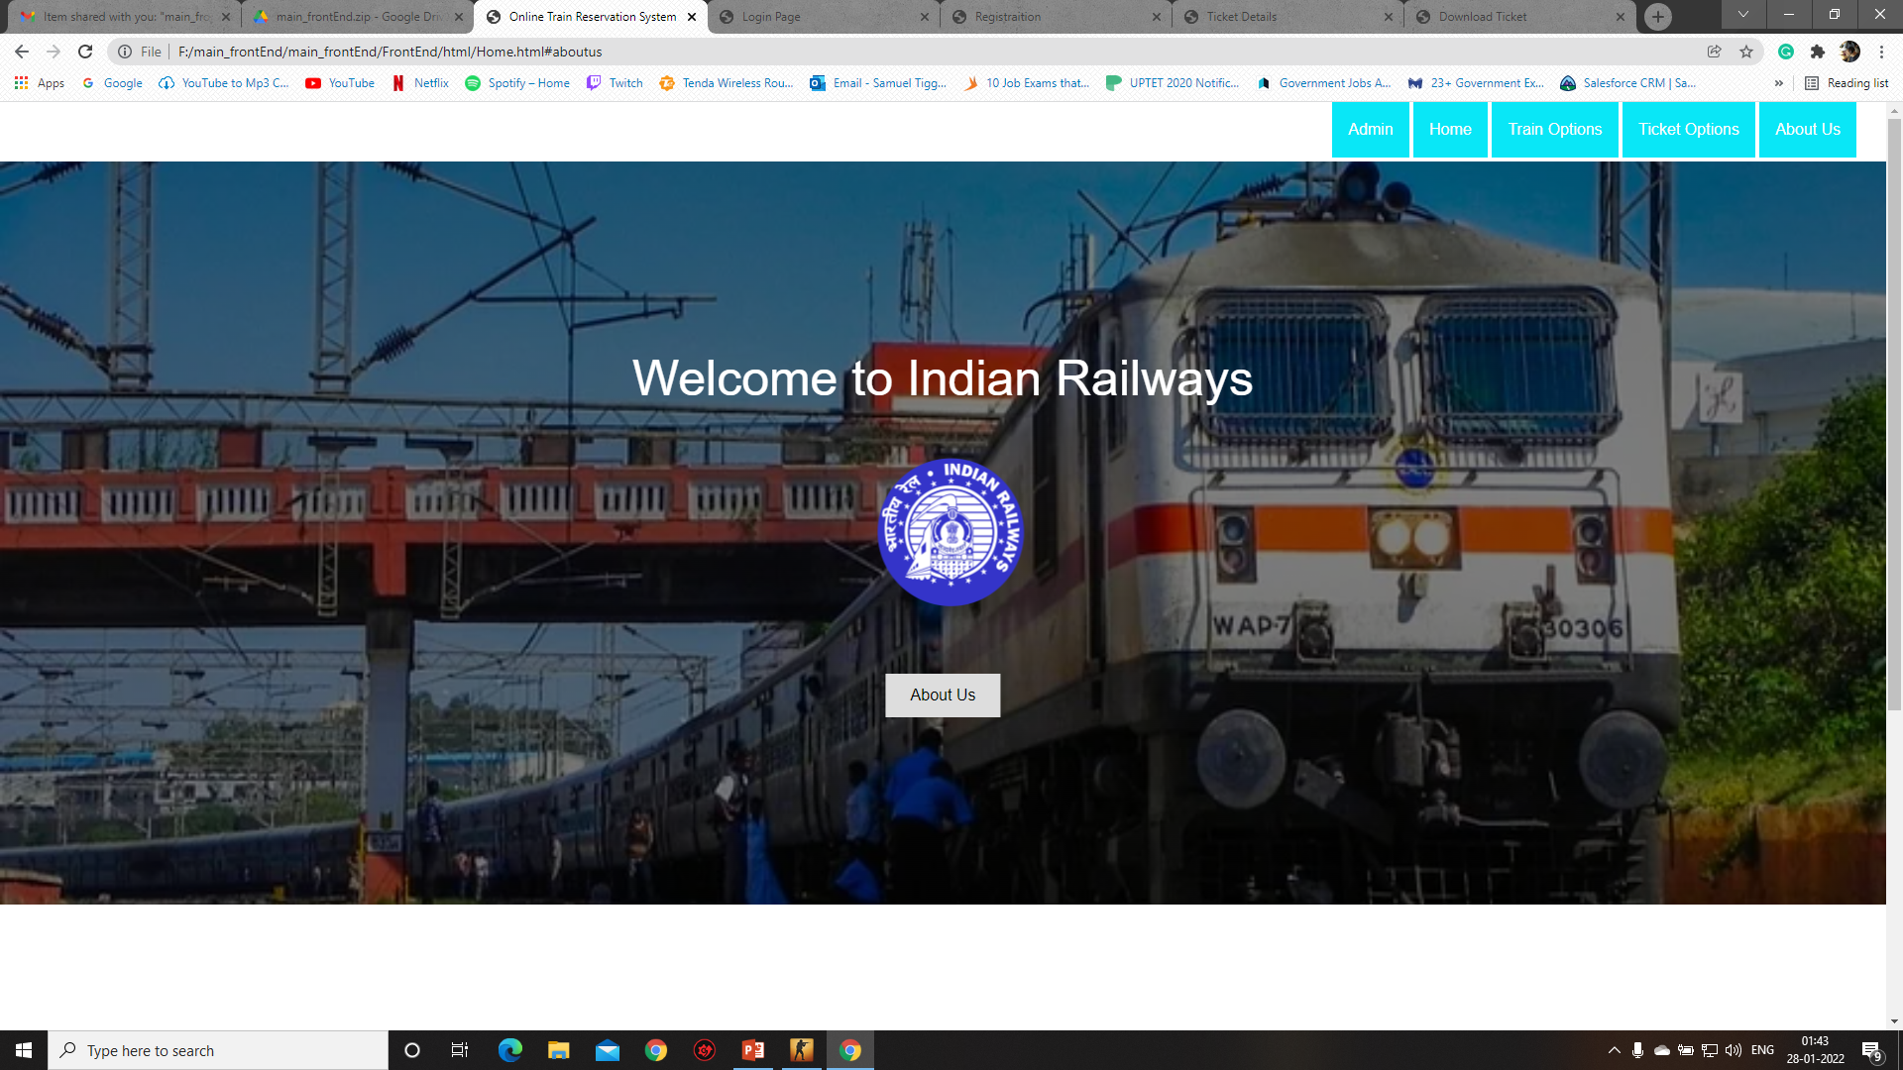
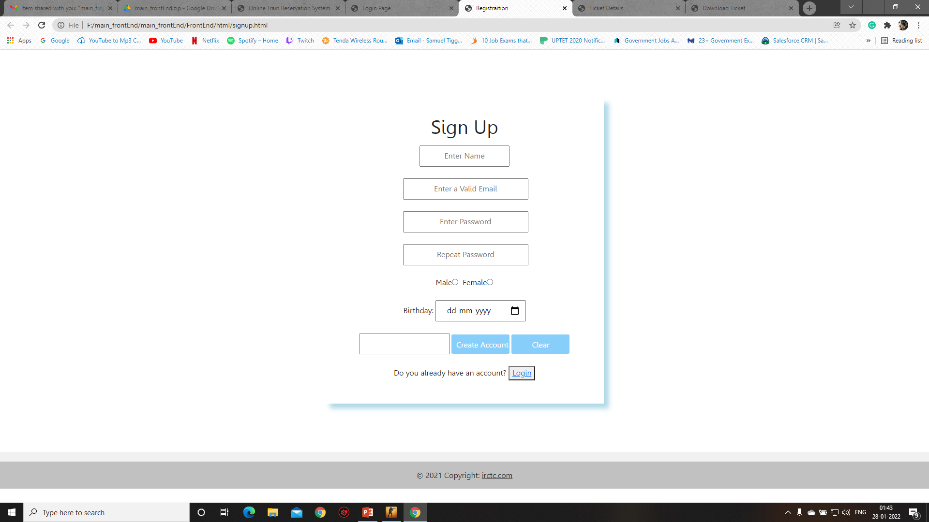
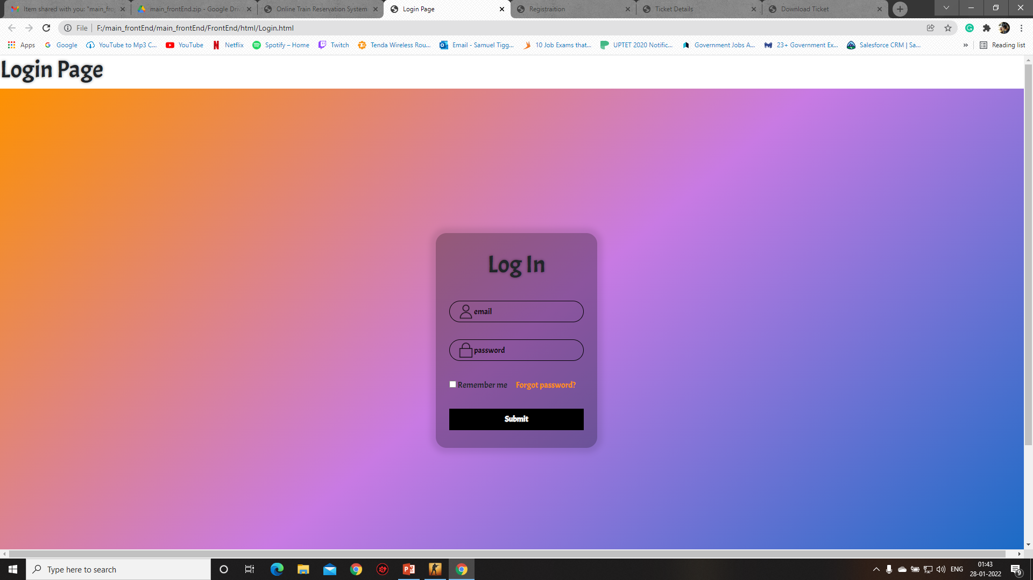


Home Page
Registration Page
Login Page

Slide 5
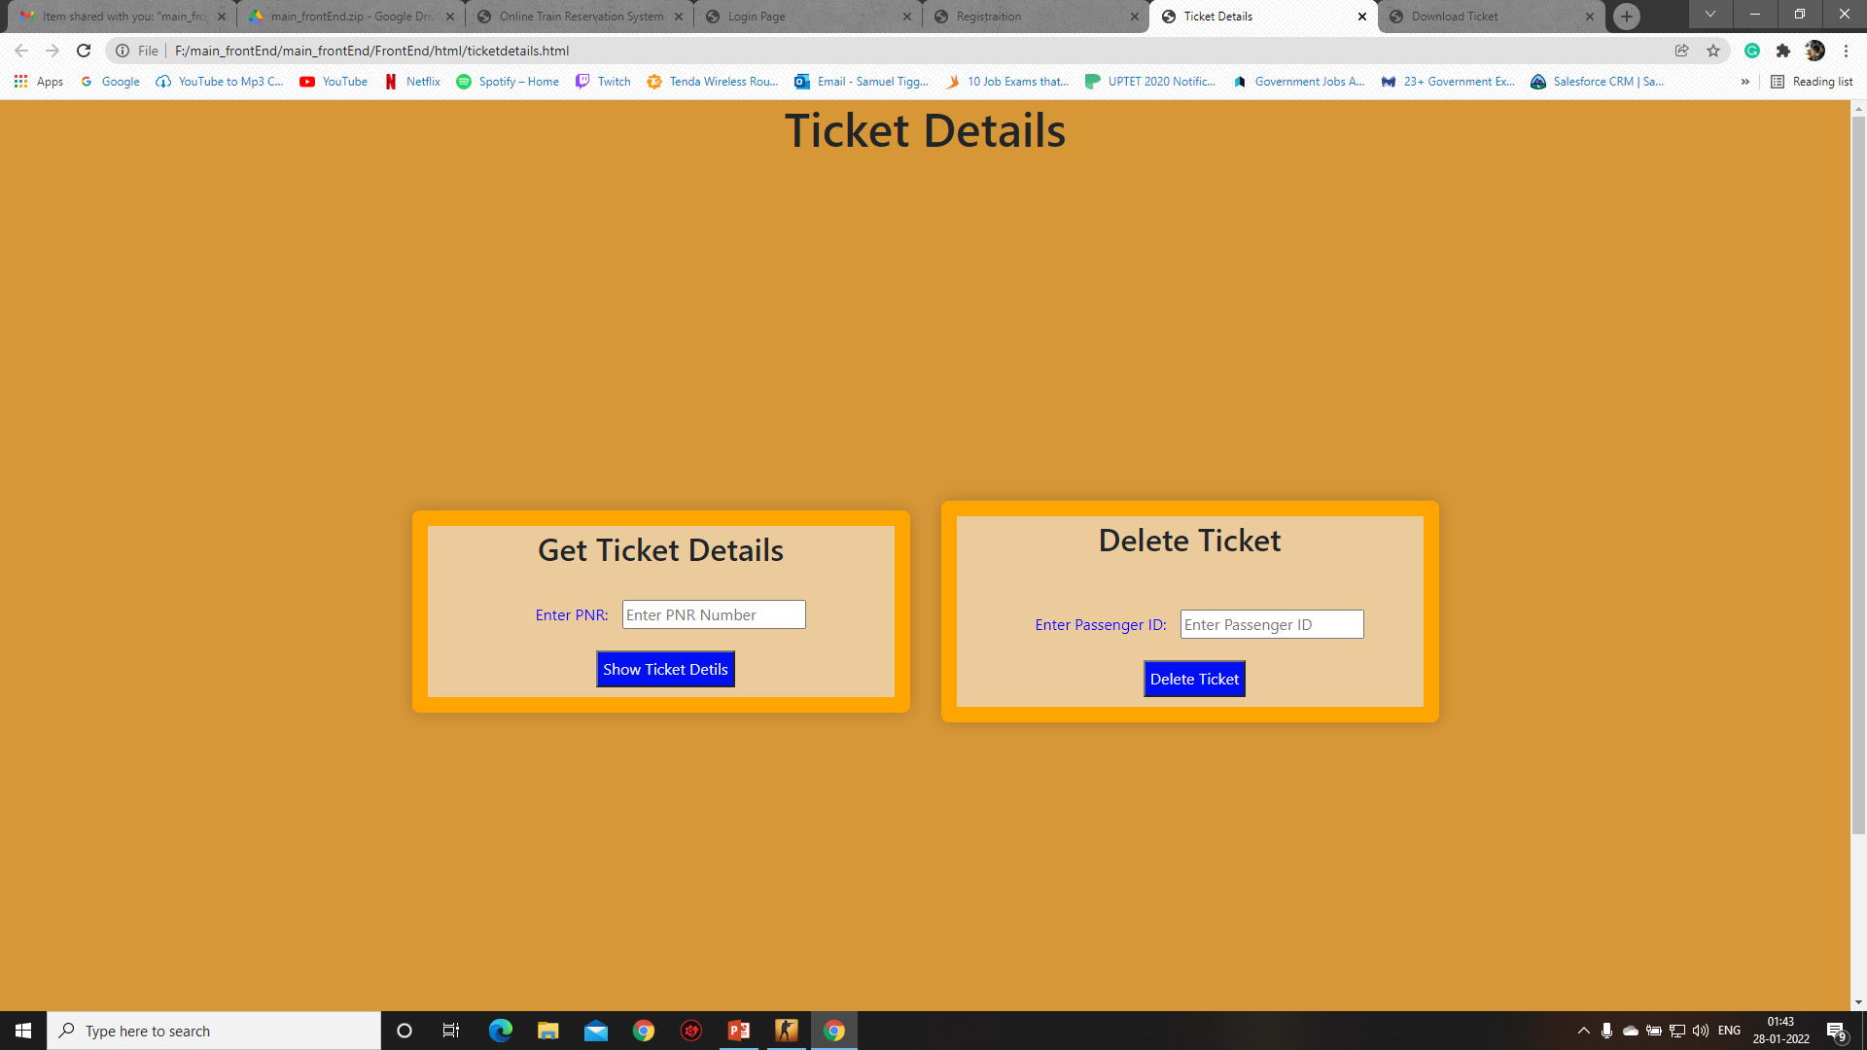
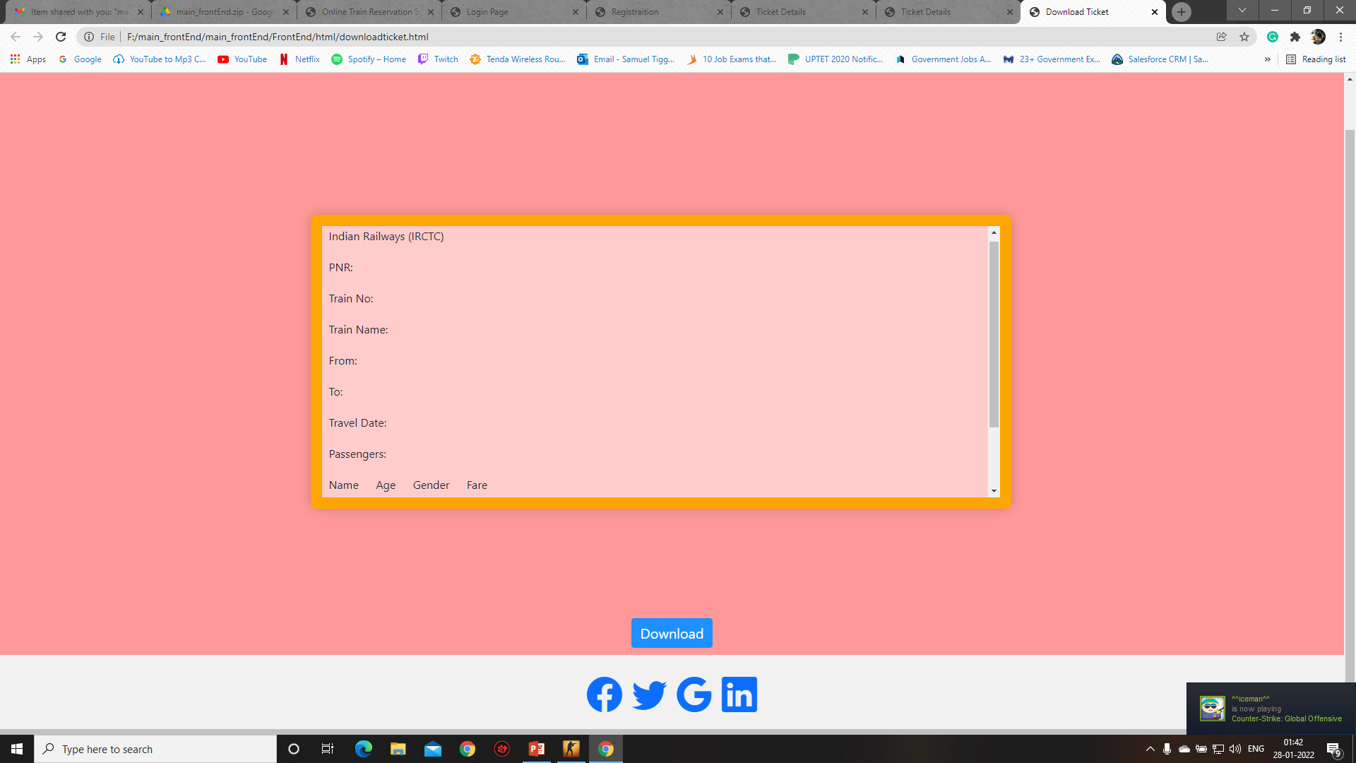
Confirmation Page
Ticket Details Page

Slide 6
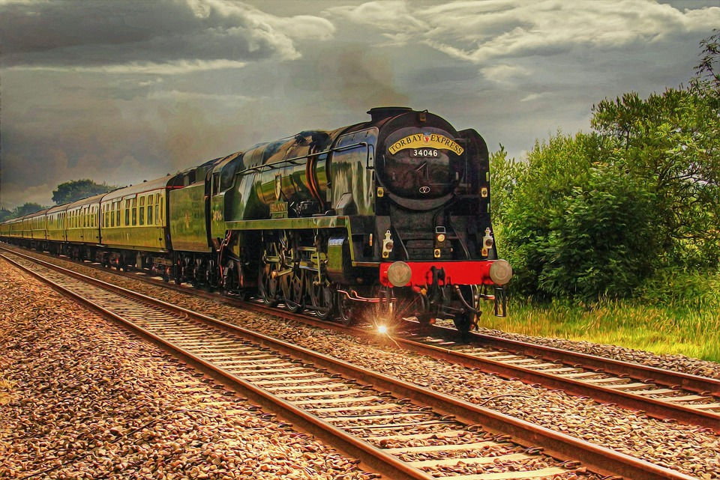
THANK YOU

