Slide 1








₅ ₇ 10 15 11 9 ₈ 16 2 12 13 ₆ 1 14 4 3
 | Walton High School Engineering |  |  |  | DATE 4/8/2024
 | PROJECT Arbor Press
 | SIZE A | CLASS IED |  | TITLE Exploded View |  |  | PER 6
 | SCALE 1:2.5 |  | AUTHOR Siddharth Gupta |  |  | SHEET 1/1

Slide 2
PARTS LIST
ITEM | QTY | PART NUMBER | MATERIAL | MASS
1 | 1 | PART 2: BASE | ALUMINUM 6061 | 15.471 OUNCEMASS
2 | 1 | PART 1: COLOUMN | ALUMINUM 6061 | 18.108 OUNCEMASS
3 | 1 | PART 4 TABLE | ALUMINUM 6061 | 0.932 OUNCEMASS
4 | 1 | PART 10 PUNCH HOLDER | ALUMINUM 6061 | 1.014 OUNCEMASS
5 | 1 | PART 15 GEAR PLATE | ALUMINUM 6061 | 1.417 OUNCEMASS
6 | 1 | 12A - ACTUATOR V1 | GENERIC | 1.60 OUNCEMASS
7 | 1 | 14 - GEAR BY MR. BENTON V1 (1) | ALUMINUM 6061 | 0.69 OUNCEMASS
8 | 1 | PART 6 RACK | ALUMINUM 6061 | 2.337 OUNCEMASS
9 | 1 | PART 7 RACK PAD | ALUMINUM 6061 | 0.547 OUNCEMASS
10 | 1 | PART 8 COVER PLATE | ALUMINUM 6061 | 1.391 OUNCEMASS
11 | 3 | 16 - GEAR PLATE SCREW V1 | STEEL, MILD | 0.069 OUNCEMASS
12 | 2 | ACTUATOR SCREW | STEEL, MILD | 0.15 OUNCEMASS
13 | 1 | 3 - COLUMN SCREW V1 | STEEL, MILD | 0.942 OUNCEMASS
14 | 1 | PART 5 TABLE PIN | ALUMINUM 6061 | 0.065 OUNCEMASS
15 | 4 | 8 - COVER PLATE SCREW V1 (1) | STEEL, MILD | 0.054 OUNCEMASS
16 | 2 | 11 - PUNCH HOLDER SCREW V1 (1) | STEEL, MILD | 0.128 OUNCEMASS
Walton High School Engineering
DATE
3/24/2024
PROJECT Arbor Press
^{SIZE} CLASS
TITLE
Parts List
PER 6
A
IED
SCALE 1:4
AUTHOR
Siddharth Gupta
SHEET 1/1

Slide 3
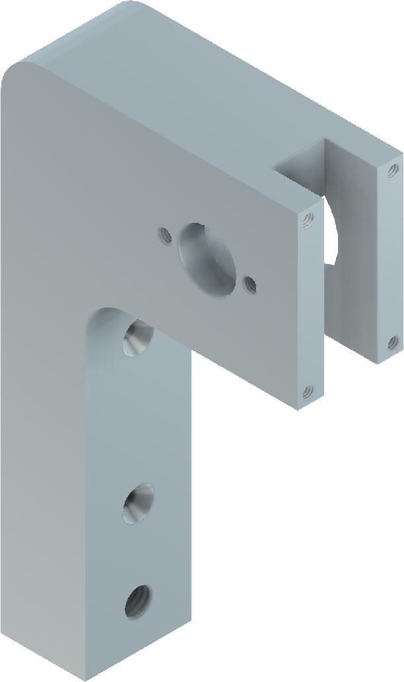



.125
.625
3.5
4X Ø.1345 .4
8-32 UNC - 2B
1.562
R.5
.562
.313
.125
1
1.875
2
2 x Ø.16 .25
10-32 UNF - 2B
6
R.5
2X Ø.17 THRU Ø.37 X 80°
1.7
Ø.314 1
3/8-16 UNC - 1B Ø.562 .375
1.5
.5
.625
1
Walton High School Engineering
DATE
3/17/2024
X.X = +/- .020
X.XX = +/- .010
X.XXX = +/- .005
PROJECT Arbor Press
^{SIZE} CLASS
TITLE
Coloum Multiview
PER 6
A
IED
SCALE 1:3
AUTHOR
Siddharth Gupta
SHEET 1/1

Slide 4
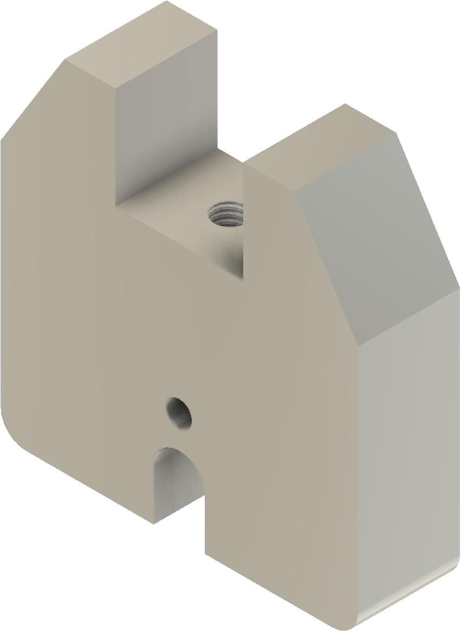



Ø.314 .75 3/8-16 UNC - 1B
.5
1
3.5
2.875
2.375
SECTION A-A SCALE 1:1.5
1.125
A
Ø.25
.562
R.25
1.062
.5
R.25
A
.625
Walton High School Engineering
DATE
3/13/2024
X.X = +/- .020
X.XX = +/- .010
X.XXX = +/- .005
PROJECT Arbor Press
^{SIZE} CLASS
TITLE
Part 2: Base Multiview
PER 6
A
IED
SCALE 1:2
AUTHOR
Siddharth Gupta
SHEET 1/1

Slide 5
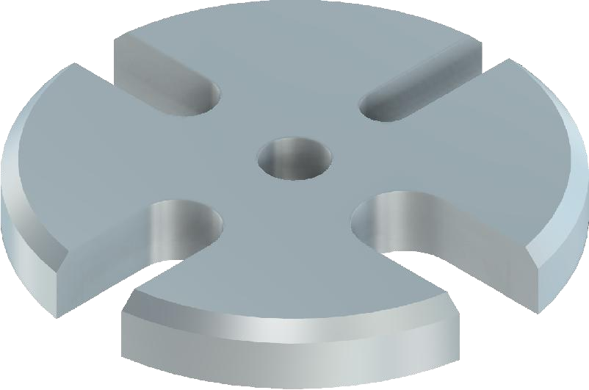


.53 R.094 _{R.125} Ø.255 THRU .44 R.188 .56 R.157 _{R1} 45' x 0.06 chamfer .25
X.X = +/- .020 X.XX = +/- .010 X.XXX = +/- .005 | Walton High School Engineering |  |  |  | DATE 3/17/2024
 | PROJECT Arbor Press
 | SIZE A | CLASS IED |  | TITLE Table Multiview |  |  | PER 6
 | SCALE 1:1 |  | AUTHOR Siddharth Gupta |  |  | SHEET 1/1

Slide 6
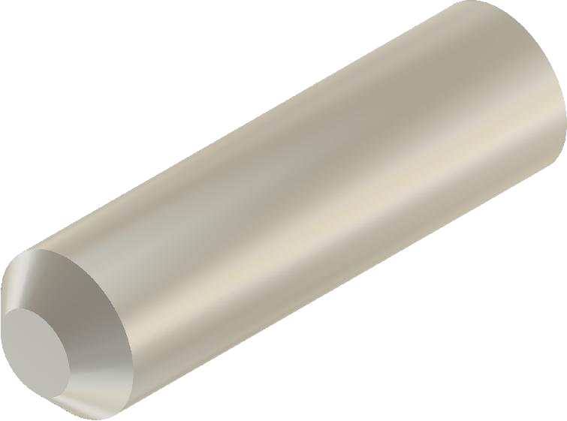
45° x 0.06 .875 Ø.25 X.X = +/- .020
X.XX = +/- .010 X.XXX = +/- .005 | Walton High School Engineering |  |  |  | DATE 3/14/2024
 | PROJECT Arbor Press
 | SIZE A | CLASS IED |  | TITLE Part 5 Table Pin Multiview |  |  | PER 6
 | SCALE 2:0.4 |  | AUTHOR Siddharth Gupta |  |  | SHEET 1/1

Slide 7
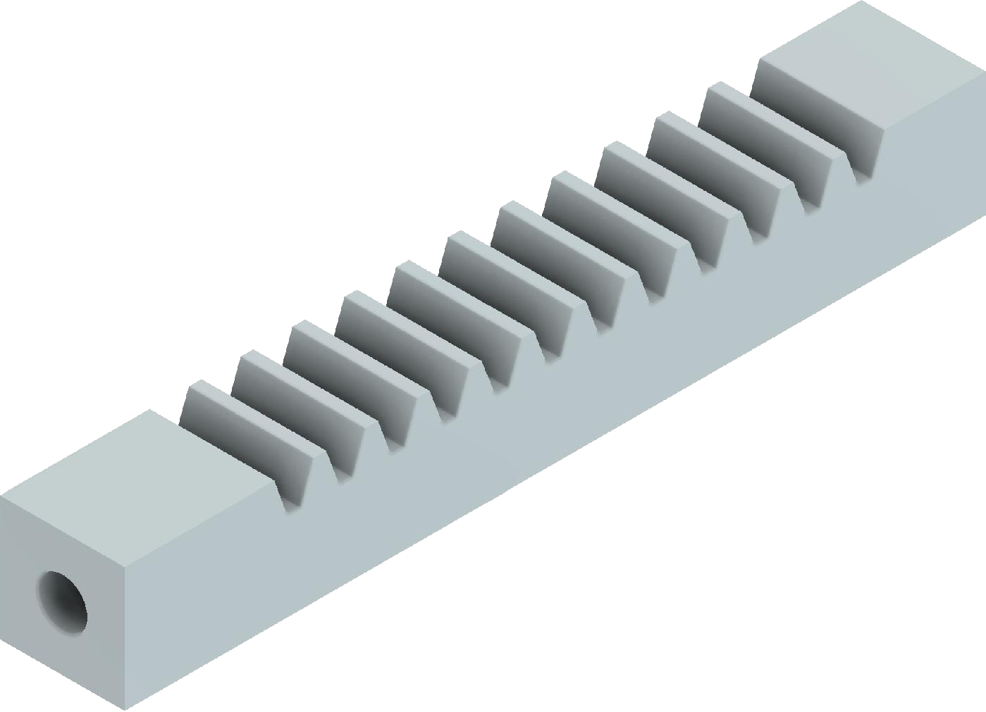




4.375
12 Teeth
12 Pitch rack
Linear Pitch .262
Tooth depth 0.179
DETAIL A SCALE 1.25
.75
A
45' x 0.6
Chamfer
Ø.25
.625
.313
.313
Walton High School Engineering
DATE
3/17/2024
.625
PROJECT Arbor Press
X.X = +/- .020
X.XX = +/- .010
X.XXX = +/- .005
^{SIZE} CLASS
TITLE
Rack Multiview
PER 6
A
IED
SCALE 1:1
AUTHOR
Siddharth Gupta
SHEET 1/1

Slide 8
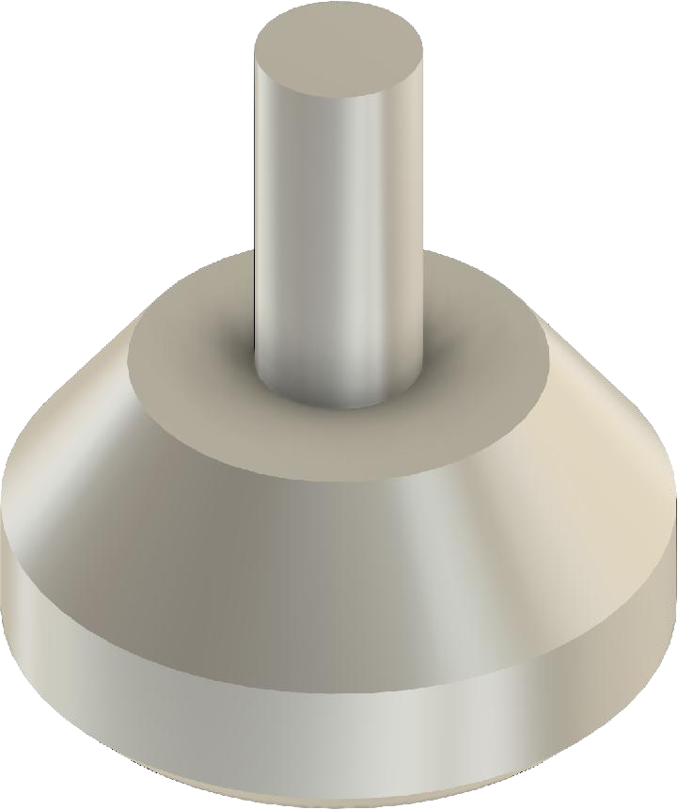
^{Ø1} Ø.625 Ø.25 .562 .812 1.062 45' x .06
X.X = +/- .020 X.XX = +/- .010 X.XXX = +/- .005 | Walton High School Engineering |  |  |  | DATE 3/14/2024
 | PROJECT Arbor Press
 | SIZE A | CLASS IED |  | TITLE Part 7 Rack Pad Multiview |  |  | PER 6
 | SCALE 1.8:1 |  | AUTHOR Siddharth Gupta |  |  | SHEET 1/1

Slide 9
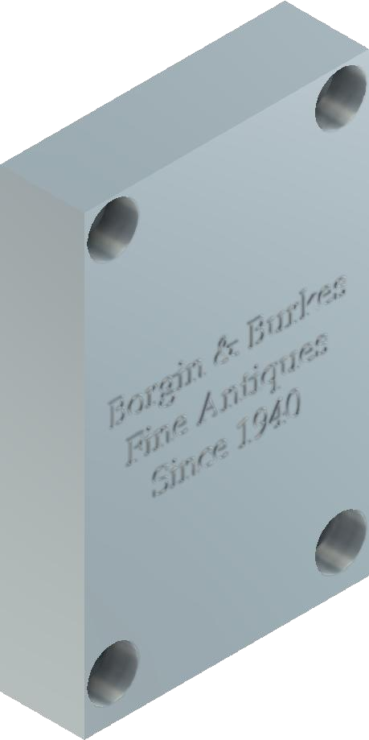




.37 1.25 _{.125} 2 4X Ø.13 THRU Ø.226 .138 .125 1.125
X.X = +/- .020 X.XX = +/- .010 X.XXX = +/- .005 | Walton High School Engineering |  |  |  | DATE 3/17/2024
 | PROJECT Arbor Press
 | SIZE A | CLASS IED |  | TITLE Cover Plate Multiview |  |  | PER 6
 | SCALE 1:1 |  | AUTHOR Siddharth Gupta |  |  | SHEET 1/1

Slide 10
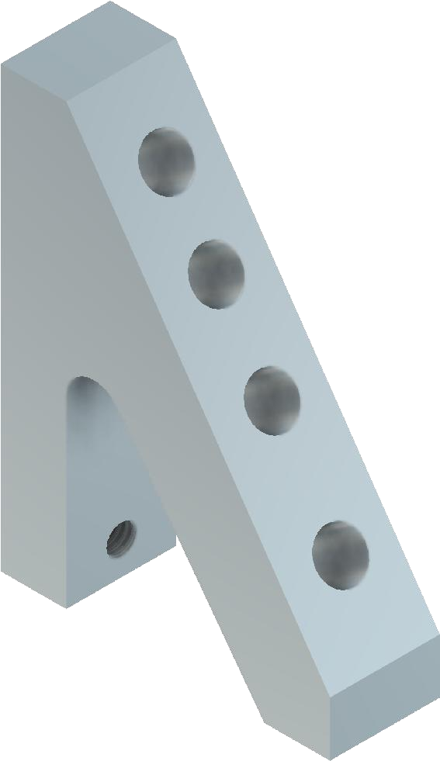





.736
1.186 1.736
.336
R.125
2
1.85
.5
.841
.25
.15
.3
1.5
Walton High School Engineering
DATE
3/17/2024
X.X = +/- .020
X.XX = +/- .010
X.XXX = +/- .005
PROJECT Arbor Press
^{SIZE} CLASS
TITLE
Punch Holder Multiview
PER 6
A
IED
SCALE 1:1
AUTHOR
Siddharth Gupta
SHEET 1/1

Slide 11
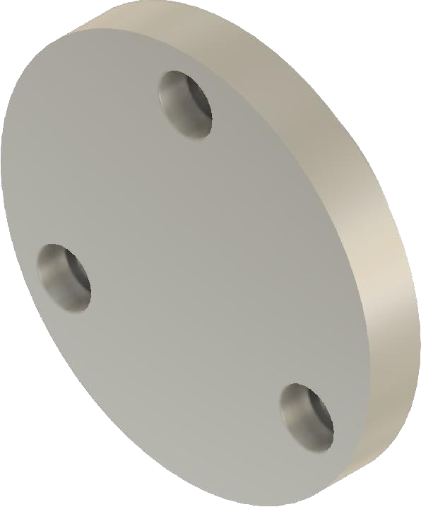





3X Ø.164 THRU ^{.5} Ø.27 .164 _{.25} 1.165 Ø1.85
X.X = +/- .020 X.XX = +/- .010 X.XXX = +/- .005 | Walton High School Engineering |  |  |  | DATE 3/14/2024
 | PROJECT Arbor Press
 | SIZE A | CLASS IED |  | TITLE Part 15 Gear Plate Multiview |  |  | PER 6
 | SCALE 1:1 |  | AUTHOR Siddharth Gupta |  |  | SHEET 1/1

