Slide 1
EcoWave
Siddharth Gupta

Slide 2
PROBLEM
SUSTAINABILITY IS A MAJOR GLOBAL CHALLENGE
Climate change, biodiversity loss, and resource depletion make sustainable everday choices important.
TARGET AUDIENCE
Students
Environmentally-conscious individuals
THE PROBLEM
People lack motivation to recycle, reuse, or shop secondhand consistently.

Slide 3
SOLUTION
EcoWave turns everyday sustainable choices into an easy, rewarding habit.
- Scan trash to identify recyclables, browse or list finds in the marketplace, and locate nearby thrift stores — all in one app.
- Every action earns XP, which unlocks real rewards like gift cards and donations.
- A built-in learning hub also helps users understand the pollution problem EcoWave is solving.
Scan → Recycle → Earn → Redeem

Slide 4
DESIGN
How the core loop works, input to output:
Scanner — camera image → AI model classifies it as recyclable or not → XP awarded
Marketplace — item is searched or uploaded → listing goes live → XP earned
Rewards — XP balance → redeemed for a gift card or donation

Slide 5
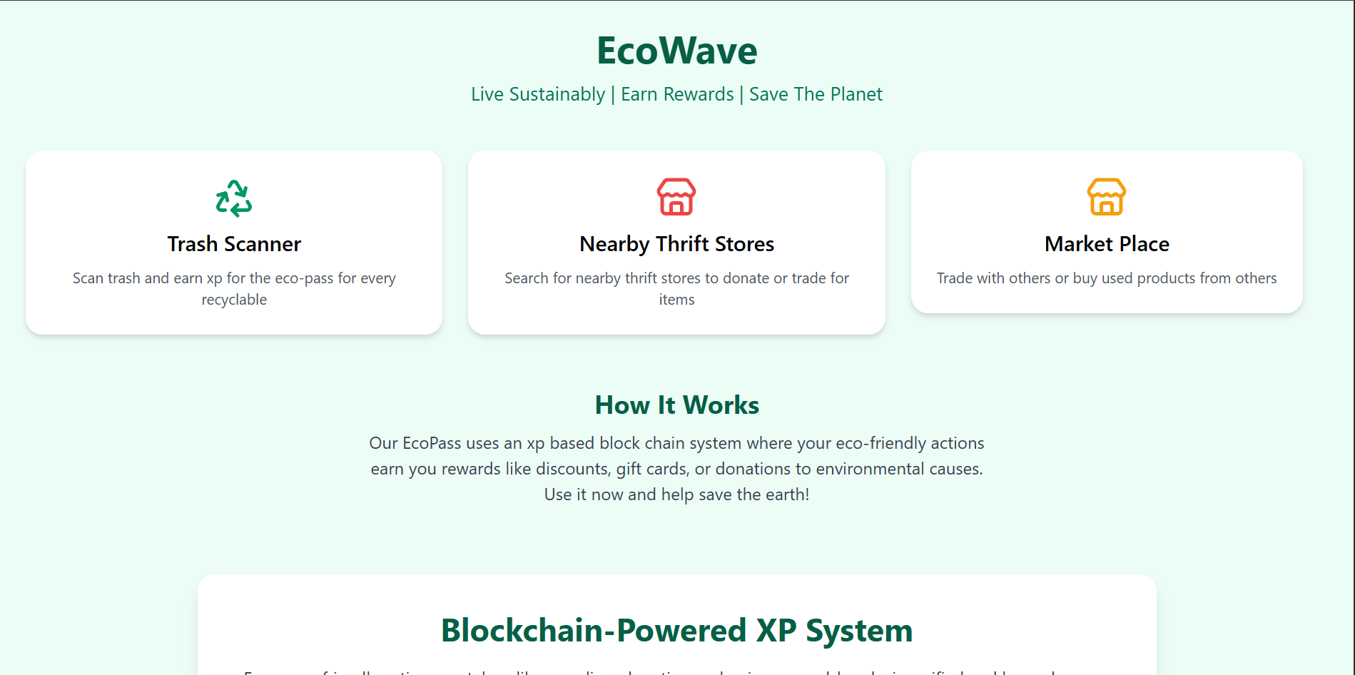
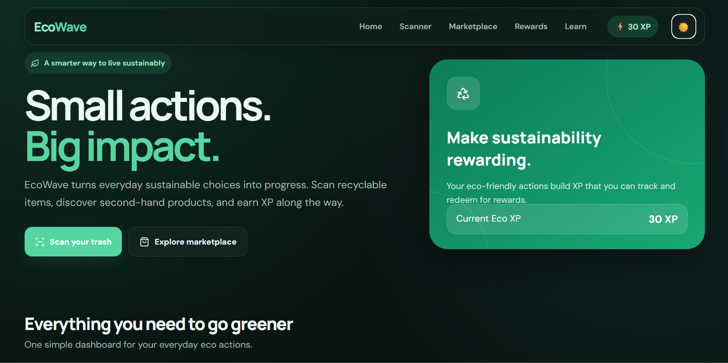
ITERATION & REDESIGN
Got feedback from parents and friends who tried the first version, then redesigned the site around it.
Added a dark mode toggle, cleaned up the overall look, and made the site easier to navigate.
BEFORE
AFTER

Slide 6
DEMO!

