Slide 1
UNEP Case – Landslide PredictionLandslide prediction in Hongkong
An improvement on the current model

Slide 2
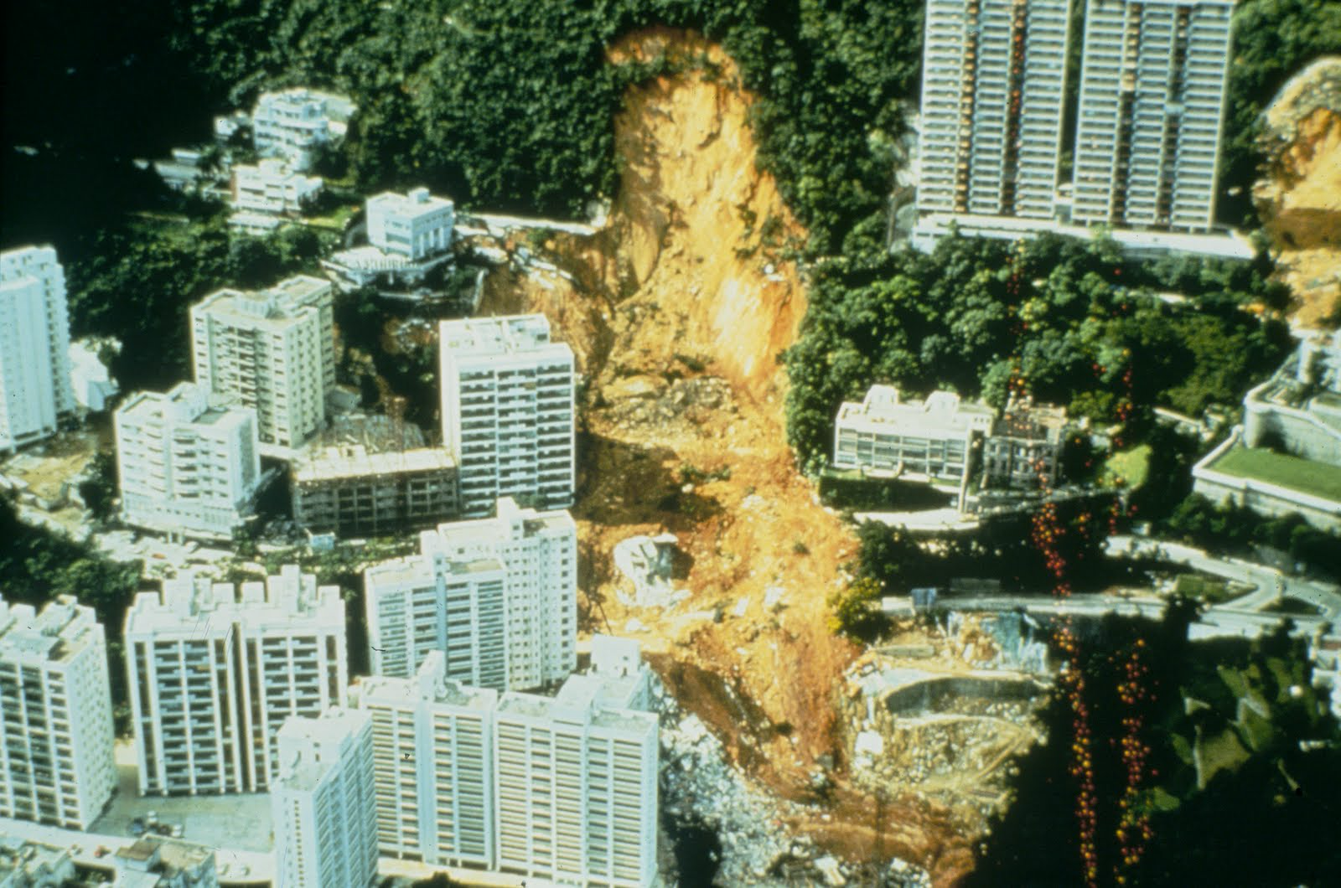
Relevance
Many Deaths every year
Structural damage to the city infrastructure

Slide 3
Technical Challenge and SolutionsML model
Data preprocessing:
Balancing
Dealing wiht outliers
Feature Engineering
Learning Model

Slide 4
Vision for LandSLide PredictionFeasability and usability
Goal: Enable cost-efficient landslide prediction for any location!
Challenges:
Different locations have different geographical structures (Different parameters for the prediction)
May not have as much historical landslide data
Manually taking measurements is very cost and time-intensiveEasy interface to query and train ML-algorithm
Notes:
Our goal is very broad → Not easy to accomplish

Slide 5
IdeasPotential in harnessing technology
Using drones for terrain image recognition? Prof. Ryley Beddoe

Slide 6
Interface Demo
Features:
Insert new measurements (different structure) → Model improvement
Predict based on measurements → City planning and catastrophe prevention

