Slide 1
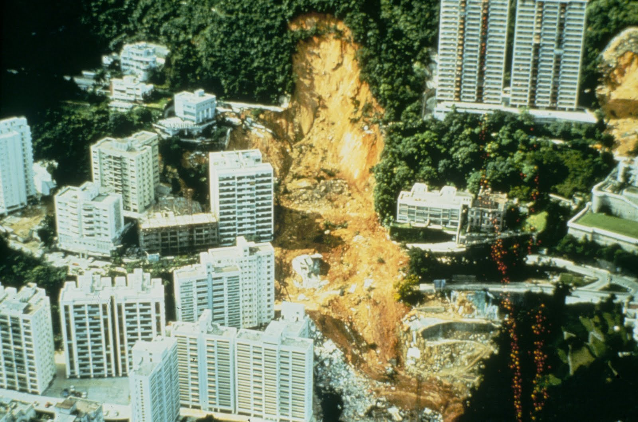

Slide 2
Landslide Database
Balancing
Feature Engineering
Model Training
Model Selection
Prediction

Slide 3
Enable a landslide prediction system for different affected areas

Slide 4
Feasability and usability
Easy interface to query and train ML-algorithm
WebAPP?
Weighing predictions?
Percentage?

Slide 5
Potential in harnessing technology
Using drones for terrain image recognition? Prof. Ryley Beddoe

