Slide 1

DEPARTMENT OF INFORMATION SCIENCE & ENGINEERING
“TRAINING CENTER MANAGEMENT SYSTEM”
Presentation by,
NAME: SOMYA
USN: 1NH19IS160
Under the Guidance of ,
Guide Name: Dr. P. Mangayarkarasi
Designation: Associate Professor

Slide 2
Agenda
Introduction
Abstract
Objectives
Existing system
Proposed system
System Design
Methodology
Tools and concept used
Project Plan :Using Grant Chat
Expected Outcome
Conclusion

Slide 3
Introduction
The Training Centre Management requires a system that manages all the required and minute information easily and in compliance with the user's data base protection.
This project is a computer-based program and it manages the gym members, the personal and the inventory.
Maintains the client details, to provide the valuable reports regarding the progress of the gym member.

Slide 4
Abstract
Gym Management System is a simple console application without graphics.
In this project, you can add, view, edit, search and delete members.
All added and edited records are saved in a file.
Members can be searched by their name or id.

Slide 5
Objectives
Lower data leakage chances.
Computerization as a means of saving time and money can be helpful.
It will reduce information duplication in order to develop a precise and scalable database.
Simple to use and a computerized process effective.

Slide 6
Existing System
Unstable management system.
No proper storage.
Retrieval of information is time taking
Security is easily compromised
No proper record maintenance

Slide 7
Proposed System
It increases efficiency and saves the time.
No any danger and obstacles from external entities
Easy access of saved data inside the system.
Can run on any windows operating systems.

Slide 8
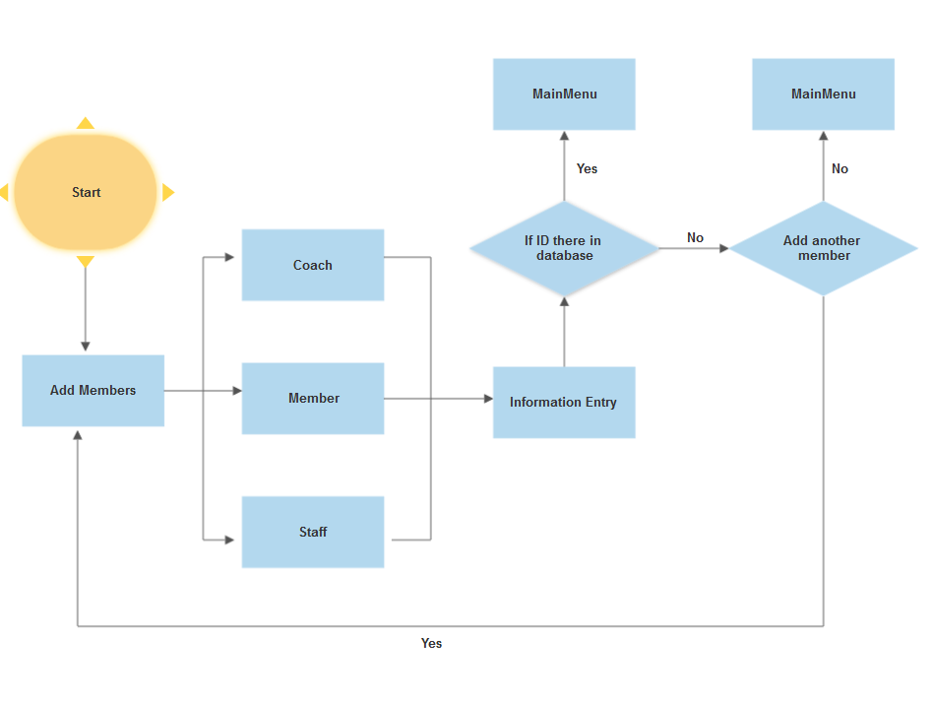
Architectural Design
ADD MEMBER:

Slide 9
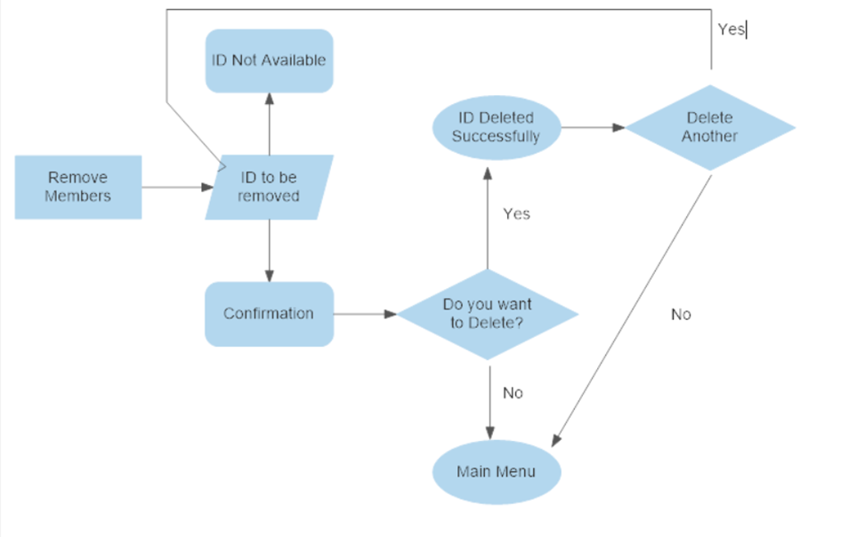
REMOVE MEMBER:

Slide 10
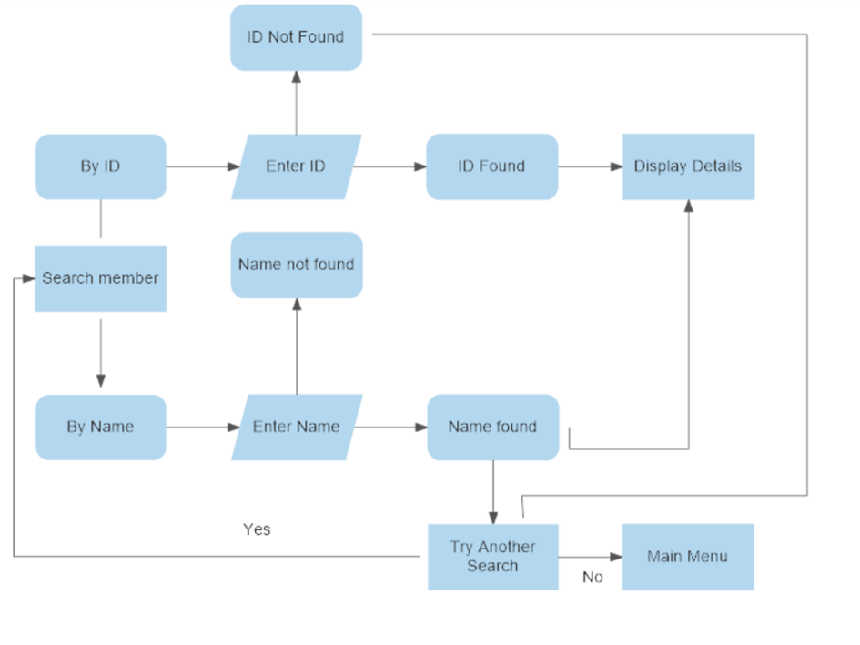
SEARCH:

Slide 11
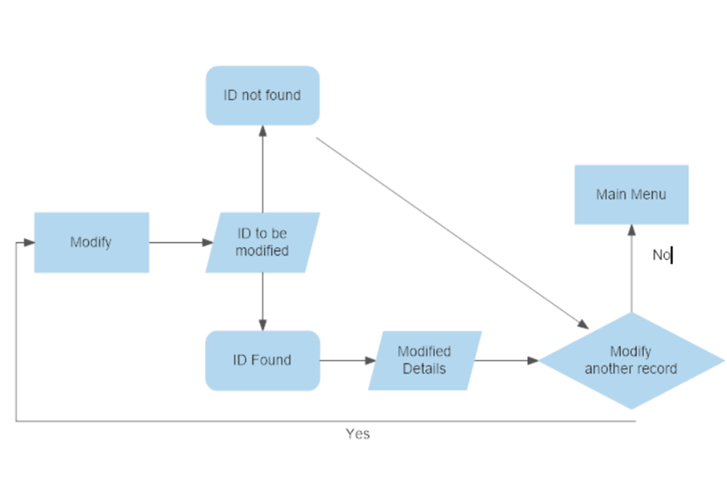
MODIFY:

Slide 12
Methodology
When the program will start user needs to enter the password to use the functions.
Then from the main menu user can perform the following actions: 1.add members 2.remove members 3.search 4.view 5.modify 6.exit

Slide 13
Tools and Concept
Concepts used:
Functions
Arrays
Switches
For loops
If else statement
Language & Software:
C
Dev C++

Slide 14
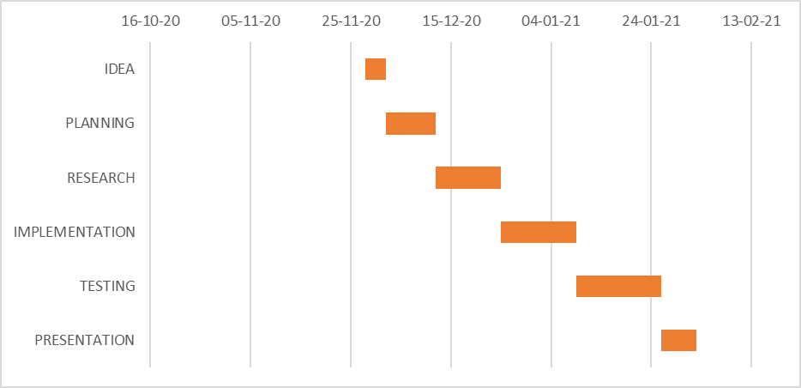
Project Plan

Slide 15
Expected Outcome
Upon successful authentication user will be redirected to main menu.
Main menu consists of following functions:
Add members: this functions will add new members to the database of the management system.
Remove: this function will remove members from database
Search: this function takes either id or name as input for searching a particular member.

Slide 16
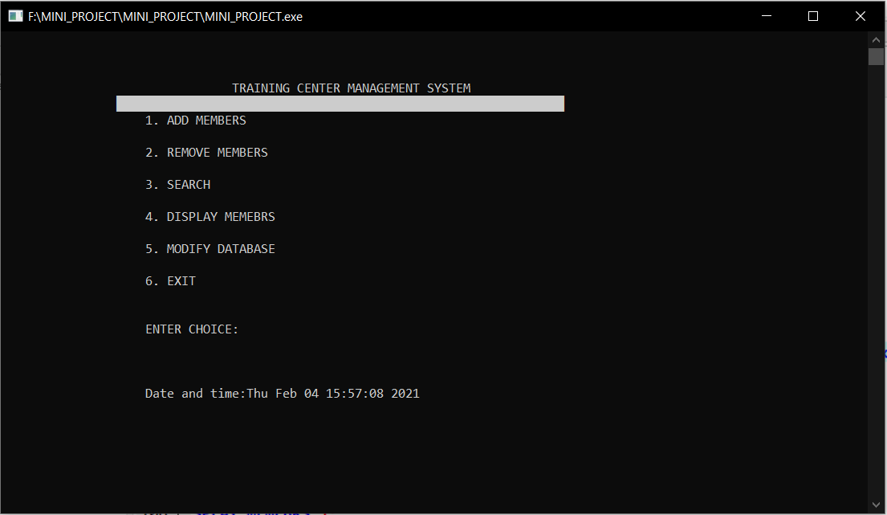
Output

Slide 17
Conclusion
It has been found that the new computerized system is much faster and reliable and user-friendly than the existing system.
the system has been gradually designed and developed and successfully tested.
The system results in a rapid collection of information that is vital to any organization progress.
The burden of manual work is reduced as it is done efficiently and in no time when any kind of change is needed.

Slide 18
References
https://www.geeksforgeeks.org
https://www.geeksforgeeks.org
Fundamentals of Data Structures in C (Ellis Horowitz)
SOLO LEARN APP

Slide 19
Thank you
Queries ?

