Slide 1
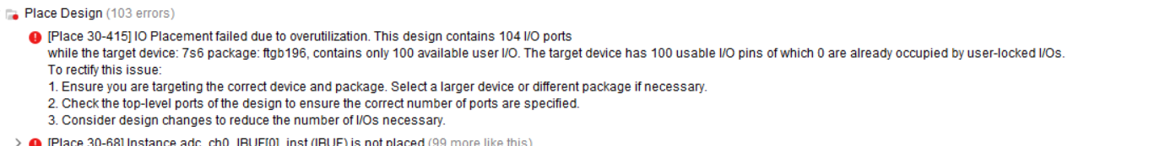
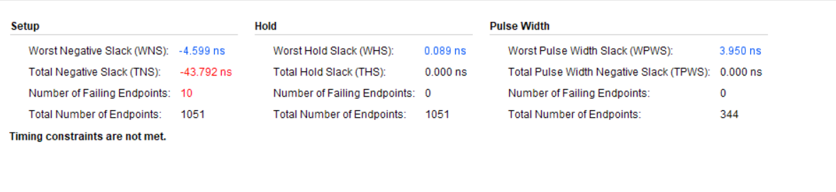
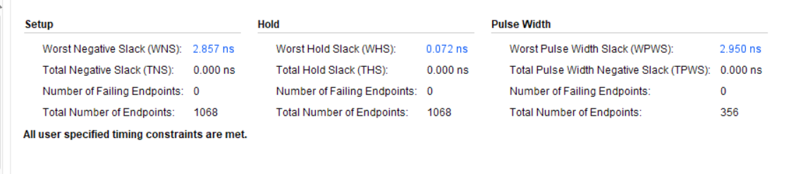
From Spartan to Artix Architecture
Applying Pipelining to the Packetizer Module, making the USB-output Asynchronous.

Slide 2
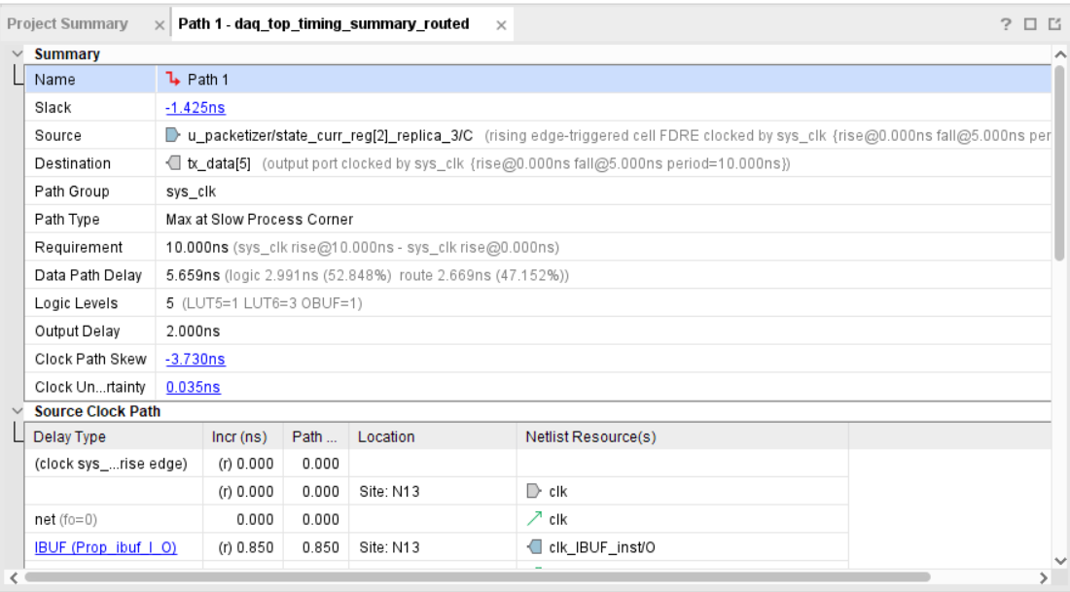
Fig. Path Delay due to Combinatorial State Machine output

Slide 3
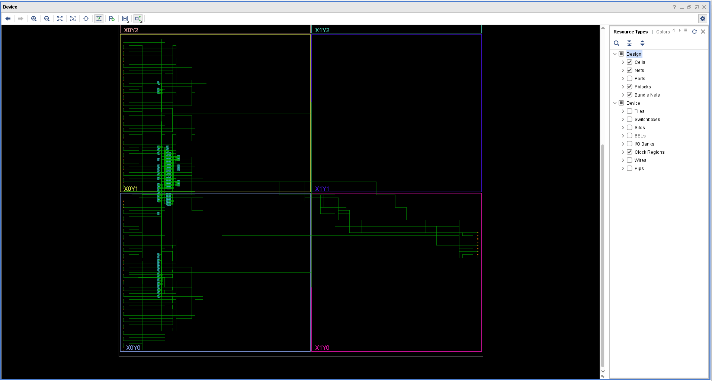
Fig. Artix-7(xc7a35tftg256-3) Implementation

Slide 4
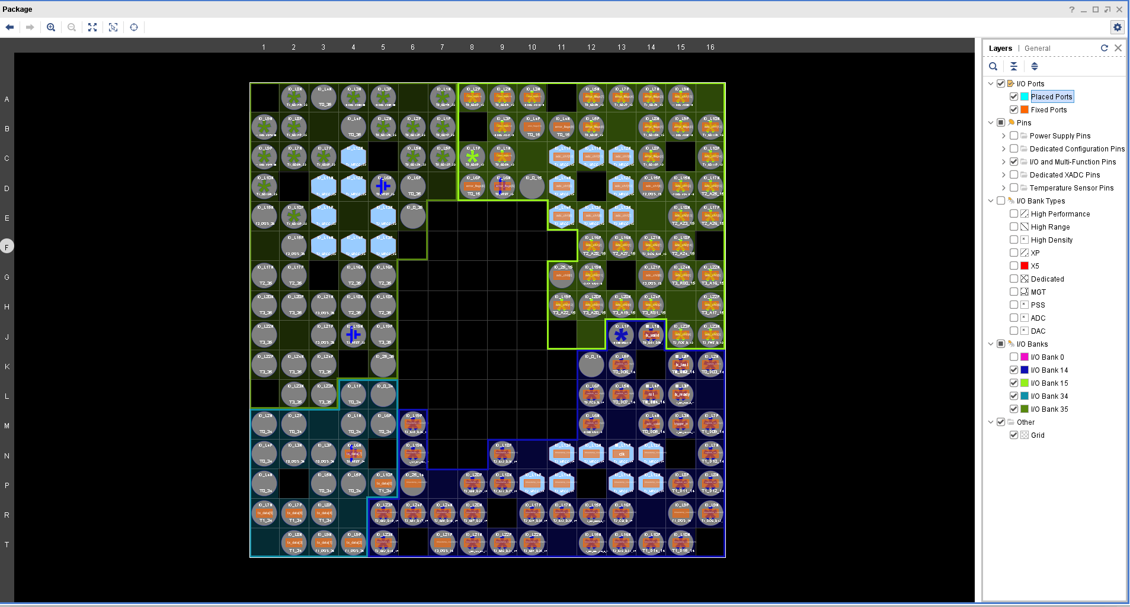
Fig. Artix-7(xc7a35tftg256-3) Device Pinout (Marked in Brown)

