Slide 1
Bamboo Breeze
Vennce Bravo 23140264

Slide 2
ABOUT Me
I am Vennce Bravo. I am a 3rd year student at BCU studying Computer Games Technology. I have experience in both Unity and Unreal Engine 5 whilst also having experience in web development.

Slide 3
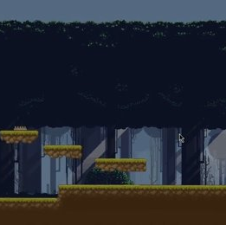
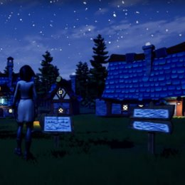
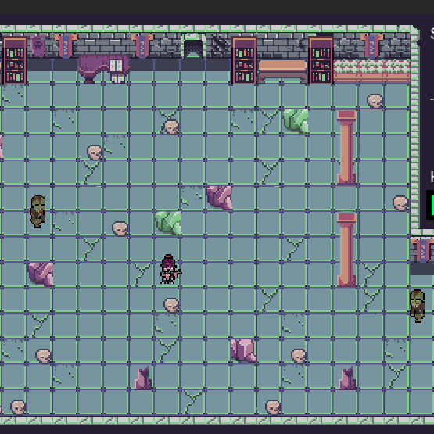
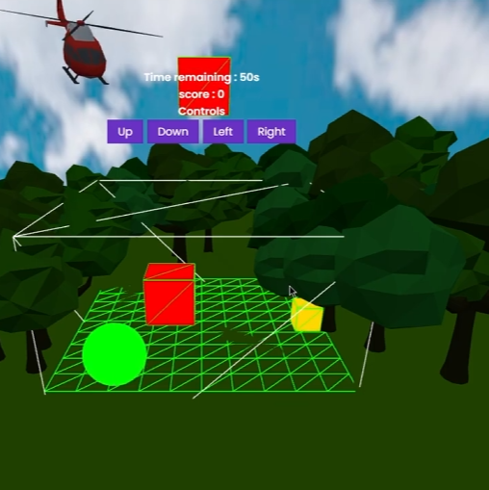
Past work Examples
Year 1 - unity
Year 1 - Unreal
Year 2 – Unity Colaberation
Year 2 – Web Game

Slide 4
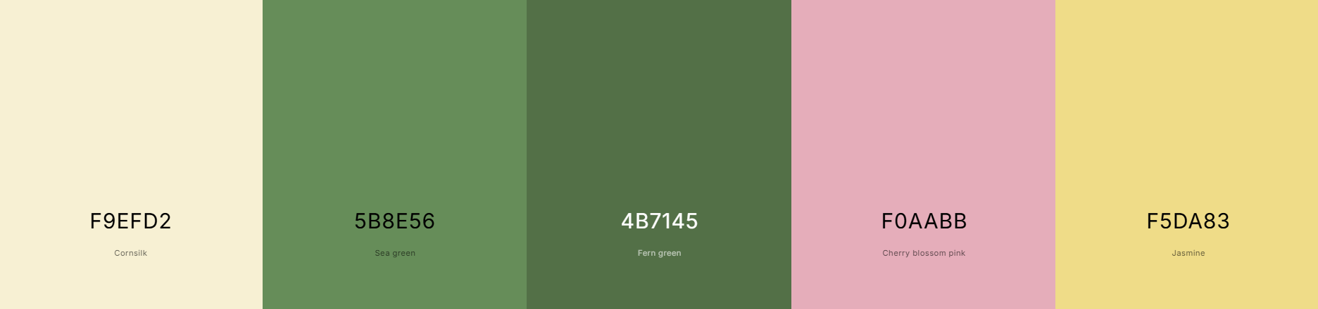
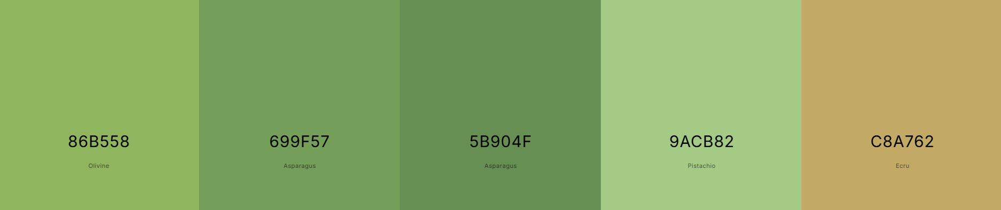
Overview
Colour pallet
Bamboo Breeze:
Genres: Hyper Casual, 2D, Idle, Tycoon, Simulation
Theme: Bamboo forest
Game Engine: Unity 2D
Graphic style: Low poly
Planned platform: Google Play Store
Audience: Children -> Adults
Ui
Ui
Ui
Accent
Highlight
Bamboo
Bamboo
Bamboo
Background elements
Accent

Slide 5
About the game
The game is going to be about growing bamboo and selling it for profit. The gameplay is going to be a tyoon-based 2D game inspired by similar games such as cookie clicker and clicker hero.
The main game is going to be primarly for mobile users meaning that the primary gameplay loop will be simple and easy. The main hook would be that the player would generate money slowly and progress into making a lot of money so basically the user would see bigger numbers as they buy upgrades.
It will also attempt on the integration of monetisation methods through methods such as banner advertisement or on-screen advertisement.

Slide 6
Project aims
Robust Ui + Ux
The game Ui should be catered to all mobile devices whilst also being very user-friendly.
Mobile-specific features
The game would feature mobile-specific features such as the use of the gyroscope.
Use of Additional Libraries
The game would use additional libraries for things that are not native in unity. For instance: TMPEffects
Use of Frameworks
The game would use frameworks to obtain data such as location, date and time and the weather at the current position of the device.

Slide 7
Gameplay mechanics and objectives
Interaction with the bamboo
Live weather effects and day/night cycles
Main objective
The player would be able to interact with the bamboo plant by tapping on the screen to increase its growth stages.
The player would be able to move the phone to make the bamboo plant lean.
Game uses REST API to get the player’s location and uses OpenWeatherMap API to get the current weather status. With this, it will create effects in-game to emulate the real-life weather. Game also tracks device time and simulates the real-life day/night cycle.
The main game objective is to interact with the bamboo plant enough that it fully grows and then sell said plant.
The player is encouraged to buy upgrades to increase a series of multipliers to gain more money.

Slide 8
Current implemented Gameplay features
Interaction with the bamboo
Live weather effects and day/night cycles

Slide 9

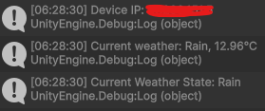
Current implemented Gameplay features
Data persistence
Tracking of device data

Slide 10
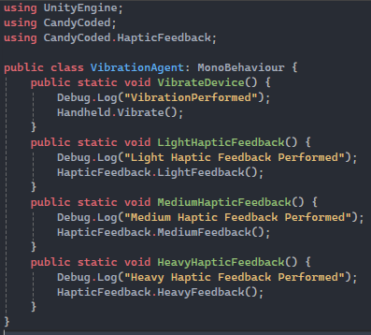
Current implemented Gameplay features
Functional Ui that scales with device
Vibrations and haptics

Slide 11
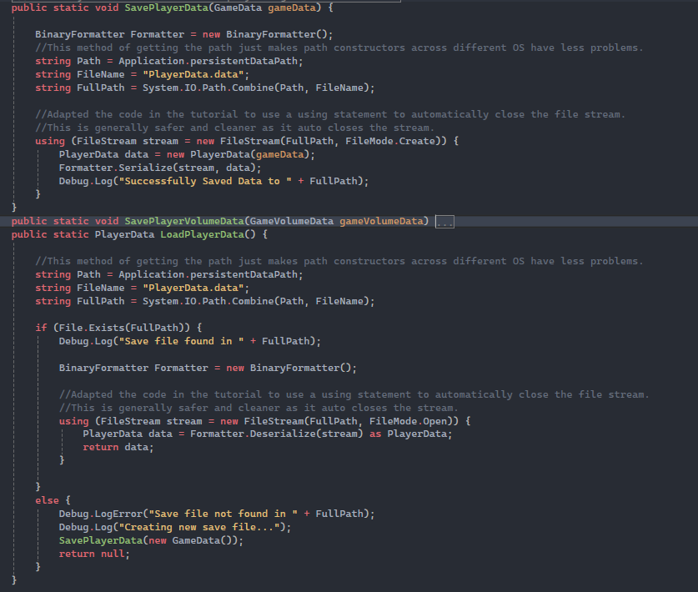
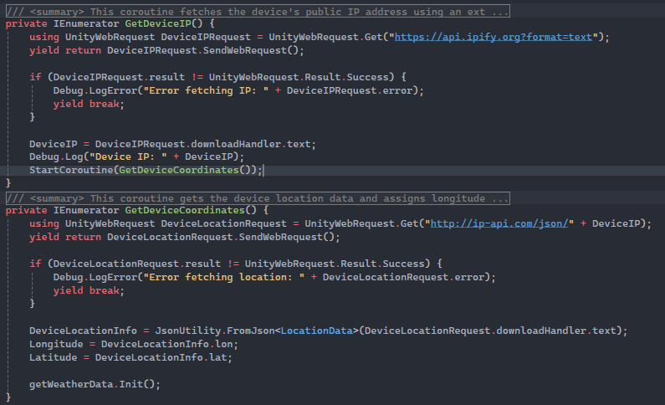
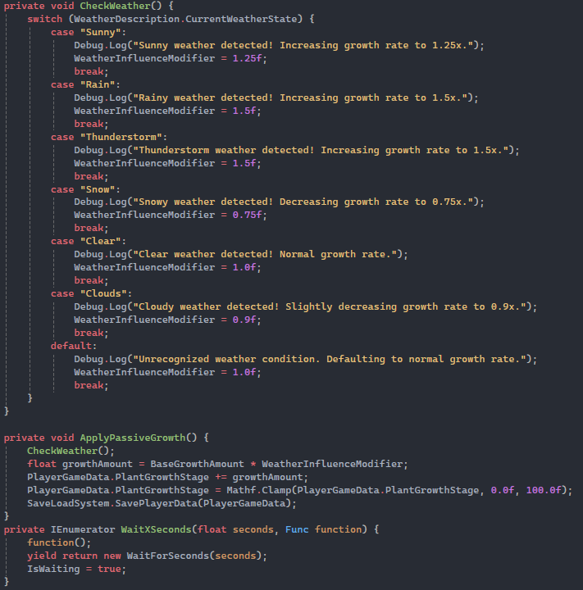
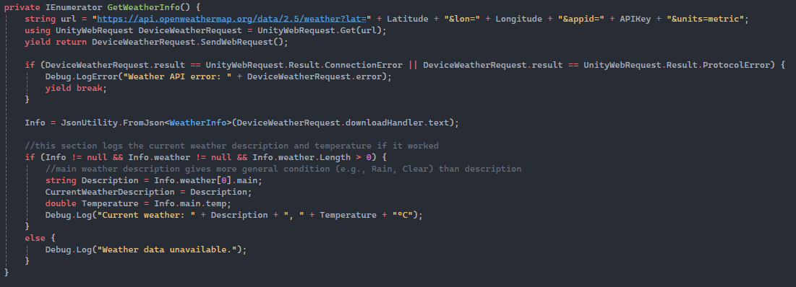
Code Screenshots
Data persistence between sessions
Live location
Weather affecting income/growth
Vibrations
Live weather

Slide 12
Market research
Android platform
According to statscounter.com, Android holds a market share of 75.18% globally compared to iOS of 24.44%. According to worldpopulationreview.com, lower income countries hold the highest split between Android and iOS meaning that android is more accessible than iOS.
Genres
The most popular genres by revenue in the mobile games market are Strategy, RPG, Puzzle, Casino and Simulation. This means that by making a simulation game that is successful, the revenue generated can be as high as $1.2 billion.
Age demographic
Ages 16-24 have around 52% of them playing mobile games which is quite normal however the percentage of people playing mobile games only starts to taper off towards 65+ meaning that the age range of which people play games is large so art style must comply to all ranges. source
Monetisation
Mobile games have the highest market share out of all the game industry (~$100 billion). Popular forms of monetisation strategies are in-app purchases, in-app ads and subscriptions.

Slide 13
Market research (Cont.)
Similar games
Non-similar games
Main take from this
I have looked at a bunch of games that are in-line to the game idea I have (Cookie clicker, Clicker Hero, Pou).
I have also looked at other games (Clash Royale, Mobile Legends: Bang Bang, Fate/Grand Order)
Similar Games:
Ui must be simple
Basic mechanics but other mechanics build upon it
Some form of progression
Non-similar Games:
FOMO is very prevalent
Ui must be smooth, clear and easily traversable
Monetisation is very much in your face

Slide 14
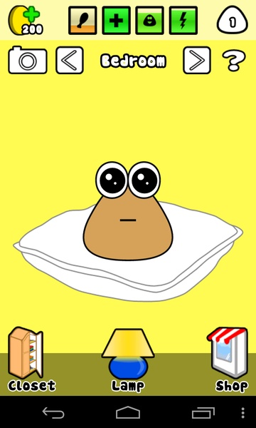
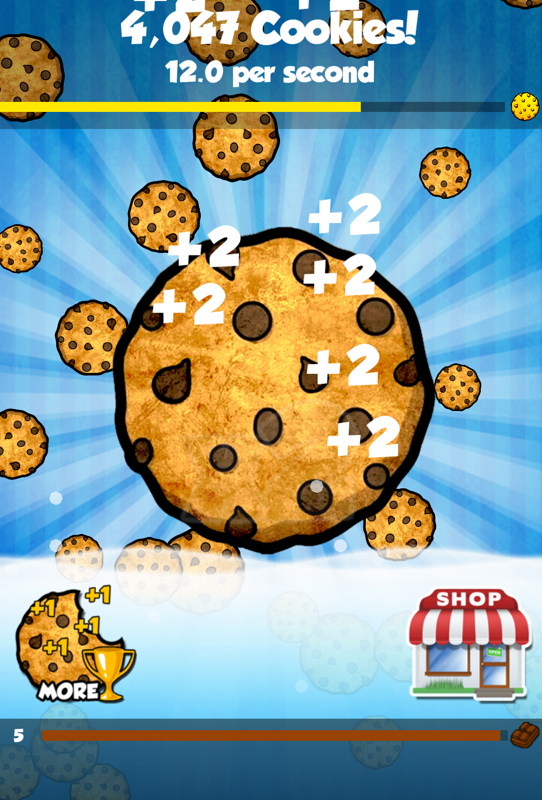
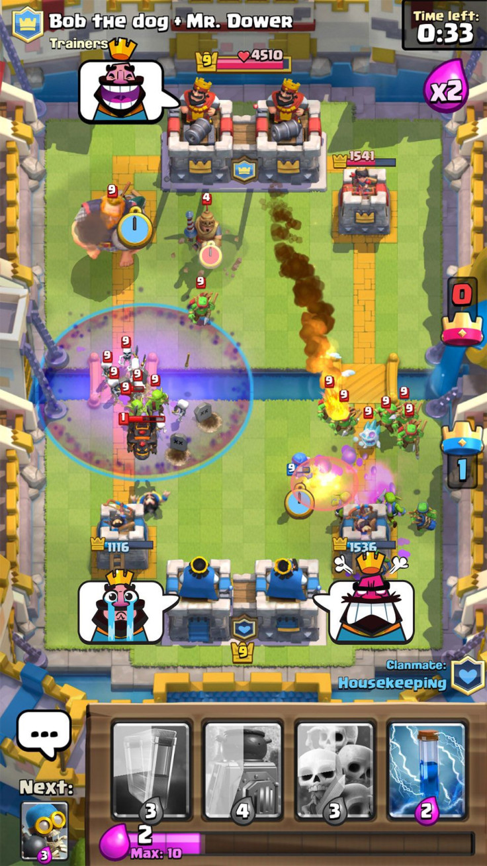
Comparison of the Ui from the games
Cookie Clicker
Pou
Ui is very simple, small amount of text labels
Shop button is in a very UX-friendly position
Clear goal without needing to know how to play
Big numbers so dopamine spikes
Very clear graphic on Ui
Graphic for Ui elements are clear so text isn’t fully reliant
Most important Ui elements are in areas which are most accessible for Ux
Clear gradient and colour palette used
Clash Royale
Only interactable Ui is at the bottom
Clear visuals on resources
Very Ux friendly since most of game can be played with bottom half of screen

Slide 15
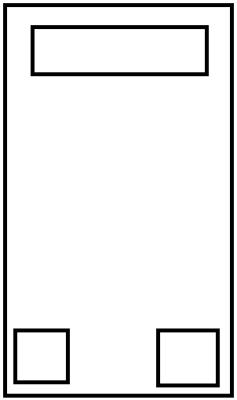
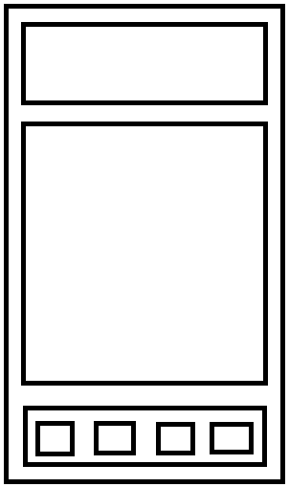
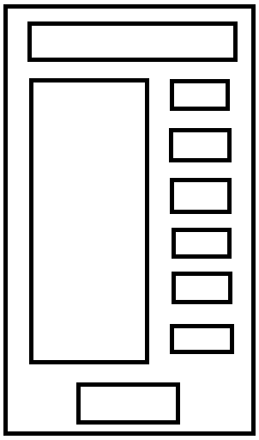
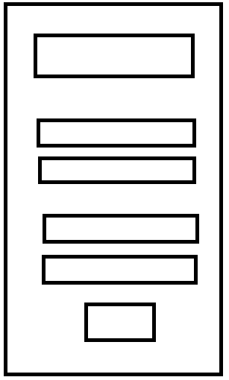
Drafts of ui
Main Menu
Game Scene
Title
Simple buttons to move Uis
Top Ui
Went with simple ui for main game
Easy Ux since focus is on the bottom half of screen
Bamboo Plant
Credits
Options
Bottom Ui
Upgrades Scene
Settings
Text
buy
Placed buy buttons on right side of screen since most people hold their phone with right hand
Most buttons are easily accessed
Text
Upgrades
buy
Slider
buy
Slider
Sliders for audio types
Toggles for audios or features
buy
Toggles
buy
Toggles
buy
Back
back

Slide 16
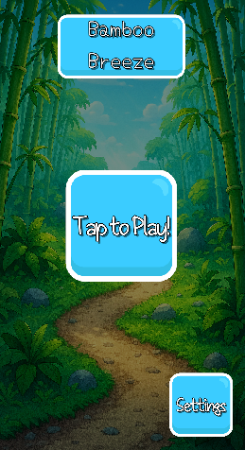
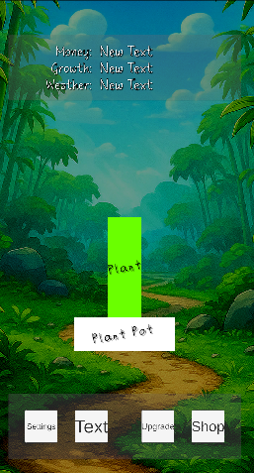
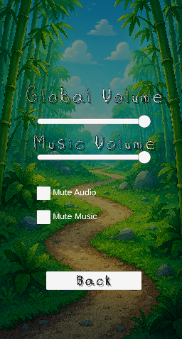
Current Ui implementation
Main Menu
Game Scene
Settings
Title
Top Ui
Bamboo Plant
Credits
Options
Bottom Ui
Text
Text
buy
Upgrades
buy
Slider
buy
Slider
buy
Toggles
buy
Toggles
buy
Back
back

Slide 17
Features to be added
Cinemachine
Going to use dynamic camera to switch between scenes rather than have a sudden transition to the Ui.
Unity monetisation
Going to implement ad breaks every so often .
Google play service
Going to be used for the achievements.
Gyroscope
Going to use gyroscope to add swaying to the bamboo plant.

Slide 18
Monetisation
Free to play
Most games that generate a large sum of revenue are free to play (source).
In-app purchases
Many games use in-app purchases to accelerate player progression. My plan is to use in-app purchases to give player premium upgrades that cannot be bought through free currency.
Annoying ads
Planning on having the ads be quite frequent so that the user is more inclined to pay for an one-time payment to disable ads

Slide 19
Current limitations
Placeholder Assets
The assets used in the game now are pretty much all placeholders as I have yet to make any assets for the game.
No Audio
Even though audio systems are implemented, there is no audio but some placeholder audio.
No Upgrades or Shop Ui
Have not yet started on the upgrades or shop ui however the framework is there for it to be implemented.
No gyro on the plant
Have not yet started on gyro in the game so the bamboo plant is yet to move with the phone.

Slide 20
Demo

Slide 21
THANK YOU

