Slide 1
COLLEGE COMPANION APP
t. VIGNESH RAJ (211419205178)
k. SIDDHARTH(211419205156)
v. VISHNUPRASAD(211419205184)
GUIDED BY
V.KANDASAMY M.E.,

Slide 2
ABSTRACT
The aim of the app is to guide the students and keep them updated about what's happening in the class.
In this app, the student can get the announcement regarding any examinations, holidays, etc..
Also the student can get the notes of their respective subjects. Newly join students feel difficulty to find their way to their classes, laboratory etc., in their department block.

Slide 3
Also the previous day absentees don't know what happened in the class or laboratory etc. Hence this project is developed to know about colleges informations through phone.
It is highly efficient and necessary for students . No cost required , Helpful for students for knowing the college informations simultaneously.

Slide 4
In this app ,we have developed only one department information for students, by developing all department information this app is helpful for all students studing in that college.
This application is mainly used for the students from saving timing complexity. Hence this application is used for gather new information about class for students and highlight the direction to the each students.

Slide 5
Literature Survey

Slide 6
S.No | Paper Details | Methodology | Pros | Cons
1. 2. | “Android Based Student Reminder System” by S.Bhavani ,Y.Sanjay. “Fire base in android app development –study” by Daniel pan , supriya. | They can know the attendance status and can get alert information It Stores the data in database in online | In this paper Proposed android based application useful for students Easy to use the database to store data | Only when the internet is on it alert message It will stores the limited data in firebase

Slide 7
Existing System
Newly joined students feel difficulty to find their classes laboratories etc. Also previous day absentees don’t know what’s happening in the class.
And their also don’t know what announcements given in the class. And their cannot be able to calculate their gpa.
GOOGLE CLASSROOM APP AND STUCTOR APP ARE EXAMPLES OF EDUCATIONAL APP DEVELOPED FOR STUDENTS .

Slide 8
FROM THAT EXAMPLE APPS HAVE DEVELOPED AN NEW EDUCATIONAL APP FOR STUDENTS WITH NEW PROPOSED SYSTEM.
In this app ,the students can get the announcement regarding any examinations, holidays etc..
To overcome the problem , we developed an companion app to solve all difficulties faces by the student in the class.

Slide 9
Proposed System
To Overcome the problems in the existing system, we developed an app to guide the students and keep them updated about what’s happening In the class.
Through this app , Students can get the notes of their respective Subjects and exam results also .Through this app students can know Which location their class is located

Slide 10
Student can get the announcement regarding any examinations, holidays, etc. Students can receive notices about upcoming exam result, and other events.
Hence this project is developed to know about colleges informations through phone. It is highly efficient and necessary for students.

Slide 11
HARDWARE & SOFTware Requirements

Slide 12



HARDWARE REQUIREMENTS
Hard disk -250GB.
MICROSOFT
WINDOWS
10 REQUIRED.
RAM SPACE -8GB.

Slide 13



Software REQUIREMENTS:
android studio
(for developing
Mobile app)
Firebase
(for data
Storage)
Figma illustrator
(for design)

Slide 14
Architecture diagram

Slide 15
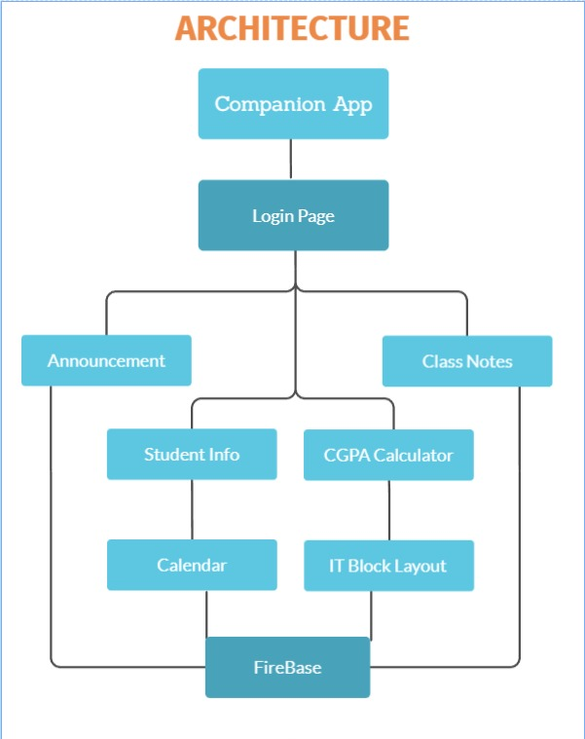

Slide 16
Methodology

Slide 17
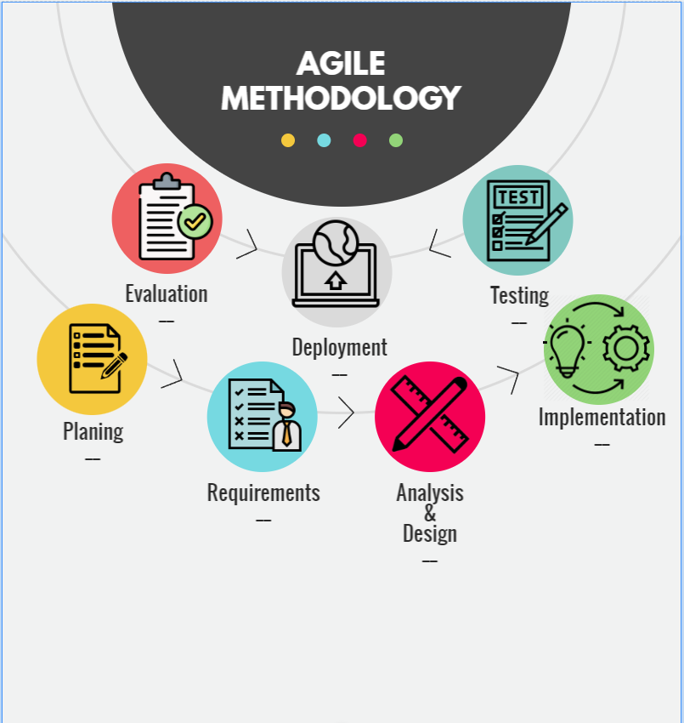

Slide 18
MODULES SPLIT UP

Slide 19

COLLEGE COMPANION APP
MAIN page
STUDENT INFO
Login page
HOME page
NOTES
USER NAME
ANNOUNCEMENT
CALENDAR
PASSWORD
SIGN IN
CGPA
LAYOUT

Slide 20
Modules and its description

Slide 21
Home page
The aim of the mobile application home page is to guide the user ,rapidly Present content and its content . Home page typically encountered first on a website that usually contains links to other pages of the site.
For developing home page ,android studio and figma illustrator is used. In this home page we created a login button and logo . Next in home page announcement bar is also developed to check the announcements For regarding students Information about examinations and results

Slide 22
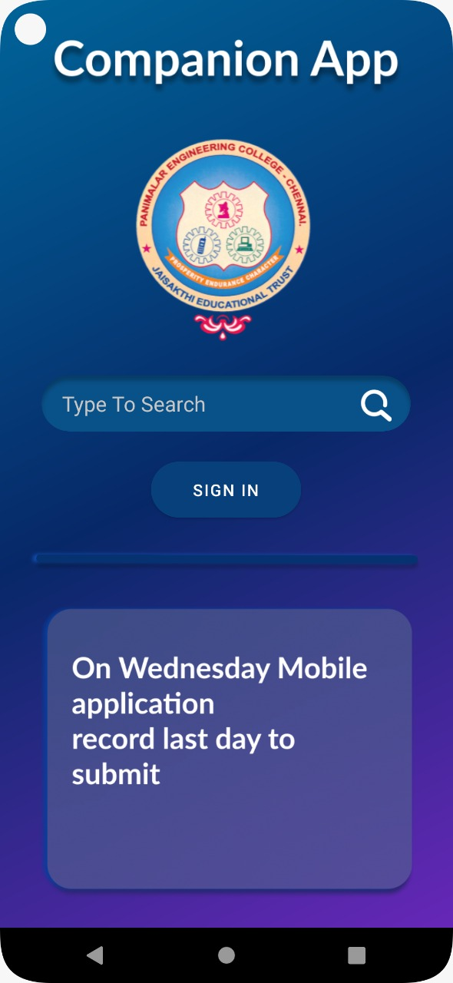
Home page snapshot

Slide 23
login page
A login application is a screen asking your credentials to login to some particular application .Login page asks the username and password of that student in that college .It also consists of the logo of that particular college .
login page access for that Candidate and it shows all details about the candidate examination results, subjects etc.

Slide 24
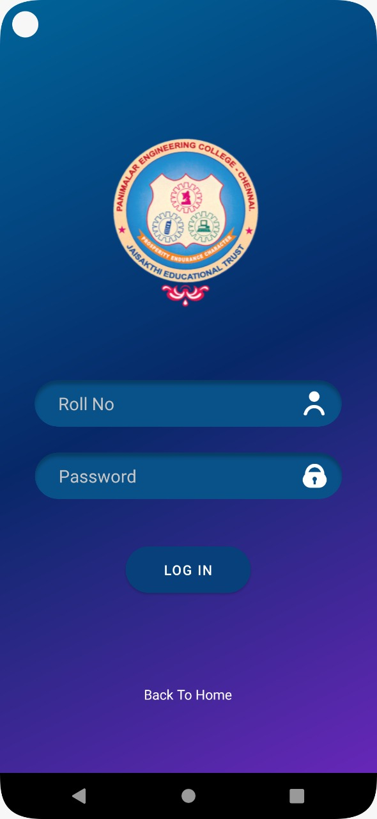
login page snapshot

Slide 25
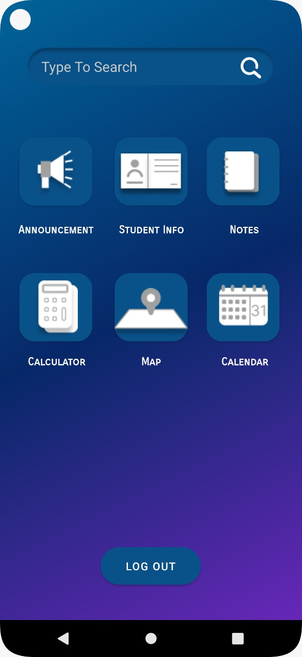
main page snapshot

Slide 26
ANNOUNCEMENT :
Announcement details shows in the home page itself.but for seeing the full announcement and the previous announcement is icon is used. Staff given announcement to their students for examination date, timing, results, notes required. This are the details seen in the announcement page.

Slide 27
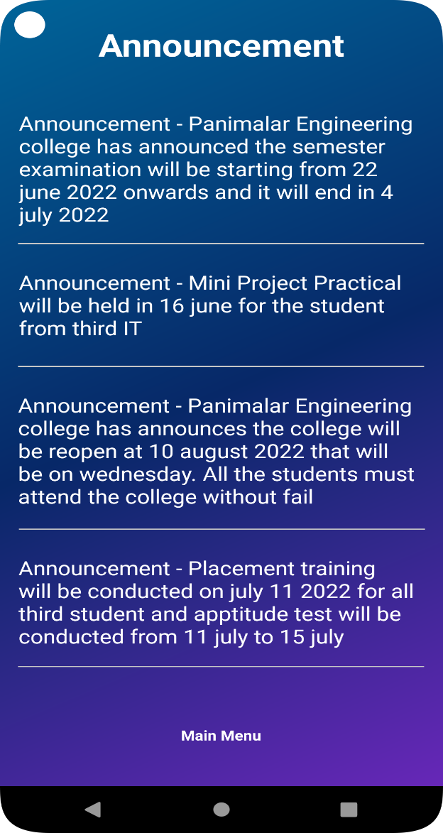
AnNouncement page

Slide 28
Student info :
students details shows in the home page itself.but for seeing the full announcement and the previous announcement is icon is used. Staff given announcement to their students for examination date, timing,results, notes required. This are the details seen in the announcement page.

Slide 29
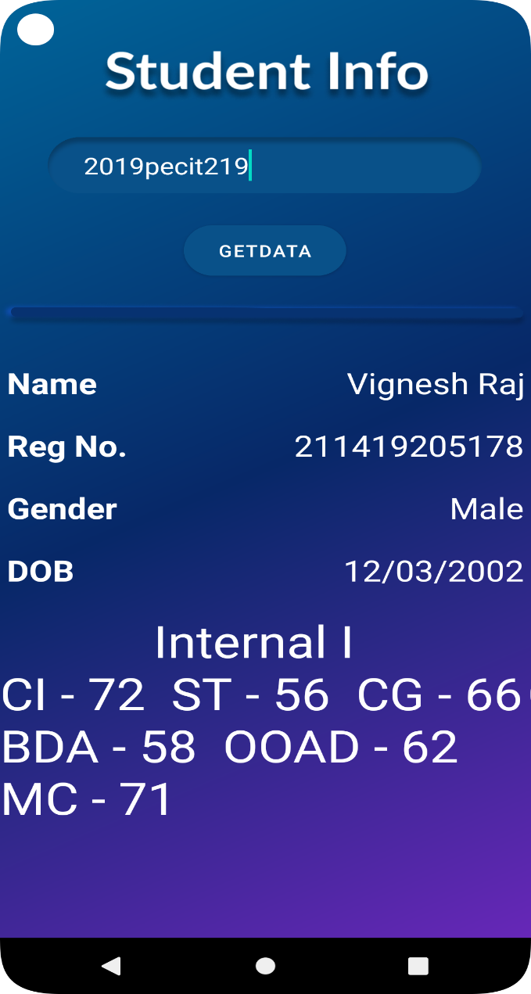
Student Info snapshot

Slide 30
notes :
This app is mainly used to show the examination results and used for Downloading their respective notes also this mainly used to reduce the Time for the staff and also for the students. With the help of the username And password in the login page we can see the examination results..

Slide 31
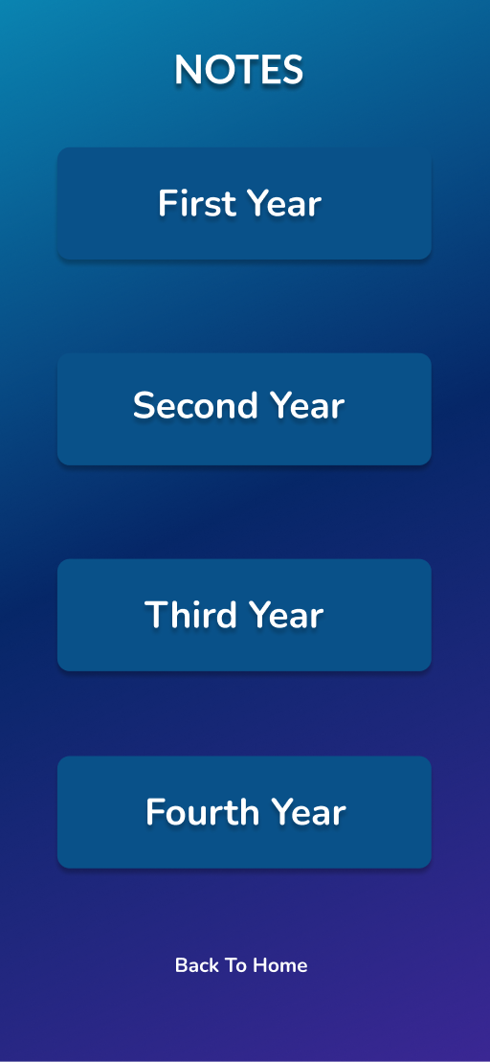
Student Notes

Slide 32
BLOCK LAYOUT:
Newly joined students feel difficulty to find their way to their classes Laboratories etc.. in their department block . This app solves the difficulaties For finding the way. In this app we build a block layout to show the students Where the classes and laboratories are located .

Slide 33
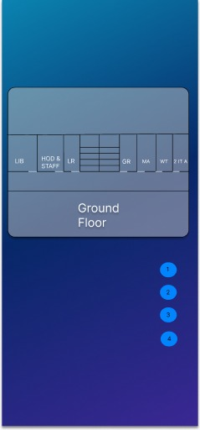
block layout

Slide 34
Gpa calculator and calendar :
We designed a gpa calculator in this app for calculating the students semester exam gpa. Gpa calculator is designed with java coding and xml . Credits are updated in the java coding itself. Just students want to give their grade to calculate their gpa . And calendar also developed for seeing the dates.

Slide 35
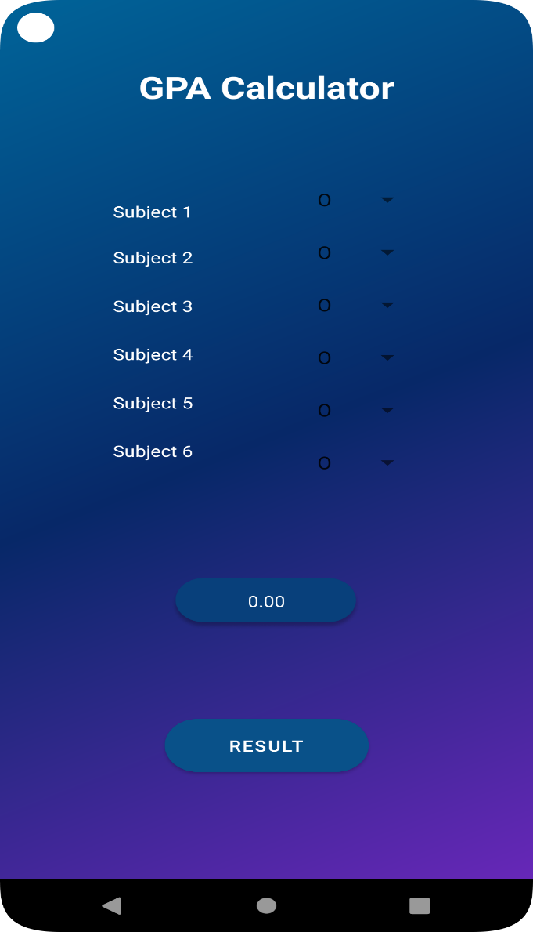
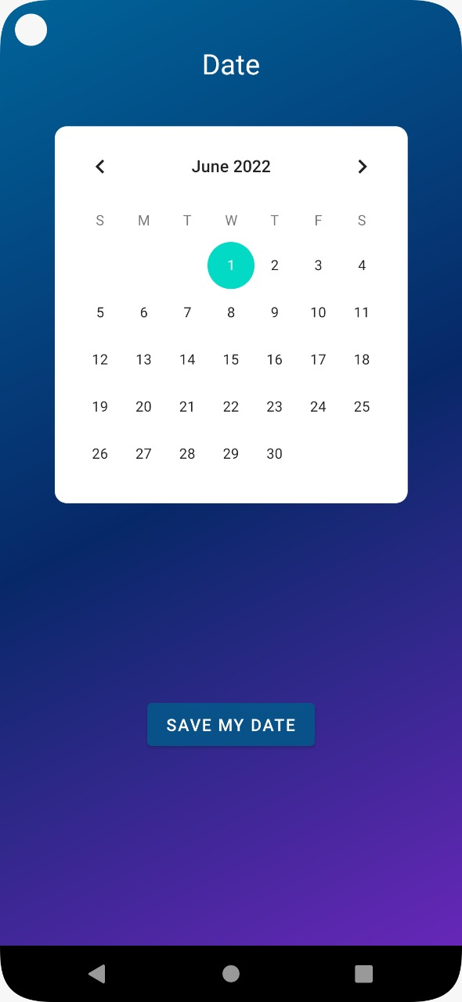

Slide 36
References
[1] “Educational app for Students academic Performance” by Jasmine Erika A. Ababa, Cyrel Sean
[2] “An Android Based Mobile Framework for Student Alert Notification” by Winfred Adjardjah Geor.
[3] “Android Based Student Reminder System” by S.Bhavani ,Y.Sanjay.
[4]“Fire base in android app development –study” by Daniel pan , supriya.
[5]“Android Programming in a Day! The Power Guide for Beginners In Android App Programming” by Sam Key

Slide 37
[6] “Head First Android Development: A Brain-Friendly Guide” by Dawn Griffiths and David Griffiths.
[7]“The Definitive Guide to Firebase: Build Android Apps on Google's Mobile Platform” Moroney, Laurence.
[8]“Build Mobile Apps with ionic 4 and firebase: Hybrid Mobile App Development” Cheng, Fu.

Slide 38
Conclusion
This application is mainly used for the students from saving time.
Hence this application is used for guide the students to update them about the class information.

