Slide 1


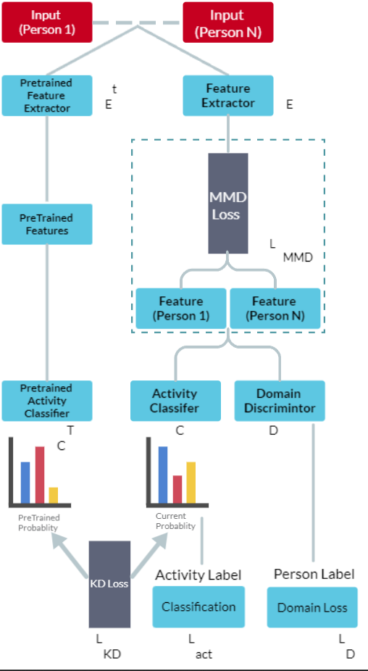
PANIMALAR ENGINEERING COLEGE
An Autonomous Institution
Improving Feature Relevance Analysis Sensor-Based Behavioral Context
Recognition using Deep Metric Context Learning
ABSTRACT
Architecture
Project Module:
Sensors in everyday devices like smartphones and wearables can gather large amounts of data on behavior and context, which can be useful in creating solutions for fitness tracking, sleep monitoring, and assisted living. A multi-stream network is proposed to recognize multi-label behavioral context using extracted representations to infer a user's context and contextualizing learning for each modality. An end-to-end trained deep network achieves optimal recognition rates. The proposed architecture can be expanded to include additional sensors for improved performance and handle missing modalities through multitask learning. The paper proposes a logical-based framework to recognize and analyze behavioral specifications in a formal logic language to build seamless human-computer interactions.
Module 1: Data Preprocessing.
The first step in data analysis involves two critical processes, data acquisition and data integration. The data acquired from the real world can often be incomplete, noisy, or redundant, and therefore data cleansing is necessary to ensure consistency in the data
Module 2: Feature Preprocessing.
Usually, feature extraction is employed to recognize significant attributes of prepared data that assist in resolving the classification issue at hand. The accuracy of classification results is directly influenced by the selection of appropriate features
Conclusion
Module 3: Model Training and Behavioral Context Recognition.
This article proposes a method for detecting and analyzing behaviors in sensor-based environments to support proactive decision making. It uses deep multi-modal convolutional neural networks to recognize multiple types of behaviors and suggests strategies for combining learned representations. The authors also propose regularization schemes to improve the model's ability to generalize and suggest a modification to the network's architecture to handle missing sensors.
Deep Metric Context Learning Neural Networks typically consist of three layers: input, hidden, and output. These layersare made up of interconnected neurons with nonlinear activation functions, which improve the network's ability to handle nonlinearity.The input layer receives data, which is then analyzed in the hidden layer before the results are passed to the output layer for display.

