Slide 1
Cuckoo Search
via Levy Flights
Final metaheuristics presentation | continuous optimization demo
Reference: Yang & Deb, NaBIC 2009

Slide 2
MOTIVATION
A population search with rare long jumps
Related to evolutionary algorithms and PSO through population search; distinctive because exploration uses heavy-tailed Levy flights.
Intensification
Diversification
Best nests are preserved across iterations.
Levy flights sometimes make very large moves.
Steps shrink naturally when nests approach the best solution.
Discovery probability replaces weak nests.
Yang & Deb, Cuckoo Search via Levy Flights, NaBIC 2009

Slide 3
DEFINITION
From metaphor to optimization objects
The biological story is only a design analogy. In code, everything becomes candidate solutions and objective values.
Paper rule
Optimization meaning
What my demo implements
One egg
new candidate solution
Levy-generated vector in 10D
Best nests survive
elitist selection
global best copied back if needed
Discovery pa
abandon weak regions
population random-walk replacement
x in R^10
min f(x)
elitist
candidate
fitness
selection
Yang & Deb, Cuckoo Search via Levy Flights, NaBIC 2009

Slide 4
ALGORITHM
The CS loop is short enough to explain live
Most implementation complexity is in the Levy sampler and boundary handling.
Initialize fixed number of nests uniformly in the search domain.
for iteration in range(max_iter):
new = levy_flight(nests, best)
nests = keep_improvements(nests, new)
discovered = random_walk(nests, pa)
nests = keep_improvements(nests, discovered)
best = min(nests, key=fitness)
Generate new nests with Levy flights.
Keep a candidate only when it improves fitness.
Discover/replace part of the population using pa.
Track the best nest after each iteration.
Yang & Deb, Cuckoo Search via Levy Flights, NaBIC 2009

Slide 5
LEVY FLIGHTS
Small steps usually, large jumps sometimes
That heavy tail is the search trick: local refinement remains possible, but the algorithm can still jump out of a bad basin.
small
normal local search move
Implementation detail
rare
step = alpha * Levy(beta) * (x_i - best)
Levy-flight escape move
Mantegna sampler: Levy(beta) = u / |v|^(1 / beta), beta = 1.5
mixed
After the move, each coordinate is clipped to the benchmark domain.
effect on search
Yang & Deb, Cuckoo Search via Levy Flights, NaBIC 2009

Slide 6
DEMO DESIGN
Three benchmarks, one fair baseline
Continuous functions match the original CS paper, connect to the semester labs, and make the exploration-exploitation trade-off visible.
Function
Why it is useful
Expected behavior
Sphere
smooth unimodal sanity check
converge close to zero
Rastrigin
regular local minima across the domain
large jumps should help
Michalewicz
sharp multimodal valleys
good solutions, not guaranteed optimum
30
10D
~10k evals
same budget
independent runs
dimensions
per-run budget
baseline
Yang & Deb, Cuckoo Search via Levy Flights, NaBIC 2009

Slide 7
RESULTS
CS beats random search on every benchmark
Best CS setting by average performance over 30 runs; lower objective value and smaller gap are better.
Benchmark
Best CS avg +/- std
Random avg
Gap
Wins
Sphere
exploratory: 3.00e-7 +/- 3.39e-7
12.50
3.00e-7
30/30
Rastrigin
balanced: 11.82 +/- 5.651
68.38
11.82
30/30
Michalewicz
exploratory: -8.601 +/- 0.642
-4.829
1.059
30/30
3.00e-7
11.82
-9.379
Sphere avg
Rastrigin avg
Michalewicz best run
Experiments in Cuckoo_Search_via_Levy_Flights_Final.ipynb; wins compare CS and Random Search run indices under the same budget.

Slide 8
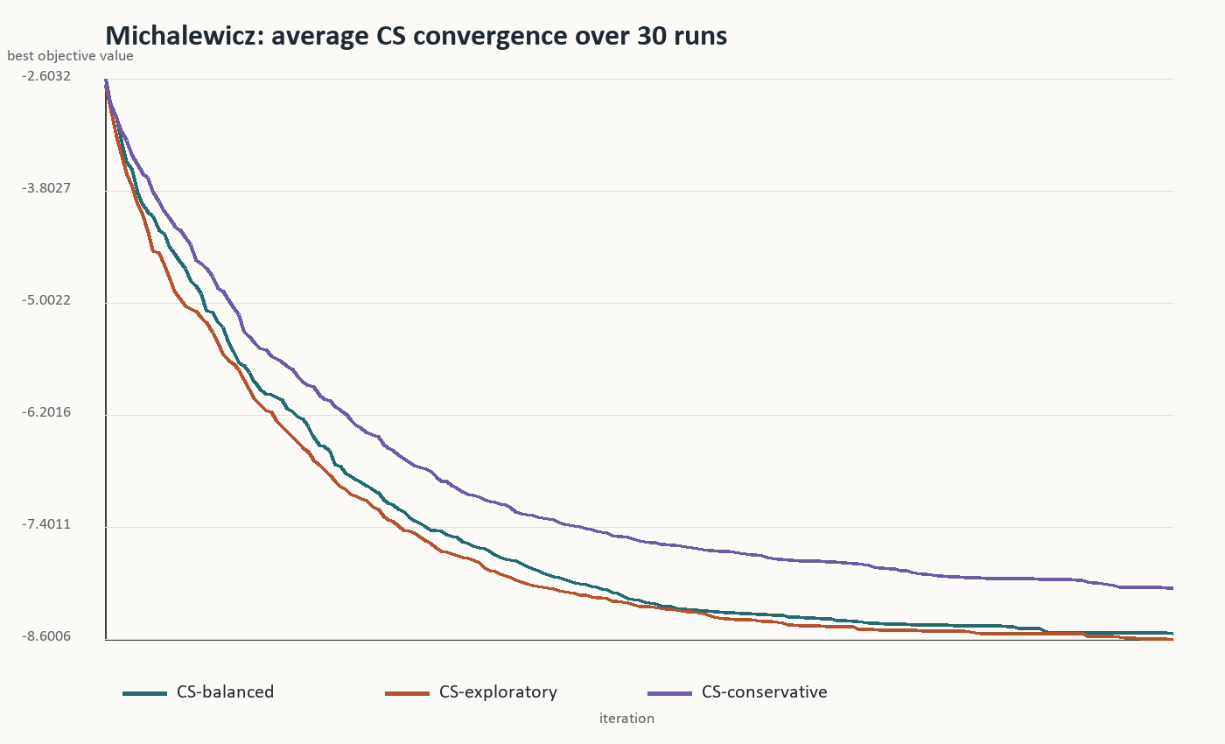
CONVERGENCE
The useful pattern is fast early improvement
Average curves over 30 runs show where CS is stable and where it remains sensitive to settings.
steep drop
early phase
Most improvement happens before the final iterations, which is typical for population metaheuristics.
visible
parameter effect
The exploratory setting reaches better Michalewicz values here, but it also has higher run-to-run variance.
Representative plot from the same 30-run experiment; Sphere and Rastrigin plots are saved in the output folder.

Slide 9
DISCUSSION
The algorithm is simple, but not magic
The important scientific point is the exploration-exploitation trade-off, not just the nature metaphor.
Advantages
Limits
Extensions
few parameters
sensitive to alpha and pa
adaptive step size
strong global jumps
no guarantee of global optimum
hybrid local search
easy continuous encoding
discrete problems need redesign
multi-objective CS
Yang & Deb, Cuckoo Search via Levy Flights, NaBIC 2009

Slide 10
Main takeaway
Cuckoo Search is a compact global optimizer that gets its strength from elitism plus heavy-tailed exploration.
Best use in this demo: continuous multimodal search where occasional long jumps are useful, but parameter tuning still matters.
Questions

