Slide 1
Cloud Computing
Chapter 4

Slide 2
Can the Cloud Help Operations?
Organizations rely on IT infrastructure to ensure their daily operations achieve organizational goals.
In traditional IT, educated guesses and expensive capital investment purchases were normal
Cloud computing eases these pressures by introducing a ‘pay-as-you-go’ approach
Two tools that help are load balancing and scalability/elasticity

Slide 3
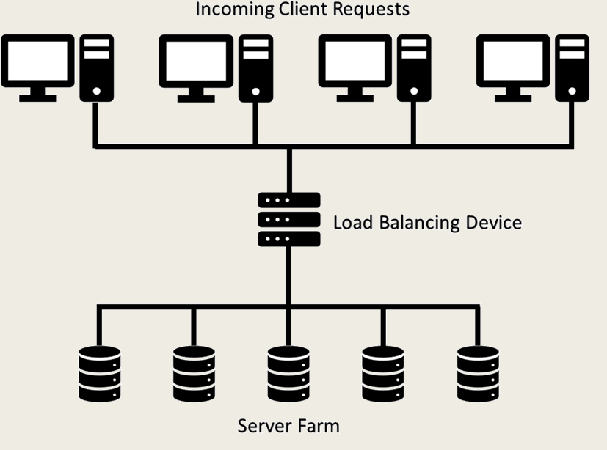
Load Balancing
Process of efficiently distributing incoming network traffic among servers
Multiple network servers used to prevent system from being overwhelmed with request high volumes
Balancing algorithms can be static or dynamic, and centralized or distributed

Slide 4
Load Balancing
Systems expecting constant, uniform requests work well with centralized, static load balancers
Unpredictable, varying loads are better served with using a decentralized, dynamic algorithm that uses information collected at run time
Decentralized approaches require more system communication which slows processing overall

Slide 5
General Load Balancer Tasks
Ensures client and application resource requests (as well as network traffic load) are efficiently allocated across multiple servers
Manages resources to ensure high levels of uptime by monitoring availability and sending requests to online servers within the pool.
Ensures flexibility of resource pool size
Provides tools for elasticity and scalability according to demand levels

Slide 6
Centralized Balancing Algorithms
Rely on a control management node used to gather information from nodes eligible to process loads
Central node makes distribution decisions
Hardware or software load balancer sits between the clients and server farm performing a “traffic cop” role
Requests are allocated across all available servers in an intelligent way.
Servers are utilized to maximize speed and enhance utilization.
Servers used uniformly to extend their lifespan

Slide 7
Decentralized Balancing Algorithms
No central manager exists
Nodes eligible for processing exchange their system state information with every other node
Inter-node communication can slow processing

Slide 8
Static Load Balancing
Determined upfront by IT specialists and then put into place for use
Best practice approaches that may not use specific network characteristics to determine or adjust load allocation
Non-preemptive = once a request has been allocated to a specific server, it will not be transferred to another
Seeks reduction of execution time
Less server monitoring and communication takes place
Primary downside is that current system state not considered when allocations are made so if a server is slowed, it may still receive additional workload
Requestors may experience noticeable differences in response times from visit to visit

Slide 9
Static Load Balancing Algorithm Examples
Random: Randomly selecting the next server to receive a request is one method used to distribute workload
Round Robin Algorithm: Best suited when servers are homogeneous, and requests are approximately the same magnitude. Server requests are put into an ordered sequence
IP Hash: Like random method. Uses IP address of client to select host to service request

Slide 10
Dynamic Load Balancing
Use available information when trying to decide what server should receive next assignment
Monitor each servers’ status and related changes to distribute work
Centralized dynamic algorithms rely on a central node for communication and load assignment
Decentralized dynamic algorithms move the decisions to nodes

Slide 11
Dynamic Load Balancing Algorithm Examples
Central: Centralized and dynamic approach. Requests stored in FIFO queue. Oldest node request for work receives next processing task
Transfer: Looks at on-going server loads and determines if node is overworked. If so, central manager can move task from one server to another
Least Connection Algorithm: Looks at load distribution based on number of active connections between a server and clients. Distribution of new loads (or re-distribution of tasks) seeks to keep connections approximately even

Slide 12
Cloud Load Balancing Algorithms
Cloud environments that are highly virtualized often have specialized load balancing algorithms
Virtual server nodes can be created as demand increases
Interesting implementation algorithms include variants of the central manager and threshold approaches
Sophisticated and imaginative approaches exist

Slide 13
Example Cloud Load Balancing Algorithms
Central Manager: Central server selects node for load transfer. Generally, server having least current load chosen to receive newest request. New processing nodes created as load increases, or nodes removed if load reduces
Threshold Algorithm: As demand increases, new processing nodes are created. Loads assigned immediately to new nodes.
Hybrid: Uses multiple stage approaches to determine best node for processing task. Two-stage model may: (1) perform static balancing algorithm; and (2) enhance node selection with dynamic analysis.
Ant colony: Intelligent agents move forward and backward to track overloaded and underloaded nodes. Ants update ‘pheromones’ to track node resources. Foraging pheromones help find overloaded nodes and trailing pheromones help find underloaded nodes.
Bee’s life: Inspired by natural world and honeybee’s process of searching for food
Genetic algorithm: Employs a ‘survival-of-the-fittest’ paradigm to ensure algorithms with higher efficiency produce ‘offspring’ that inherit best features

Slide 14
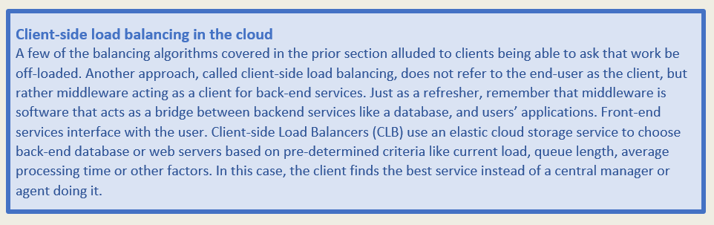

Slide 15
Hardware versus Software Balancing
Hardware Balancing
In traditional IT operations, load balancing relied on hardware solutions.
Hardware resided in on-premise data center maintained by in-house IT specialists
Balancing used special appliance from a vendor like Cisco, Citrix, or Barracuda.
Specialized devices sat in server racks and distributed traffic to directly connected physical servers
Software Balancing
Most cloud providers use software solutions running on virtual machines
Part of the server suites included by cloud providers
Affordable even for small companies

Slide 16
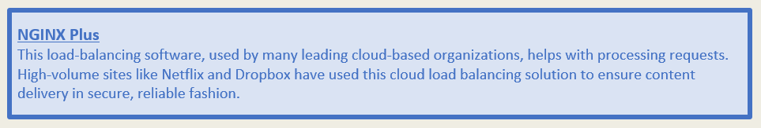

Slide 17
Cloud-based Balancing
Best practice to provision load balance server in the same environment as what it balances
For organizations using cloud, cloud-based balancing is preferable
Cloud-based systems must balance goals in addition to loads: one is to ensure traffic and load are routed in efficient and sensible ways; another is to maintain security

Slide 18
Noisy Neighbors Problem
Cloud environments provide cost savings, elasticity, and other benefits due to multi-tenant architecture.
Like an apartment complex, if the walls are thinly insulated or if too much infrastructure is shared, presence of annoying neighbor becomes obvious
In cloud, noisy neighbors monopolize bandwidth, storage access, CPU, or other resources.
System performance may be impacted by what neighbors are doing
‘Cheap' cloud means not enough infrastructure exists to accommodate all the tenants.
Noisy neighbors are avoided by ensuring adequate bandwidth is present and having up-to-date fast storage devices and servers.
Having effective balancing algorithm will ensure requests receive prompt fulfillment
Effective VLAN can help solve issues

Slide 19
Cloud Load Balancing vs. DNS Load Balancing
DNS balancing
Network optimization technique
Used to route web domain's incoming traffic flows to appropriate web server
Concerned with faster access to resources
Balances load requests for domain
Cloud load balancing
Roots in DNS balancing
Instead of transferring requests to a pool of web servers, it routes loads among data centers, server pools, virtual machines, and/or other resource groups
Cloud load balancing much broader and meant to handle a wider variety of traffic and workload needs

Slide 20
Scalability versus Elasticity
Elasticity adjusts a system on-the-fly to match workload changes. Can be up in scale or down in scale
Scalability related to system’s capability to accommodate larger loads easily by adding resources. Might mean improving hardware power (scale up) or adding additional nodes to the server farm (scale out).
Scalability is capability to grow, elasticity is ability to react to changes dynamically

Slide 21

Scaling Up versus Scaling Out
Scaling up increases individual capabilities.
Server scales up by adding more memory or more storage
Scaling out refers to duplication and expansion by adding more
Server scales out by adding more servers to the pool
In a military group, scaling up means an individual soldier receives training so she can perform better and scaling out means more soldiers added to complete a task

Slide 22
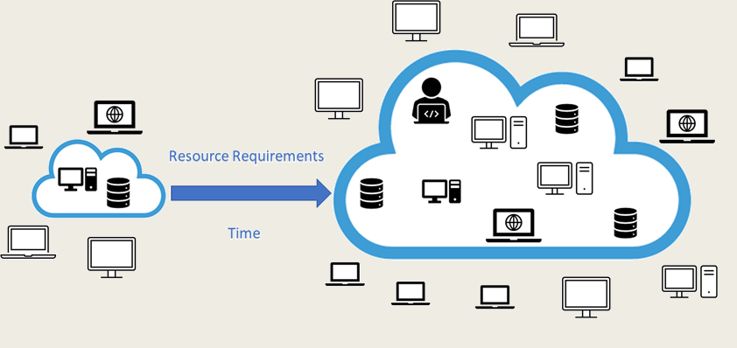
Elasticity in Cloud Environments
In cloud infrastructure, hypervisors create new VMs or containers as system demand ramps up. Likewise, as demand decreases, hypervisors can remove extra VMs or containers. Hypervisors work in real time to ensure computing resources meet demand.

Slide 23
Elasticity Challenges
Learning Curve: Requires rethinking the ways resources are allocated, costs are accounted, and systems are licensed/used
Response Time: Implementing elasticity requires response time
Monitoring Elastic Applications: Inherently volatile so tools for monitoring resource use need to be sophisticated
Stakeholder Needs: Requirements of each user need to be gathered and considered during the implementation.
Multiple Levels of Cloud Control: Serves the needs of many users so control structures must be in place.
Security: Resources appear and disappear and access to resources must be managed carefully
Privacy and Compliance: Data privacy and compliance with international laws are inherently complex

Slide 24
Benefits of Elasticity
Ease of Implementation: Elasticity often transparent
Failover and Fault Tolerance: Failing server can be cloned proactively and deployed on a new VM before old one stops
On-Demand Computing: When usage requirements spike, capacity is readily available
Pay only for what you use: Economic benefits of paying only for computing, storage, and networking resources an organization uses is a huge benefit
Standardization of Server Pool: Techniques such as IaC ensure homogeneity of infrastructure

Slide 25
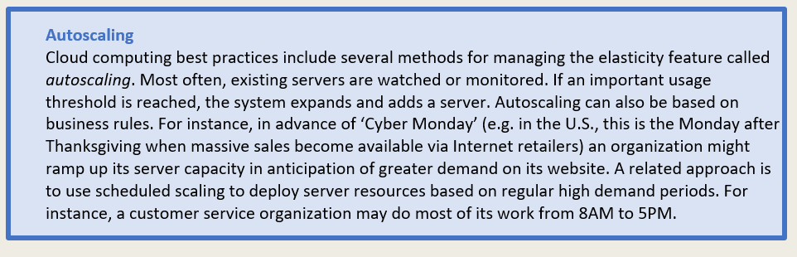

Slide 26

Archetype computer geeks working in the basement and hoarding knowledge is less realistic in today’s cloud computing environments

Slide 27
Chapter 4 Summary
Concepts at root of cloud computing: load balancing and elasticity/scalability
Cloud load balancing ensures workloads are distributed in efficient and effective manner
Resources balanced in the cloud including processing capability, network interfaces and services, application instances, storage acquisition, and more
Cloud load balancing done using software solutions from cloud vendors
Large-scale public clouds provide balancing features to ensure applications maintain high availability and performance across multiple virtualized application servers
Cloud load balancing relies on the concept of elasticity to manage demands as resources grow and shrink
Elasticity reallocates resources to scale up to meet increasing demands or scale down as resource needs decrease
Scalability is ability to upsize operations from a managerial perspective

