Slide 1
Cloud Computing
Chapter 6

Slide 2
What are cloud business concerns?
Cloud computing has a complex business model that transforms how accountants and financial managers view IT costs
Movement away from upfront investment in capital equipment
Organization use pay-as-you-go model to directly tie use to expense
Management tools in areas such as monitoring and consoles, service level agreements (SLAs), and subscriptions/billing support business operations

Slide 3
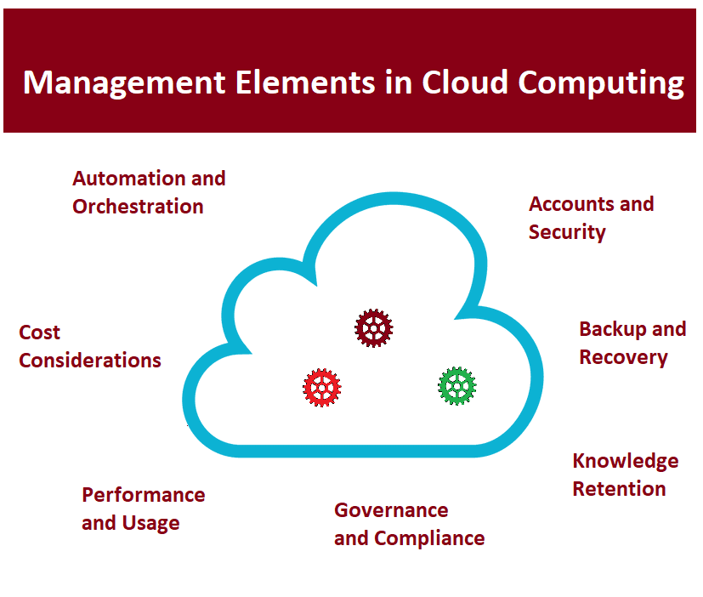
Management Elements in Cloud Computing

Slide 4
Monitoring and Console Tools
Usage tied directly to organizational entities
Knowing who uses what and to what extent enables understanding the costs of production, support, and organizational overhead
Helps avoid or at anticipate cost overruns
Ensure resources operate as desired.
Problems and issues with capacity can be watched directly or through automated management tools that send out alerts
Aids in security processes

Slide 5
Sources of Monitoring Tools
Cloud provider tools: Default option because most cloud providers have these built into their platform. No installation is required, and administrators can use these immediately
Third party vendor tools: Can be purchased, often on a subscription basis, to integrate monitoring operations and provide specialized reporting and oversight

Slide 6
Benefits of Cloud Monitoring
Costs are contained and controlled
Interruptions can be preempted and avoided
Maintenance costs can be reduced
Paying for more resources than required is avoided

Slide 7
Monitoring Tool Plan Considerations
Identification of key metrics – Recognize important, key activities and monitor related resources
Integration of monitoring results – Summarize key elements dashboard or other accessible medium
Cost considerations – Linking costs to resource use should be integrated into reporting
Identify triggers for action – Particular threshold levels should be identified, and automatic notifications sent to key personnel under appropriate conditions
User metrics – Assess user experience, for instance, are response times acceptable, are there any bottlenecks in workflows or resource access?
Testing – Monitoring events during failures and resource outages should be included in the plan. Does the system react as expected? What is user impact?

Slide 8
Example Native Cloud Monitoring Tools
Microsoft Azure Monitor: Helps IT administrators gage performance of their cloud-based resources. Built into Azure cloud infrastructure. Some monitoring items free, and others use subscription model. The software permits highly granular review of resource performance and utilization. Features enable actions, based on alerts, to be automatically invoked. Provides drill down features.
Amazon CloudWatch: Native suite of tools that oversees, monitors, and diagnoses issues on AWS Cloud. Available to all AWS Cloud users. Provides data describing resource performance, activity, and usage. Invokes actions automatically to correct ongoing issues or problems with overall dashboard describing system health. Collects operational data in logs, metrics, and events that can be ported into analytics tools.
Google Cloud Operations: Google acquired Stackdriver which provides performance and diagnostics data derived from operations in Google Cloud. Offers monitoring, event logs, activity traces, error reporting, and alerts. Permits developers to engage with problems and track the source issues more easily with visual tools.

Slide 9
Software | Overview | Description of Third Party Cloud Monitoring Tools
AppNeta | SaaS app monitoring tool | Monitor networks. Looks at resource usage, user experience.
AppRiver | Monitors web apps, Office 365 and email services | Protect email systems, reduce spam and encrypt emails.
BMC TrueSight Pulse | Monitors web apps | Add-on to Amazon CloudWatch or Azure Monitoring and includes visualization features and advanced notifications.
Datadog | Infrastructure monitor | Provide additional monitoring features, dashboard capabilities, and visualizations.
Dynatrace | Monitors business analytics, containers, applications, and infrastructure | Mature package that is highly rated. It works with all major cloud platforms and offers a great deal to Google Cloud users.
LogicMonitor | Monitors overall stack of cloud operations | Comprehensive monitoring software that has received numerous accolades and awards.
Rackspace Monitoring | Used for enterprise-wide monitoring | Comprehensive package with excellent notification system for Openstack
Retrace by Stackify | Performance monitoring for .Net and Java development | Provides performance metrics, error monitoring, and logs.

Slide 10
Monitoring Challenges
Hybrid and multicloud systems present complexities with unique situations
Single monitoring solution may not be within the reach of all organizations (e.g. single pane of glass monitoring solution)
Development of monitoring as a service (MaaS)
Understanding end-user experience which may be deeply rooted in organizational culture and activities
Managing vast amount of data collected by monitoring, tracking, troubleshooting, and logging

Slide 11
Cost Monitoring
Several factors such as adding more VMs, storage, database instances, application licenses, and other more tangible items correlated to higher expense
Subtle issues like a surge in web app use might result in higher costs
Failing to manage deprecated VMs and other resources can result zombie instances
Monitoring tools can help locate and remove these cost incurring, non-productive items

Slide 12
Typical Cost Monitoring Tool Functions
Identification and removal of unused or unintentionally provisioned resources
If operational trends show an increase in cost without corresponding increases in demand, the tool can be used to identify why extra bandwidth or other consumption is taking place.
Regular costs are broken down into more detail both in reports and on a dashboard to help IT administrators track costs and assign these to organizational activities.
Insightful visualizations of costs over time can be produced.

Slide 13

Zombies can Plague IT Adminstrators

Slide 14
Zombie Instances of Resources
Resources may be created and forgotten
Usually results from IT-related action that either fails, is interrupted, or is invoked incorrectly
VM build failure can create a zombie VM
File may be opened and never closed by software
Obsolete datasets held in memory
Software makes updates or changes to files and temporary copy is not removed

Slide 15
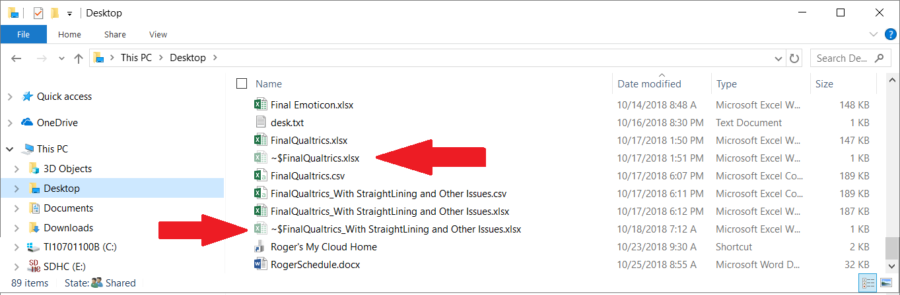
Temporary files in Windows take up storage space

Slide 16
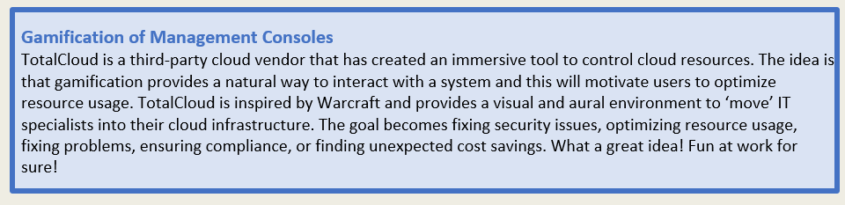

Slide 17
Service Level Agreement
Binding contact between a cloud vendor and their client
Describes conditions for use and minimum level of service and performance by cloud vendor
Service and performance levels include uptime, availability, reliability, and responsiveness
May contain information relating to actions if the system goes down or interruption occurs
SLA protects vendor and provides reasonable expectations for client
Many cloud vendors offer standard SLAs; others are negotiated

Slide 18
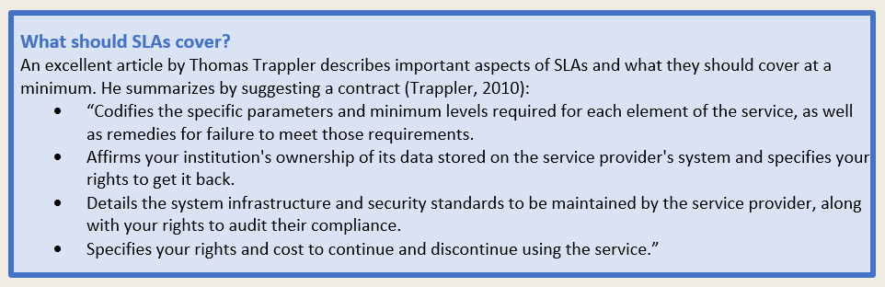

Slide 19
General SLA Areas
Management features - Standards, measurement techniques, methods for collecting data, report types, and report frequencies to provide the information used to define service levels. Also include conflict resolution, SLA update processes, and finally an indemnification clause.
Service elements - Exact services provided, what is not specifically provided, conditions for service, time frames for service, responsibilities of each party related to service items, penalties for failures, metrics for service levels, and cost/service tradeoffs.

Slide 20
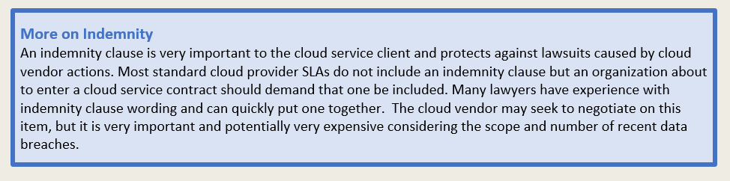

Slide 21
SLA Metrics
Mean time between failures (MTBF)
Mean time to repair (MTTR)
Downtime per year or other time frame
SLA Metric Considerations
SLA Metrics must not reward poor performance
SLA Metric measurement source (vendor, client or third party?)
Time frame for metric collection

Slide 22
Metric Types
Service availability metrics: Common metric used to assess vendor obligations. Basically, the vendor guarantees service uptime.
Service performance metrics: Service performance speed often considered in development of metrics.
Service quality metrics: Some cloud customers more worried about accuracy of storage, backups, web services, and other items.
Security metrics: For other organizations, privacy and security-related concerns are paramount.
Key business performance metrics: The best metric may be a key business performance related item to help cloud vendor and customer work together to achieve a desired outcome.

Slide 23
Example Service Uptime Metric Calculation
1 year of time = 24 hours X 60 minutes per hour X 60 Seconds per minute X 365 Days.
So, 1 year is about 31,536,000 seconds.
If we multiply that by the 99.5% uptime figure we get: 31,378,320 seconds.
If we subtract the uptime from the total time: 31,536,000 - 31,378,320 = 157,680 seconds
157,680 seconds / 60 seconds per minute / 60 minutes per hour = 43.8 hours of downtime
Is that too much downtime?

Slide 24
Other Metric Considers
Exclusions and exemptions
Crucial time frames or key uptime dates
Testing dates / frequency

Slide 25
Performance Failure Penalties
Service account credit
Direct compensation. Amounts could be tied to revenue loss during service outages
Outside oversight
Covering costs to switch to new vendor.
Earn-backs are the right to reduce service credits if actions accomplished by the cloud vendor---may not cover entire penalty amount but incentivizes cloud vendors to fix issues in a timely fashion

Slide 26
SLA Data Ownership Clause
Who owns the data?
Where is the data physically located?
What happens to the data upon contract termination?
What happens should a data breach occur?
How are government or other requests for data access managed?

Slide 27
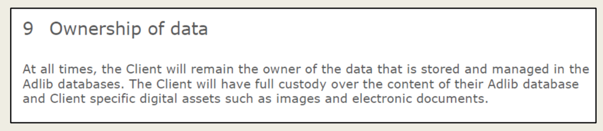
Sample data ownership clause - SLA from Axiell ALM Cloud Service in the Netherlands

Slide 28
Data Location
Legal issues have emerged due to data location. The laws of countries and jurisdictions vary, and legal problems concerning data migration, import, export, and storage can result if a data center or backup is physically located in a country other than your own.

Slide 29
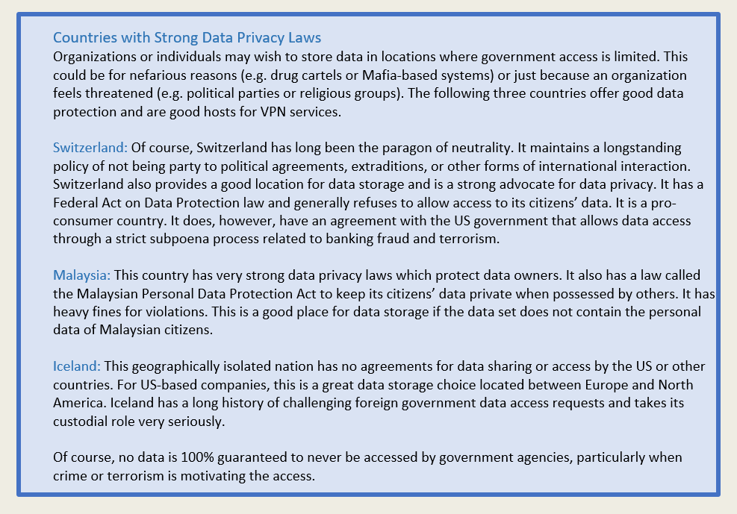
Data Location

Slide 30
Data Disposition
Deal with vendor actions after a contract is terminated
Organization does not want to be indefinitely tied to the same vendor---need for orderly way out
Must be economically feasible and realistic way to transfer to another vendor
Migration
Issues relate to vendor performance or costs
Need to migrate because of consolidation or purchased and systems will be integrated
What media migration will use, time delays involved, and who completes the migration

Slide 31
Data Breaches
Contracts may include indemnity clause that shifts the cost of a data breach to the cloud provider should it be their fault
Ensures any lawsuits are covered by the vendor rather than the cloud client
Important to consider actions needed should a worst-case scenario occur

Slide 32
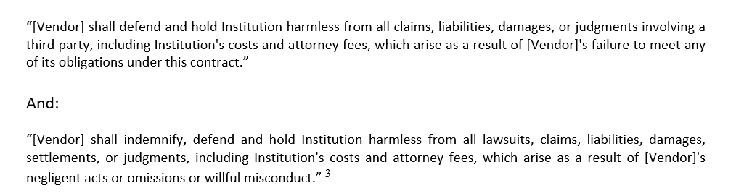
Sample Data Breach Indemnity Wording

Slide 33
Governmental Access Rights
Both client and vendor expect to follow all laws within the terms of service
May require vendor to turn over data for a criminal investigation of an individual whose credit card or other data resides on their system.
Could be circumstances where another client of the cloud provider is under investigation and as a result government agency has access to all portions of the provider’s cloud
Cloud customer should ensure the provider is responsible for contacting them should this occur
Ideally, prior to releasing data but some court orders could prohibit that from occurring

Slide 34
Other SLA Considerations
SLA revision policies
SLA Transfers with ownership changes

Slide 35
SLA Advice
Read agreement carefully prior to subscribing. May impact choice of a cloud vendor.
Have an IT specialist from within the organization, or technical consultant from an uninvolved organization, review the SLA for any details that might not be clear.
Ensure the legal framework for the SLA is sound and fair. Get legal counsel to review the agreement and provide advice.
Ensure you have contingency plans in case the vendor goes out of business or has other difficulties. This may mean having an onsite backup periodically made or having another solution.

Slide 36
Billing
Side benefit of cloud computing is approach to billing.
Instead of paying large, up-front costs, most cloud users start the service and pay a periodic bill much as they would with any utility.
Many cloud systems have native billing systems
Third party billing tools are available

Slide 37
Chapter 6 Summary
Cloud computing has complex business model that matches well with a modern businesses’ information requirements
Managers and accountants must be able to understand IT costs from a usage perspective and tie that into requirements for elasticity, resource demand changes, flexibility, agility, and smart planning
Cloud moves businesses from a capital investment model for computing infrastructure to one that more closely matches a utility company
Monitoring and console tools provide IT specialists and managers with ways to understand and predict usage
Issues with capacity and other important attributes can be ‘watched’ either directly or through automated management tools that send out alerts
Monitoring aids in the security process and ensures the correct resources are accessed only by authorized users
SLAs are binding contacts between cloud vendors and their clients that describe conditions for use and minimum level of service and performance the cloud vendor provides
Performance level requirements may be uptime, availability, reliability, and responsiveness
SLAs generally contain information describing actions should the system go down or an interruption occurs
SLA protects the vendor and provides reasonable expectations for the client
Cloud providers use the utility billing approach to charge for services

