Slide 1
LeanBio Forum · ScienceClaw 2026
EVIDENCE IN HAND
Biology has never built the thing
you check a design against.
Mathematics has mathlib. Biology has papers, protocols and the people who know how to make them work. We are building the missing object: biological laws that hold in Lean, survive agent debate on the evidence, and then constrain what a design model is allowed to propose.
claim
nanopub
debate
Lean
axiom
design
validate
Everything in this deck runs. Where a result does not exist, the slide is greyed instead of guessed — including on our own headline claim, which fails.

Slide 2
LeanBio Forum · ScienceClaw 2026
EVIDENCE IN HAND
The knowledge that makes biology work
is not written down.
Biology design knowledge lives primarily as tacit knowledge: the know-how that makes an experiment work demonstrably does not transfer through publication alone.
Michael Polanyi, The Tacit Dimension, Doubleday 1966 / Routledge 1967, p. 4
names it
“We can know more than we can tell.” The origin of the term.
H. M. Collins (1974), “The TEA Set”, Science Studies 4:165–186, doi:10.1177/030631277400400203
demonstrates it
No laboratory built a working TEA laser from the published sources. Only people with substantial social contact with a successful builder succeeded — phone calls and visits, not papers. Companion: Collins & Harrison (1975), Social Studies of Science.
Caveat: Later work (Philosophia Scientiae, 2013) reads the TEA case as RELATIONAL tacit knowledge: knowledge that could in principle be made explicit. That is our claim exactly — the explicit artefact was never built, not that it cannot be.
Kathleen Jordan & Michael Lynch (1992, 1993, 1998) on the plasmid prep, Social Studies of Science 28(5), doi:10.1177/030631298028005005
documents it in biology, without ever naming it
A protocol every molecular biology lab supposedly shares, and which in practice every lab performs differently — persistent, unresolvable variation in how a shared technique is actually carried out.
Caveat: Collins (2001) notes that Jordan & Lynch never use the term “tacit knowledge” and do not engage that literature. Cite them for the PHENOMENON, never as authorities on the term.
Biology observed the phenomenon for thirty years and never built the vocabulary for it, let alone the formal object. That third line is not a footnote on the other two. It is the finding: the discipline that lives on this problem never even named it.
Read from deck/FACTS.md · Polanyi 1966 p. 4 · Collins 1974 doi:10.1177/030631277400400203 · Jordan & Lynch 1998 doi:10.1177/030631298028005005 · Collins 2001 on the Q of Sapphire

Slide 3
LeanBio Forum · ScienceClaw 2026
EVIDENCE IN HAND
So an agent has nothing to check against.
In mathematics: a kernel proof
verifiable
An agent writes a statement, a proof assistant accepts or rejects it, and the verdict needs no referee. Agents are extremely good at this.
In biology: a reviewer
unverifiable
An agent proposes a design. Nothing can say whether it is consistent with what is already known, at any scale, because what is already known has no machine-checkable form.
What is missing, precisely: a statement of a biological law a machine can evaluate on a candidate design; a way to tell a law that BINDS from one that merely sounds true; a record of what each law rests on, so a later correction reaches every result built on it.
A design model can generate a sequence all day. Without a formal object to check it against, every proposal is as good as every other, and the only filter left is an experiment that costs a year.

Slide 4
LeanBio Forum · ScienceClaw 2026
EVIDENCE IN HAND
The asymmetry, in one line.
292,237
688
0 of 34
theorems in mathlib, over 140,094 definitions, from 772 contributors — 1 Nov 2026, 02:07 UTC
papers this year whose abstract talks about formalising maths in Lean; 148 in October alone. We counted these ourselves.
Not one of mathlib’s 34 subject areas is biology.
mathlib holds 292,237 theorems across 34 subject areas — algebra, topology, number theory. Not one of the 34 is biology.
What we are NOT claiming: Formal methods have been used on biology for twenty years: model checking of gene networks, Coq proofs about neuronal circuits, HOL for synthetic biology, and a Lean formalisation of the genetic code posted six days ago (arXiv:2610.36343, Jones & Josephson, 2026-10-26). Every one formalises something biologists already knew, or proves a property of a model.
The narrow sense in which this is new: We found no prior formalisation of classical population genetics — Kimura, Fisher, Maynard Smith — in any proof assistant, and no prior system that uses machine-checked biological laws to rule a proposed organism out. That is a negative search result over a 44-million-paper corpus, not a proof of absence.
A bald “zero biology theorems” would be false, and the newest counterexample is six days old. The zero we can defend is a zero OF SOMETHING: zero of mathlib's 34 subject areas. You can check it from the stage.
Read from leanprover-community.github.io/mathlib_stats.html, gen_date 2026-11-01 02:07:42 (gitstats4.js) · deck/FACTS.md §1.1 — measured 2026-11-01, window 2026-01-01 to 2026-10-31 · deck/FACTS.md §2.2–2.4 · GitHub API /repos/leanprover-community/mathlib4/contents/Mathlib, fetched 2026-11-01

Slide 5
LeanBio Forum · ScienceClaw 2026
EVIDENCE IN HAND
That is why this is expensive.
9 in 10
drug programmes that enter clinical trials never reach approval
If almost everything that reaches a trial fails, the leverage is not in running more trials. It is in theoretical biology: knowing which experiment would change what you believe, before the experiment is paid for.
Say it exactly this way. The data are about PROGRAMMES, not individual trials. "90% of clinical trials fail" is a different and false claim, and is the likeliest factual challenge in this deck.
Corrigendum: Wong, Siah & Lo carries a corrigendum (doi:10.1093/biostatistics/kxy072) that corrected exactly the phase-transition table. Quote its 13.8% headline, never its per-phase figures.
Read from BIO / Informa / QLS 2011–2020: 12,728 phase transitions; Phase 1 → approval 7.9% · Wong, Siah & Lo, Biostatistics 2019 (MIT): 185,994 trials; 13.8% — quote the headline only · Schuhmacher 2025: 14.3% for leading pharma, which cuts the other way · 86–92% across the sources; 14.3% success for the top 20, so "90% of drugs fail" overstates it there

Slide 6
LeanBio Forum · ScienceClaw 2026
EVIDENCE IN HAND
LeanBio Forum: a theorem becomes an axiom
only if it survives both gates.
UPLOAD
a nanopub-backed theorem
DEBATE
agents argue it on the evidence
LEAN
the kernel checks it follows
AXIOM
it may now constrain a design
OR
rejected, contested or retired — kept, with its reason
Both gates, or neither. A statement that compiles but loses the debate is not a law; one that wins the debate but does not follow from its premises is not a law either. Neither failure is deleted: it is recorded with its reason, so nobody proposes it again.
Read from lean/registry/lawsets/current.json · lean/registry/laws/*.json

Slide 7
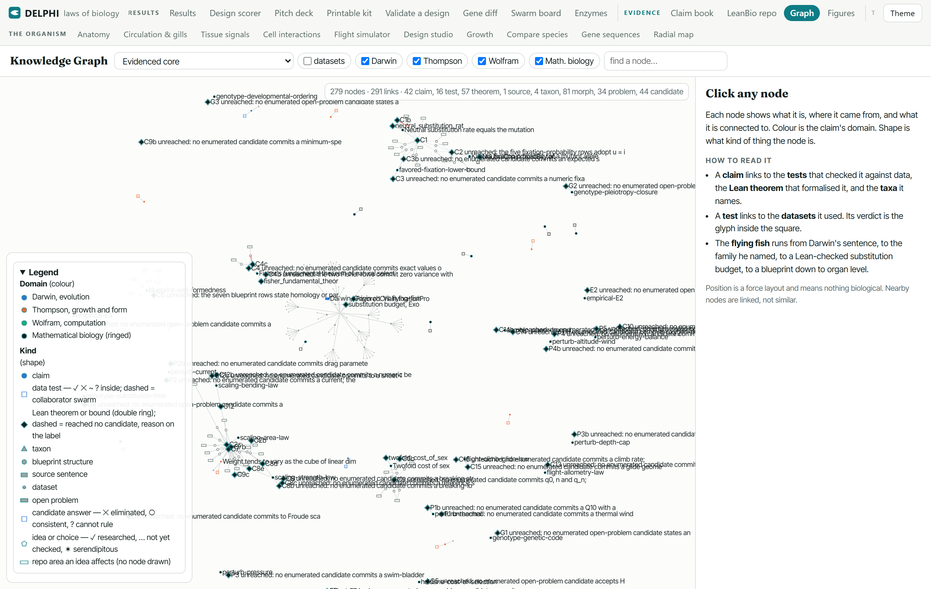
LeanBio Forum · ScienceClaw 2026
EVIDENCE IN HAND
Today's theorems came out of four books.
Darwin — On the Origin of Species, 1859
primary
Sentences read from the source text itself
Thompson — On Growth and Form, 1917
primary
Scaling and growth claims, taken verbatim and then operationalised
Turing — reaction–diffusion
secondary
Reached through the mathematical-biology literature that formalised it
Wolfram — A New Kind of Science
tertiary
Computation-in-biology claims, the least dataset-shaped of the four
The claim graph as served: each claim linked to the tests that checked it and the theorem that formalised it — Screenshot of this project's own page /graph/, rendered headless in Edge at 1500x950 on 2026-11-01 07:02 UTC (dashboard/shot-pages.mjs). Not a mock-up.
And then almost none of it was proved. Of the 859 claims we extracted from these books, FOUR are proved in the built Lean library — all four Thompson's, none Darwin's, none Wolfram's. Two of Thompson’s four proved propositions are statements he made about birds in 1917. Birds are our frozen holdout, so we do not show them. So two of the four are not on any slide here.
Decentralised agent swarms distilled the assertions into nanopublications and argued the evidence sources BEFORE anything was formalised. Formalising first would have produced beautiful proofs of sentences nobody had checked anyone actually wrote.
Read from docs/claims.json · darwin-origin/ · thompson-growth-form/ · wolfram-nks/ · math-bio-theorems/

Slide 8
LeanBio Forum · ScienceClaw 2026
EVIDENCE IN HAND
The distillation was done by a swarm,
and we measured whether that mattered.
Each arm wrote 20 pre-registered test plans, each naming one real public dataset. Both numbers are plans whose dataset URL and DOI a script could actually fetch — same model, same prompt, same schema, same budget. No arm fabricated a single identifier: every URL was fetched once by script, and a 404 counts as fabrication, not bad luck.
Read from swarm/PREREG.md · swarm/compare/results.json · swarm/compare/verify.mjs

Slide 9
LeanBio Forum · ScienceClaw 2026
ANTICIPATED — NO DATA YET
Single agent vs decentralised swarm vs
centralised swarm, across four levels.
Running now
Ground truth is frozen (swarm/benchmark/fixtures/gt-l4-t1…t3). No arm has reported. This slide fills in or stays grey.
What it will and will not settle
— Four task levels of increasing difficulty, the same three organisations on each.
— Ground truth was written and frozen BEFORE any arm ran, so a late result cannot be fitted to it.
— It compares organisations on one task family. It is not a claim about swarms in general.
The deck reads the same whether or not this fills. We would rather hand you a grey slide than a number we chose after seeing it.
Read from swarm/benchmark/fixtures/ · swarm/PREREG.md

Slide 10
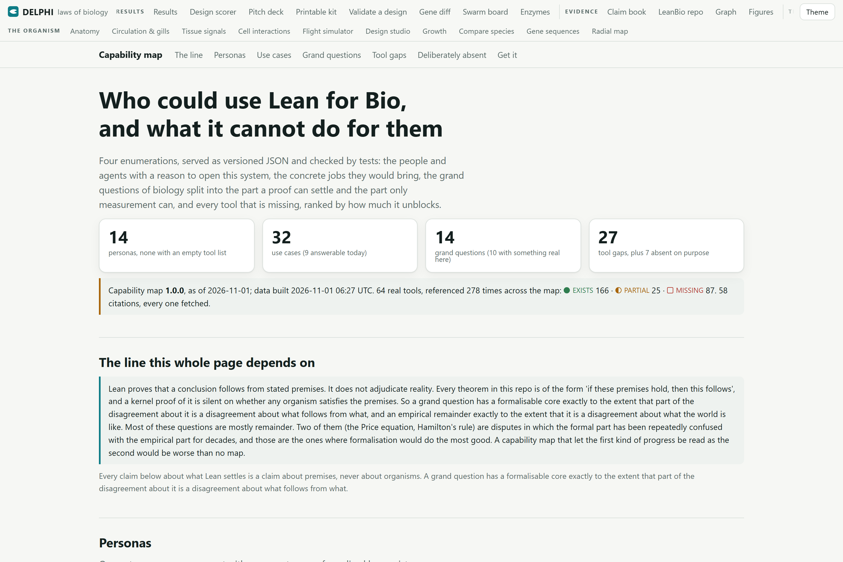
LeanBio Forum · ScienceClaw 2026
EVIDENCE IN HAND
Served as an MCP server,
so an agent can ask it things.
Personas
14
One per person or agent with a reason to open a formalised law registry over biology
Use cases
32
One row per job, with the tool sequence that answers it today; 9 answerable now, 8 not
Grand questions
14
Each split into the formalisable core and the empirical remainder
Ranked tool gaps
27
Ranked at build time; a test tampers with a stored rank to prove no gap can assert its own importance
And what it cannot do: most of these questions are mostly empirical remainder. A capability map that let progress on the formal part be read as progress on the empirical part would be worse than no map.
The capability map, live: who would use this, what they would ask, and every tool that is missing — Screenshot of this project's own page /leanbio/capability.html, rendered headless in Edge at 1500x1000 on 2026-11-01 07:02 UTC (dashboard/shot-pages.mjs). Not a mock-up.
Read from /leanbio/capability.html · pipeline/leanbio/capability-map/build.mjs

Slide 11
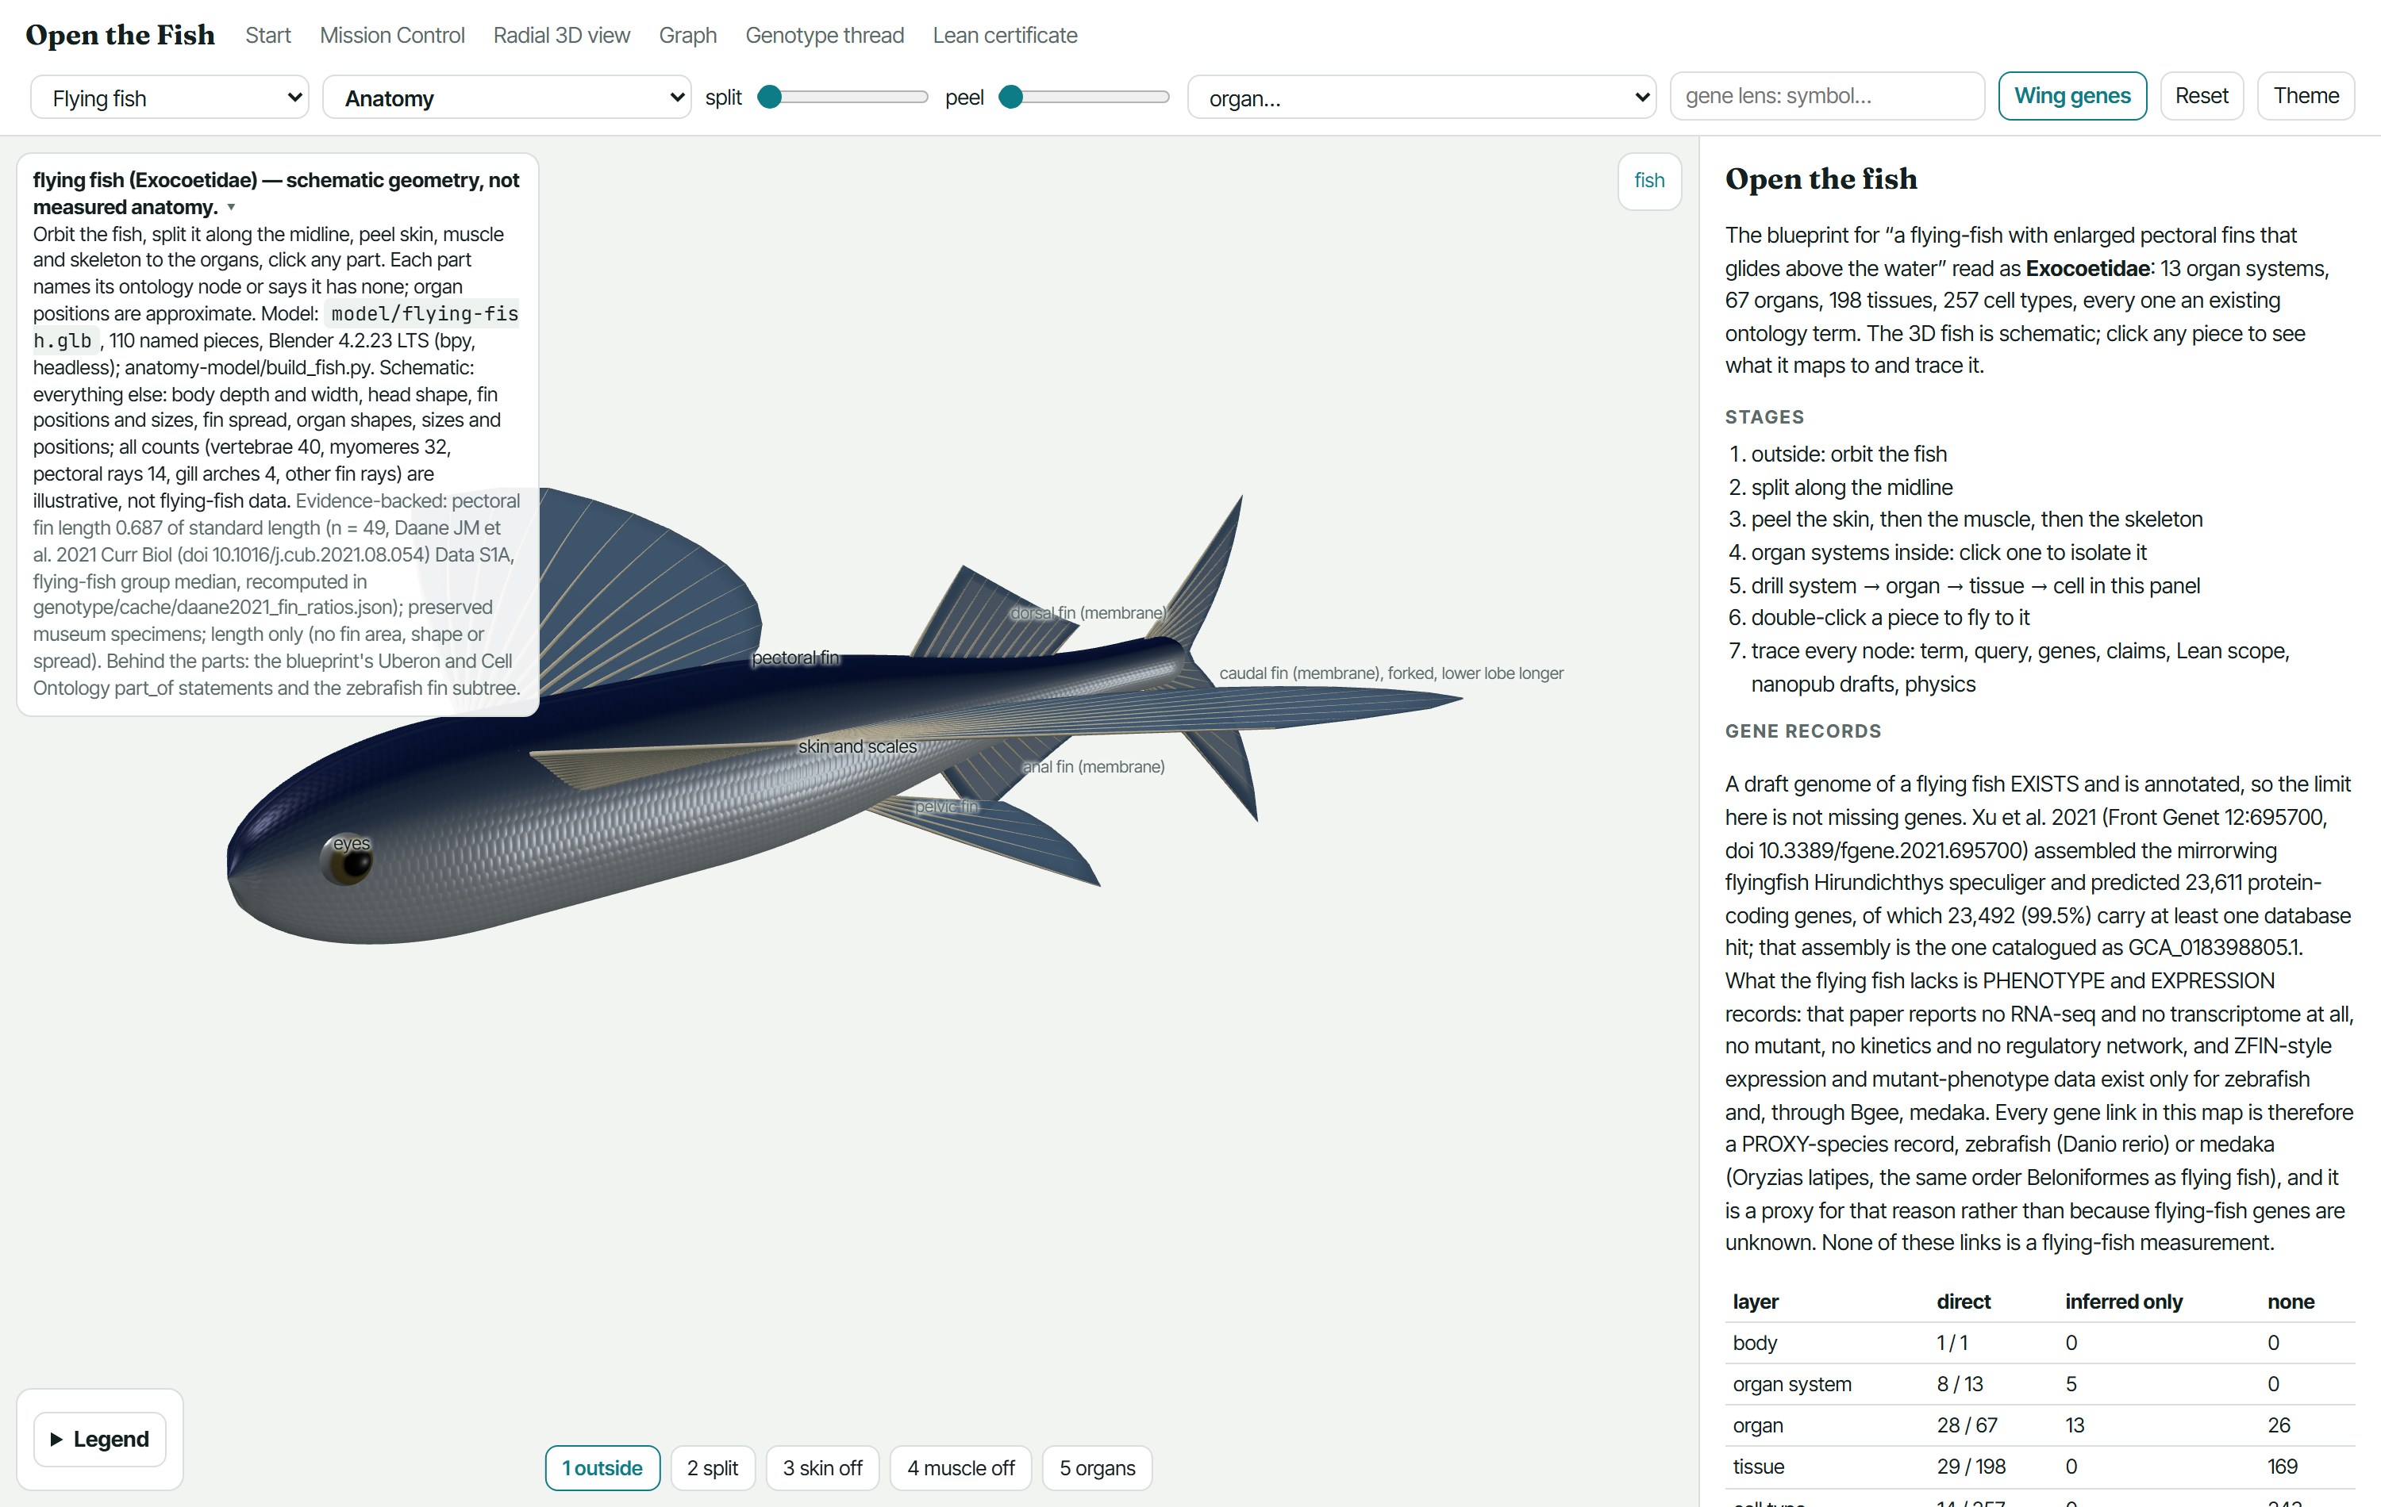
LeanBio Forum · ScienceClaw 2026
EVIDENCE IN HAND
Those theorems constrain
a text-to-organism model.
You type a phenotype. The model has to say which genetic change produces it, at every layer and at every developmental stage — and every layer it touches is an existing ontology term, so a law can be evaluated on it.
Named pieces across the models
357
flying fish, adult zebrafish, larval zebrafish
Mapped to an ontology term
297
60 are not, and are shown as unmapped rather than quietly dropped
Values that are a real measurement
23
everything else in the flying-fish model is schematic, and the page says so
The blueprint the studio writes into: a morphological change on a base organism, resolved down every layer — Screenshot of this project's own page /blueprint3d/, rendered headless in Edge at 1500x950 on 2026-11-01 07:02 UTC (dashboard/shot-pages.mjs). Not a mock-up.
One measured proportion carries the flying-fish model: pectoral fin length 0.687 of standard length, n = 49 museum specimens. Body depth, fin spread, organ shapes and every count are illustrative.
Read from anatomy-model/manifest.json · Daane et al. 2021, doi 10.1016/j.cub.2021.08.054

Slide 12
LeanBio Forum · ScienceClaw 2026
EVIDENCE IN HAND
A law that binds nothing
is worse than no law.
Laws in lawset 1.8.1
59
versioned, pinned to a commit, and mirrored into the MCP server
Accepted
36
may rule a design out
… of which produce NO design row
15
each with a written reason and what would make it bind; the check fails if an entry stops being true
Retired, never deleted
3
so an older lawset still reproduces
Three of the fifteen reasons, verbatim:
kimura-fixation-probability — fixation probability of an allele in a population; a design commits no population size or selection coefficient.
scaling-bending-law — the section modulus needs a cross-section; the resolved state carries none, so no design can be judged.
fick-principle — it is the named hypothesis the aerobic bound rests on, not the law that rules anything out, so it owns no constraint.
Read from lean/registry/check-exposed.mjs · lean/registry/lawsets/current.json · mcp/server.mjs

Slide 13
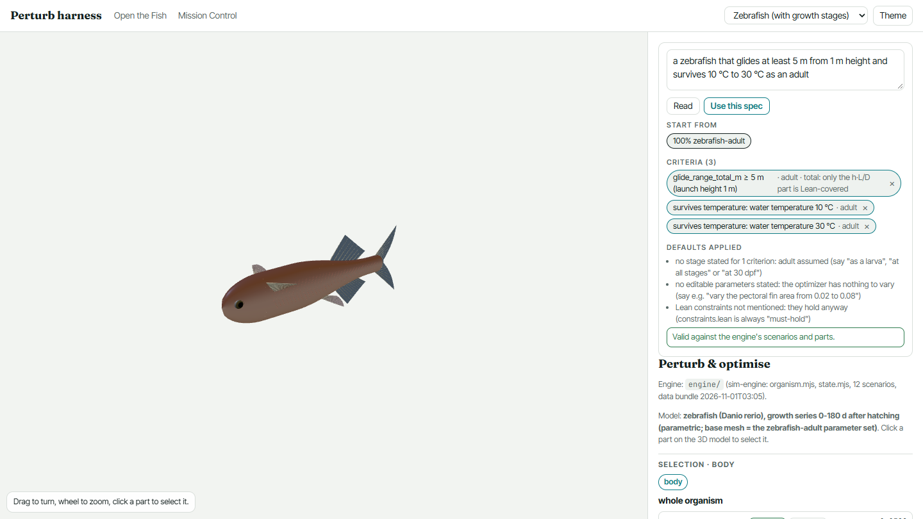
LeanBio Forum · ScienceClaw 2026
EVIDENCE IN HAND
Design Studio: type the phenotype,
get the criteria.
The studio turns a sentence into criteria the engine can actually run. A clause it cannot parse is shown in red and is NOT checked by anything downstream, rather than being silently dropped.
11 scenarios the engine runs:
altitude, current, daynight, digestion, glide, grip, predator, pressure, sleep, temperature, wind
Typed into the live studio, not a mock-up: “a zebrafish that glides at least 5 m from 1 m height and survives 10 °C to 30 °C as an adult” — 3 criteria parsed, valid against the engine.
Read from sim-engine/scenarios/*.mjs · sim-engine/CONTRACT.md · deck/fig/studio_spec.json (dashboard/shot-studio.mjs)

Slide 14
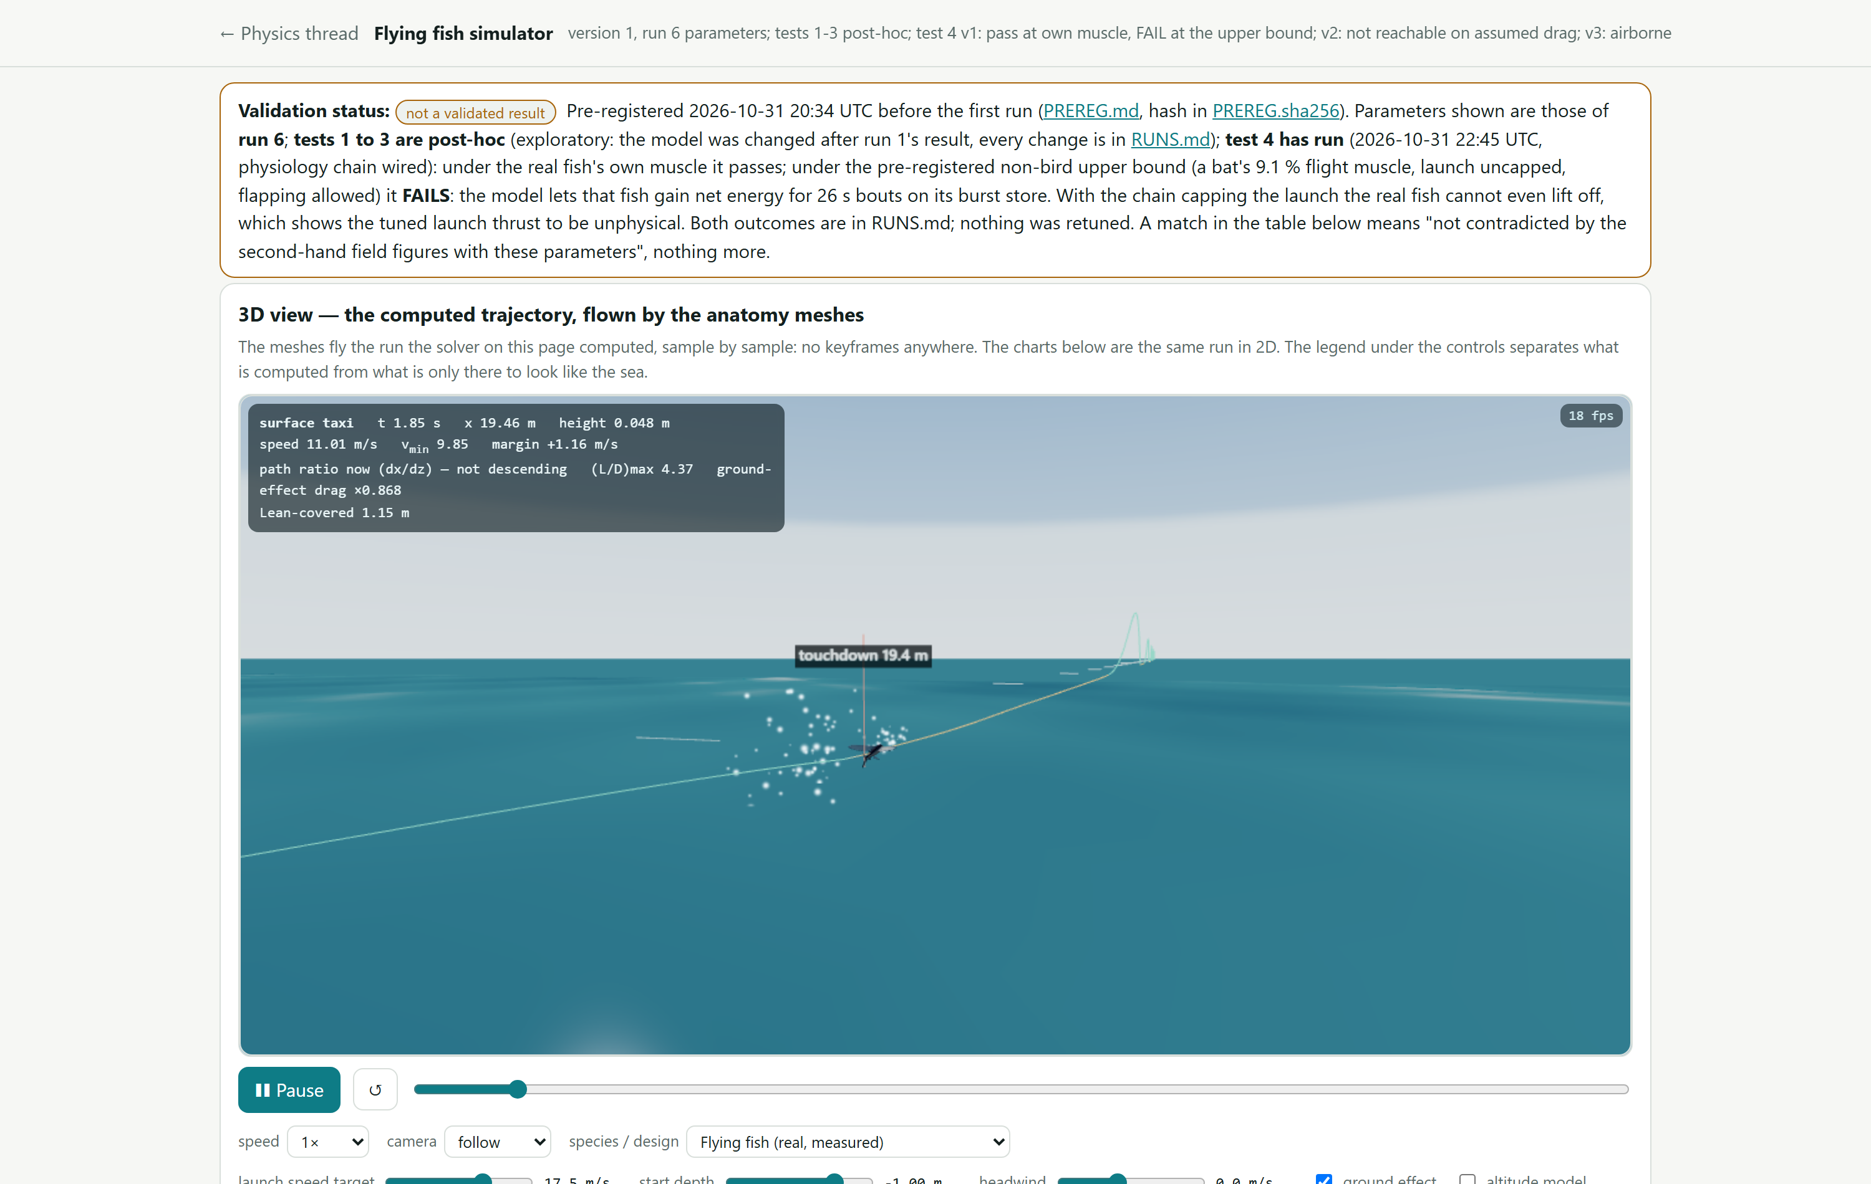
LeanBio Forum · ScienceClaw 2026
EVIDENCE IN HAND
Then physics, flow and development
stress-test it.
Physics simulation
runs
A glide solver over the design's own mesh and mass, with ground effect, headwind, altitude and depth as parameters
Developmental simulation
runs
The same design resolved at each stage, so a criterion can be demanded at adult and failed at larva
Flow matching
not here yet
The generative half of the design model; nothing in this deck rests on it
The simulator page carries its own banner: NOT A VALIDATED RESULT. Tests 1 to 3 are post-hoc, and under the pre-registered upper bound the model lets a real fish gain net energy — which shows the tuned launch thrust to be unphysical. Both outcomes are in the run log; nothing was retuned.
The flying-fish simulator: the solver computes the trajectory and the anatomy meshes fly it, sample by sample — Screenshot of this project's own page /t/physics/sim/, rendered headless in Edge at 1500x950 on 2026-11-01 07:02 UTC (dashboard/shot-pages.mjs). Not a mock-up.
Read from /t/physics/sim/ · physics/sim/RUNS.md · physics/PREREG.md

Slide 15
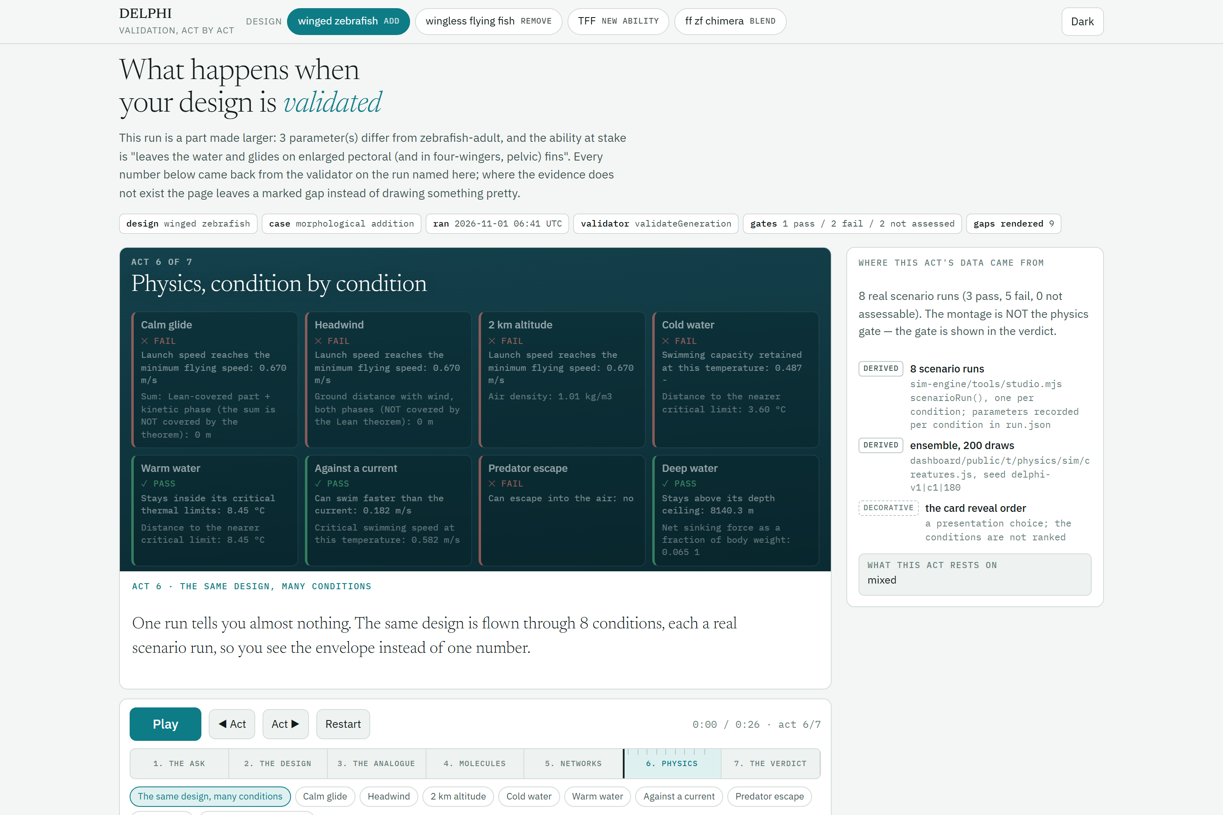
LeanBio Forum · ScienceClaw 2026
EVIDENCE IN HAND
The validation harness, in four moves.
STEP 1
take the predicted sequence and the desired function
STEP 2
find the closest FUNCTIONAL analogue, not the closest relative
STEP 3
annotate every functional difference, interpretably
STEP 4
score formally in LeanBio, then run physics on the mesh
Five named results, side by side, each with its own gate. They are never summed. Where the evidence does not exist the page leaves a marked gap instead of drawing something pretty — nine gaps on this run.
On the run shown: 1 pass · 2 fail · 2 not assessed. The next three slides are what the two failures and the gaps actually say.
The harness on the headline design, at the physics act: five named results, each with its own gate — Screenshot of this project's own page /validate-show/, rendered headless in Edge at 1500x1000 on 2026-11-01 07:02 UTC (dashboard/shot-pages.mjs). Not a mock-up.
Read from sim-engine/validate/pipeline/index.mjs · dashboard/public/validate-show/run-winged-zebrafish.json

Slide 16
LeanBio Forum · ScienceClaw 2026
EVIDENCE IN HAND
Our headline design does not fly.
launch speed reached
minimum flying speed
lifting area short by
draws in which it glided
0.67 m/s
8.64 m/s
166×
0 of 200
The reachable launch speed is 0.67 m/s against a minimum flying speed of 8.64 m/s, and the lifting area is 166× too small: 1.91 cm² against the 317.76 cm² needed to carry 0.007 N.
This is the design the whole deck is built around, and the gate it fails is the one that matters. A deck that claimed a working flying fish would lose to one honest question; this is the answer to that question, put on a slide before anyone has to ask it.
Read from dashboard/public/validate-show/run-winged-zebrafish.json → physics_check.gate

Slide 17
LeanBio Forum · ScienceClaw 2026
EVIDENCE IN HAND
And the negative control scores
exactly as well.
requirements assessable
unresolved, our design
unresolved, unedited control
rows the edits moved
22 of 73
19
19
1
The functional-analogue ledger can assess 22 of 73 requirements, and leaves 19 unresolved. An unedited zebrafish scored against the same flying fish leaves the same 19 unresolved: the design’s edits move one row from one hypothesis to another, and neither is a demonstrated resolution.
Why that is the sharpest result we have: on this ledger the designed fish is exactly as far from the flying fish's known requirement set as an unedited zebrafish is. The control was pre-registered, and it behaved as it must. · What the ledger is not: every requirement is a SEQUENCE STATE of the analogue, never a measured function of it. Zero of the loci have functional data of any kind.
Read from sim-engine/validate/functional/RESULTS.md · run-winged-zebrafish.json → functional_resolution

Slide 18
LeanBio Forum · ScienceClaw 2026
EVIDENCE IN HAND
Five more results that go against us.
Our compensation rule does not predict new cases
4 of 13
Applied with its case table disabled, the rule chain scores 11 of 12 on the cases it was derived from and 4 of 13 on independent ones. All nine independent errors are false positives: it predicted a compensation response where the experimenters looked and found none. It is kept only in its refusing direction.
Two of 3,283 interaction edges are zebrafish experiments
2 of 3,283
In the molecular pack behind the design, 2 edges are curated zebrafish experiments and 2 more are STRING links whose zebrafish experiments channel reaches 0.4. The other 3,279 are 955 experiments transferred from another species, 1,382 pathway-database assertions and 942 text-mining or co-expression predictions.
Fifteen of 36 accepted laws can bind nothing
15 of 36
An accepted law that evaluates nowhere gives false assurance — the law base reads as though a design were checked against it when nothing was. So each of the 15 is listed with a written reason and what would make it bind, and the check fails if an entry stops being true.
Most of what we published carries no approval field
248 of 269
269 of our records are live on the public production nanopub registry. Only the 21 math-biology theorems record who approved the promotion; the 248 Darwin records carry no approval field at all. Their manifest holds a file, an id, a trusty URI, a registry, a timestamp and a commit — and nothing that names a human who signed off.
Nine of our 12 failed theorems were never attempted
9 of 12
Each one is read back out of its own source file at build time. If a number drifts, the row disappears from this slide rather than quietly going stale.
A failed-theorem record marked attempted:false was never tried at all — the single Lean build lock was contended, or it was abandoned on cost, or withheld on purpose. It is not a result about the statement, and the counts report attempted and never-attempted separately so it cannot be read as one.
Read from sim-engine/validate/functional/compensation/COMPENSATION.md + VALIDATION.json · dashboard/public/validate-show/structures/README.md · lean/registry/check-exposed.mjs → NO_DESIGN_ROW · darwin-origin/nanopubs/manifest.jsonl · math-bio-theorems/nanopubs/manifest.json · dashboard/public/api/lean/failed-theorems/*.json → attempted

Slide 19
LeanBio Forum · ScienceClaw 2026
EVIDENCE IN HAND
We are not going to give you one number.
Three different composite values for this same design are under investigation right now. Until that is settled, no composite score goes on any slide, in any deck, or into any record. You get the gates.
Physics gate
FAIL
the design does not do what was asked
Functional-analogue ledger
FAIL
19 differences unresolved; the unedited control scores the same
Phenotype similarity
PASS
the one gate it clears
Genotype similarity
CANNOT ASSESS
no gene-level edit, so no sequence was compared. This is not a pass.
Lean law check
CANNOT ASSESS
25 cannot-evaluate, 10 out of scope
Why a single score is the dangerous output: a composite hides which gate failed and lets “cannot assess” average against “pass”. Two of the five results above are not verdicts at all. Summing them would turn an absence of evidence into a middling grade, which is the one thing this system exists to prevent.
Read from run-winged-zebrafish.json → verdict · sim-engine/validate/SCORER-RESULTS.md

Slide 20
LeanBio Forum · ScienceClaw 2026
EVIDENCE IN HAND
Design studio and harness,
served as a second MCP server.
Two servers, two jobs. The first answers questions about the law registry. The second takes a phenotype, returns a design, and validates it — so an agent can run the whole loop without a human in it.
Rows scored by the harness
31
against a pre-registration hashed before the first number was produced
Pass
19
the prediction matched a target taken from the literature
Circular
5
the engine was asked to reproduce a number it was given. Counted, named, never scored as a pass.
Fail
3
the prediction missed its target
The circular rows are the point: five of the scored rows reproduced a value that had been fed into the engine. A harness that counted those as passes would report a working validator. Ours labels them and keeps them visible on the scorecard.
Self-test
20 of 20
every assertion was checked to be capable of failing before it was trusted
Read from mcp/server.mjs · sim-engine/validate/SCORER-RESULTS.md · sim-engine/contract.json

Slide 21
LeanBio Forum · ScienceClaw 2026
ANTICIPATED — NO DATA YET
The round trip.
phenotype
design
sequence
fresh session
design
phenotype?
Not run
the predicted sequence fed back into Design Studio in a fresh session, with the phenotype it returns. The harness exists; this loop has not been closed.
Why it is the test that matters
Feed the predicted sequence back into Design Studio in a session that has never seen the original ask, and see whether the phenotype comes back. It is the one check the system cannot pass by remembering, and the only one that would show the mapping is a mapping rather than a lookup.
Both halves exist and both are served. Nothing has been run end to end and back, so this slide stays grey.

Slide 22
LeanBio Forum · ScienceClaw 2026
EVIDENCE IN HAND
What we are not claiming.
— No wet lab. Nothing here was measured at a bench by us; no organism, protein or variant was made.
— No proof about biology. Every theorem says a conclusion follows from premises. That any organism satisfies those premises is assumed, and a kernel proof is silent on it.
— We did not design an organism. The “designed” fish is Daane et al. 2021's published double heterozygote, and our pre-registered test of it came back unsupported. The apparatus is ours; the animal is not.
— 4 of our own claims were corrected in one day — 3 by our own checks, 1 by a collaborator's independent cross-check. Each was withdrawn or narrowed in public, never as a silent edit.
— Published, and that cuts both ways. 269 of our records are live on the public production nanopub registry (248 Darwin claims, 21 classical math-biology theorems, promoted to production under a named human’s ORCID); 2,107 are signed in all. But 248 of the 269 carry no approval field at all. A further 151 thread drafts are written and deliberately unsigned, and 13 Aves-holdout drafts are excluded from every count here.
All of this is on the public dashboard too, next to the result it limits.
— No bird data anywhere. Class Aves is a frozen holdout, excluded at build time from every layer, figure and record in this deck.

Slide 23
LeanBio Forum · ScienceClaw 2026
EVIDENCE IN HAND
What we want.
Laws, from people who own them.
Upload a theorem with its nanopub. If it holds in Lean and survives the debate, it becomes an axiom that constrains every design after it — and it keeps your name on it.
One functional assay on a non-model organism.
Zero of the 73 requirements in our ledger have functional data of any kind. One real assay would move more rows than another year of sequence.
A second kernel, and a second debate.
We will not let the system that wrote a proof grade it. Run the registry against your own checker and tell us where it disagrees.
LeanBio Forum — the system this repository still calls DELPHI.
delphi-mission-control.ashenoy000.workers.dev

