Slide 1
Google Pixel Watch
Business Plan Overview

Slide 2
Overview of the Business Plan
- Target Market: Tech-savvy consumers, fitness enthusiasts, and professionals.
- Key Features: Seamless Google integration, premium design, health monitoring.
- Distribution Channels: Online stores, retail outlets, Google partners.
- Marketing Strategy: Digital campaigns, influencer marketing, and bundling with Pixel phones.

Slide 3
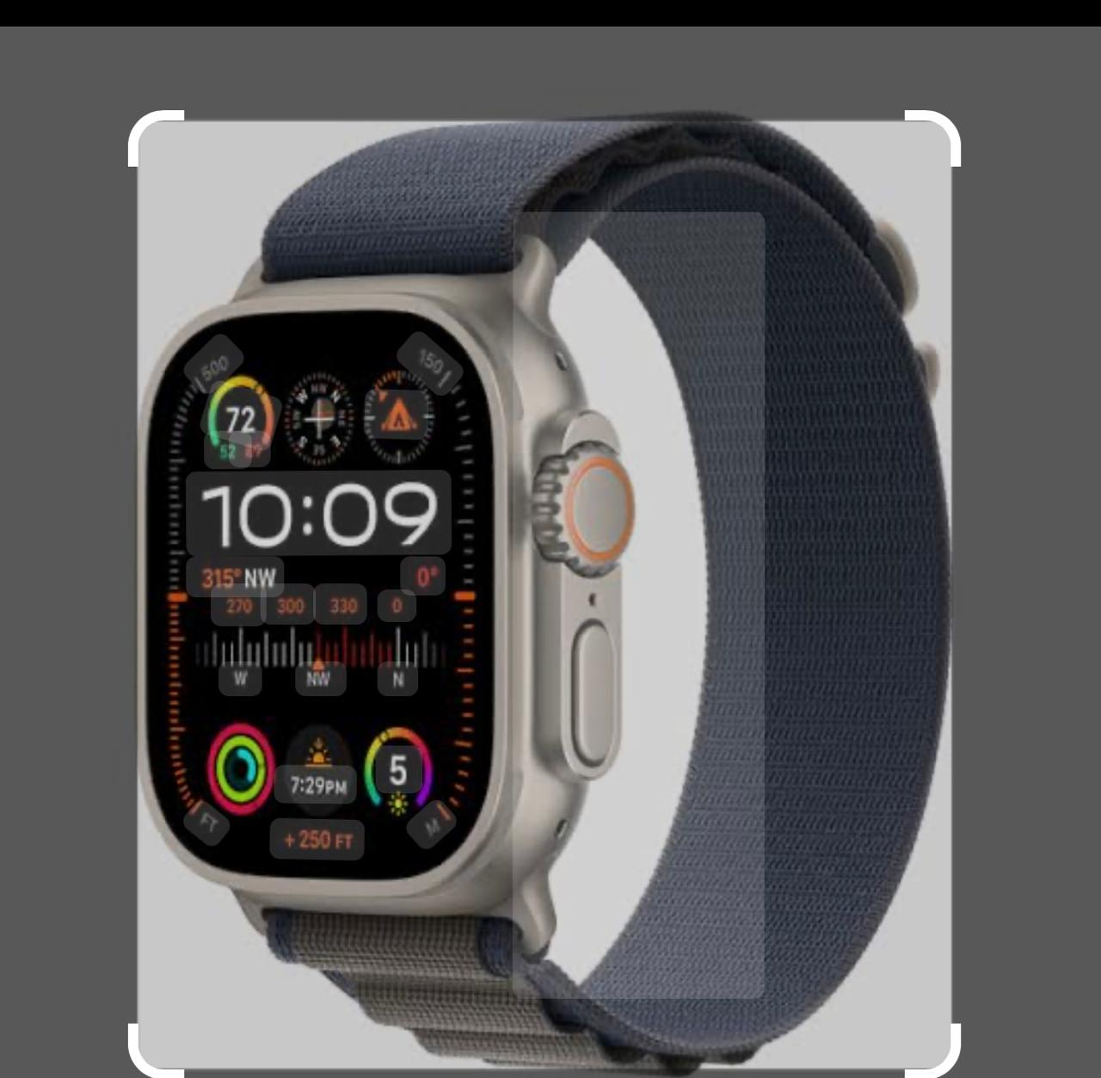
Price Points
- Standard Model: $349
- LTE Model: $399
- Bundles and Discounts: Discounts when purchased with Pixel phones or Google accessories.

Slide 4
Competitors
- Apple Watch Series: Known for its ecosystem integration and advanced features.
- Samsung Galaxy Watch: Popular among Android users for its design and performance.
- Fitbit: A leader in fitness tracking with affordable options.
- Garmin: Targeting fitness enthusiasts with detailed health tracking.

Slide 5
Issues and Solutions
Issues in the Market:
- Lack of seamless integration for Android users.
- Limited premium smartwatch options for non-Apple users.
- Fragmented app ecosystems.
Google Pixel Watch Solutions:
- Full integration with Google services (e.g., Google Assistant, Maps, and Calendar).
- Premium design for Android users.
- Health and fitness tracking powered by Fitbit technology.

Slide 6
Conclusion
The Google Pixel Watch combines premium design, health tracking, and Google integration to address market gaps, positioning it as a strong contender in the smartwatch market.

Slide 7
Thank you

