Slide 1
Graphical Management of Multiple Runtime Models to Improve the Comprehension of Contextual Behavioral Programs
Nick Ruider
Chair of Software Technology
Defense of Master Thesis
Andreas-Pfitzmann-Bau // 25th June 2026
Notes:
very warm welcome everyone and thank you for being here
my name is Nick and today I am excited to defend my master thesis on Graphical Management of Multiple Runtime Models to Improve the Comprehension of Contextual Behavioral Programs

Slide 2
Structure Defense of Master Thesis
Research Questions
Background
Behavioral Programming (BP)
Universal Variability Language (UVL)
Graphical Language Server Platform (GLSP)
State Of The Art
Existing Tools
Research Gap
Implementation
Extensions to FMBP & UVL Metamodel
UVL- & UVL-BP GLSP
Demo
Evaluation & Future Work
Notes:
I will begin by outlining the structure
first, I will outline the primary research questions I investigated
next, I will establish the theoretical foundation by briefly explaining the three core domains of this work:
Behavioral Programming (short BP), the Universal Variability Language (short UVL) and the framework Graphical Language Server Platform (short GLSP)
following that, I will review the current state of the art regarding existing tooling
specifically focusing on Tom’s FMBP framework as a foundational piece of this thesis
I’ll also highlight the resulting research gap that this thesis addresses
I will then detail the implementation of the proposed tool
finally, I will provide a short demo, before concluding with an evaluation of the results and a brief discussion on potential future avenues of work

Slide 3
Research Questions Motivation of this thesis
Graphical tool improving the comprehension of behavioral programs for multiple runtime models
1. .
2. .
3.1. .
3.2. .
How feasible is the graphical visualization of UVL feature models for improving the comprehension of contextual BP?
How can BP concepts be integrated into a graphical tool while maintaining extensibility for future features and analyses?
How can changes to the feature model during the execution of a behavioral program be automatically reflected in the graphical representation?
How can user interactions with the graphical model be translated into valid runtime modifications of the underlying behavioral program?
Notes:
driven by the need to improve the comprehension of behavioral programs at runtime, I want to answer four primary research questions
first, feasibility:
I investigate how a graphical visualization of UVL feature models can enhance the comprehension of contextual behavioral programs
second, extensibility:
I examine how to design the tool's architecture so that BP concepts can be integrated without sacrificing future extensibility
third, runtime synchronization: I leverage a models@run.time approach
this means the graphical model and the executing system are causally connected—any change in one should be reflected in the other
I split this into two parts
3.1: how to automatically reflect live, runtime changes of the behavioral program directly in the graphical view
3.2: how to translate direct user interactions with the diagram back into valid, real-time modifications of the underlying behavioral program
together, these questions establish the framework for both the implementation and the evaluation at the end

Slide 4
Background
Core domains of this thesis

Slide 5
Behavioral Programming Software Development Paradigm
use cases and scenarios elevated to executable constructs [1]
behavioral threads (b-threads) as main building blocks
b-threads communication via a shared event mechanism at synchronization points
b-event types: requested, waited-for and blocked
context-oriented extension handling dynamic environment changes [2]
Notes:
the thesis heavily revolves around Behavioral programming as the main software development paradigm
It is scenario-based meaning that use cases and scenarios defined by the user should be elevated into first-class executable constructs
behavioral threads (b-threads) are the main building blocks of this approach
each b-thread represents a distinct requirement
all b-threads are independent decoupled modules running concurrently
to communicate, b-threads leverage an enhanced publish-subscribe protocol
at a synchronization point, the program suspends execution until the b-events submitted by the b-threads are evaluated
there are three types:
requested proposes the execution of this event
waited-for events ask to be notified when a certain b-event is successfully requested
blocked acts as a veto against the execution of an event
while standard BP encapsulates state entirely within local b-threads, Context-Oriented BP introduces a global system state and dynamic environmental data
allowing b-threads to conditionally trigger based on environmental context

Slide 6
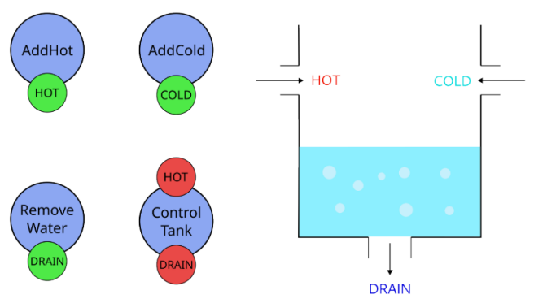
Behavioral Programming Water Tank Example
Water Tank Example [3]
Notes:
to illustrate BP, let‘s look at the water tank example, a system maintaining a target water level and temperature
each requirement of the water tank is managed by an indepenedent b-thread
AddHot manages the hot-water tap
AddCold manages the cold-water tap
RemoveWater requests the drain event
the control tank acts as a supervisor, enforcing operational limits by blocking specific events
here, the temperature is too hot and the water level is too low
the events HOT & DRAIN are blocked
at a synchronization point, only the b-event COLD gets requested, adding cold water to the tank

Slide 7
Universal Variability Language Feature Modeling
describing commonalities & variabilities with a software product family (Software Product Lines)
commonly modeled as feature trees [4]
basic parent-child-relationships: mandatory, optional, or & alternative
cross-tree constraints, e.g.: requires & excludes
cardinality-based modeling: feature cardinality & group cardinality
extended feature models via feature attributes
Universal Variability Language (UVL) as standardized textual exchange format [5]
Notes:
next, let's look at how we can manage software product lines by modeling the commonalities and variabilities within a software product family
most commonly, this variability is structured as a feature tree, which is a hierarchically arranged collection of features
at its core, it relies on basic parent-child relationships such as
mandatory and optional child features
but also feature groups like alternative (where only one feature of the group may be active)
or the or relationship (which requires at least one active sub feature)
other dependencies can be captured by using cross-tree constraints like requires and excludes, but also more complex constraints depending on the complexity of the feature tree
extended feature models may also include cardinality-based relationships for both a single feature and a group of features …
… but also feature attributes to add metadata to a feature
these attributes can then be used for complex constraints, for example
crucially, the Universal Variability Language acts as a standardized architectural description language to model such feature trees

Slide 8
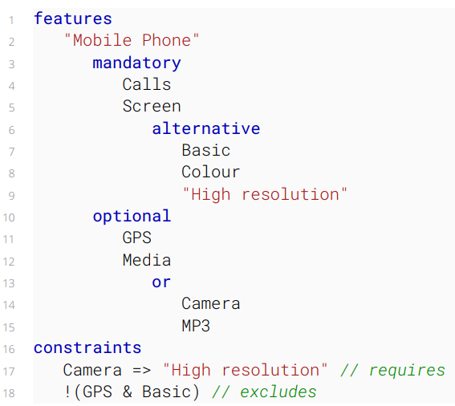
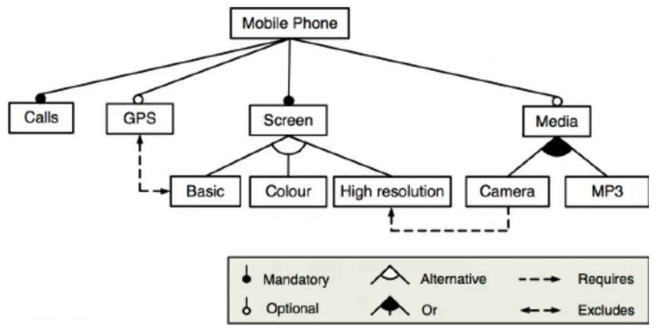
Universal Variability Language Mobile Phone Example
Feature tree for mobile phone example [4]
UVL for mobile phone example
Notes:
here we can see an example of a feature tree for an old mobile phone
it includes mandatory features like calling and a screen
but also, for example an optional GPS feature, which excludes the selection of a basic screen
the same feature tree can be modelled using UVL, which is displayed on the right side of the slide
it includes the hierarchical structure of the feature tree and also the cross-tree constraints at the bottom

Slide 9
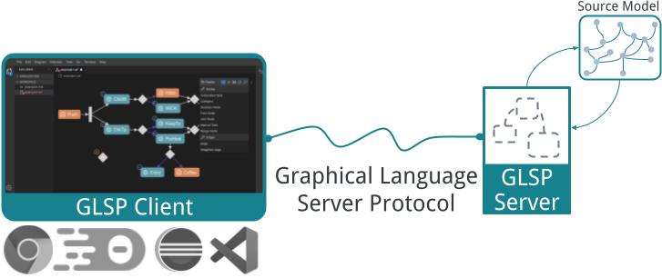
Graphical Language Server Platform Technical foundation
open-source framework hosted by the Eclipse Foundation
replicates decoupled architecture of Language Server Platform for graphical modeling tools [6]
action-based communication via JSON-RPC protocol
GLSP framework [6]
Notes:
the technical foundation for this thesis is the Graphical Language Server Platform
it is an open-source framework by Eclipse for building web-based diagram editors
it follows a similar architectural pattern to the widely used Language Server Protocol but applies it to graphical modeling
the server is responsible for model management, editing logic and the transformation of the underlying semantic source models
the source model must be transformed into the Graphical Model (called GModel) of GLSP, which is sent to the client
the client renders the visual diagram typically as SVG using Eclipse Sprotty
client and server rely on an action-based communication via the JSON-RPC protocol

Slide 10
State Of The Art
Existing Tools & Research Gap
Notes:
- these were the three core domains addressed in the thesis – let‘s move on to the existing tools and the remaining research gap

Slide 11
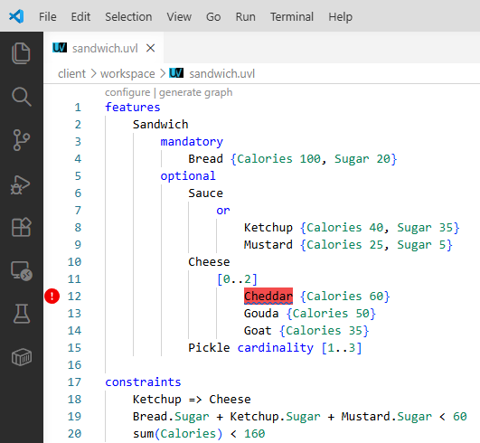
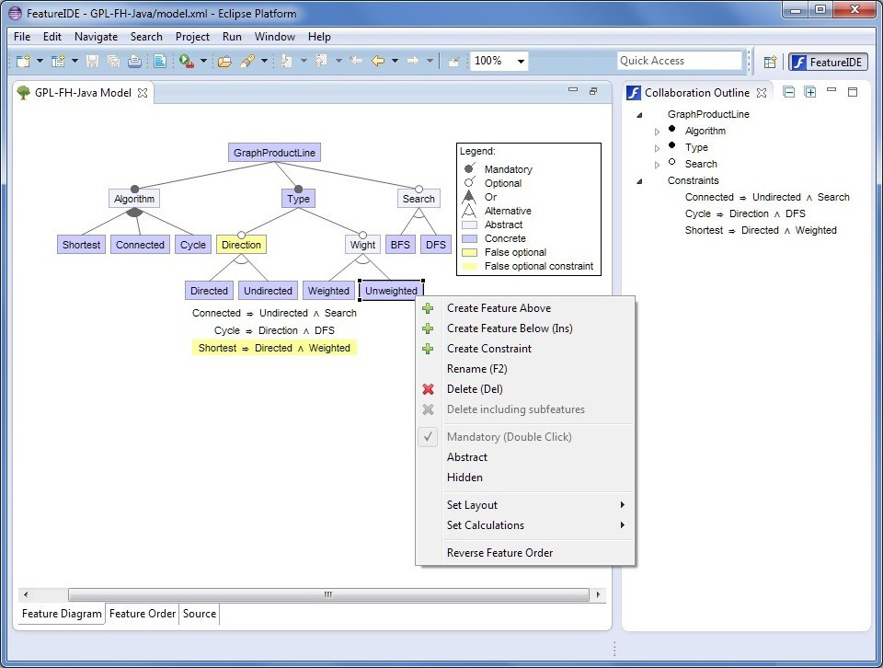
State Of The Art Feature Modeling
VS Code with UVLS extension
UI of FeatureIDE [7]
Notes:
first, what are the existing tools available for feature modeling, based on UVL
a textual solution is the Universal Variability Language Server (UVLS)
implementation of the Language Server Protocol
it offers textual editing assistance and validation specifically for UVL feature models
on the left, we can see an example with UVLS, also marking the feature Cheddar as a “dead feature”
when it comes to a graphical solution, FeatureIDE stands as the benchmark academic framework
it covers the entire Feature-Oriented Software development workflow and offers native support for UVL
although, it is limited, for example it does not support cardinality-based modeling

Slide 12
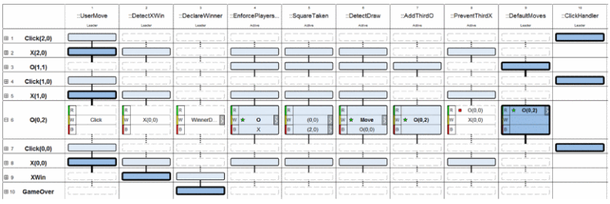
State Of The Art Behavioral Programming
Trace Visualization [8]
post-execution analysis tool
BP Runtime Debugger [9]
hooks directly into behavioral program, including state information and runtime controls
TraceVis of Tic-tac-toe game example [8]
Notes:
for Behavioral Programming, there are also some existing tools
TraceVis was published along the original paper about BP
it shows the state of a behavioral program over time
but it is a strict post-execution analysis tool using a trace file
an opposite approach is made by the BP runtime debugger which was developed by Tom at this chair
it hooks directly into a behavioral program and streams state data to the browser at every synchronization point
the approach provides runtime controls like those in symbolic debuggers, for example the ability to pause execution

Slide 13
State Of The Art Behavioral Programming
FMBP as framework for comprehensibility at the architectural design phase [10]
extends UVL to represent BP as an Architecture Description Language (ADL) [3]
b-threads ➔ feature
b-events ➔ attributes
context ➔ additional top-level features Config & Env
additional aggregate constraint functions
FMBP includes extended UVLS for BP & Python framework based on BPpy [10]
execute behavioral programs based on UVL model files
Notes:
an important tool used throughout this thesis is FMBP
it is a framework designed to improve the comprehensibility of behavioral programs at the architectural design phase
FMBP introduces an extended version of UVL to represent behavioral programs
b-threads are modelled as features with a designated type attribute
b-events can be added to b-threads as attributes, containing their information using sub attributes for the event type
the context of a behavioral program is represented by two additional top-level features, Config & Environment
the extended UVL also introduces additional aggregate constraint functions
FMBP leverages this extended UVL model to create both an extension to the existing LSP and a python framework for running behavioral programs
the executed behavioral program is based on a UVL model file and can be updated through changes to the model itself

Slide 14
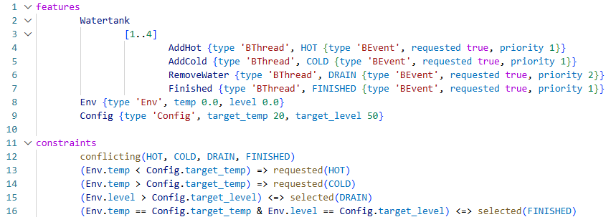
State Of The Art Behavioral Programming
Notes:
here is an example of an UVL model with behavioral programming elements
it‘s the water tank example we previously discussed
in line 4 to 7, we can see the b-threads with an additional type attribute
in each of them, we also have an event attribute with the actual type of the event which would be requested here and also a priority
in lines 8 to 9, we can see the additional contextual features for this model
and at the bottom, we can see some constraints using the additional functions for BP

Slide 15
State Of The Art Research Gap
FMBP as foundational work
presents ADL for behavioral programs
only textual representation
existing graphical solutions of UVL not extendable on language-level
GLSP as available framework for graphical modeling tools
extensibility: how to separate base UVL from BP-enhanced UVL
runtime integration with model synchronization
Notes:
as a result, there is a research gap that should be addressed by this thesis
I build directly on the FMBP framework as a foundational piece
using the proposed ADL for behavioral programs and its capability to execute those programs
however, FMBP is restricted entirely to a textual representation
on the other side, existing graphical solutions for UVL lack the language-level extensibility needed to incorporate behavioral elements
to address these limitations, I’ll leverage GLSP to develop a visual modeling environment
in doing so, the implementation remains with some technical challenges that need to be solved
first, Language Extensibility – so how can I design a clean architectural separation that allows me to extend the base UVL metamodel with BP concepts without tightly coupling them
second, runtime integration – how can I enable dynamic, bidirectional model synchronization between the running system and GLSP

Slide 16
Implementation
Create GLSP for UVL & UVL-BP
Notes:
- so let‘s move on to the implementation

Slide 17




Implementation Framework Selection
uvl-parser
java-fm-metamodel
Behavioral Program
tfelbr/FMBP
Server-Sent Events (SSE)
UVL
UVL-BP
Notes:
first, I‘d like to present an overview of the selected framework structure
on client side, I use the VS-Code variant of GLSP as the supported IDE as it is widely used and supports the .vsix format
in this case, it enables me to create a clean separation between the base UVL tool and it’s BP-specific extension
on server side, we need to discuss the source model first
GLSP supports some source models out of the box, like the usage of EMF metamodels
in this case, this was not suitable to use because the UVL ecosystem provides some packages regarding UVL parsing already
I integrate the UVL parser based on an ANTLR grammar, parsing it to Java objects based on the java-fm-metamodel package provided by the maintainers of UVL
this library enables the GLSP server to load UVL models directly, modify them during editing operations, and re-serialize them back to UVL files as well
I adopt a custom dual-model approach, using the UVL file as the main source model and adding a visual layer to save notation data
therefore, the GLSP server must be implemented in the Java variant of GLSP
the behavioral programs shall be executed using FMBP because it uses the same UVL feature model loaded by GLSP
what’s missing are the runtime data updates
FMBP does not write back the changes made to the Env feature and, the selected b-events are not available in the UVL model itself anyway
to create a connection, I use server-sent events to push any useful data from FMBP to GLSP
SSE is a lightweight, unidirectional streaming protocol
FMBP exposes such an endpoint while running the behavioral program
GLSP connects to it and listens for incoming events
so this is the basic setup – let’s talk about each component separately

Slide 18
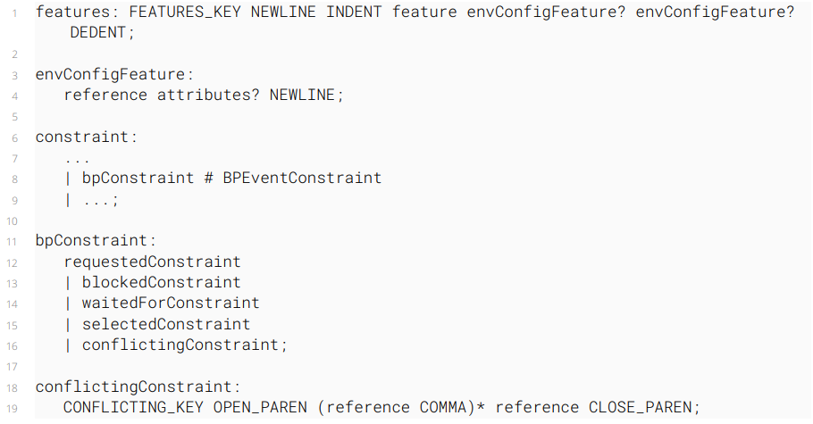
Implementation Extending UVL Metamodel
Notes:
to extend the UVL metamodel, changes are needed for both the UVL-parser and the java metamodel library
the ANTLR grammar already supports b-threads and b-events using the common attributes
but it does not support multiple top-level features
this is needed for the contextual features Env & Config
therefore, I added a new rule to the ANTLR grammar so these features are allowed as well
the additional BP constraints need to be added to the grammar as well
as an example, the conflicting constraint is defined to support multiple references in its aggregate function style

Slide 19
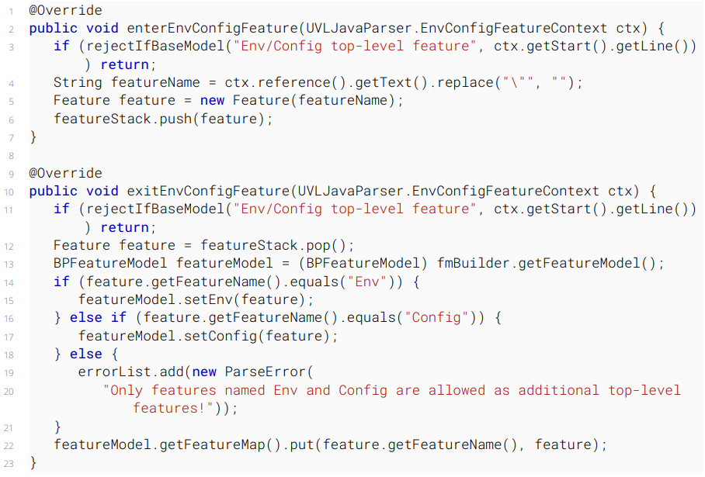

Slide 20
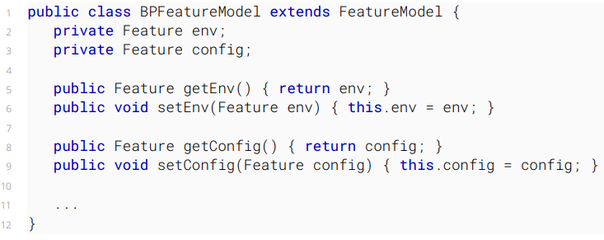
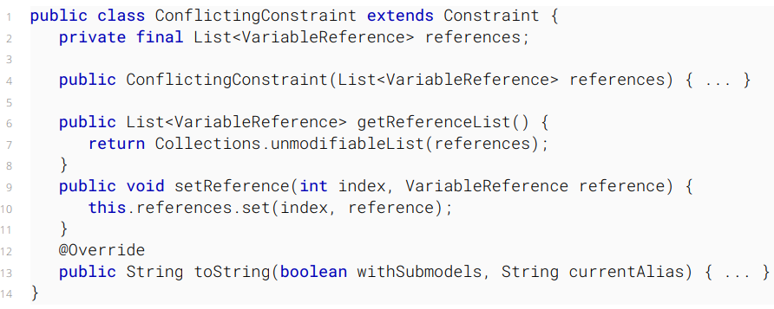
Implementation Extending UVL Metamodel
Notes:
the java metamodel needs to be adjusted accordingly
I extended the existing FeatureModel class to a BPFeatureModel
this includes the contextual feature objects in specific attributes
also, I created classes for each constraint added through BP
example: ConflictingConstraint which includes the sub elements as references

Slide 21
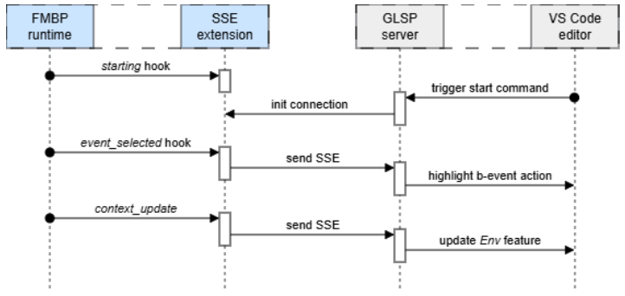
Implementation Extending FMBP
selected b-events ➔ extension based on BPConfigurator
dynamic environment attributes ➔ decorator for context sources
single SSE server sending model path
Notes:
to enable the models@run.time approach, I also extended the FMBP framework
the added functionality addresses the missing link from the behavioral program to the graphical view
the other direction is covered already through the usage of FMBP
the framework already supports modifications to the UVL file config and constraints at runtime
because the GLSP will run on the exact same UVL model file, changes in the graphical view will be reflected in the behavioral program as well
but let’s discuss the other directional link
the main configuration class of FMBP receives the option to add additional extensions that may be injected at startup
in this case, I created the BEventStreamerExtension which uses the hook when a b-event is selected to parse the information and send it via SSE
additionally, FMBP contains the context source which contains the current contextual data of the running program
using the decorator design pattern, it also pushes this data via SSE to GLSP
to ease the setup of GLSP, there is only one SSE server endpoint so it is not needed to provide a differentport to each GLSP instance
to map the correct UVL model to the GLSP, the model path is also part of each SSE message
in the diagram, we can see the basic setup of this
…

Slide 22
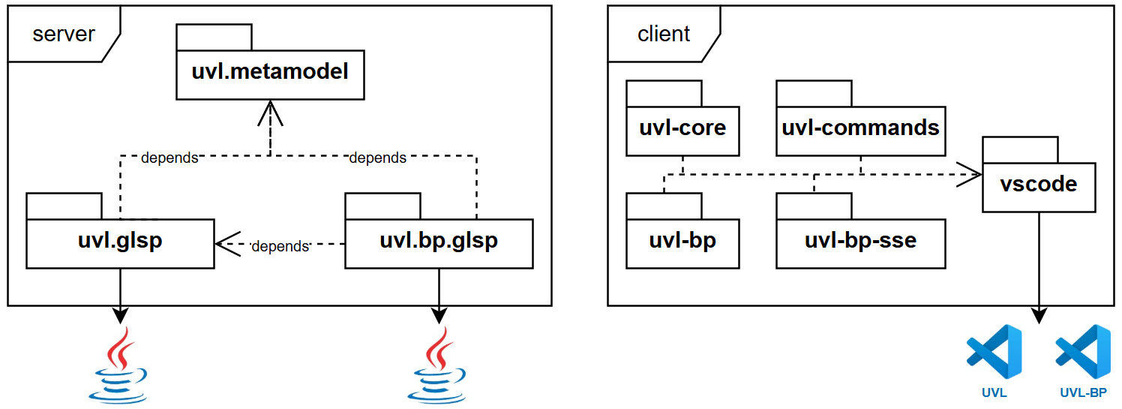
Implementation GLSP package structure
Notes:
one goal of the thesis was also to keep the project extendable and not tightly couple the BP packages to UVL
therefore, on server side, I created a distinct UVL GLSP implementation using the UVL metamodel
another package for UVL BP extends the already implemented GLSP server and adapts it where needed
as a result, there are two different GLSP jar files that may be used by the VS Code extension
on client side, a multi-profile approach was taken
I created several packages each responsible for a different task
to prevent the duplication of the VS Code related package, I leverage profiles that inject packages at runtime
for example, the UVL profile only needs the UVL core defining the visual representation of the elements and the uvl commands
the UVL BP profile needs additional implementations for the visuals and also an additional commands package for the SSE communication
additionally, I append the relevant server JAR to each profile
therefore, I can package two different VS Code extensions from the same code base

Slide 23
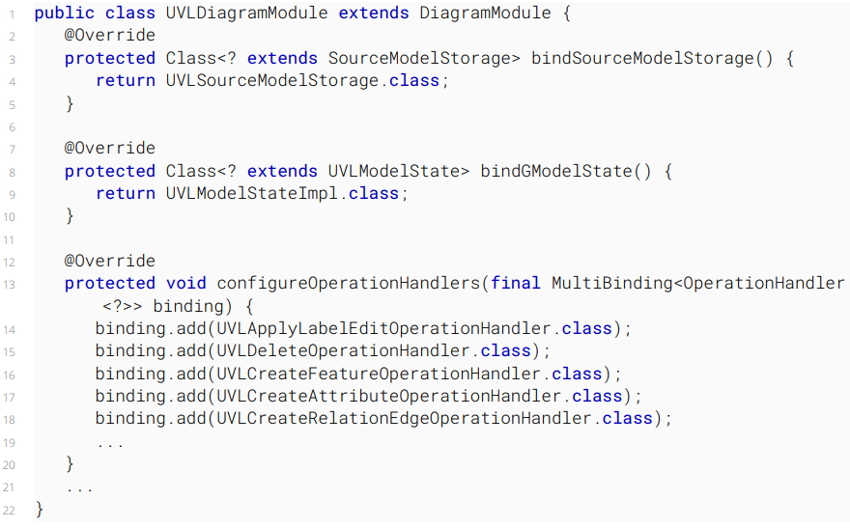
Implementation Extending uvl.glsp to uvl.bp.glsp
Notes:
as an example, the GLSP server uses a central UVL Diagram Module where each handler needs to be injected
in this excerpt, we can see the binding of the UVL source model storage and the model state implementation
also, the relevant operation handlers are added here

Slide 24
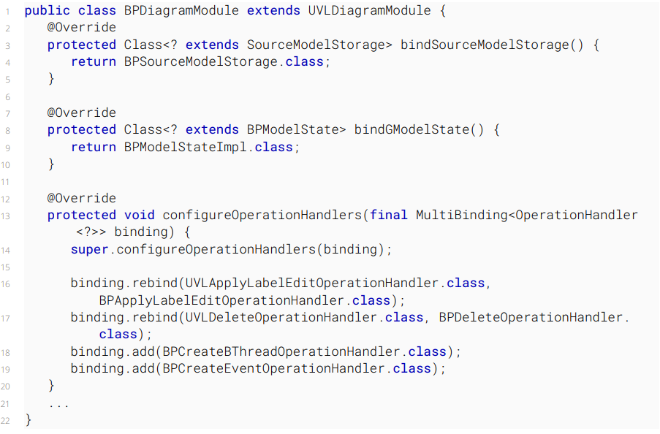
Implementation Extending uvl.glsp to uvl.bp.glsp
Overridden source model storage and GModel state
Reuse existing operation handlers
Rebind required operation handlers
Add new BP-related handlers
Notes:
the BP diagram module in the dedicated BP package takes the UVLDiagramModule and adjusted it where needed
the source model storage is overridden to use the BP parsing mode of the UVL metamodel
the GModelState is overridden to use the BPFeatureModel class instead of the base feature model
some existing operation handlers are rebound or added to the implementation as well

Slide 25
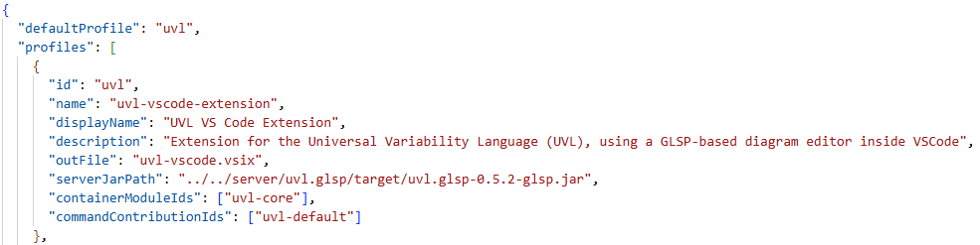
Implementation GLSP-based multi-profile VS Code extensions
Notes:
on client side, this injection based approach is quite similar so I won‘t be looking into this in detail
I want to show how the profiles work
here we can see the definition of the base UVL extension with its metadata
it also contains the reference to the server path and the needed modules that should be injected at build-time

Slide 26
Demo
VS Code Extensions for UVL & UVL-BP

Slide 28
Evaluation
Contributions & Future Work

Slide 29
Evaluation Contributions
1.
2.
3.1.
3.2. .
Feasibility:
Graphical editor built on GLSP, supports modeling of contextual BP models
Extensibility:
Architecture separating core UVL modeling from the BP extension using profile-based approach
Runtime synchronization: Behavioral Program ➔ Graphical View
Extend FMBP providing runtime information using SSE
Runtime synchronization: Graphical View ➔ Behavioral Program
Working on the same UVL model, changes are applied via FMBP integration
Notes:
finally, let‘s talk about the contributions made through this thesis
feasability was answered by creating a graphical editor based on GLSP
it supports modeling of contextual BP models through UVL
extensibility is covered as well
architecture separates core UVL modeling from the BP extension using profiles and distinct packages
last but not least, the models@run.time approach was also implemented
I extended FMBP to provide the necessary runtime information of the behavioral program to the graphical view using SSE
in the other direction, changes made to the UVL model are applied to FMBP directly by using the same underlying model file

Slide 30
Future Work Improve the proposed tool
improve performance
architecture and maintainability through smaller modules & BP-specific grammar and metamodel
improvements to visuals & usability
additional editor views
end-to-end tests via Playwright
new extensions based on UVL
Notes:
the resulting tool chain is a proof-of-concept that still has a lot of potential avenues for future work
performance is probably the main issue
for example, the communication flow can be optimized by creating a dedicated action for updating the environment feature
the architecture could also be improved, for example through smaller modules or splitting the UVL metamodel into a distinct BP variant
the visuals of the editor might be improvable, especially for the constraint box
testing is missing for now, but there is a playwright implementation for GLSP that might be useful for end-to-end tests
and at the end, other domains based on UVL feature models could be added through the creation of a new VS Code extension

Slide 31
Thank you for your attention
Questions & Discussion
Notes:
- that‘s it!

Slide 32
Bibliography References to the literature and images
[1] David Harel, Assaf Marron, and Gera Weiss. “Behavioral programming”. In: Commun. ACM 55.7 (July 1, 2012), pp. 90–100. ISSN: 0001-0782. DOI: 10.1145/2209249.2209270
[2] Achiya Elyasaf. “Context-Oriented Behavioral Programming”. In: Information and Software Technology 133 (May 1, 2021). ISSN: 0950-5849. DOI: 10.1016/j.infsof.2020.106504
[3] Tom Felber and Sebastian Götz. “Behavioral Programming in the Large using Variability Management”. In: Proceedings of the 19th International Working Conference on Variability Modelling of Software-Intensive Systems. VaMoS ’25. New York, NY, USA: Association for Computing Machinery, May 28, 2025, pp. 126–130. ISBN: 979-8-4007-1441-2. DOI: 10.1145/3715340.3715443
[4] David Benavides, Sergio Segura, and Antonio Ruiz-Cortés. “Automated analysis of feature models 20 years later: A literature review”. In: Information Systems 35.6 (Sept. 1, 2010), pp. 615–636. ISSN: 0306-4379. DOI: 10.1016/j.is.2010.01.001
[5] David Benavides et al. “UVL: Feature modelling with the Universal Variability Language”. In: Journal of Systems and Software 225 (July 1, 2025). ISSN: 0164-1212. DOI: 10.1016/j.jss.2024.112326
[6] Dominik Bork, Philip Langer, and Tobias Ortmayr. “A Vision for Flexible GLSP-Based Web Modeling Tools”. In: The Practice of Enterprise Modeling. Ed. by João Paulo A. Almeida et al. Cham: Springer Nature Switzerland, 2024, pp. 109–124. ISBN: 978-3-031-48583-1. DOI: 10.1007/978-3-031-48583-1_7
[7] FeatureIDE. https://featureide.de/ (22.06.2026)
[8] Nir Eitan et al. “On Visualization and Comprehension of Scenario-Based Programs”. In: 2011 IEEE 19th International Conference on Program Comprehension. 2011 IEEE 19th International Conference on Program Comprehension. ISSN: 1092-8138. June 2011, pp. 189–192. DOI: 10.1109/ICPC.2011.10
[9] Tom Felber and Sebastian Götz. “Debugging Behavioral Programs Using Models@run.time”. In: 2024 50th Euromicro Conference on Software Engineering and Advanced Applications (SEAA). 2024 50th Euromicro Conference on Software Engineering and Advanced Applications (SEAA). ISSN: 2376-9521. Aug. 2024, pp. 160–167. DOI: 10.1109/SEAA64295.2024.00032
[10] Tom Felber and Sebastian Götz. “Comprehensible Self-Aware Behavioral Programming”. In: 2025 IEEE International Conference on Autonomic Computing and Self-Organizing Systems Companion (ACSOS-C). 2025 IEEE International Conference on Autonomic Computing and Self-Organizing Systems Companion (ACSOS-C). Sept. 2025, pp. 215–220. DOI: 10.1109/ACSOS-C66519.2025.00064

Slide 34
Appendix
Additional slides
Notes:
- that‘s it!

Slide 35
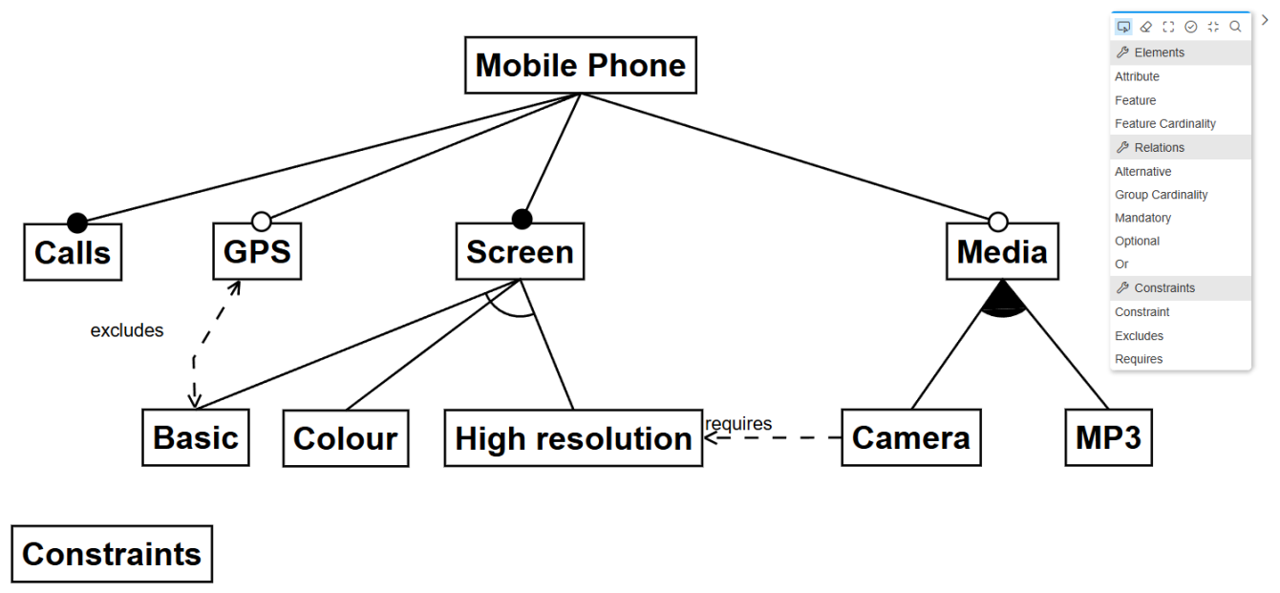
GLSP Example Model Mobile Phone

Slide 36
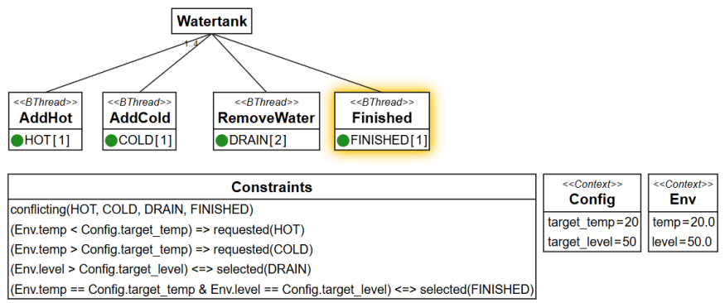
GLSP Example Model Water Tank

Slide 37
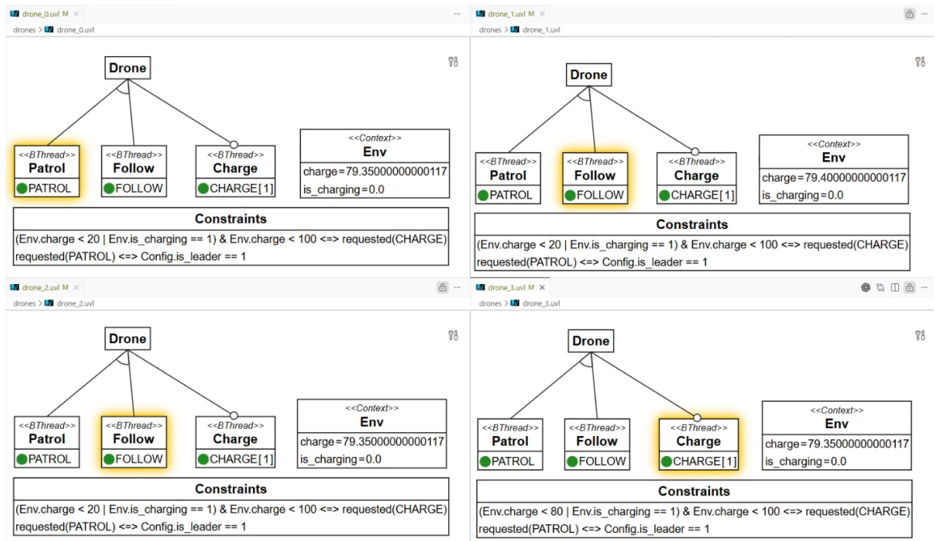
GLSP Example Model Drones

Slide 38
Visual Representation Theory
Semiotic Clarity: Each semantic construct should map to one distinct graphical symbol; violations produce redundancy, overload, excess, or deficit.
Perceptual Discriminability: Symbols must be easy to tell apart; discriminability depends on the "visual distance" across variables such as shape, color, and size.
Semantic Transparency: Symbols should visually suggest their meaning so that appearance provides intuitive cues and reduces learning effort.
Complexity Management: Notations should offer mechanisms (for example, layered views) to present information incrementally and avoid cognitive overload.
Cognitive Integration: Provide contextual anchors, overview maps, and cross-references so readers can relate individual diagrams to the larger system of representations.
Visual Expressiveness: Leverage multiple visual channels (color, size, brightness, texture, position, etc.) so the notation can encode information across a richer perceptual space.
Dual Coding: Combine concise textual labels or annotations with graphics to leverage both verbal and visual cognitive systems and improve comprehension and retention.
Graphic Economy: Keep the visual vocabulary compact so distinct symbols remain within human discriminative abilities, especially for novice users.
Cognitive Fit: Tailor the notation to task and audience, offering simplified and expert variants so the representation matches users’ goals and skills.

Slide 39
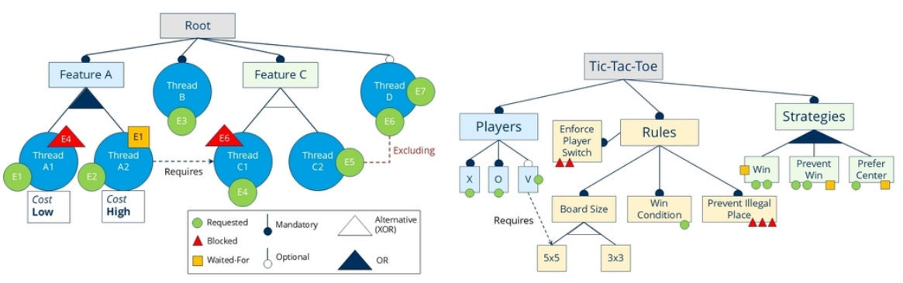
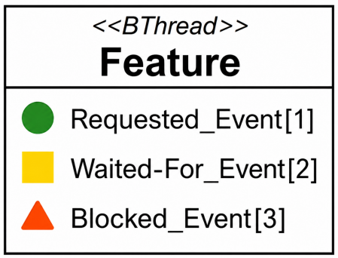
B-Event Visualisation Comparison

Slide 40
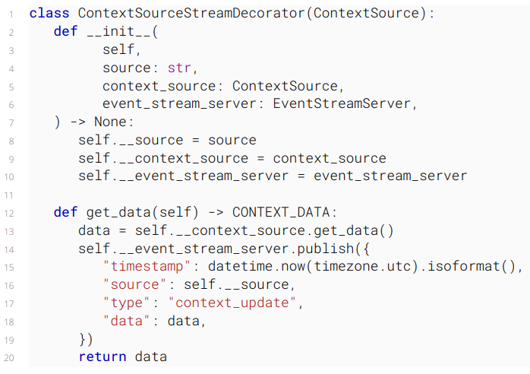
FMBP Extension Context Source Decorator

Slide 41
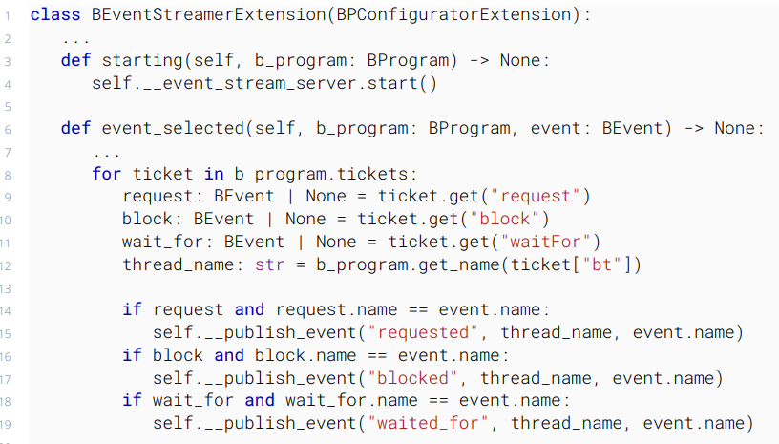
FMBP Extension BEventStreamerExtension

Slide 42
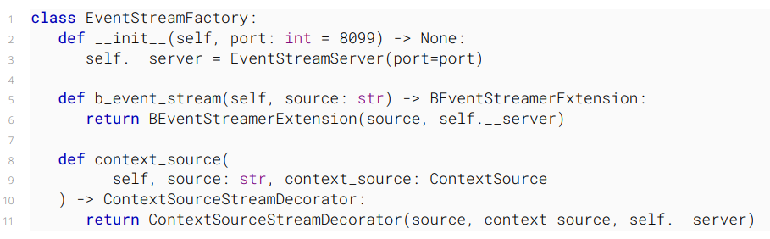
FMBP Extension EventStreamFactory

Slide 43
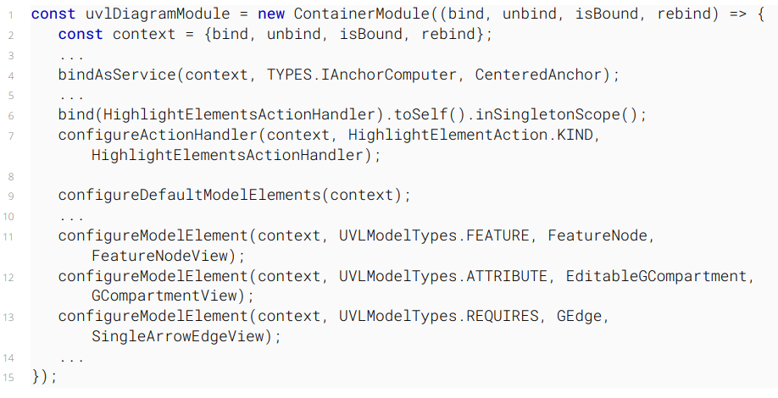
GLSP Client UVL Diagram Module

Slide 44
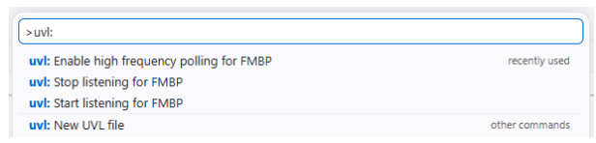
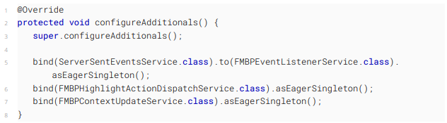
Models@run.time in GLSP Commands & Injection in GLSP Server

Slide 45
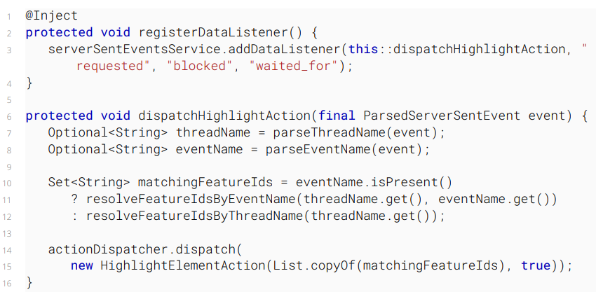
Models@run.time in GLSP Highlight dispatch

Slide 46
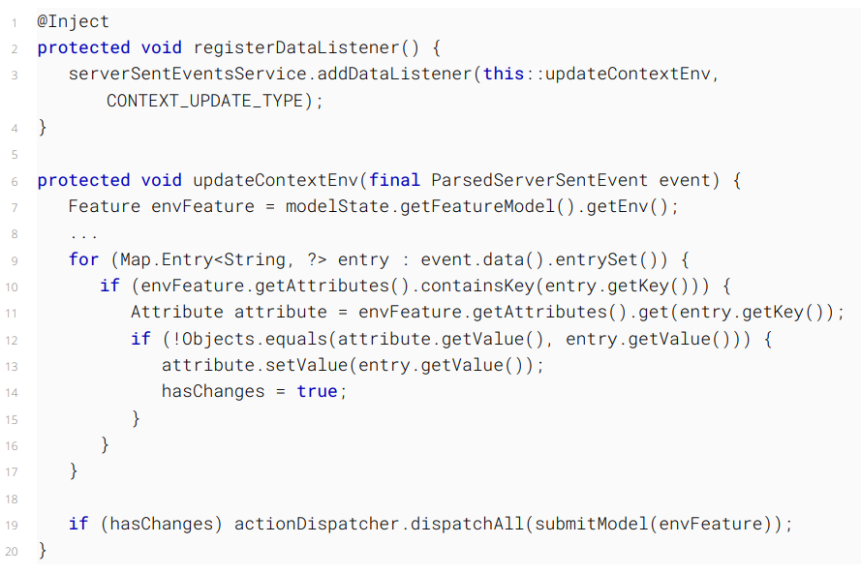
Models@run.time in GLSP Context Update

