Slide 1
M1.-csapat 2022 1. Project
Made by Gyányi Dániel and Menczel Balázs

Slide 2
The task
In 2022 our class received a task to make a website about János Neumann or about human rights.
We decided to make one about human rights.

Slide 3


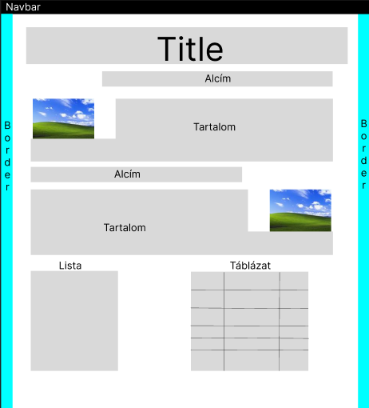
The Plan
We created a Wireframe and a concept art of the site.

Slide 4
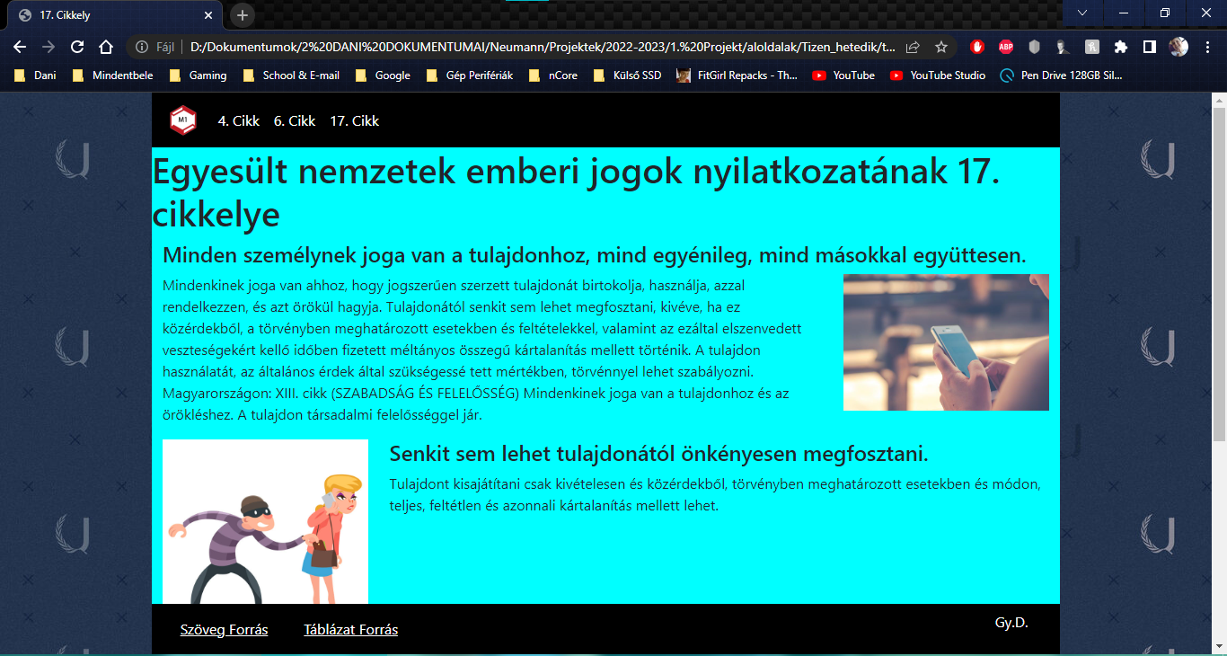
Each member chose which right he would make a website of.

Slide 5
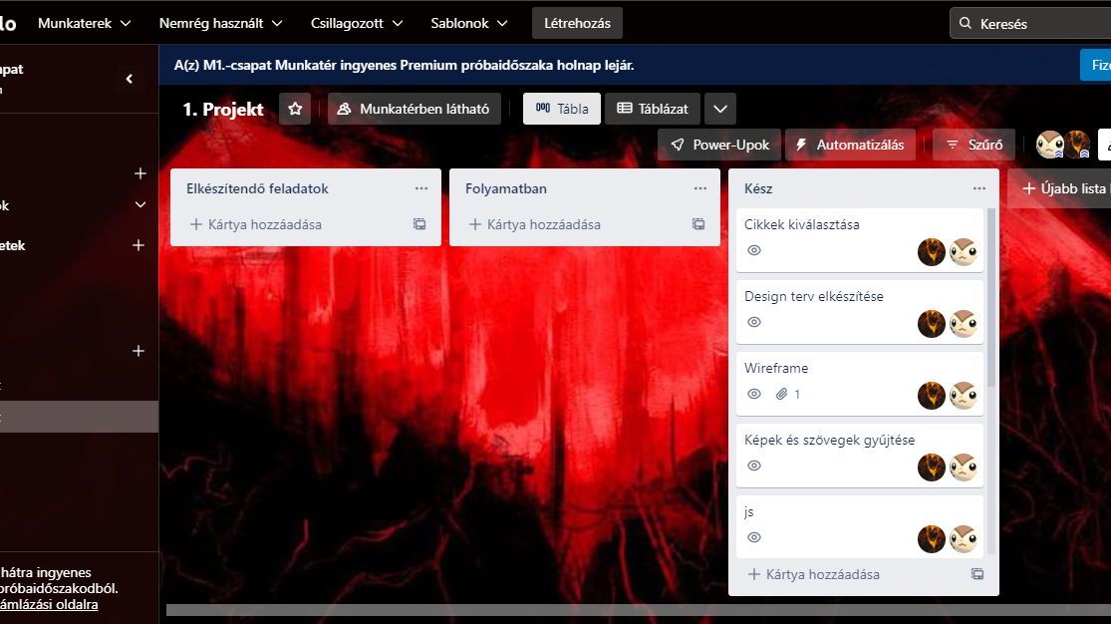
We also used the app named
Trello to keep track of
the smaller tasks completion process.

Slide 6
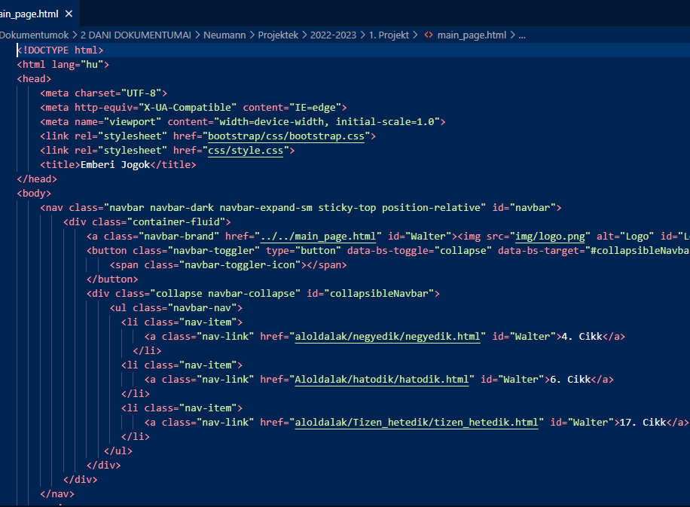
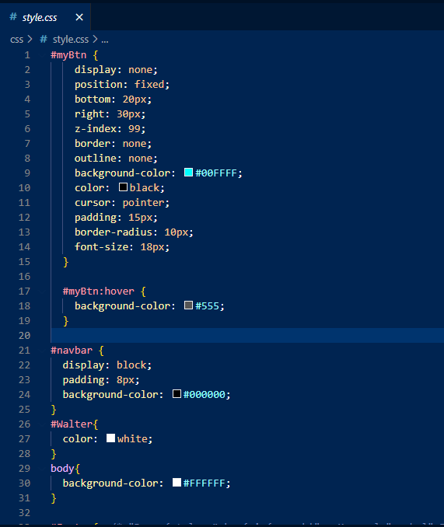
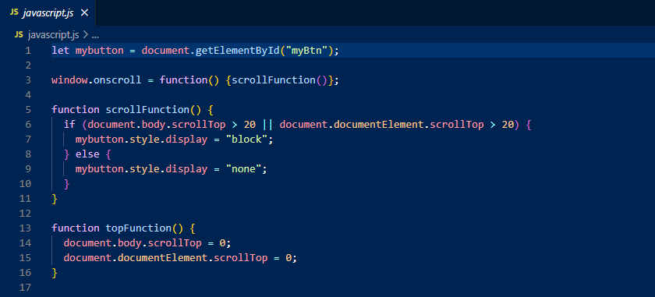
The Coding
We created the Hyper Text Markup Language, Cascading Style Sheets, and JavaScript files.

Slide 7
Köszönjük a figyelmet!
Elérhetőség:
Gyányi Dániel:
06302422599
gyanyi.daniel.hu@freemail.hu
Menczel Balázs:
06304879197
mnczlblzs@gmail.com

Slide 8
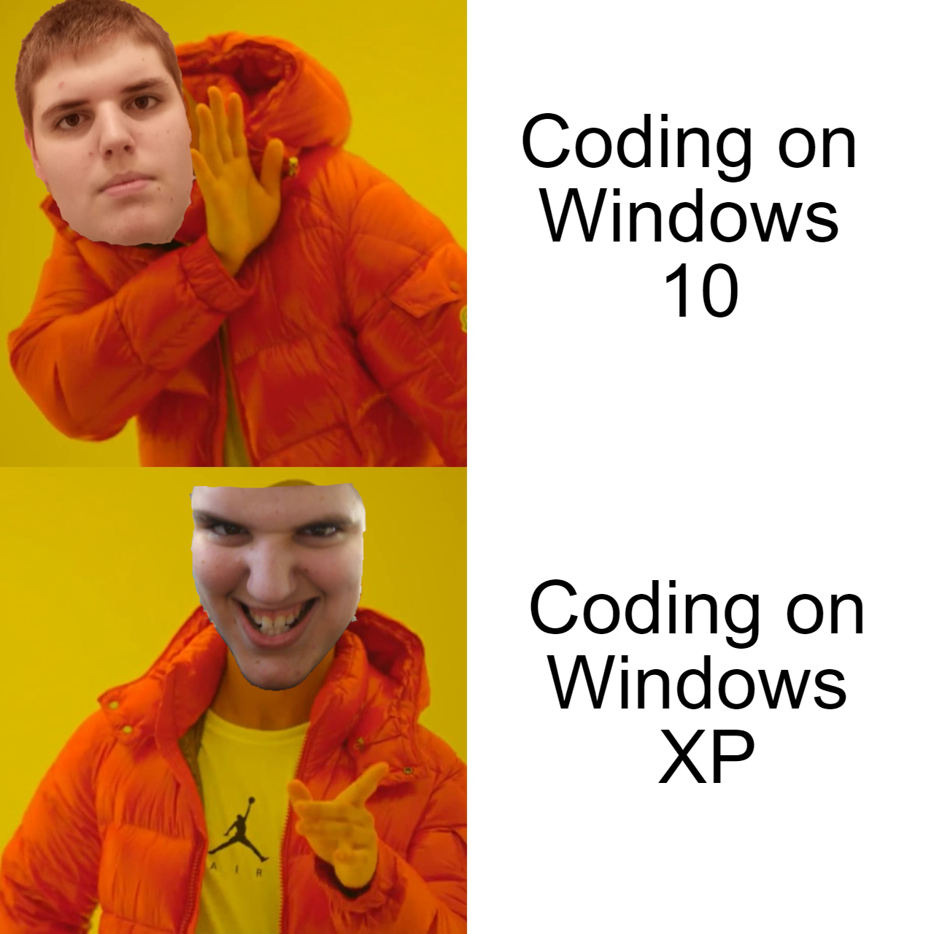

Slide 9
Fogalmak
Wireframe: A drawing (physical or digital) or the design plan of the website.
Trello: A web-based list-making app for projekt management.

Slide 10
Szavak
Angol
Magyar
Wireframe
Human Rights
Concept Art
To keep track of sg
Drótváz
Emberi Jogok
Előzetes grafikai terv
Valami nyomon követése

