Slide 1
₹10,000 A MONTH
SECURITY ANALYSIS (BBAT35F97) · DATA AS OF 13 OCT 2026
OUR ANSWER IN THREE MOVES
01
PICK
Three sectors, three macro drivers, correlations of 0.16–0.24
INTO HUL, SUN PHARMA AND ICICI BANK: HOW A STUDENT SHOULD OWN THEM
02
PRICE
All three trade above our blended value, so we buy slowly, through a SIP
Median 15-year corpus ₹64.8 lakh from ₹38.1 lakh invested, for a Balanced investor (A = 4), from a 10,000-path Monte Carlo of our portfolio.
03
PORTFOLIO
31 · 19 · 50 satellite around a Nifty 50 index core
0.34 vs 0.44
44 / 47
0 of 8
SHARPE RATIO: OUR 3 STOCKS VS THE NIFTY
AI-EXTRACTED FIGURES WITHIN 1%
TRADING RULES THAT BEAT BUY-AND-HOLD
TAPMI · BBA(H) SEMESTER V · GROUP PROJECT
Notes:
[0:30] Ten thousand rupees a month. That is what each of us expects to invest after graduation, and this project asks one question: should that money own Hindustan Unilever, Sun Pharma and ICICI Bank, and how? Our answer has three moves. Pick three businesses whose returns don't move together. Price them honestly: all three trade above our blended values, so we buy slowly. And size the portfolio to each of us: 31, 19, 50 percent, as a satellite around a Nifty index core.

Slide 2
THREE SECTORS, THREE DIFFERENT DRIVERS
01 - THE PICKS
WHY THEY BELONG TOGETHER
0.16–0.24
Top-down: an investment-led economy, then three businesses driven by different demand.
PAIRWISE CORRELATIONS, 2016–2026
7.8%
+11.9%
5.25%
5.52%
Betas of 0.60, 0.65, 1.29: two defensives and one cyclical.
REAL GDP GROWTH, Q1 FY27
INVESTMENT (GFCF) GROWTH
RBI REPO RATE
91-DAY T-BILL RATE
WHAT WE REJECTED
FMCG
PHARMA
PRIVATE BANK
MEDIA
Strongest sector (+11.2% vs 200-day), but its certainty equivalent at A = 4 is −8% to −38%: chasing it is recency bias.
Hindustan Unilever
Sun Pharma
ICICI Bank
DEFENSIVE ANCHOR
DEFENSIVE GROWTH
GROWTH ENGINE
Lowest beta in the weakest sector: out-of-favour quality.
Demand ignores the cycle; US sales earn dollars.
The direct play on investment-led growth: loans +19.6%.
INFOSYS
IT is 8.9% below its 200-day; Sun keeps the dollar hedge at a lower beta.
β 0.60 · CAGR 9.6%
β 0.65 · CAGR 8.7%
β 1.29 · CAGR 19.1%
HDFC BANK
The 2023 merger breaks its history.
Sources: MOSPI, RBI, Zerodha Aftermarket Report (12 Oct 2026). Full funnel: docs/macro_industry.md.
Notes:
[1:30] We worked top-down. The economy is growing 7.8%, led by investment, up 11.9%, rather than consumption. So we wanted three different engines. ICICI Bank is the credit engine of an investment-led cycle. Hindustan Unilever is the defensive anchor: the lowest beta, 0.60, in the weakest sector right now, so we are buying out-of-favour quality rather than chasing. Sun Pharma's demand doesn't follow the cycle, and its US business earns dollars. The proof that they diversify each other: pairwise correlations of only 0.16–0.24. Just as important is what we rejected. Media was the strongest sector, 11% above its 200-day average. But on our class utility function a balanced investor would refuse it, with certainty equivalents of minus 8 to minus 38 percent. Buying it would be recency bias, the behaviour our own policy statement bans.

Slide 3
PRICED FOR MORE GROWTH THAN WE CAN JUSTIFY
02 - VALUATION
Intrinsic value from our Excel models at CAPM discount rates, against today's price and the analysts' targets.
−14%
Hindustan Unilever
Price implies 7.4% growth a year for ever, at r = 9.8%
BLENDED VS PRICE
−30%
Sun Pharma
Price implies 8.6% growth a year for ever, at r = 10.1%
BLENDED VS PRICE
−37%
ICICI Bank
Price implies 13.9% growth a year for ever, at r = 14.7%
BLENDED VS PRICE
ICICI grew loans 19.6% last quarter. The gap is mostly our 14.7% cost of equity (β 1.29), not unrealistic growth.
Two-stage DDM (HUL), two-stage residual income (Sun Pharma, ICICI Bank), peer P/E and ROE-adjusted P/B: workbook/valuation.xlsx. Blended = average of model and peer values. Analyst targets: Yahoo Finance consensus.
Notes:
[1:30] Excel is our source of truth: a two-stage dividend discount model for HUL, which pays out most of its profit, and residual income for Sun Pharma and for ICICI, a bank. Against today's prices, the blended values are 14% below for HUL, 30% for Sun Pharma and 37% for ICICI Bank. So is the market wrong? Reverse the model and ask what growth the price implies: 7.4% a year for ever for HUL, 8.6% for Sun Pharma and 13.9% for ICICI Bank. ICICI grew loans 19.6% last quarter, so its implied growth is not crazy; the gap comes mostly from our 14.7% cost of equity, driven by a beta of 1.29. Analysts are far more bullish, with mean targets well above the price. Our honest reading: good companies at full prices.

Slide 4
FIVE AI TASKS, EACH CHECKED AGAINST A BENCHMARK
03 - AI-AUGMENTED ANALYSIS
AI reads and labels; Python computes every number. Each task reports how far it can be trusted.
01
RATIO EXTRACTION
02
SENTIMENT
03
BIAS & FRAMING
04
FORECASTING
05
RISK HEATMAPS
WHAT
Claude reads the FY26 annual reports and returns line items as JSON.
WHAT
FinBERT scores 2,428 headlines and 9,133 call sentences.
WHAT
An LLM tags 120 headlines for framing, authority, herding and hype.
WHAT
Moving-average and RSI rules, an earnings event study, analyst consensus.
WHAT
Correlation, rolling correlation, risk contribution, stress tests.
CHECKED AGAINST
Yahoo Finance and Screener.
CHECKED AGAINST
Management vs analysts on every call.
CHECKED AGAINST
70% agreement with FinBERT.
CHECKED AGAINST
Buy-and-hold, after a 0.25% trading cost.
CHECKED AGAINST
Four real sell-offs since 2020.
44 / 47
+0.28
41%
0 of 8
57%
within 1%; 0 extraction errors
HUL tone gap: management far more upbeat
carry a bias cue; 14% aren't about the company
trading rules beat buy-and-hold
of portfolio risk is ICICI, at 50% weight
Prompts: docs/ai_prompts.md. Extraction: data/ai/ratio_extraction.json (page references for every figure). FinBERT: ProsusAI/finbert. Headlines: Google News RSS, last 12 months.
Notes:
[1:00] The brief asked how AI can augment this, so we ran five tasks, and each one is checked against something independent. Claude read the FY26 annual reports and extracted 47 numbers: 44 match Yahoo and Screener within 1%, and the rest are definition differences, not errors. FinBERT scored over 2,400 headlines and every earnings-call sentence: HUL's management is far more upbeat than the analysts questioning them. An LLM tagged 120 headlines for behavioural cues: 41% carry one, mostly broker authority and herding, and 14% weren't about the company at all. The rule throughout: AI reads and labels; every number is computed.

Slide 5
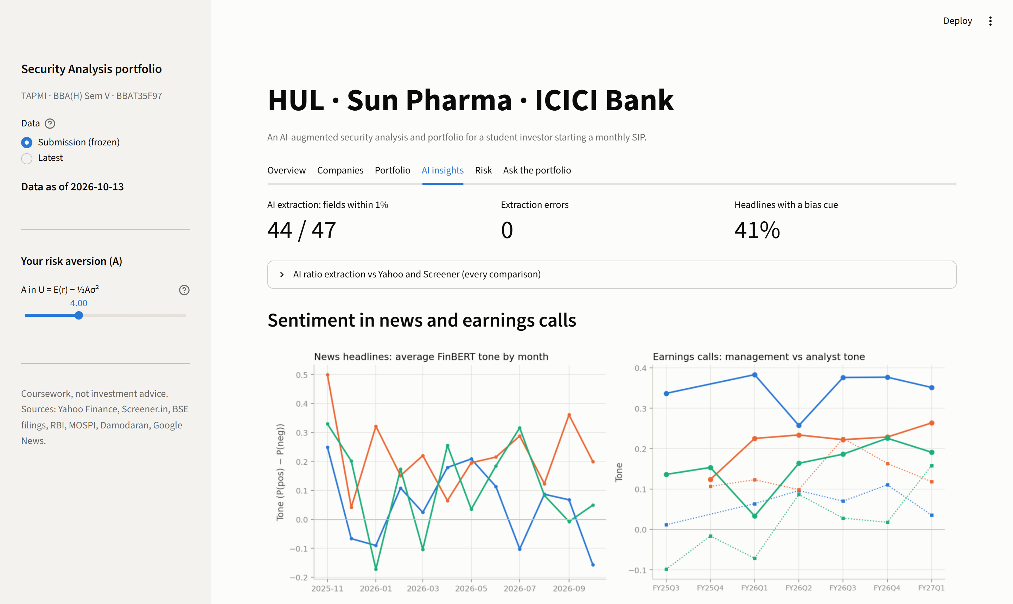
SEE IT LIVE
04 - LIVE DEMO
Two minutes, four stops on our dashboard.
01
AI INSIGHTS
Monthly sentiment; news framing
02
RISK
Correlation heatmap; stress tests
03
ASK THE PORTFOLIO
One question, answered with its sources
04
YOUR OWN PORTFOLIO
Slide A from 4 to 2: your share in P goes from 44% to 87%
IF ANYTHING TAKES MORE THAN 10 SECONDS
1 Live link → 2 Local copy → 3 Recorded walkthrough → 4 Screenshots (A3)
LOCAL COPY
streamlit run app.py
Notes:
[2:00] DEMO DRIVER: open the dashboard on Submission data, so the screen matches the slides. (1) AI insights: 'This is a year of headlines and every earnings call, scored by FinBERT. Notice HUL's management sounds far more positive than the analysts asking the questions.' (2) Risk: 'The heatmap shows why these three diversify; in all four sell-offs since 2020 our portfolio fell less than the Nifty.' (3) Ask the portfolio: pick 'Why is ICICI Bank the largest weight?'. 'Every number in the answer cites the file it came from.' (4) Sidebar: move risk aversion from 4 to 2. 'This is your own portfolio: your share in P goes from 44% to 87%.' Then flip the data selector to Latest and say what has changed since submission. If any step takes more than 10 seconds, drop down the backup ladder without apologising.

Slide 6
TECHNICAL ANALYSIS LOSES AFTER COSTS
05 - FORECASTING
WEAK-FORM EFFICIENCY
0 OF 8
The brief asked: is technical analysis possible? Sharpe ratio 2016–2026, after a 0.25% round-trip cost.
RULES THAT BEAT BUY-AND-HOLD
The rules cut drawdowns, so they are risk controls, not return engines.
SEMI-STRONG: NEWS IS PRICED FAST
+1.2% / −1.6%
3-DAY ABNORMAL RETURN AFTER EARNINGS BEATS / MISSES
72 results announcements since 2016; market-model CAR over days −1 to +1.
Prices: Yahoo Finance, 2016–2026. Earnings surprises: Yahoo Finance earnings dates. Figure: data/submission/figures/ta.png.
Notes:
[0:45] Is technical analysis possible? We tested two classic rules, a 50/200-day moving-average crossover and RSI mean reversion, after a 0.25% trading cost. Buy-and-hold has the higher Sharpe ratio in all 8 cases. The rules do cut drawdowns, so they're risk controls, not return engines. That is weak-form efficiency. And prices digest news fast: across 72 earnings announcements, stocks rose 1.2% in three days after a beat and fell 1.6% after a miss.

Slide 7
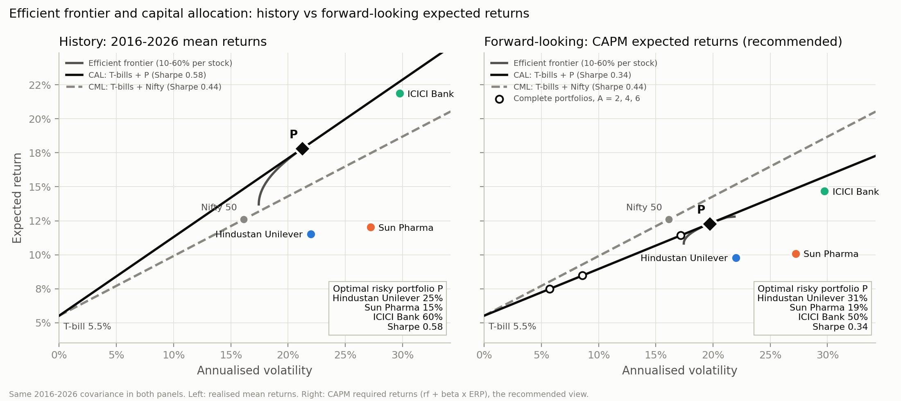
31 · 19 · 50, SIZED TO EACH INVESTOR
06 - PORTFOLIO
Forward-looking (CAPM) expected returns, 10–60% per stock. History alone would put 60% in last decade's winner.
87%
AGGRESSIVE · A = 2
E(r) 11.4% · σ 17.2%
Certainty equivalent 8.5%
IN P
44%
BALANCED · A = 4
E(r) 8.5% · σ 8.6%
Certainty equivalent 7.0%
IN P
29%
CONSERVATIVE · A = 6
E(r) 7.5% · σ 5.7%
Certainty equivalent 6.5%
IN P
SHARPE 0.34 vs 0.44
Three stocks don't beat the index on risk-adjusted terms, so the SIP pairs them with a Nifty core. Out of sample (2023–26): forward P +7.9%/yr, Nifty +7.4%, history-based P +3.2%.
Notes:
[1:30] Now the portfolio. On history alone, the optimiser puts the maximum 60% in ICICI, because it was the last decade's winner. That's hindsight. So we use forward-looking CAPM returns and get 31% HUL, 19% Sun Pharma, 50% ICICI Bank. Here's the honest part: that portfolio's Sharpe ratio is 0.34, below the Nifty's 0.44. Three stocks can't beat the market's diversification, which is why the long-term plan keeps a Nifty core. Then each of us sizes it with the utility function: with A of 2 you put 87% in P; with 4, 44%; with 6, 29%. The rest goes to T-bills. Out of sample, weights fitted on 2016 to 2022 earned 7.9% a year from 2023, against 7.4% for the Nifty and 3.2% for the history-based weights, with the caveat that we chose Sun Pharma after its run.

Slide 8
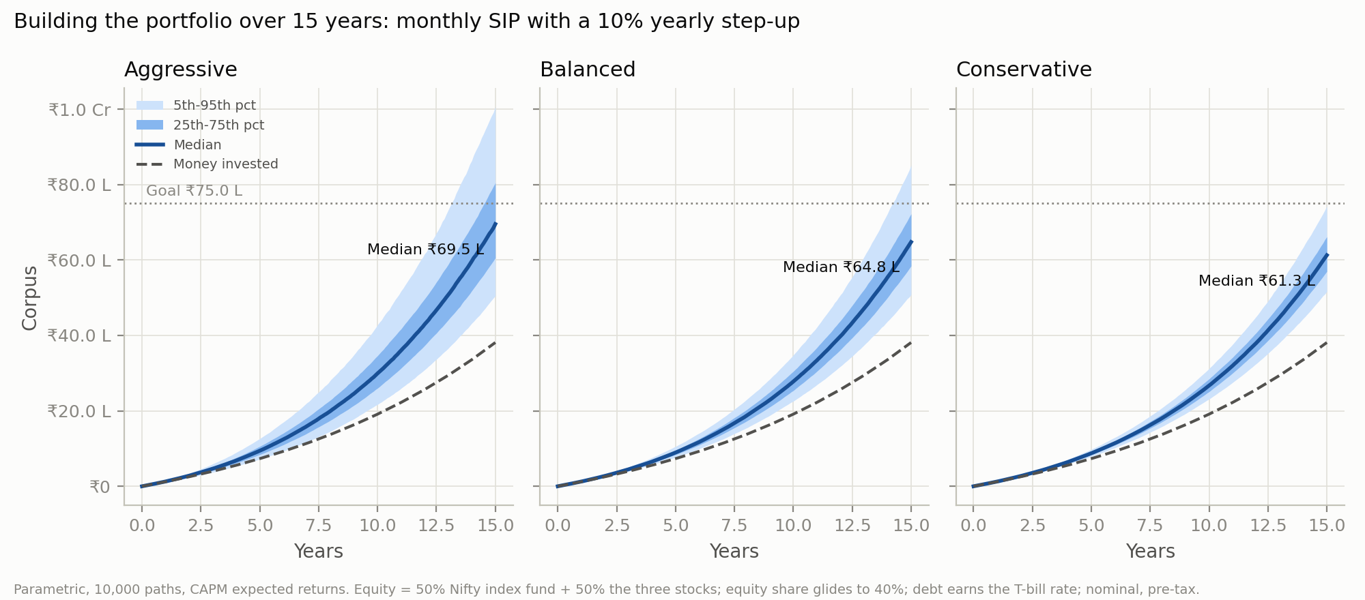
OVER THE YEARS
07 - THE LONG GAME
₹38.1 lakh
₹64.8 lakh
19% / 11%
INVESTED (10% STEP-UP A YEAR)
MEDIAN CORPUS, BALANCED
CHANCE OF ₹75 LAKH (TWO MODELS)
₹10,000 a month for 15 years, under our Investment Policy Statement.
RETURN
Beat 4% inflation clearly; target ₹75 lakh
RISK
Balanced (A = 4) unless the questionnaire says otherwise
LIQUIDITY
6 months of expenses kept outside the portfolio
REBALANCE
Once a year, with new SIP money first
BEHAVIOUR
No selling in the month after a 20% fall
50% Nifty 50 index fund + 50% our three stocks, gliding to 40% equity. Parametric and bootstrap Monte Carlo, 10,000 paths, pre-tax. Aggressive: 36% / 29% chance of ₹75 lakh.
Notes:
[1:00] How do you build this over the years? A ten-thousand-rupee SIP rising 10% a year puts in ₹38.1 lakh over 15 years. Half goes to a Nifty index fund and half to our three stocks, and equity glides down to 40% as the goal nears. For a balanced investor the median outcome is ₹64.8 lakh. The chance of reaching 75 lakh is 19% with normal returns and 11% when we resample real history. Our investment policy statement adds the discipline: an emergency fund outside the portfolio, yearly rebalancing with new money, and behavioural rules, starting with no selling in the month after a 20% fall.

Slide 9
OUR CALL
08 - RECOMMENDATION
BUY THE PORTFOLIO SLOWLY, THROUGH THE SIP
Range: our blended value to the analysts' mean target.
Good businesses at full prices: own them, but let monthly buying average the entry price.
HINDUSTAN UNILEVER
RISKS WE ARE WATCHING
BUY
01
CONCENTRATION ICICI is 50% of the weight but 57% of the risk.
₹1,592–2,396 · price ₹1,862
02
VALUATION Today's prices assume 7.4% to 13.9% growth a year, for ever.
SUN PHARMA
HOLD
03
REGULATION Proposed caps on trade margins for anti-cancer drugs (Sun Pharma).
₹1,225–2,174 · price ₹1,760
LIMITATIONS
ICICI BANK
One risk-free rate for 2016–26 · Nifty total return estimated (+1.22%/yr dividends) · Sun Pharma chosen after its run · pre-tax, no fees · coursework, not investment advice.
HOLD
₹857–1,747 · price ₹1,351
Notes:
[1:00] So, our recommendation. HUL: buy; our models call it fairly valued. Sun Pharma and ICICI Bank: hold. Our models say they are expensive and analysts say they are cheap, so add only through the SIP, never as a lump sum. Each range runs from our blended value to the analysts' mean target. The risks we are watching: ICICI is half the weight but 57% of the risk; drug-price regulation for Sun Pharma; and all three prices assume growth for ever. The limitations are on the slide, and every number here is live on our dashboard. Thank you.

Slide 10
METHODS AND ASSUMPTIONS
APPENDIX A1 - METHODS
Every number in this deck is computed from these choices; the code is in our GitHub repository.
Item | Choice | Source
Prices | Daily adjusted closes from 2016; HUL demerger (Dec 2025) adjusted | Yahoo Finance; NSE special pre-open
Risk-free rate | 5.52%, 91-day T-bill | RBI, 1 Oct 2026
Equity risk premium | 7.08% (India) | Damodaran, 5 Jan 2026
Benchmark | Nifty 50 price index + 1.22%/yr estimated dividends | Nifty BeES vs index gap, 2016–2026
Valuation | Two-stage DDM (HUL); two-stage residual income (Sun Pharma, ICICI); peer multiples; r × g grids | workbook/valuation.xlsx
Optimisation | Maximum Sharpe ratio, 10–60% per stock, CAPM expected returns (rf + β × ERP) | scipy SLSQP
Complete portfolio | y* = (E[rP] − rf) / (Aσ²), capped at 100%; A = 2, 4, 6 | BKM Ch 6
Monte Carlo | 10,000 paths, 1 year; normal (Cholesky), 10-day block bootstrap, EWMA λ = 0.94 | numpy, seed 42
SIP | ₹10,000/month, +10%/yr, 15 years; 50% Nifty core; glide to 40% equity | Pre-tax, no fees
AI | FinBERT sentiment; Claude for extraction, aspects and headline tagging | docs/ai_prompts.md
Notes:
Backup slide for questions on method.

Slide 11
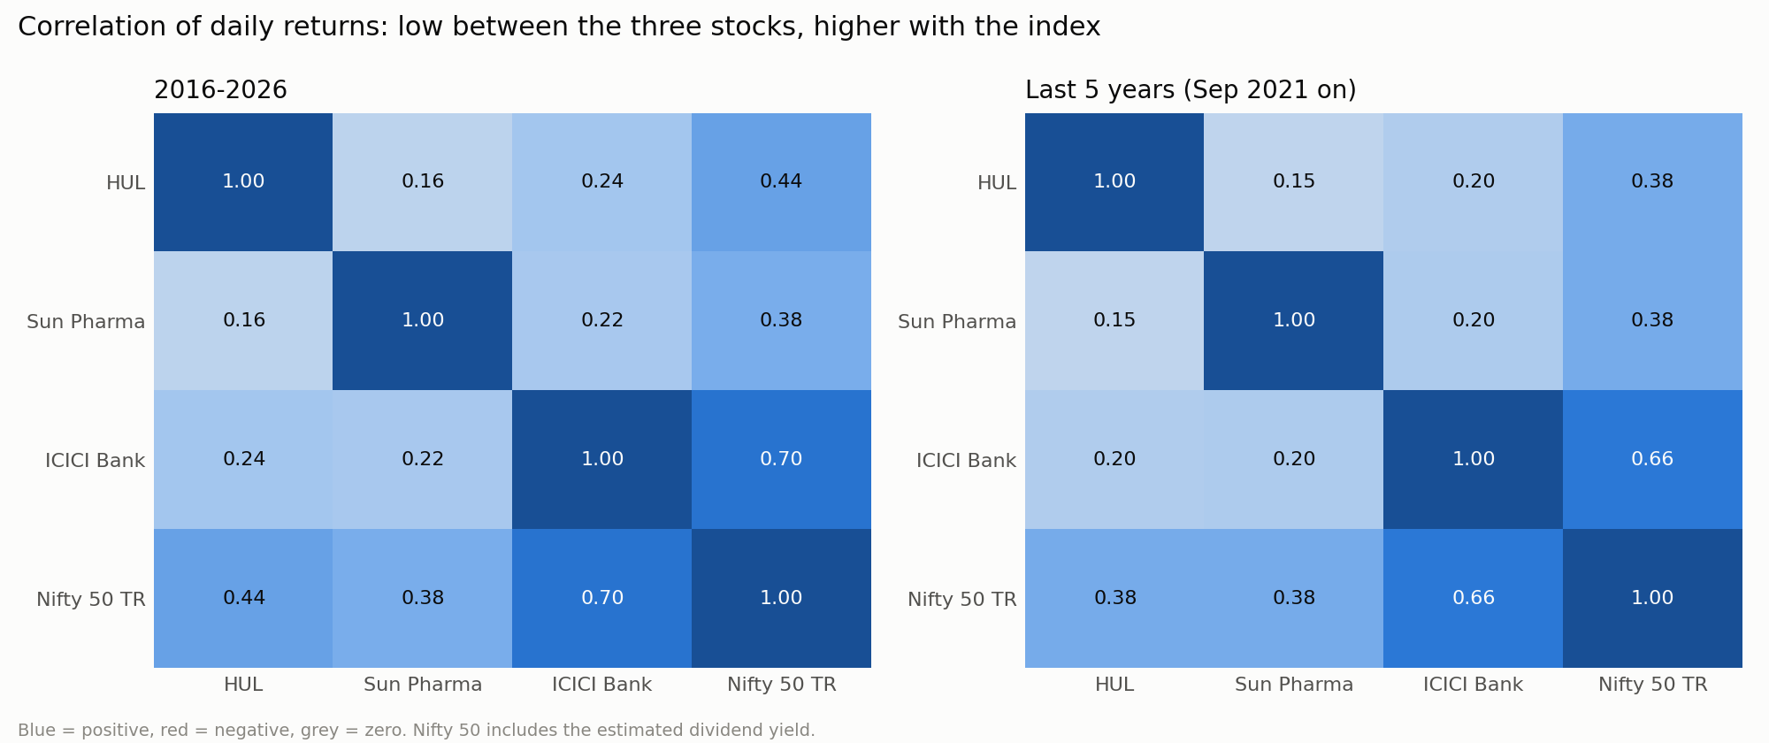
WHERE THE RISK SITS
APPENDIX A2 - RISK
Correlations of daily returns, and what happened to the portfolio in four real sell-offs.
Episode | Our P | Nifty 50
COVID crash (Feb-Mar 2020) | −34.6% | −37.2%
Rate-hike sell-off (Jan-Jun 2022) | −12.3% | −16.1%
Election-result shock (4 Jun 2024) | −2.3% | −5.9%
2026 drawdown (02 Jan 2026 to 13 Oct 2026) | −5.1% | −13.7%
32%
11%
57%
Our portfolio fell less than the Nifty in 4 of 4 episodes.
HUL
SHARE OF PORTFOLIO RISK
SUN PHARMA
SHARE OF PORTFOLIO RISK
ICICI BANK
SHARE OF PORTFOLIO RISK
Notes:
Backup slide: correlation, risk contribution and stress tests.

Slide 12
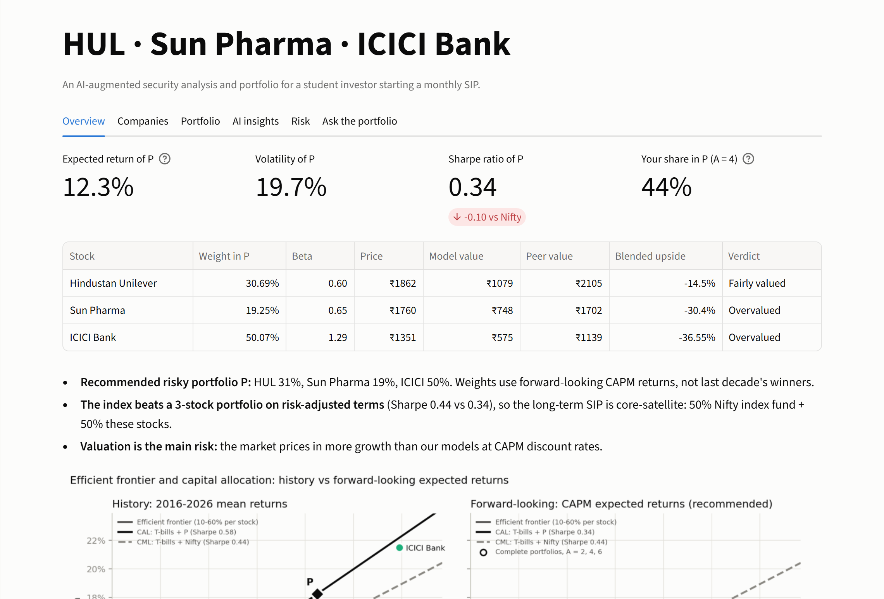
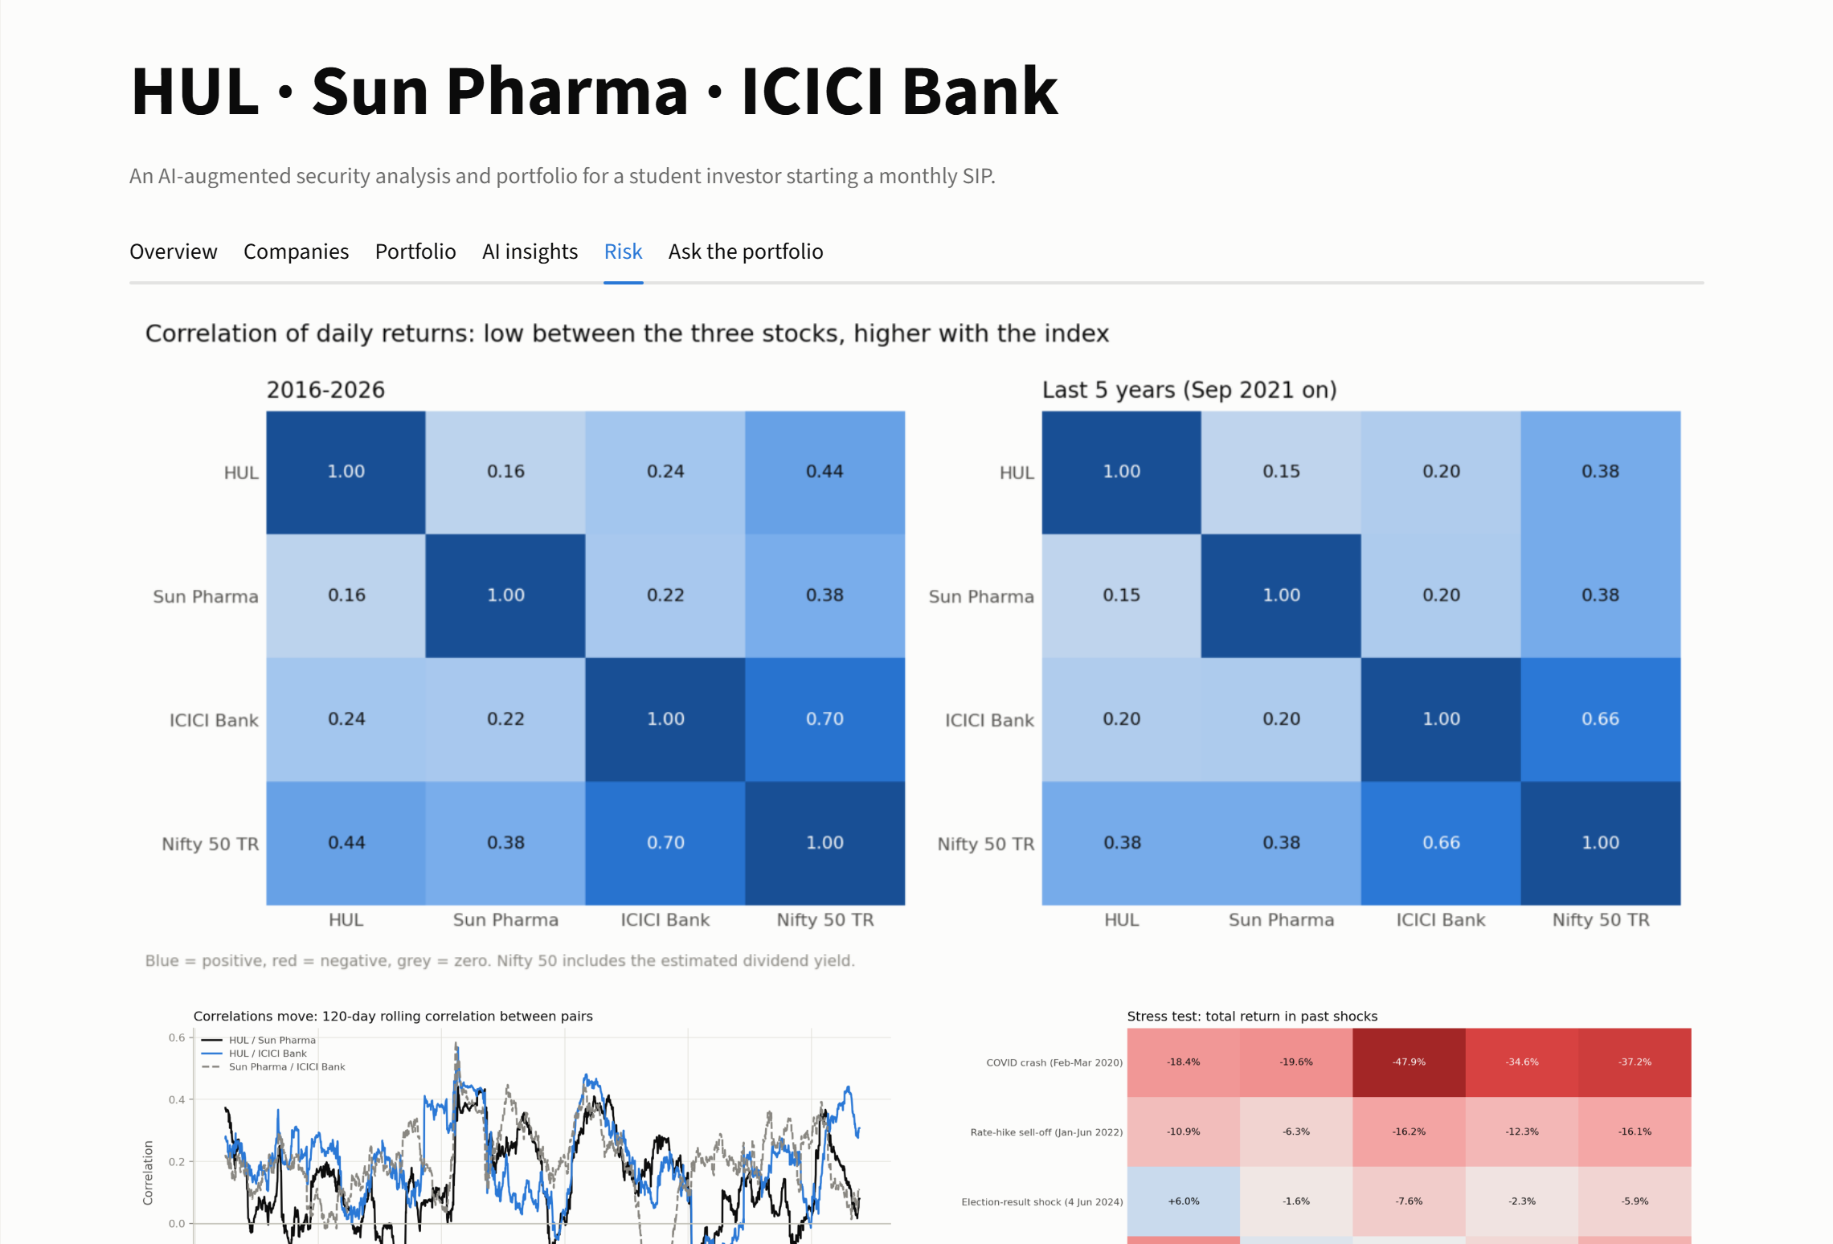
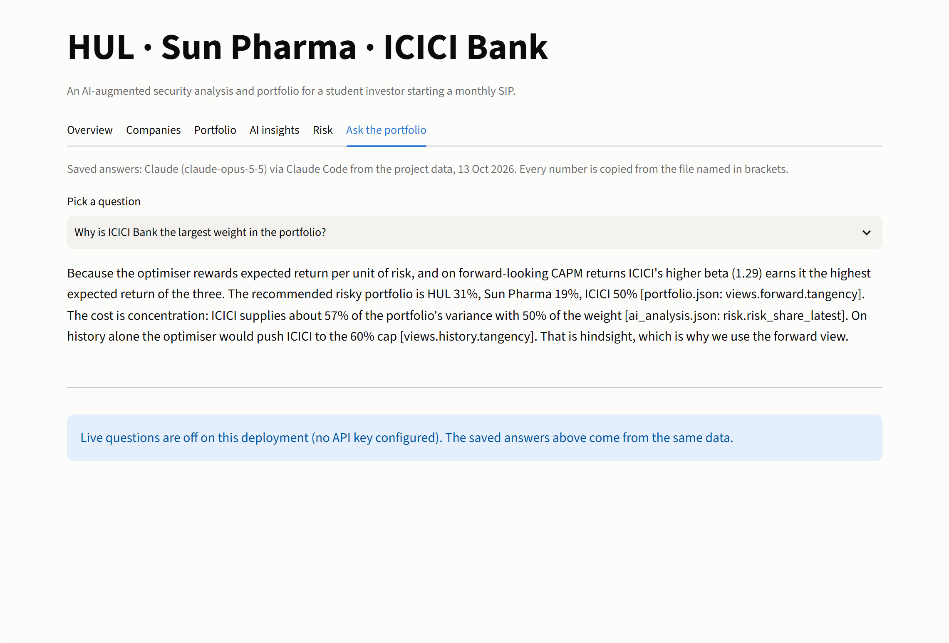
THE DASHBOARD, IF THE DEMO FAILS
APPENDIX A3 - DEMO BACKUP
Rung 4 of the backup ladder: the same screens as the live demo.
OVERVIEW: P, VALUATION, VERDICTS
RISK: HEATMAPS AND STRESS
ASK THE PORTFOLIO: SAVED ANSWERS
Notes:
Use only if the live link, the local copy and the recorded walkthrough all fail.

Slide 13
DATA SOURCES AND AI PROMPTS
APPENDIX A4 - SOURCES
Free and public sources only; every AI prompt is saved with its output.
DATA
AI AND METHOD
Prices, statements, analyst consensus: Yahoo Finance (yfinance)
Ten-year financials: Screener.in public pages
Annual reports and earnings-call transcripts: BSE filings and company IR sites
Risk-free rate and repo rate: Reserve Bank of India
GDP and demand mix: MOSPI press note, 31 Aug 2026
Equity risk premium: Damodaran, India, Jan 2026
Headlines: Google News RSS, 12 months
Sector momentum: Zerodha Aftermarket Report, 12 Oct 2026
FinBERT: ProsusAI/finbert (Hugging Face)
Claude (Anthropic): ratio extraction, concall aspects, headline tagging
Prompts P1–P5 and outputs: docs/ai_prompts.md, data/ai/
Bodie, Kane & Marcus, Investments: Ch 6, 7, 12, 17, 18, 24
Valuation workbook: workbook/valuation.xlsx (live formulas)
Code, tests and the nightly refresh: GitHub repository
Notes:
Backup slide: sources.

