Slide 1
BEHAVIOUR-AWARE PORTFOLIO CONSTRUCTION
PYTHON PROJECT (BBAT5E07) · TAPMI · PROF. JINU SARA
ONE FILE: PYTHON_PROJECT.PY
1,108
LINES OF PYTHON
14
How much of an investor's money should go into HUL, Sun Pharma and ICICI Bank, given how much risk that investor can bear?
NUMBERED SECTIONS
21
Abhay S (246213044)
Sankarshana Mulugundam (246213080)
AUTOMATED TESTS AGAINST THE REAL PIPELINE AND EXCEL
DATA FROZEN ON 13 OCT 2026
Notes:
[Abhay · 0:20] Our project answers one business question: how much money should an investor put into a portfolio of three Indian stocks, given how much risk they can bear? All of the code is in one Python file. Our tests check that it reproduces the numbers from our Excel workbook and our larger pipeline.

Slide 2
FROM ANSWERS AND PRICES TO RUPEES
01 - PROBLEM AND DATA
EXAMPLE OUTPUT
A = 4
The input is ten questionnaire answers and an amount. The output is a rupee split and a measure of risk.
BALANCED INVESTOR, ₹1,00,000
PRICES AND RETURNS
Daily, Jan 2016 to 13 Oct 2026: Parquet files built with yfinance
HUL
₹13,382
Sun Pharma
₹8,394
VALUATION INPUTS
workbook/valuation.xlsx, read cell by cell with openpyxl
ICICI Bank
₹21,833
T-bills
₹56,392
SETTINGS
config.yaml: risk-free rate, simulation sizes, SIP terms
One-year 95% VaR: ₹5,582
TEXT
2,428 headlines scored by FinBERT; PDFs read with pypdf
Notes:
[Abhay · 0:40] The program reads four kinds of data: price and return files, the inputs from our Excel valuation workbook, a settings file, and text. It takes an investor's ten questionnaire answers and an amount, and gives back a rupee split. A balanced investor with one lakh holds ₹21,833 of ICICI, for example, and the rest as shown, with a one-year 95% Value at Risk of ₹5,582.

Slide 3
FOUR STAGES, AS PLANNED IN OUR PROPOSAL
02 - COMPUTATIONAL THINKING
Each stage shaped how the file is organised.
DECOMPOSITION
PATTERN RECOGNITION
ABSTRACTION
ALGORITHM DESIGN
Split one question into smaller ones: load and validate data; measure risk; value each stock; score the investor; optimise; simulate; report.
Volatility, correlation and beta in returns. Every valuation model has the same shape: cash flows plus a terminal value.
Keep only what the decision needs. An Investor is a name, A, an amount and a SIP. A Security is a beta, a return and a volatility.
Recursive bisection for implied growth; merge sort and binary search for outcomes; Cholesky for correlated simulation.
IN THE CODE
14 sections, each one job
IN THE CODE
The shared base class
IN THE CODE
Three small classes
IN THE CODE
Each checked another way
Notes:
[Abhay · 0:45] We followed the four computational-thinking stages from our proposal. Decomposition: one large question became smaller ones, which is why the file has fourteen sections. Pattern recognition: every valuation model is cash flows plus a terminal value, and that repeated shape became a base class. Abstraction: an investor needs only a name, a risk-aversion number, an amount and a SIP. And algorithm design: each algorithm is checked against a second method, which you will see next.

Slide 4
EVERY COURSE CONCEPT, MAPPED TO THE FILE
03 - WHERE EACH CONCEPT LIVES
The same map sits at the top of python_project.py. Each concept does real work in the project.
Concept | Section | What it does in the project
Variables, numbers, strings | 1 | Settings; Indian-style rupee formatting
Files and exceptions | 2 | JSON, YAML, CSV, Parquet, PDF; a clear DataError
Functions, Pandas | 3 | Returns, Sharpe, beta, Treynor, Jensen's alpha
Decisions, loops, dictionaries | 4, 10 | Questionnaire scoring; trading-rule signals
Classes | 5 | Security, Investor, Portfolio
Inheritance, recursion | 6 | ValuationModel and two subclasses; recursive PV, bisection
Sorting and searching | 7 | Merge sort, binary search, grid search
SciPy | 8 | Maximum Sharpe weights, efficient frontier
NumPy | 9, 10 | Cholesky Monte Carlo, block bootstrap, EWMA, SIP
Sets, Transformers, pypdf, yfinance | 2, 11 | Hedge words, FinBERT, PDF text, price download
Matplotlib, Seaborn | 12 | Frontier, fan chart, correlation heatmap
Streamlit | 14 | A small interactive demo in the same file
Notes:
[Abhay · 0:40] This is the map of the file, and it's the same list at the top of the code. Every topic in the course outline appears here, and each one does real work rather than being a separate exercise. Sections 5, 6 and 7 are the ones we'll show you in code, because they are the core of the course.

Slide 5
ONE BASE MODEL, TWO SUBCLASSES
04 - CLASSES AND INHERITANCE
The base class holds discounting and the reverse solve. A subclass only says what its cash flows are.
class DividendDiscountModel(ValuationModel):
def __init__(self, name, price, r, g2, n, d0: float, g1: float):
super().__init__(name, price, r, g2, n)
self.d0, self.g1 = d0, g1
def cash_flows(self) -> list[float]:
flows, dividend = [], self.d0
for year in range(1, self.HORIZON + 1):
dividend *= 1 + (self.g1 if year <= self.n else self.g2)
flows.append(dividend)
return flows
def terminal_value(self) -> float:
return self.cash_flows()[-1] * (1 + self.g2) / (self.r - self.g2)
ValuationModel (ABC)
present_value, implied_growth
DividendDiscountModel
HUL: pays out most of its profit
ResidualIncomeModel
Sun Pharma, ICICI Bank
BUSINESS ENTITIES
Security (dataclass): ticker, beta, return, volatility
Investor: A, amount, SIP; from_answers classmethod
Portfolio: checks weights sum to 1; complete, allocation, ranked
present_value and implied_growth are not written here: both come from the base class.
Notes:
[Abhay · 1:00] Inheritance is justified here because the models really do share logic. The base class, ValuationModel, is abstract: it discounts cash flows and solves for implied growth, and it refuses bad inputs such as a discount rate below growth. Each subclass only says what its cash flows are. Here is the dividend model: dividends grow at g1 for the first n years, then at g2, and the terminal value uses Gordon growth. HUL uses this one, because it pays out most of its profit. Sun Pharma and ICICI use residual income. We also have three business classes: a Security, an Investor that can be built from questionnaire answers with a class method, and a Portfolio that checks its weights sum to one.

Slide 6
TWO RECURSIVE FUNCTIONS, EACH CHECKED BY ALGEBRA
05 - RECURSION
Each has a base case and a smaller problem. Each result is compared with a closed-form formula and the Excel workbook.
def present_value(flows: list[float], r: float, t: int = 1) -> float:
if not flows: # base case: nothing left to discount
return 0.0
return flows[0] / (1 + r) ** t + ValuationModel.present_value(flows[1:], r, t + 1)
def implied_growth(self, low, high, tol):
gap_low = self.single_stage_value(low) - self.price
middle = (low + high) / 2
if high - low < tol: # base case: the range is small enough
return middle
if gap_low * (self.single_stage_value(middle) - self.price) <= 0:
return self.implied_growth(low, middle, tol)
return self.implied_growth(middle, high, tol)
BASE CASE
An empty list of cash flows is worth 0. For bisection, a range narrower than 1e-10 is the answer.
SMALLER PROBLEM
One fewer cash flow, one year later. Bisection halves its range on every call.
Stock | Class | Value | Implied growth
HUL | Dividend | ₹1,079.12 | 7.41%
Sun Pharma | Residual income | ₹747.63 | 8.63%
ICICI Bank | Residual income | ₹574.65 | 13.89%
PROOF
A test asserts recursive value = closed form = Excel, and bisection = algebra.
Notes:
[Abhay · 1:00] Recursion appears twice. The present value of a list of cash flows is the first flow discounted, plus the present value of the rest. The base case is an empty list. Then bisection: what growth rate makes the model equal the market price? We take the middle of a range, see which half contains the answer, and call the function again on that half. About 35 calls reach a width of one in ten billion. A loop would work too, so why trust it? Because we check each one: the recursive value equals the closed-form formula and our Excel workbook, and bisection equals the algebra. The results for all three stocks are in the table.

Slide 7
BAD DATA STOPS THE PROGRAM, WITH A CLEAR MESSAGE
06 - DATA STRUCTURES, FILES, EXCEPTIONS
We never fill a gap with a guess. A missing file or column raises DataError, which names the file and the fix.
def read_returns(path: Path, needed: list[str]) -> pd.DataFrame:
try:
table = pd.read_parquet(path)
except FileNotFoundError as err:
raise DataError(f"{path} not found; run the pipeline first") from err
missing = [c for c in needed if c not in table.columns]
if missing:
raise DataError(f"{path} lacks columns {missing}")
gaps = int(table[needed].isna().sum().sum())
if gaps:
raise DataError(f"{path} has {gaps} missing values in {needed}")
return table[needed]
DICTIONARY
QUESTIONS maps each question to its kind, text and five options
LIST
The answers for capacity and for willingness, kept separately
SET
HEDGE_WORDS: fast lookup of cautious words like may, might, could
A missing file is caught, not ignored: ...does_not_exist.parquet not found; run the pipeline first
Bad inputs are refused: Bad input: the discount rate 5.00% must exceed terminal growth 6.00%
Notes:
[Abhay · 0:40] Financial data is messy, so we decided that bad data should stop the program rather than be filled with a guess. This function reads a returns file and raises our own DataError if the file is missing, a column is missing, or there are gaps. The file reads JSON, YAML, CSV, Parquet, Excel and PDF, each with its own error handling. The data structures are chosen for a reason: a dictionary for the questionnaire, lists for the answers, and a set for hedge words because lookup in a set is fast. The two messages at the bottom are real output.

Slide 8
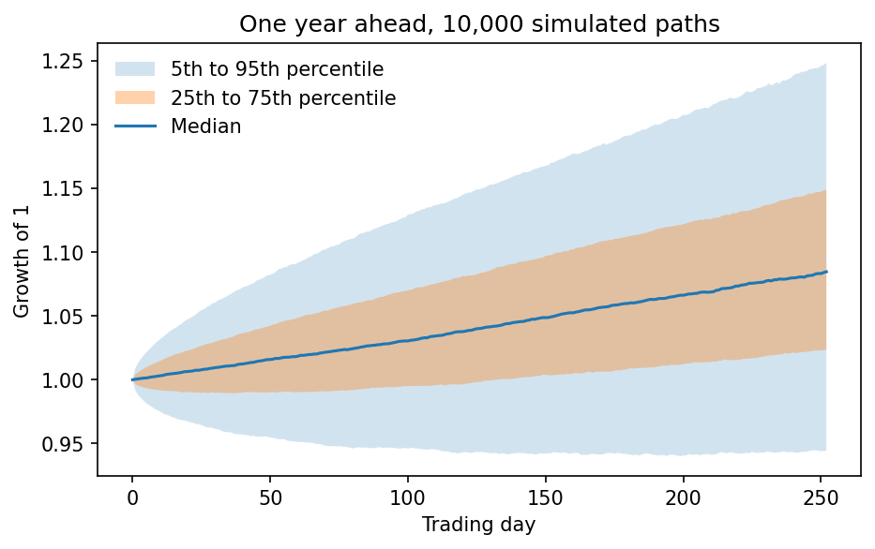
10,000 SIMULATED YEARS, WITHOUT A PYTHON LOOP
07 - NUMPY
Monte Carlo: Cholesky keeps the correlation between the stocks; arrays do the work on every path at once.
def simulate_normal(mu, cov, n_sims, horizon, rng):
chol = np.linalg.cholesky(cov)
return rng.standard_normal((n_sims, horizon, len(mu))) @ chol.T + mu
def wealth_paths(risky_returns, y, rf_period):
growth = np.cumprod(1 + y * risky_returns + (1 - y) * rf_period, axis=1)
return np.hstack([np.ones((risky_returns.shape[0], 1)), growth])
₹1,08,463
₹5,582
₹5,465
MEDIAN AFTER ONE YEAR, ₹1 LAKH, A = 4
95% VaR, NORMAL RETURNS
95% VaR, BLOCK BOOTSTRAP
Half of all paths end between ₹1,02,377 and ₹1,14,860.
Cholesky: split the covariance matrix so that cov = L Lᵀ. Independent draws multiplied by L have the correlations we measured.
Type hints trimmed to fit the slide.
Notes:
[Sankarshana · 1:00] Now the simulation. We need thousands of possible futures in which the three stocks move together realistically. Independent random numbers wouldn't do that, so the Cholesky factor of the covariance matrix turns them into correlated returns. Because these are NumPy arrays of shape paths by days by stocks, one line handles all 10,000 paths at once. The wealth function compounds each path, with a share y in the portfolio and the rest in T-bills. We also resample real history in blocks, which keeps fat tails. On one lakh, the 95% Value at Risk is ₹5,582 with normal returns and ₹5,465 with the bootstrap.

Slide 9
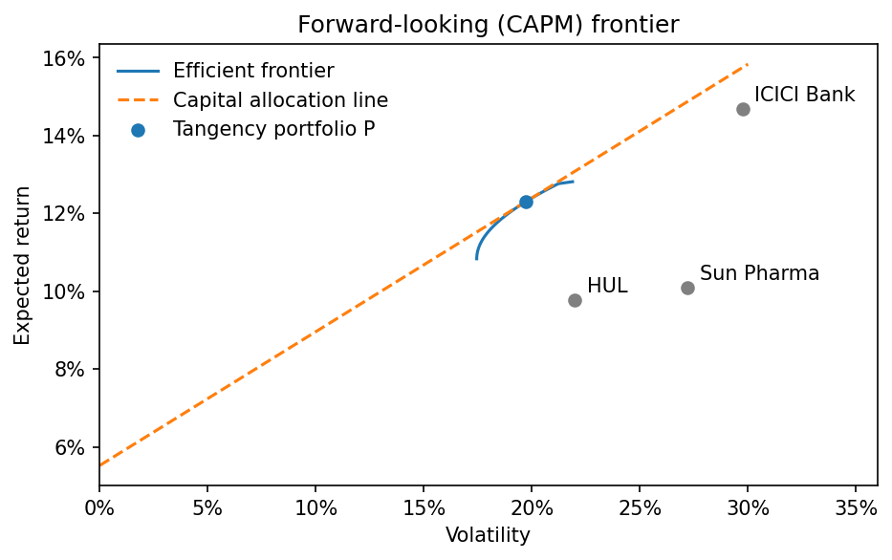
THE OPTIMISER, CHECKED BY BRUTE FORCE
08 - SCIPY
SciPy finds the maximum-Sharpe weights within 10–60% limits. A separate grid search on every 1% mix finds the same portfolio.
def max_sharpe_weights(mu, cov, rf: float, bounds=WEIGHT_BOUNDS) -> np.ndarray:
mu, cov = np.asarray(mu), np.asarray(cov)
return _optimise(lambda w: -(w @ mu - rf) / np.sqrt(w @ cov @ w), len(mu), bounds)
def _optimise(objective, n: int, bounds, constraints=()) -> np.ndarray:
all_constraints = [{"type": "eq", "fun": lambda w: w.sum() - 1.0}, *constraints]
result = minimize(objective, np.full(n, 1.0 / n), method="SLSQP", bounds=[bounds] * n,
constraints=all_constraints, options={"ftol": 1e-12, "maxiter": 500})
SCIPY SLSQP
1% GRID SEARCH
31 / 19 / 50
31 / 19 / 50
Sharpe 0.3436
Same portfolio, found by trying every mix
Then y* = (E[rP] − rf) / (Aσ²) sizes it for each investor: 87% at A = 2, 44% at A = 4, 29% at A = 6. The rest goes to T-bills.
Notes:
[Sankarshana · 0:40] SciPy's minimize function solves the constrained problem: maximise the Sharpe ratio, with weights that sum to one and stay between 10 and 60 percent. It gives 31, 19, 50. How do we know it worked? We wrote a plain grid search that tries every mix at 1% steps. It's slow, but it's easy to trust, and it finds the same portfolio. Then the formula on the slide sizes it for each investor using their risk aversion.

Slide 10
RANKING 10,000 OUTCOMES, FINDING WHAT MATTERS
09 - SORTING AND SEARCHING
Merge sort ranks the outcomes. Binary search then finds how many end below ₹1 lakh.
def merge_sort(items: list, key=lambda x: x) -> list:
if len(items) <= 1:
return list(items)
middle = len(items) // 2
left, right = merge_sort(items[:middle], key), merge_sort(items[middle:], key)
merged, i, j = [], 0, 0
while i < len(left) and j < len(right):
if key(left[i]) <= key(right[j]):
merged.append(left[i])
i += 1
else:
merged.append(right[j])
j += 1
return merged + left[i:] + right[j:]
def binary_search(ordered, value):
low, high = 0, len(ordered)
while low < high:
middle = (low + high) // 2
if ordered[middle] < value:
low = middle + 1
else:
high = middle
return low
Each step halves the list: about 14 steps. Scanning it could take 10,000.
WORST THREE
BEST THREE
BELOW ₹1 LAKH
₹78,719, ₹79,877, ₹80,171
₹1,46,320, ₹1,46,757, ₹1,47,604
17.1% of paths
Merge sort checked against sorted() on 2,000 paths; sorted() ranks all 10,000. A = 4, ₹1 lakh, one year. Type hints trimmed.
Notes:
[Sankarshana · 0:40] A risk manager cares about the tails, so we sort the simulated outcomes. Merge sort is recursive: sort each half, then merge them. We wrote it ourselves and check it against Python's sorted on 2,000 paths, then use Python's sorted for all 10,000, since a pure-Python recursive sort is slower. On the sorted list, binary search halves the range each step, so it finds how many of the 10,000 paths end below one lakh in about fourteen steps. The answer is the figure on the right. We also use sorted with a key to rank securities by Sharpe ratio.

Slide 11
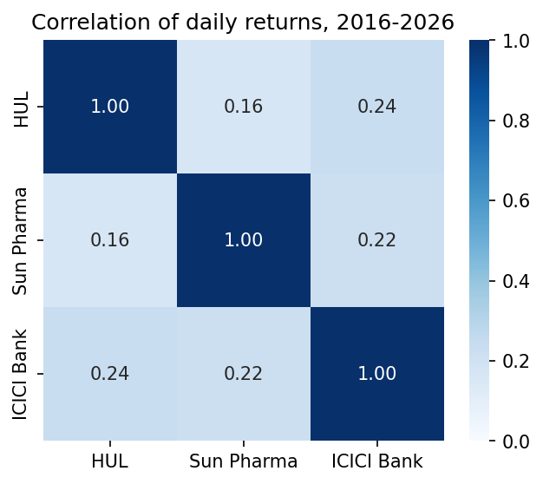
EACH LIBRARY HAS ONE JOB
10 - LIBRARIES
Heavy libraries are imported inside the function that needs them, so the file still starts on a machine that lacks one.
Library | Job
Pandas | Load, align and summarise returns; metrics tables
Matplotlib | Efficient frontier and Monte Carlo fan chart
Seaborn | Correlation heatmap
yfinance | Fresh prices (--fetch)
Transformers (FinBERT) | Financial tone of a sentence (--finbert)
pypdf | Text from annual reports and transcripts (--pdf)
openpyxl | Excel valuation inputs, cell by cell
Streamlit | Interactive demo on one screen
requests | Optional live answers through OpenRouter
Notes:
[Sankarshana · 0:30] Each library has one clear job. Pandas handles the tables, Matplotlib and Seaborn draw the charts, like this heatmap, yfinance downloads prices, FinBERT reads tone, pypdf reads reports and Streamlit gives us the demo. One design choice: the heavy libraries are imported inside the function that needs them, so the file still runs on a machine that doesn't have them all.

Slide 12
THE SAME PORTFOLIO, SIZED THREE WAYS
11 - RESULTS
On ₹1 lakh for one year, then a ₹10,000 monthly SIP rising 10% a year for 15 years. Simulated; not investment advice.
AGGRESSIVE · A = 2
BALANCED · A = 4
CONSERVATIVE · A = 6
87%
44%
29%
IN THE THREE STOCKS
IN THE THREE STOCKS
IN THE THREE STOCKS
Expected return
11.4%
Expected return
8.5%
Expected return
7.5%
Volatility
17.2%
Volatility
8.6%
Volatility
5.7%
95% VaR on ₹1 lakh
₹16,138
95% VaR on ₹1 lakh
₹5,582
95% VaR on ₹1 lakh
₹1,940
Chance of loss
28%
Chance of loss
17%
Chance of loss
10%
15-year SIP median
₹69.5 lakh
15-year SIP median
₹64.8 lakh
15-year SIP median
₹61.3 lakh
Notes:
[Sankarshana · 0:40] Here is what the program tells three different investors. They all hold the same mix of stocks, 31, 19, 50, because that is the best risky portfolio for everyone. What changes is how much of it they hold: 87%, 44% or 29%. This is the separation property from finance, and it's also a nice software result: one Portfolio object, three Investor objects.

Slide 13
21 TESTS: HOW WE KNOW THE CODE IS RIGHT
12 - TESTING
Because this file is self-contained, it could quietly drift from the rest of the project. The tests stop that.
SAME ANSWERS
SECOND METHODS
BAD INPUTS
Valuations equal the Excel workbook
Metrics and weights equal the pipeline's files
Simulations reproduce mc.json and sip.json exactly
Trading rules match the pipeline's
Recursion and bisection equal closed forms
Grid search finds SciPy's optimum
Own merge sort equals Python's sorted
Questionnaire equals the dashboard's
Discount rate below growth is refused
Weights not summing to 1 are refused
A blank Excel cell gives a clear error
Missing and broken files raise DataError
python -m pytest tests/test_python_project.py 21 passed
Notes:
[Sankarshana · 0:30] We have 21 automated tests in three groups. First, the file must give the same answers as our Excel workbook and our main pipeline, down to the rupee. Second, each algorithm is checked by a different method. Third, bad inputs must fail with a clear message. We'll run them live in the demo.

Slide 14
FOUR COMMANDS
13 - LIVE DEMO
Everything runs on the frozen data, so the screen matches these slides.
01
python python_project.py
The full tour: each section prints its result next to the pipeline's, marked OK
02
python python_project.py --charts out/
Saves the Matplotlib and Seaborn charts
03
streamlit run python_project.py
Move A from 4 to 2: the share in P goes from 44% to 87%
04
python -m pytest tests/test_python_project.py
21 tests, in a few seconds
IF A COMMAND FAILS Show the saved output and charts in deliverables/assets/python, and keep going.
Notes:
[Both · 1:30] DEMO: Abhay drives the terminal; Sankarshana explains. (1) Run the tour and point at the OK marks against Excel and the pipeline. (2) Save the charts and open one. (3) Start Streamlit, move A from 4 to 2, and show the rupee split and VaR changing, then open Portfolio.complete in the editor to show the formula. (4) Run pytest. If asked to explain any function, open it in the editor; docs/python_walkthrough.md has the function map and likely questions.

Slide 15
AI ASSISTANCE, AND WHAT CHANGED FROM THE PROPOSAL
14 - HONEST NOTES
We list what differs from the approved proposal, and why, so nothing is hidden.
Proposal said | The project does | Why
FINRA NCFS investor microdata | A 10-question questionnaire (capacity and willingness) | It sets A for one investor directly; we did not calibrate it on NCFS
Loughran–McDonald word lists | A small hedge-word set of the same kind | Keeps the file self-contained; it is not the full list
NSE total-return index | Nifty 50 price plus an estimated 1.22% a year | Estimated from the gap between Nifty BeES and the index
Anthropic SDK (optional) | A free model through OpenRouter (optional) | No cost for a live demo; every number still comes from our files
AI ASSISTANCE
Claude helped write and review this code. We checked it by running it, by testing it against Excel and the pipeline, and by reading it until we could explain each function; docs/python_walkthrough.md is our map. This is coursework, not investment advice.
Notes:
[Abhay · 0:30] Two honest notes before we finish. First, four things differ from our proposal, and the table says what and why. Second, we used AI to help write and review this code. That is why we built so many independent checks, and why we made sure each of us can explain each function. Thank you, and we'd welcome your questions.

