Slide 1
Web-site development
Using Adaptive Layout
Vladimir Getmantsev
Beograd, MB University
2022

Slide 2
If you enjoy the tools you use, then the job will be done successfully.
- Donald Ervin Knuth

Slide 3
Contents
Task statement
Technologies in use
Theory
Project structure
Conclusion

Slide 4
Task statement
Learn the principles of creating an Adaptive Layout.
Understand how to work with Cascade Style Sheets (CSS) and how to apply them
Get acquainted with SASS
Learn the basics of JavaScript and DOM

Slide 5
Theory
DOM, SASS
Adaptive layout

Slide 6
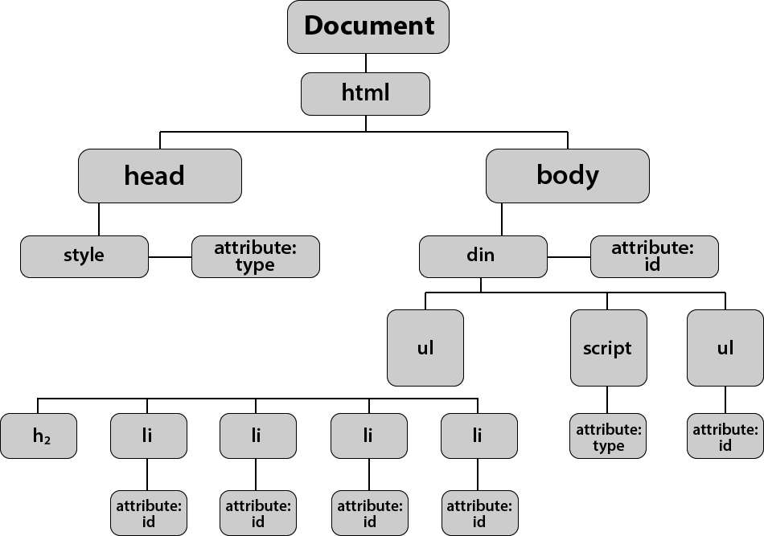
DOM — Document Object Model
DOM is an object model of a document that the browser creates in the computer's memory based on the HTML code it received from the server.
Such a tree is necessary for the correct display of the site and making changes to the pages using JavaScript

Slide 7




Visual Studio Code
Vanilla JavaScript
VS Code is a code editor, which is used for building and debugging applications, especially web-applications. It’s suitable for many languages and free for use.
Vanilla JS is a pure JavaScript without any type of additional libraries. It’s one of the lightest solutions for non-complex web-development.
Figma
Figma is an application for interface design, which has a rich selection of vector graphics editor and prototyping tools.
CSS + SASS
SASS is a metalanguage, based on the CSS and is used for simplifying yet extending CSS usage.
Git & GitHub
Git is free and open source software for distributing version control.
GitHub is based on Git and is used for hosting remote project repositories. Although it provides to users an abilities of a social network.
HTML
HTML is the standart markup language for Web pages.

Slide 8



Adaptive Layout methods
Responsive Layout
Fluid Layout
Adaptive Layout (MediaQueries)
Page layout is build with both relative units of measurement and CSS media queries.
Which implies using the advantages of both a "liquid" and an adaptive layout.
It uses relative units of measurement in CSS styles instead of fixed ones. Typically, "liquid" template layouts use
percentages instead of pixels.
The page uses CSS media queries to determine the width of the browser and change the page layout accordingly.

Slide 9
SASS
01
Preprocessing
03
Variables
When we have to deal with a huge CSS, SASS helps us to structurize our work with using nested code, mixines and other nice things
Variables work as a way to store information that you want to use throughout the writing of all project styles. You can store colors, font stacks, or any other CSS values you want to use.
04
And others
In one hand CSS has a clear nested and visual hierarchy, on the other hand, doesn't. Sass will let you nest your CSS selectors in a way that follows the same visual hierarchy of your HTML. Be aware that overly nested rules will result in over-qualified CSS that could prove hard to maintain and is generally considered bad practice.
02
Nesting

Slide 10



01 Explore the prototype
02 Create a layout and set up styles
Figma allows designers to divide your project into blocks and layers. Thus it would be useful for developer to understand and follow the project structure.
You can start from making a Static Layout. Then enhance it with applying an Adaptive Layout approaches. In conclusion set up adaptive styles and animations.
03 Add a script
JS script wil allow you to change styles and animations, as well as respond to changes in the web-page scale.

Slide 11
Project
How & why

Slide 12
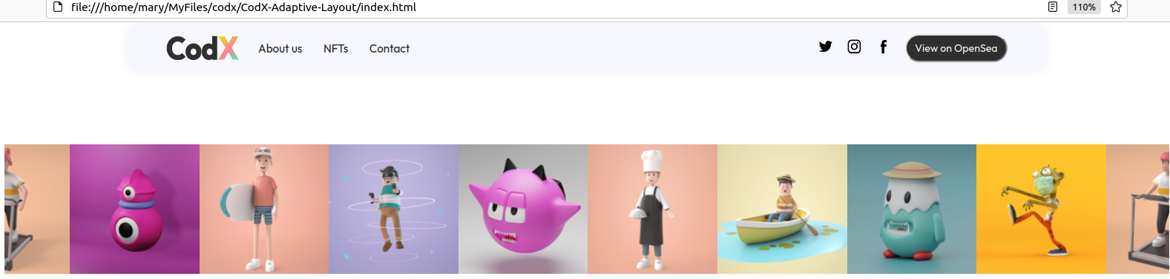
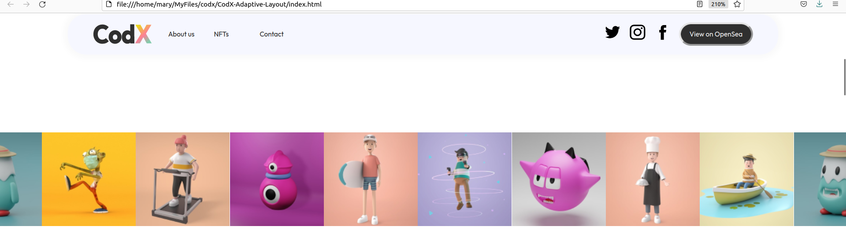
Resin Layout allows to keep static size to images, no matter hom much scaled the web-page was.

Slide 13
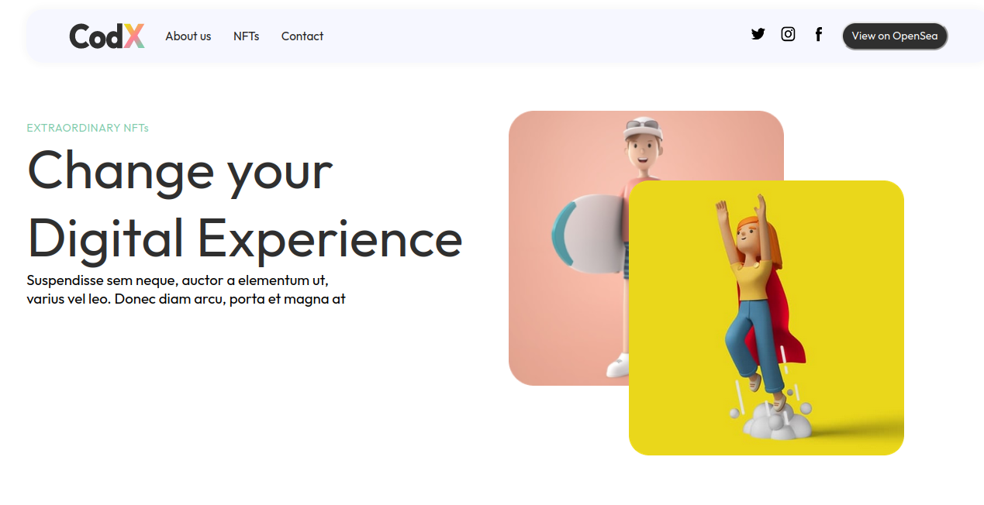
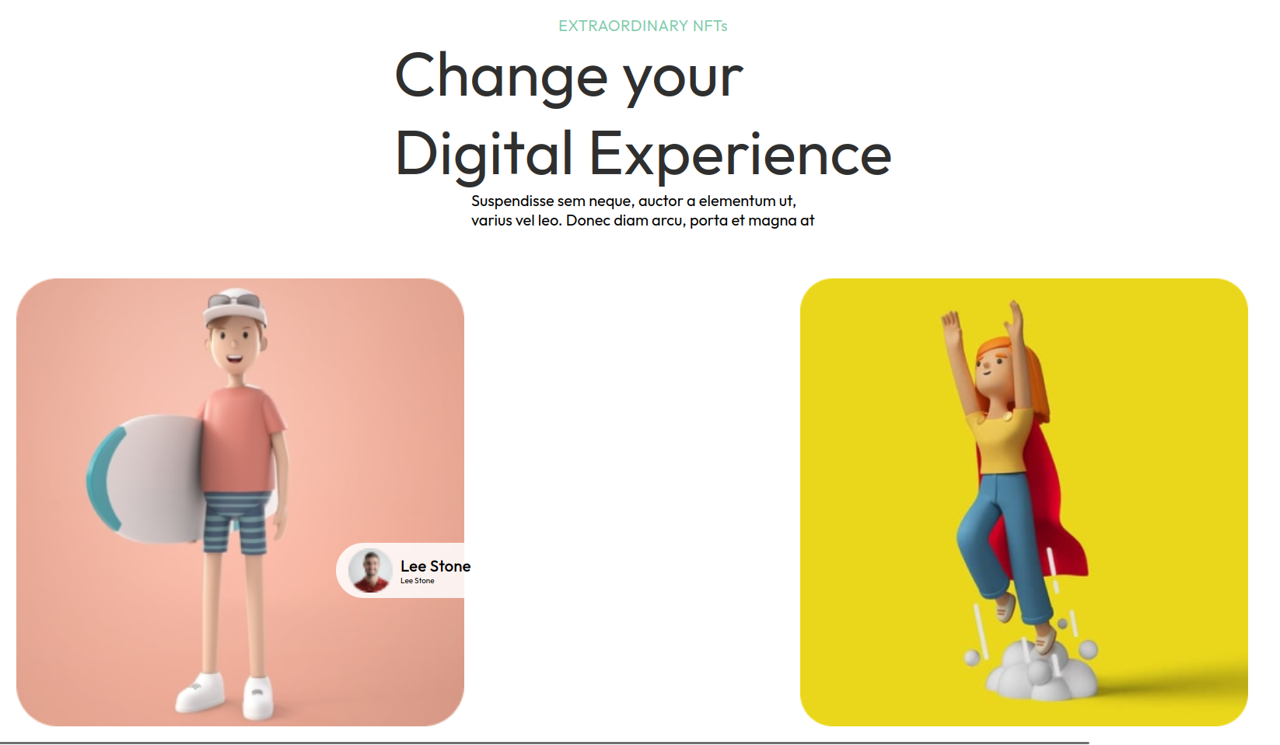
Scaling the web-page leads to the changing of images position.
It works due to a Responsive Layout

Slide 14
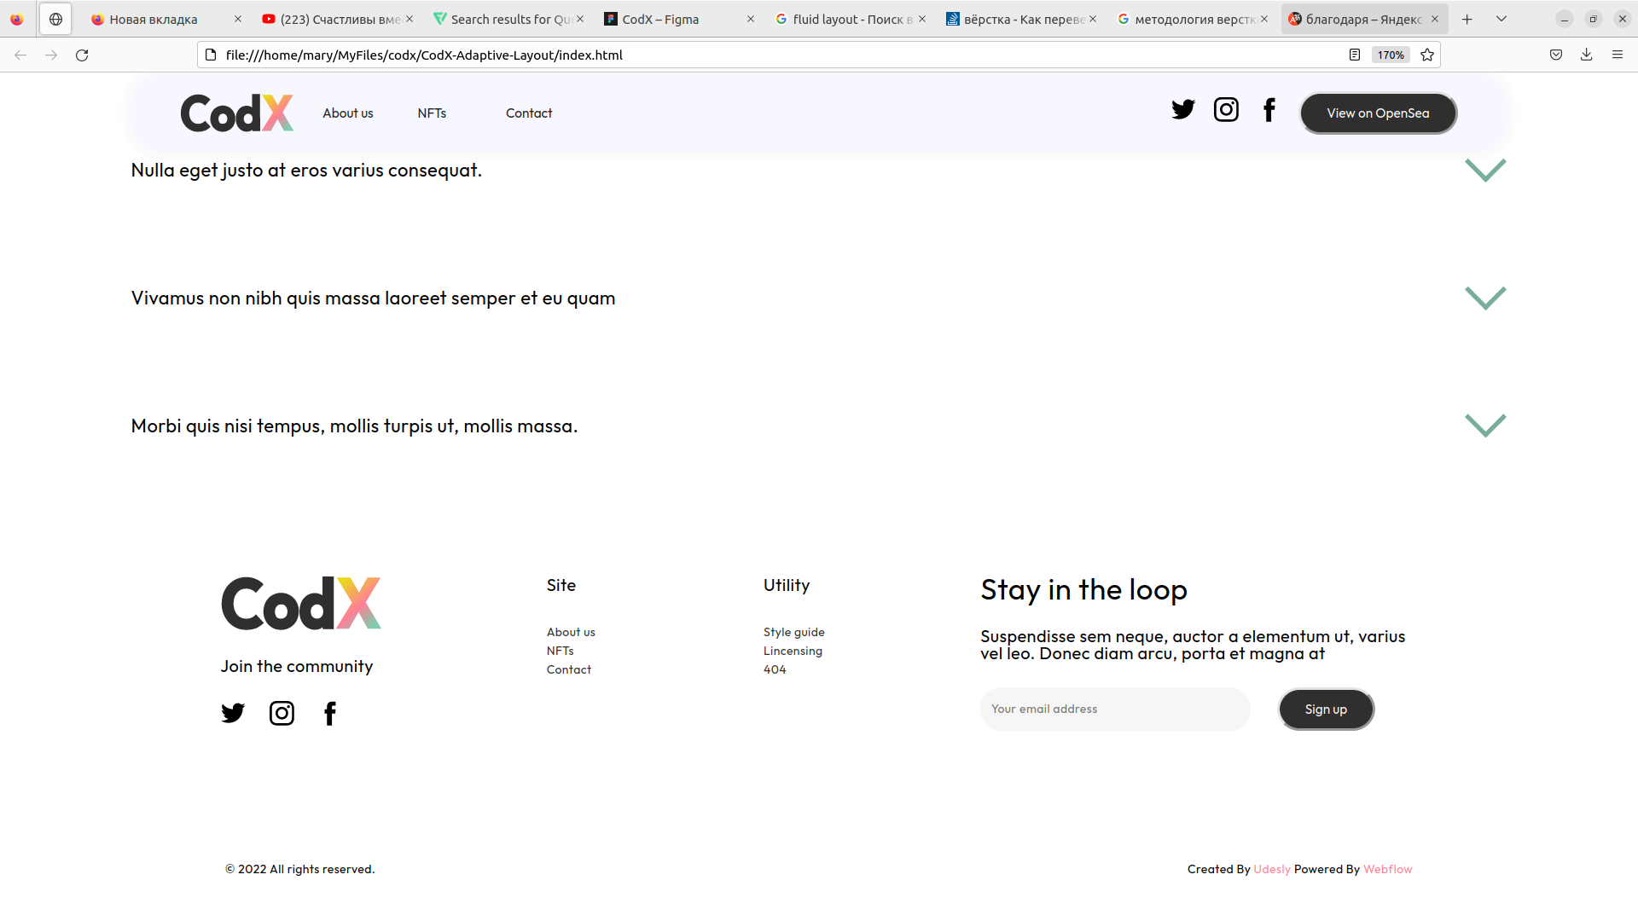
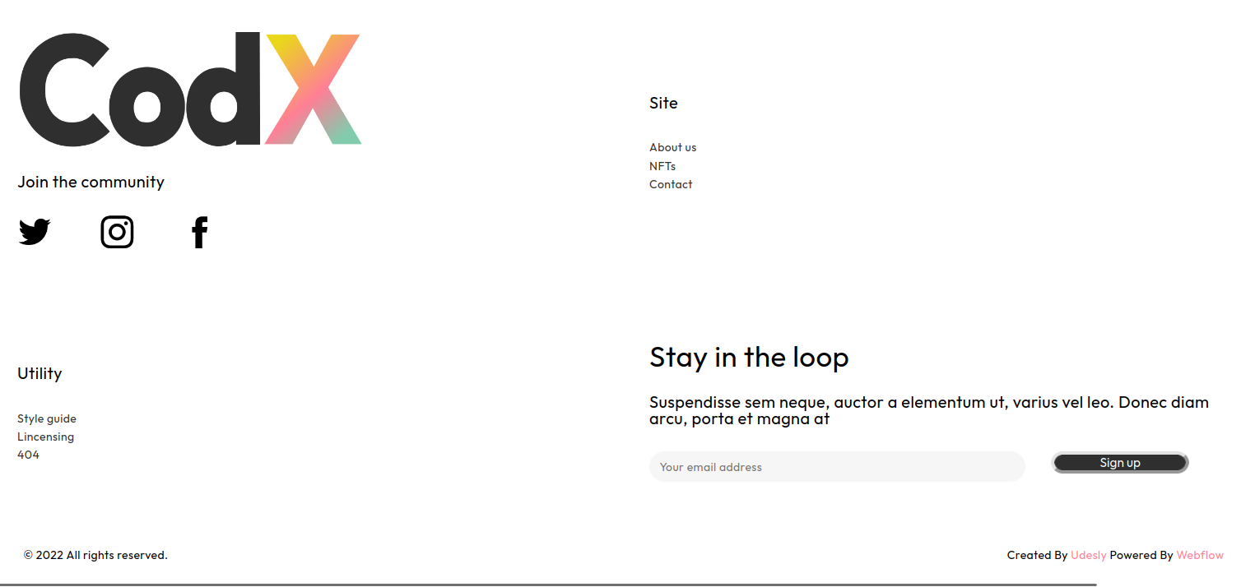
Grid Layout allows to place the content inside the cells and keep the structure of the grid.

Slide 15

Conclusion
Every tag is an object, due to DOM
Adaptive Layout uses Responsive, Fluent and MediaQueries methods and combine them
SASS is used to ease CSS implementing
Native JavaScript can easily manipulate all kinds of HTML elements, change and modify their styles, connect logic to them.

Slide 16
END OF
PRESENTATION
SLIDE: 16
THANK YOU FOR YOUR ATTENTION

