Slide 1
CIS 103 Fundamentals of Programming
Basic Python Programming Part 1
08/30/2024
Professor Ali

Slide 2
Program and Modules
Module (can be more than one)
  A file of python code
  We’ve seen the main module
Script
  Short program

Slide 3
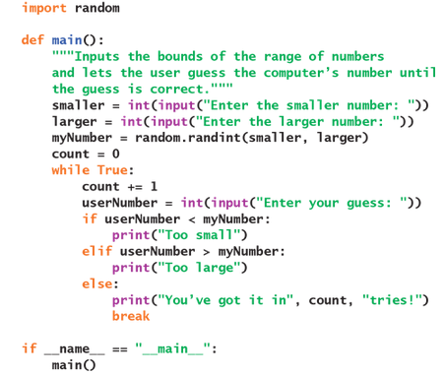
Guessing a Number Example

Slide 4
Program Comments
Text ignored by python
# This is a comment
Why are they useful?

Slide 5
Lexical Elements
Words or symbols used to construct sentences
Python’s basic symbol (e.g. if, while, and def)
Identifiers (names), literals (numbers, strings, etc.), operators, and delimiters (quotation marks, commas, parentheses, square brackets, and braces)

Slide 6
Spelling and Naming Conventions
Variable
  salary, hoursWorked, isAbsent
Constant
  ABSOLUTE_ZERO, INTEREST_RATE
Function or method
  printResult, cubeRoot, input
Class
  BankAccount, SortedSet

Slide 7
Syntactic Elements
Types of sentences
  Expressions
  Statements
  Definitions
Python
  Spaces
  Tabs
  Link breaks

Slide 8
Literals
Numbers (integers or floating-point numbers) are written as they are in other programming languages. The Boolean values True and False are keywords. Some data structures, such as strings, tuples, lists, and dictionaries, also have literals, as you will see shortly.

Slide 9
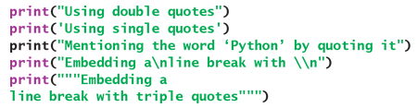
String Literals

Slide 10
Operators and Expressions
Standard Operators
+, -, *, /, %
**
<, <=, >, >=, ==, !=
and, or, not
[ ]

Slide 11
Function Calls
Functions are called with their name and then parentheses around them
min(num_1, num_2)
min(5, 2)

Slide 12
The `print` Function
The standard output function print displays its arguments on the console. This function allows a variable number of arguments. Python automatically runs the str function on each argument to obtain its string representation and separates each string with a space before output. By default, print terminates its output with a newline.

Slide 13
The `input` Function
The standard input function input waits for the user to enter text at the keyboard. When the user presses the Enter key, the function returns a string containing the characters entered. This function takes an optional string as an argument and prints this string, without a line break, to prompt the user for the input.

Slide 14

Type Conversation and Mixed Mode Operations

Slide 15
Variables and Assignment Statements
<identifier> = <expression>
PI = 3.1416
minValue, maxValue = 1, 100
a, b = b, a
x = 5

Slide 16
Python Data Typing
Any variable can name a value of any type
Data type names almost never appear in Python programs
Don’t have to worry about data types when writing code

Slide 17
`import` Statements
import math
from math import sqrt
  print(sqrt(2))
from math import pi, sqrt
  print(sqrt(2) * pi)

Slide 18

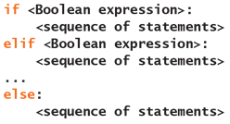

Conditional Statements
if, elif, and else

Slide 19
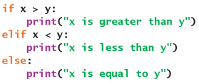
Conditional Statements

Slide 20
Using if __name__ == “__main__”
The purpose of the if statement
This is good for standalone programs modules
Larger programs can use good idioms

