Slide 1
CIS 120 – Introduction to Computer Applications
Technology for Success: Computer Concepts
CIS Department Olive-Harvey College
Professor Ali
08/27/2024

Slide 2
Impact of Technology
Reliance on Technology
  Digital Literacy
  What is a computer?
  Data
  Hardware
  Software

Slide 3
A Bit of History
First Generation of Computers
  Used Vacuum Tubes
  ENIAC
Second Generation of Computers
  Transistors
  Many components still used today e.g. tape, disk storage, memory, operating system, programs.

Slide 4
A Bit of History
1960s
  Integrated Circuits
  Microprocessors (Brains aka CPU)
1970s and 1980s
  Personal Computers (PC)

Slide 5
IoT (Internet of Things)
What is IoT?
Tagged, tracked, and monitored through local networks or the internet
Embedded Computer
  One component in a larger product
Any Examples of IoT?

Slide 6
AI, VR, and Digital Divide
What is AI?
What is VR?
  AR?
Digital Divide
  Who has access and those that do not

Slide 7
Various Roles of Technology Professionally
K-12, Higher Educations
Healthcare
Transportation Industry
Manufacturing

Slide 8
Technology Careers
Software and Apps
Technology Equipment
IT Departments
Technology Service and Repair
Technology Sales
Technology Education, Training, and Support
IT Consulting
System Development
Web Marketing and Social Media
Data Storage, Retrieval, and Analysis
Information and System Security

Slide 9
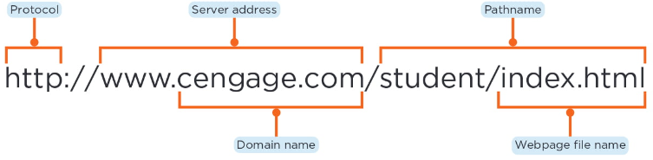
The Web
What does WWW stand for?

Slide 10
The Web
Top-Level Domains
  .biz
  .com
  .edu
  .gov
  .int
  .mil
  .mobi
  .net
  .org
  ,pro

Slide 11
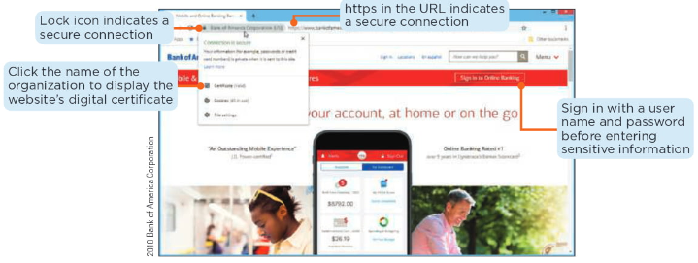
The Web
Secure Websites versus Insecure Websites

Slide 12
The Web
E-Commerce
  Business-to-Consumer
    Involves the sales of goods and services to the general public
    Shopping websites
  Consumer-to-Consumer
    Occurs when one consumer sells directly to another
    Online auctions
  Business-to-Business
    Consists of businesses providing goods and services to other business
    Market research websites

Slide 13
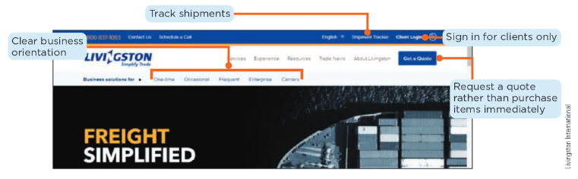
B2B Website

Slide 14
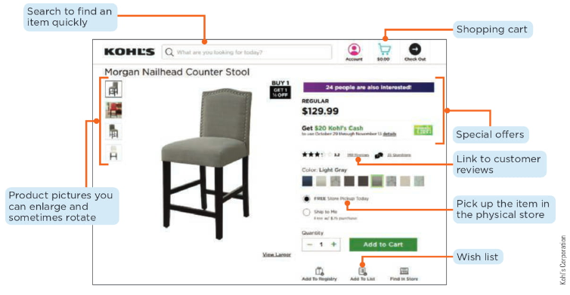
B2C Website

Slide 15
Search Engines
General Search Engines
  Google, Bing, Yahoo, Yandex, etc.
How do you get the results back?
  Spiders or crawlers
  Index

Slide 16
Computer Hardware
CPU (Central Processing Unit)
ALU (Arithmetic Logic Unit)
RAM (Random Access Memory)
  DRAM, SRAM, MRAM, Flash Memory
ROM (Read Only Memory)
Storage

Slide 17
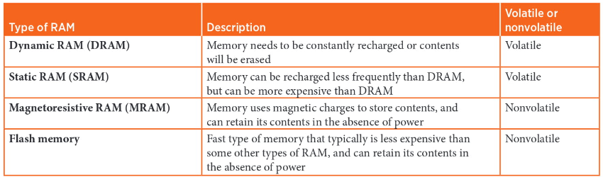
Types of RAM

Slide 18
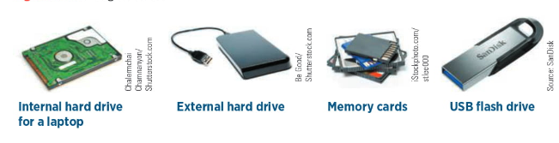
Storage Devices

Slide 19
Storage Solutions
Internal
  Hard Drives
  Solid State Drives (SSD)
External
  External Hard Drives
  Optical Media
  USBs
Cloud-Based
  Amazon, Azure, GCP

Slide 20
Different Types of Computers Pros and Cons
Desktop Computer
All-in-One Computer
Laptops
Mobile Device
Tablet

Slide 21
Operating Systems
Windows
MacOS
Linux
Andriod
Apple iOS
Let’s look at some vendors

Slide 22
Evaluating System Requirements
Processor Requirements
  Identify programs or applications that need a certain threshold
Memory Requirements
  4GB is great for basic web browsing, 32GB is used for reality applications, gaming, and other intensive tasks
Storage Requirements
  This is a personal choice
Hardware Requirements
  This is also a personal choice

Slide 23
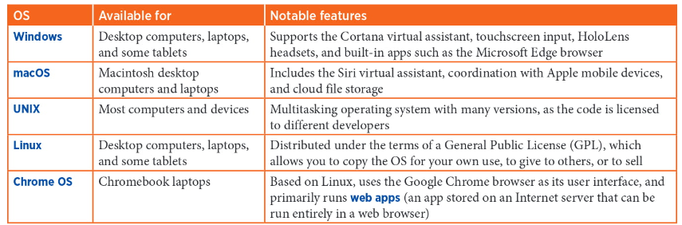
Operating Systems

Slide 24
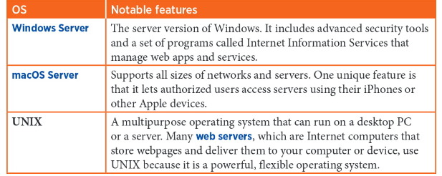
Server Operating Systems

Slide 25
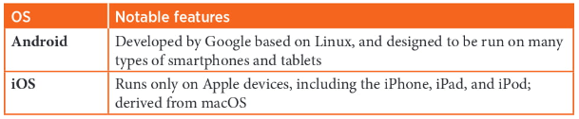
Mobile Operating Systems

Slide 26
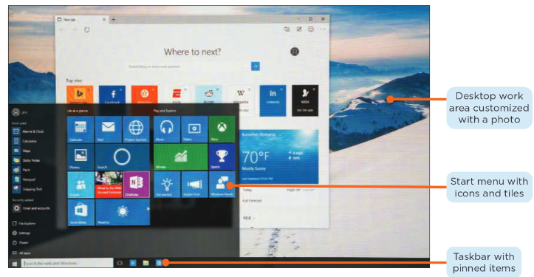
Windows 10

Slide 27
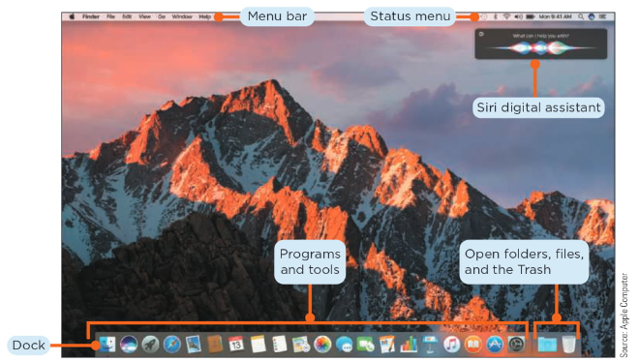
MacOS

Slide 28
Common File Extensions
Microsoft Office
  .docx (Word), .xlsx (Excel), .pptx (PowerPoint)
Text Files
  .txt, .rtf
Webpages
  .htm, .html, .xml, .asp, .aspx, .css
Graphics
  .jpg, .png, .tif

Slide 29
Four Programs We Will Be Using
Word
PowerPoint
Excel
Access

Slide 30
Mircosoft Products
What is Word?
What is PowerPoint?
What is Excel?
What is Access?
Before next class, please download the all of these products.

