Slide 1
COMPSFI 101 – Networking Essentials
Introduction to Networking
CIS Department Olive-Harvey College
Professor Ali
08/27/2024

Slide 2
What is a network?
A network is a group of computers and other devices (let’s think of some examples) that are connected by some type of transmission media. (Can you think of any other transmission methods?)
Discuss examples and transmission media

Slide 3
Some Examples
Devices
  Computers (PC, Mainframe, Servers)
  Smartphones
  Printers
  Phone Systems
  Security Cameras
  Vehicles
  Wearable Technology Devices
  IoT

Slide 4
Some Examples
Transmission Media
  Cooper Wires
  Fiber Optic Cables
  Radio Waves
  Microwaves
  Infrared
  Power Line Communication (PLC)

Slide 5
Network Models
Topology
  Physical Topology
    Network Hardware
    Devices, Cables, Wireless Signals
    How devices and cables fit together
  Logical Topology
    Software controls access
    Access to specific resources (e.g. applications, databases, etc.)
    Network resources and how resources are shared

Slide 6
Network Operating Systems (NOS)
Configuration
  P2P (Peer-to-Peer)
  Client-Server
NOS Examples
  Windows Server
  Ubuntu Server
  Red Hat Enterprise Linux (RHEL)

Slide 7
P2P (Peer-to-Peer) Network Model
Decentralized Control
  Shared Resources
  Devices are called nodes or hosts
Examples OS
  Windows, Linux, MacOS, ChromeOS on Desktops
  iOS, Andriod, ChromeOS

Slide 8
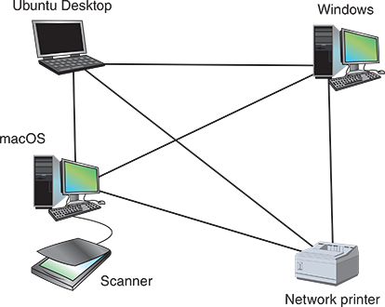
P2P (Peer-to-Peer) Network Model

Slide 9
P2P (Peer-to-Peer) Network Model
Shared files even if hosts are running different OS
Generally if < 15 computers, P2P networks are great
Think of any pros or cons for these networks?

Slide 10
P2P (Peer-to-Peer) Network Model
Pros
  Simple to configure
  Less Expensive
Cons
  Not Scalable
  Not Secure
  Not Practical for more than a few computers

Slide 11
Client-Server Network Model
Centralized Control
  Managed resources
  Devices are called nodes or hosts
Server
  Central, NOS
Client
  Don’t share resources, access from server

Slide 12
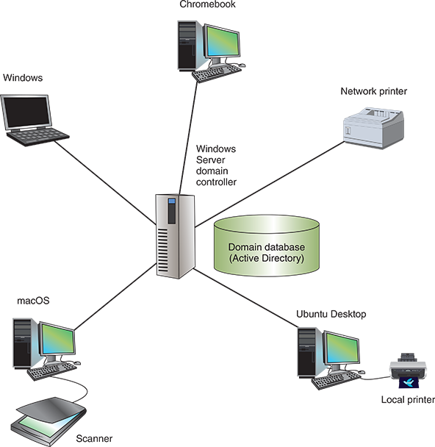
Client-Server Network Model

Slide 13
Client-Server Network Model
Windows Server
  Domain: Group of computers in a logical group
  Active Directory (AD): Centralized database that contains user account information and security for entire group of computers
  Active Directory Domain Services (AD DS): Management process for active directory and domains
Linux Server
  Ubuntu Server
  Red Hat Enterprise Linux (RHEL)

Slide 14
Client-Server Network Model
NOS (Networking Operating System)
  Require more memory (RAM)
  Require more storage
  Require more processing power
  Require more network bandwidth capacity
  Due to heavy processing from multiple clients
  RAID (redundant array of independent disks)

Slide 15
Client-Server Network Model
NOS (Networking Operating System) Responsibilities:
  Managing data and other resources for clients
  Ensuring that only authorized users access the network
  Controlling which types of files a user can open and read
  Restricting when and from where user can access the network
  Dictating which rules computers will use to communicate
  Supplying applications and data files to clients

Slide 16
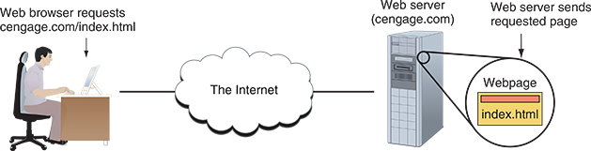
Network Services
Accessing “Resources”

Slide 17
Network Protocols
How does a client make a request anyways?
  Rules of communication (protocols)
  TCP (Transmission Control Protocol)
  UDP (User Datagram Protocol)
  IP (Internet Protocol)

Slide 18
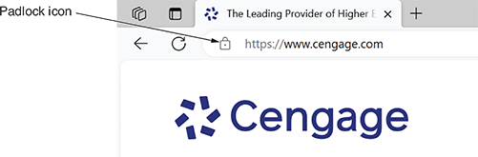
Network Protocols
Web Services
  HTTP (Hypertext Transfer Protocol)
  HTTPS, the ‘S’ is for secure (SSL or TLS)
  Apache
  Nginx

Slide 19
Network Protocols
Email services
  Sender uses SMTP (Simple Mail Transfer Protocol)
  Receiver uses one of two protocols
    POP3 (Post Office Protocol, v3)
      Email is downloaded to client and removed from server
    IMAP4 (Internet Message Access Protocol, v4)
      Email is kept on server, ideal for email accessed from multiple endpoints

Slide 20
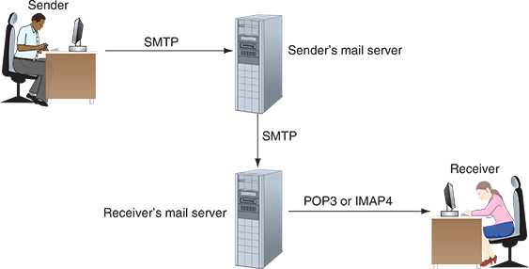
Network Protocols

Slide 21
Network Protocols
DNS (Domain Name Service)
  Helps clients find web servers (e.g. google.com or 8.8.8.8)
Database Services
  SQL Servers, Oracle Database, MongoDB
FTP (File Transfer Protocol) or FTPS (can you guess what the S stand for)
  FileZilla, CuteFTP

Slide 22
Network Protocols
Remote Access Services
  Telnet
  SSH (Secure Shell)
  RDP (Remote Desktop Protocol)
  Can you think of any remote services you might have used?

Slide 23
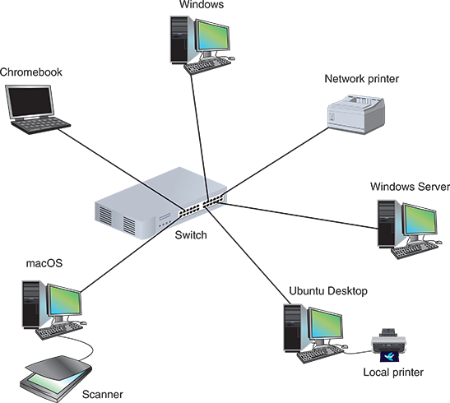
Network Hardware

Slide 24
Network Hardware
LANs (Local Area Networks)
  Usually for small spaces e.g. offices, buildings, etc.
Switch
  Incoming data from one of its ports to another or multiple ports
Star Topology
  Connected to one central device

Slide 25
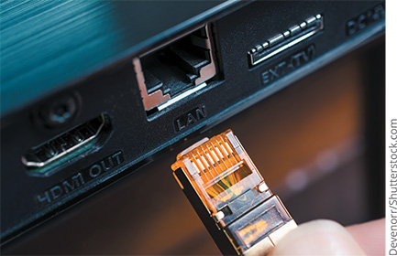
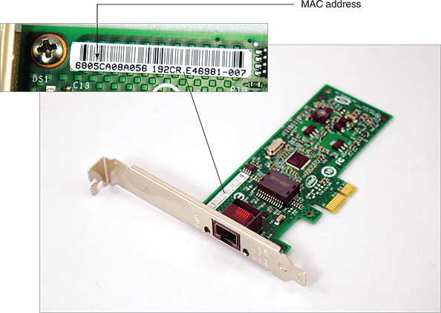
Network Hardware
WE NEED A NETWORK PORT!

Slide 26
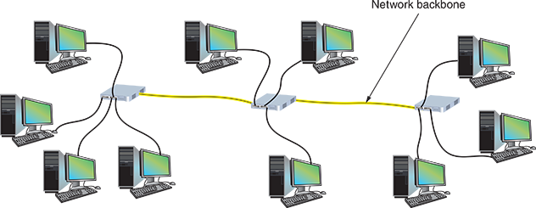
Network Hardware
Of course a LAN can have several switches.
  Bus Topology (Chaining switches by a single line)
  Hybrid Topology (Since each switch has it’s own computer)

Slide 27
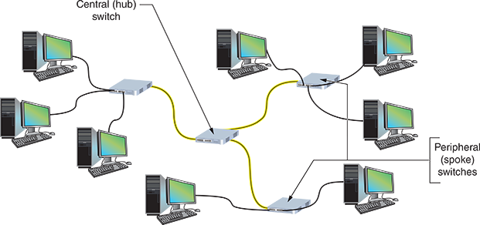
Network Hardware
Hub-and-Spoke Topology
  Central switch is called the hub and each peripheral switch is a spoke

Slide 28
Network Hardware
Routers and LANs
  LANs need to talk to the internet, this is where a router comes into play
Router
  Manages traffic between two or more networks and find the best path from each of the networks

Slide 29
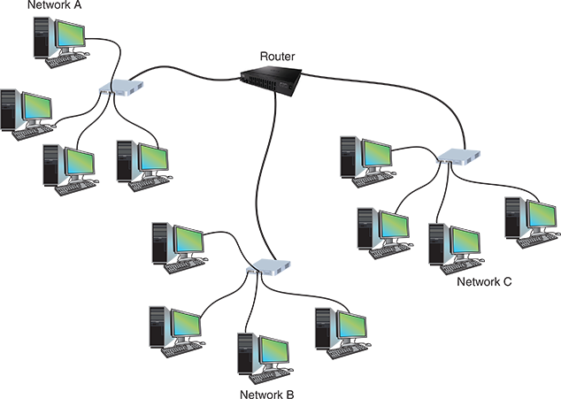
Network Hardware

Slide 30
Network Hardware
Switch versus Routers
  Switch: Belongs only to the local network
  Router: Belongs to two or more networks
Host
  Any endpoint device, connected to a network that hosts or accesses resources such as application or data
Node
  Any device, connected to a network that can be addressed on a local network or managed through a network connection

Slide 31
Network Hardware
WANs (Wide Area Networks)
  Group of LANs in the same geographical area
  MANs (Metropolitan Area Networks)
  CANs (Campus Area Networks)

Slide 32
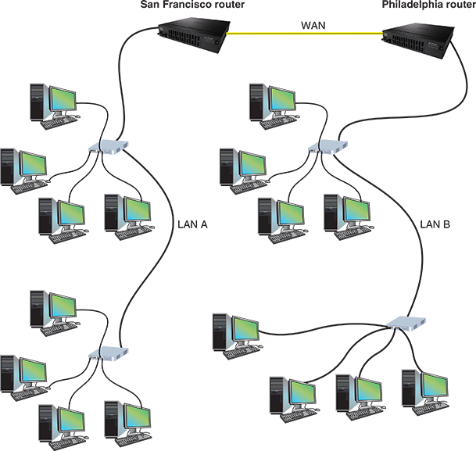
Network Hardware

Slide 33
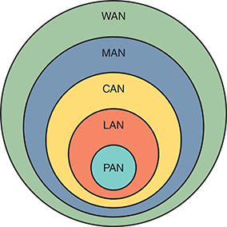
Network Hardware

Slide 34
The Seven Layer OSI Model
Application Layer
Presentation Layer
Session Layer
Transport Layer
Network Layer
Data Link Layer
Physical Layer

Slide 35
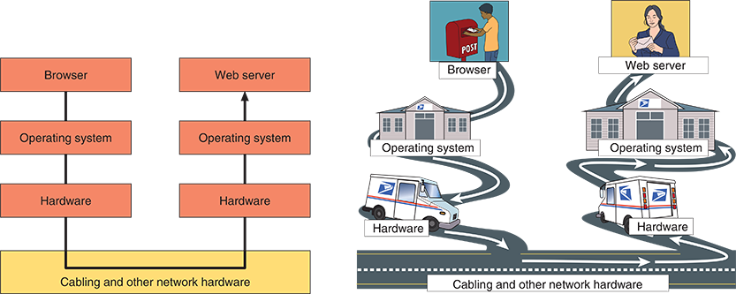
The Seven Layer OSI Model

Slide 36
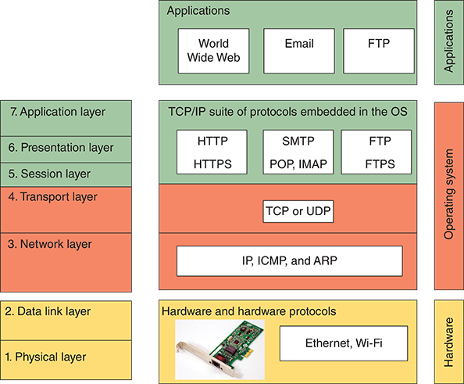
The Seven Layer OSI Model

Slide 37
The Seven Layer OSI Model
Top-to-Bottom
  All People Seem To Need Data Processing (Application, Presentation, Session, Transport, Network, Data Link, and Physical)
Bottom-to-Top
  Please Do Not Throw Sausage Pizza Away (Physical, Data Link, Network, Transport, Session, Presentation, and Application)

Slide 38
Layer 7: Application Layer
Describes the interface between two applications
Two categories
  Applications that provide services to a user, such as a browser and web server using HTTP application layer protocol
  Utilities that provide services to the system, such as SNMP (Simple Network Management Protocol), which monitor and gather information about network traffic and can alert network admins

Slide 39
Layer 6: Presentation Layer
Reformatting, compressing, and/or encrypting data in a way that the application on the receiving end can read it
Example
  An email message can be encrypted at the presentation layer by the email client or by the operating system

Slide 40
Layer 5: Session Layer
Describes how data between applications is synced and recovered if messages don’t arrive intact at the receiving applications
Example
  Zoom application works with the operating system to establish and maintain a session between two endpoints for as long as the video conference is in progress

Slide 41
Layer 4: Transport Layer
Responsible for transporting application layer payloads from one application to another. There are two main transport-layer protocols
TCP (Transmission Control Protocol)
  Connection-oriented protocol
UDP (User Datagram Protocol)
  Connectionless protocol

Slide 42
Layer 3: Network Layer
Responsible for moving messages from one node to another until they reach the destination host
This is where routers typically function
Uses IP
This is where IP addresses are found

Slide 43
Layer 2: Data Link
This determines the type of networking hardware used to the appropriate protocol
Examples
  Ethernet
  WiFi

Slide 44
Layer 1: Physical Layer
Sends bits via wired or wireless transmission
Transmission
  Wavelengths (WiFi)
  Voltage on Wires (Ethernet, cabling)
  Light (Ethernet, fiber-optics)

Slide 45
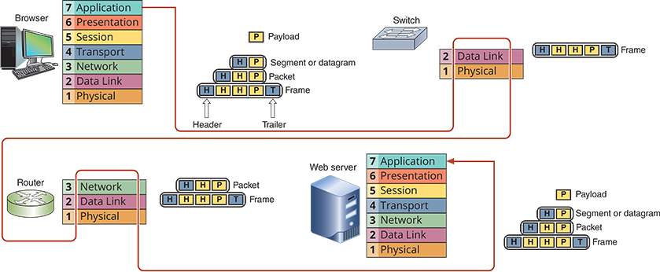
The Big Picture

Slide 46
Troubleshooting Networking Problems
Step 1: Identify the problem and its symptoms
Step 2: Establish a theory of a probable cause
Step 3: Test your theory to determine the cause
Step 4: Establish a plan for resolving the problem
Step 5: Implement the solution or escalate the problem
Step 6: Verify functionality and implement preventive measures
Step 7: Document findings, actions, and outcomes

