Slide 1
Chapter 8: Infrastructure Threats and Security Monitoring

Slide 2
On-Path Attacks
An on-path attack occurs when a threat actor positions themself in the middle between two communicating users or devices
The following are advantages of an on-path attacks:
  It can occur without the two targets knowing that an attacker is present
  It gives the attacker flexibility because they can either eavesdrop to gather valuable information or they can modify the message before sending it on to the recipient

Slide 3
On-Path Attacks
In a man-in-the-middle (MITM), a threat actor is positioned into a communication between two parties
  The goal of an MITM attack is to eavesdrop on the conversation or impersonate one of the parties
A typical MITM attack has the following two phases:
  The first phase is intercepting the traffic
  The second phase is to decrypt the transmissions

Slide 4
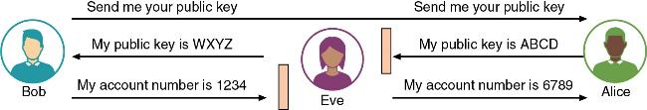
MITM Impersonation Attack

Slide 5
On-Path Attacks
A replay attack makes a copy of a legitimate transmission before sending it to the recipient
  Attacker uses the copy at a later time
A session replay attack involves intercepting and then using a session ID to impersonate a user
Threat actors use several techniques for stealing an active session ID:
  Network attacks (MITM impersonation attacks)
  Endpoint attacks (cross-site scripting, Trojans, and malicious JavaScript coding)

Slide 6
On-Path Attacks
A man-in-the-browser (MITB) attack intercepts communication between parties to steal or manipulate the data
  It occurs between a browser and the underlying computer
A MITB attack usually begins with a Trojan infecting the computer and installing an “extension” into the browser configuration
  When the browser is launched the extension is activated and waits for a specific webpage in which a user enters information such as account number and password for a financial institution
  When users click “Submit” the extension captures all the data from the fields on the form

Slide 7
DNS Attacks
Domain Name System (DNS) is a hierarchical name system for matching computer names and IP addresses
  A DNS-based attack substitutes a DNS address so that the computer is silently redirected to a different device
  A successful DNS attack has two consequences:
    URL redirection
    Domain reputation
  Attacks using DNS include DNS poisoning and DNS hijacking

Slide 8
DNS Attacks
DNS poisoning modifies a local host file on a device to point to a different domain
  Threat actors will add a single entry that directs the computer to a DNS server that is under the control of the attackers
DNS hijacking is intended to infect an external DNS server with IP addresses that point to malicious sites
  DNS hijacking has the advantage of redirecting all users accessing the server
  Attackers attempt to exploit a protocol flaw and convince the authentic DNS server to accept fraudulent DNS entries sent from the attackers’ DNS server

Slide 9
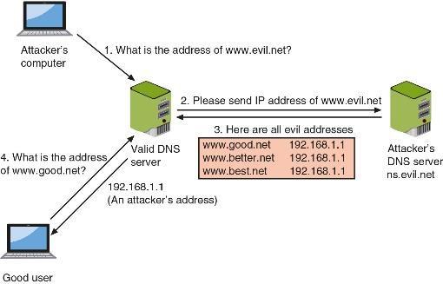
DNS Server Poisoning

Slide 10
DDoS Attacks
A denial of service (DoS) attack is a deliberate attempt to prevent authorized users from accessing a system by overwhelming it with requests
Most DoS attacks today are distributed denial of service (DDoS), which uses hundreds or thousands of devices flooding the server with requests
The devices participating in a DDoS attack are infected and controlled by threat actors so that users are completely unaware that their endpoints are part of a DDoS attack

Slide 11
DDoS Attacks
There are two means by which attackers can generate data to overwhelm a system:
  Use large numbers of compromised devices, each sending bogus requests
  Use amplified attacks (reflection attacks) where threat actors attack a misconfigured Internet device or service in such a way that causes the device or service to reflect and generate an even larger payload at the ultimate target

Slide 12
Malicious Coding & Scripting Attacks
Some network attacks come from malicious software code and scripts
PowerShell is a task automation and configuration management framework from Microsoft
  Administrative tasks are performed by cmdlets, which are specialized .NET classes that implement a specific operation
  PowerShell allows attackers to inject code from the PowerShell environment into other processes without first storing any malicious code on the hard disk

Slide 13
Malicious Coding & Scripting Attacks
Visual Basic for Applications (VBA) is an event-driven Microsoft programming language
VBA allows developers and users to automate processes that normally would take multiple steps or levels of steps
VBA is most often used to create macros, which are used to automate a complex task or a repeated series of tasks
  Macros date back to late 1990s but continue to be a key attack vector

Slide 14
Malicious Coding & Scripting Attacks
Python is a programming language that can run on several OS platforms
Best practices to follow when using Python include the following:
  Use the latest version of Python
  Stay current on vulnerabilities within Python
  Be care when formatting strings in Python
  Download only vetted Python libraries

Slide 15
Malicious Coding & Scripting Attacks
Bash is the command language interpreter for the Linux/UNIX OS
Bash scripting is using Bash to create a script
Exploits have taken advantage of vulnerabilities in Bash
  For example, one vulnerability allowed attackers to remotely attach a malicious executable file to a variable that is executed when Bash is invoked

Slide 16
Layer 2 Attacks
The OSI reference model separates networking steps into a series of seven layers
  Within each layer, different networking tasks are performed that cooperate with the tasks in the layers immediately above and below it
Layer 2, the Data Link Layer, is responsible for dividing the data into packets
  A compromise at Layer 2 can affect the entire communication

Slide 17
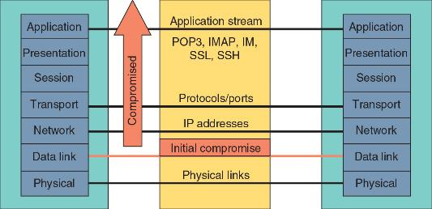
Layer 2 Compromise

Slide 18
Layer 2 Attacks
Address Resolution Protocol Poisoning
  If the IP address for a device is known but the MAC address is not, the sending computer sends an Address Resolution Protocol (ARP) packet to determine the MAC address
  MAC addresses are stored in an ARP cache for future reference
  ARP poisoning relies upon MAC spoofing, which is imitating another computer by means of changing the MAC address

Slide 19
Layer 2 Attacks
Two common attacks involving spoofing MAC addresses are MAC cloning and MAC flooding
  In a MAC cloning attack, threat actors discover a valid MAC address of a device connected to a switch and spoof the MAC address on their own device and the switch changes its MAC address table to reflect the MAC address with the port to which the attacker’s device is connected
  In a MAC flooding attack, a threat actor overflows the switch with Ethernet packets that have been spoofed so that every packet contains a different source MAC address

Slide 20
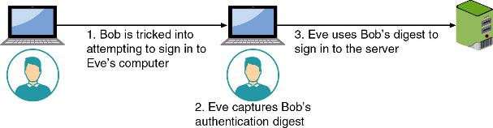
Credential Relay Attack
A credential relay attack attempts to steal authentication credentials and then use them to access a system
Attackers intercept digests of user passwords as they are being transmitted and then relay the clients’ credentials to impersonate the user

Slide 21
Question?
Kelly has discovered that the network switch is broadcasting all packets to all devices. She suspects it is the result of an attack that has overflowed the switch MAC address table. Which type of attack would she report?

Slide 22
Answer
Kelly has discovered that the network switch is broadcasting all packets to all devices. She suspects it is the result of an attack that has overflowed the switch MAC address table. Which type of attack would she report?
MAC flooding attack; In a MAC flooding attack, a threat actor will overflow the switch with Ethernet packets that have been spoofed so that the switch enters a failure mode, which is a predefined set of actions based on a failure of a network component.

Slide 23
Monitoring Methodologies
Monitoring involves examining network traffic, activity, transactions, or behavior to detect security-related anomalies
Anomaly monitoring is designed for detecting statistical anomalies
  A secure baseline of normal activities is compiled so if there is a deviation from the baseline, an alarm is raised
Signature-based monitoring examines network traffic, activity, transactions, or behavior to look for well-known patterns to compare these activities against a predefined signature

Slide 24
Monitoring Methodologies
Behavior-based monitoring uses the “normal” processes and actions as the standard
  It continuously analyzes the behavior of processes and programs on a system and alerts the user if it detects any abnormal actions
Heuristic monitoring is founded on experience-based techniques and attempts to answer the question, “Will this do something harmful if it is allowed to execute?”

Slide 25
Monitoring Activities
Activity | Description
Scanning | A frequent and ongoing process, often automated, that continuously searches for evidence of an attack
Reporting | Generating documentation on the results of monitoring activities
Quarantine | Isolating systems that have been compromised
Alerting | Detecting and notifying operators about meaningful events that may denote an attack
Alert tuning | “Tweaking” the altering function to weed out false positives
Archiving | Retaining historical documents and records of monitoring

Slide 26
Tools for Monitoring and Alerting
Collecting and analyzing data packets that cross a network can provide valuable information
Packet analysis typically examines the entire contents of the packet, which can be used extensively for security
Wireshark is a popular GUI packet capture and analysis tool
Tcpdump is a command-line packet analyzer
Tcpreplay is a tool for editing packets and then “replaying” the packets back onto the network to observe their behavior

Slide 27
Tools for Monitoring and Alerting
Flow analysis (network traffic analysis) is the process of monitoring the network’s devices and sounding an alert if it exceeds a baseline
Flow analysis for information security is different from traditional network traffic flow for several reasons:
  Eliminates monitoring agents
  Uses deep packet inspection
  Provides richer information
NetFlow is a session sampling protocol that collects IP network traffic

Slide 28
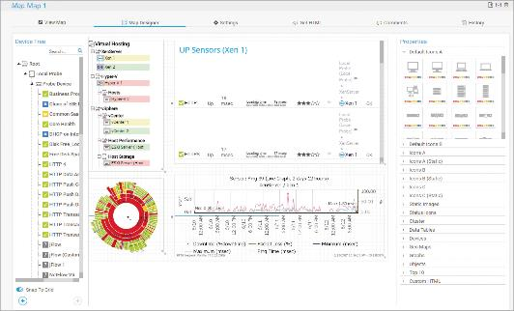
Network Traffic Analysis Output

Slide 29
Tools for Monitoring and Alerting
Data loss prevention (DLP) is a system of security tools used to recognize and identify data that is critical to the organization and ensure it is protected
Most DLP systems use content inspection, which is a security analysis of the transaction within its approved context
Administrators create DLP rules, which are uploaded to a DLP server
If a policy violation is detected by a DLP agent, it is reported back to the DLP server

Slide 30
Tools for Monitoring and Alerting
The Simple Network Management Protocol (SNMP) is a protocol used to remotely monitor, manage, and configure devices on the network
  An SNMP trap is a type of PDU that sends an unsolicited message to the manager about critical events in the managed device
Log aggregation enables security personnel to gather events from disparate sources into a single entity so that it can be searched and analyzed
Security Content Automation Protocols (SCAP) can help automate vulnerability management and determine whether the enterprise is compliant with required policies

Slide 31
Tools for Monitoring and Alerting
A Security Information and Event Management (SEIM) product consolidates real-time security monitoring and management of security information with analysis and reporting of security events
A SEIM typically has the following features:
  Aggregation
  Correlation
  Automated alerting and triggers
  Time synchronization
  Event duplication and logs

Slide 32
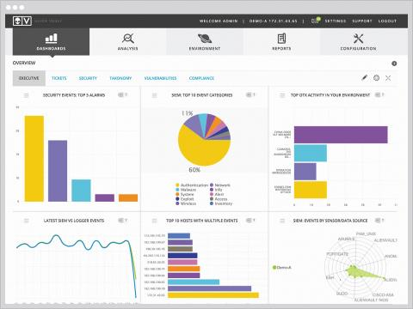
SIEM Dashboard

Slide 33
Tools for Monitoring and Alerting
A security orchestration, automation, and response (SOAR) product is similar to a SIEM in that it is designed to help security teams manage and respond to a high number of security warnings and alarms
SOARs take it a step further by combining more comprehensive data gathering and analytics in order to automate incident response

Slide 34
Question?
Which type of monitoring methodology looks for statistical deviations from a baseline?

Slide 35
Answer
Which type of monitoring methodology looks for statistical deviations from a baseline?
Anomaly monitoring is designed for detecting statistical anomalies. First, a secure baseline of normal activities is compiled over time (a baseline is a reference set of data against which operational data is compared). Whenever there is a significant deviation from this baseline, an alarm is raised.

Slide 36
Email Monitoring and Security
The basic components involved in sending and receiving email are the Mail User Agent (MUA) and Mail Transfer Agent (MTA)
  A MUA is what is used to read and send email from an endpoint
  MTAs are programs that accept email messages from senders and route them toward their recipients
As email is transferred from MTA to MTA, information is added to the email header
  Email headers also contain an analysis of the email by the MTA

Slide 37
Email Threats
Threats related to email include the following:
  Malicious payload
  Embedded links
  Impersonation
  Forwarding

Slide 38
Email Defenses
Spam and phishing filters can help address phishing attacks and anti-malware can be used to minimize malicious payloads
Other defenses include the following:
  Sender Policy Framework (SPF)
  Domain Keys Identified Mail (DKIM)
  Domain-based Message Authentication, Reporting, and Conformance (DMARC)
  Secure email gateway (SEG)

Slide 39
Email Defenses
Sender Policy Framework (SPF) is an email authentication method that identifies the MTA email servers that have been authorized to send email for a domain
  SPF helps protect a domain from spoofing and also helps prevent messages from a valid domain from being marked as unwanted spam
Domain Keys Identified Mail (DKIM) is an authentication technique that validates the content of the email message
  The validation is accomplished through a digital signature

Slide 40
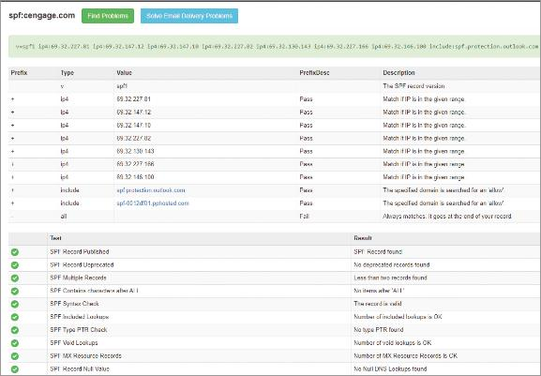
Cengage SPF Record

Slide 41
Email Defenses
Domain-based Message Authentication, Reporting, and Conformance (DMARC) allows the administrative owner of a domain to publish a policy in their DNS records to specify which mechanism (DKIM, SPF, or both) is used when sending email from that domain
Secure Email Gateway (SEG) acts as a “proxy” for the organization’s email server
  SEG can filter and inspect emails for malicious content
Limitations of SEG include single-layer security, exposing protections, multiple root domains

