Slide 1
Chapter 9: Infrastructure Security

Slide 2
Security Appliances
Principle | Description
Gap analysis | A comparison of the organization’s current state of information security with recommended controls
Segmentation | Dividing a network into multiple subnets or segments with each acting as its own small network to improve monitoring and enhance security
Isolation | Keeping multiple instances of an attack surface separate so that each instance can only see and affect itself
Least privilege | Granting access that is limited to what is only necessary for a device or user to complete their work
Configuration enforcement | Applying security measures to reduce unnecessary vulnerabilities
Decommissioning | Removing or dismantling a technology or service from a live production
Removal of unnecessary software | Deleting software that is not essential to an operation in order to eliminate an attack vector
Selection of effective controls | Choosing productive safeguards or countermeasures to limit the exposure of an asset to a danger
Device placement | Physically locating important devices in secure locations

Slide 3
Common Network Devices
A network switch is a device that connects network devices
  A switch can learn which device is connected to each of its ports by examining the media access control (MAC) address of frames it receives
  Proper hardening of a switch includes implementing port security and configuring other switch defenses
A common attack against switches is a MAC flooding attack
Switches that support port security can be configured to limit the number of MAC addresses that can be learned on ports

Slide 4
Common Network Devices
Type of attack | Description | Security defense
MAC flooding | An attacker can overflow the switch’s address table with fake MAC addresses, forcing it to act like a hub, sending packets to all devices | Use a switch that can close ports with too many MAC addresses
MAC address spoofing | If two devices have the same MAC address, a switch may send frames to each device. An attacker can change the MAC address on their device to match the target device’s MAC address | Configure the switch so that only one port can be assigned per MAC address
ARP poisoning | The attacker sends a forged ARP packet to the source device, substituting the attacker’s computer MAC address | Use an ARP detection appliance
Port mirroring | An attacker connects their device to the switch’s port | Secure the switch in a locked room

Slide 5
Common Network Devices
A router is a network device that can forward frames across different computer networks
Routers can also perform a security function by using an access control list (ACL)
  An ACL is a set of permissions or rules that functions as a network filter to permit or restrict data flowing into and out of the router network interfaces
Routers can protect against devices that imitate another computer’s IP address (this defense is called antispoofing)

Slide 6
Common Network Devices
A server distributes resources and services to devices connected to the network
The basic steps for hardening a server include the following:
  Apply patches to vulnerabilities
  Monitor the server
  Control access permissions
  Remove unnecessary software
  Secure the server location

Slide 7
Common Network Devices
Load balancing is a technology that can help to evenly distribute work across a network
  It can be performed through software running on a computer or as a dedicated hardware device known as a load balancer
The use of a load balancer has security advantages:
  They can detect and stop attacks directed at a server or application
  They can be used to detect and prevent protocol attacks
  Some can hide HTTP error pages or remove server identification headers from HTTP responses

Slide 8
Infrastructure Security Hardware
A firewall uses bidirectional inspection to examine outgoing and incoming packets
  The actions are based on specific criteria or rules (called rule-based firewalls)
  A more flexible type of firewall is a policy-based firewall which allows more generic statements instead of specific rules
  Firewalls can also apply content/URL filtering

Slide 9
Infrastructure Security Hardware
Action | Description | Example | Comments
Allow | Explicitly allows traffic that matches the rule to pass | Permit incoming Address Resolution Protocol (ARP) traffic | Implicitly denies all other traffic unless explicitly allowed
Bypass | Allows traffic to bypass the firewall | Bypass based on IP, port, traffic direction, and protocol | Designed for media-intensive protocols or traffic from a trusted source
Deny | Explicitly blocks all traffic that matches the rule | Deny traffic from IP address | Generally drops the packet with no return message to the sender
Force Allow | Forcibly allows traffic that would normally be denied by other rules | Useful for determining if essential network services are able to communicate | Traffic will still be subject to inspection by other security appliances
Log Only | Traffic is logged but no other action is taken | Bypass rules do not generate log files but Log Only will | Occurs if the packet is not stopped by a Deny rule or an Allow rule that excludes it

Slide 10
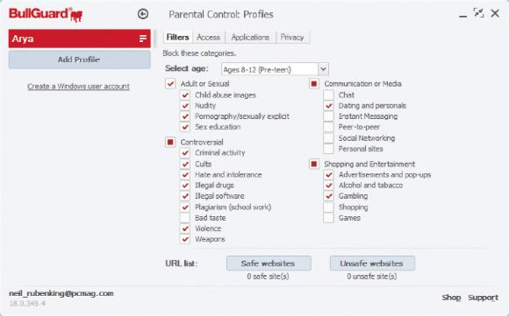
Content/URL Filter
c

Slide 11
Infrastructure Security Hardware
The following are different categories of firewalls:
  Hardware versus software
  Host versus appliance versus virtual
  Open source versus proprietary
  Stateful versus stateless
  Dedicated firewall versus network access control list (ACL)

Slide 12
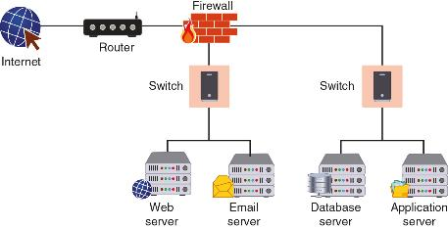
Appliance Firewall

Slide 13
Infrastructure Security Hardware
Several specialized firewall appliances include the following:
  Web application firewall
  Next-generation firewall
  Unified threat management
  Layer 7 firewall
  Network address translation gateway

Slide 14
Infrastructure Security Hardware
Proxy servers are devices that act as substitutes on behalf of the primary device
A forward proxy is a computer or an application that intercepts user requests from the internal secure network and processes the requests on behalf of the user
A reverse proxy routes requests coming from an external network to the correct internal server

Slide 15
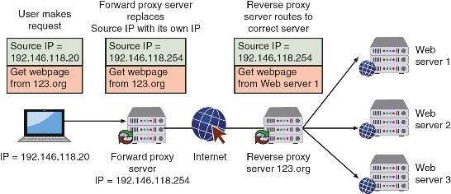
Forward and Reverse Proxy Servers

Slide 16
Infrastructure Security Hardware
Deception can be used as a security defense: by directing threat actors away from a valuable asset to something that has little or no value
A technology lure can serve as bait to threat actors
A honeypot is a computer located in an area with limited security that serves as “bait” to threat actors
Two goals of using a honeypot include the following:
  Deflect
  Discover

Slide 17
Infrastructure Security Hardware
A low-interaction honeypot may only contain a login prompt
A high-interaction honeypot is designed for capturing more information from the threat actor
A honeynet is a network of honeypots set up with intentional vulnerabilities
A sinkhole is a “bottomless pit” designed to steer unwanted traffic away from its intended destination to another device
  The goal is to deceive the threat actor into thinking the attack was successful

Slide 18
Infrastructure Security Hardware
An intrusion detection system (IDS) can detect an attack as it occurs
An intrusion prevention system (IPS) attempts to block the attack
An inline system is connected directly to the network and monitors the flow of data as it occurs
A passive system is connected to a port on a switch, which receives a copy of network traffic
The network-based systems are known as network intrusion detection systems (NIDS) and network intrusion prevention system (NIPS)

Slide 19
Question?
Maya is researching information on firewalls. She needs a firewall that allows for more generic statements instead of creating specific rules. What type of firewall should Maya consider purchasing that supports her need?

Slide 20
Answer
Maya is researching information on firewalls. She needs a firewall that allows for more generic statements instead of creating specific rules. What type of firewall should Maya consider purchasing that supports her need?
Policy-based Firewall; A more flexible type of firewall than a rule-based firewall is a policy-based firewall. This type of firewall allows for more generic statements to be used instead of specific rules.

Slide 21
Software Security Protections
Web filtering monitors the websites users are browsing so that the organization can either allow or block web traffic to protect against potential threats and enforce corporate policies
The different types of web filtering software are based on the location of the filtering engine:
  Browser scanning
  Agent-based scanning
  Centralized proxy scanning
  Cloud scanning

Slide 22
Software Security Protections
There are different methods that web filtering uses to identify malicious websites to create block rules, or criteria for which a website is inaccessible to users
  Content categorization
  Universal Resource Locator (URL) scanning
  Reputation score

Slide 23
DNS Filtering
DNS filtering blocks harmful or inappropriate content
  Web filtering blocks webpages, DNS filtering blocks entire domains
DNS resolvers can act as filters by refusing to resolve queries for certain domains
  These malicious domains are found in a list of unapproved sites that a DNS can access

Slide 24
File Integrity Monitoring (FIM)
File integrity monitoring (FIM) is a technology designed to “keep an eye on” files to detect any changes within the files that may indicate a cyberattack
A problem with FIM is the high volume of “noise,” or too much unhelpful information

Slide 25
Extended Detection & Response
Endpoint detection and response (EDR) tools monitor endpoint events by aggregating data from multiple endpoint computers to a centralized database
Extended detection and response (XDR) collects and correlates data across various network appliances, including servers, email systems, cloud repositories, as well as endpoints

Slide 26
What is Secure Infrastructure Design?
A network infrastructure should be designed with some areas for general access while other parts of the network having successively tighter restrictions
  The most restricted level of all can be a network that has physical isolation from all other networks or the Internet (called an air-gapped network)
Infrastructure separation can be achieved through physical segmentation and logical segmentation
  Logical segmentation creates subnets via “virtual networks” or through network addressing schemes

Slide 27
Virtual LANs (VLANs)
A virtual LAN (VLAN) allows scattered users to be logically grouped together even though they are physically attached to different switches
VLAN communication takes place in the following ways:
  When devices in the same VLAN are connected to the same switch, the switch can handle the transfer of packets to the members of the VLAN group
  When VLAN members on one switch need to communicate with members connected to another switch, a special “tagging” protocol must be used

Slide 28
Demilitarized Zone (DMZ)
To allow untrusted outside users access to resources such as web servers, most networks employ a demilitarized zone (DMZ)
  The DMZ functions as a separate network that rests outside the secure network perimeter
  Untrusted users can access the DMZ but cannot enter the secure network
A jump server is a minimally configured server within the DMZ that runs only essential protocols and ports
  It connects two dissimilar security zones while providing restricted access between them

Slide 29
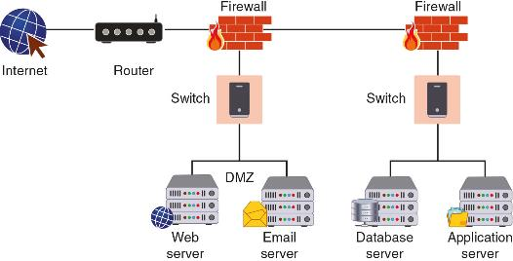
DMZ with Two Firewalls

Slide 30
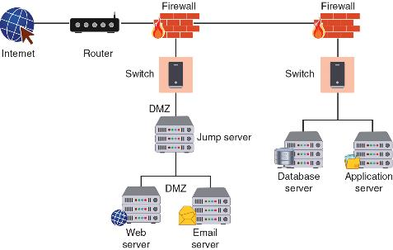
Jump Server

Slide 31
Demilitarized Zone (DMZ)
Name | Description | Security benefits
Intranet | A private network that belongs to an organization that can only be accessed by approved internal users | Closed to the outside public, thus data is less vulnerable to external threat actors
Extranet | A private network that can also be accessed by authorized external customers, vendors, and partners | Can provide enhanced security for outside users compared to a publicly accessible website
Guest network | A separate open network that anyone can access without prior authorization | Permits access to general network resources like web surfing without using the secure network

Slide 32
Zero Trust
Zero trust is a strategic initiative that is designed to prevent successful attacks by threat actors who are already within a network
  Zero trust acknowledges that trusting everyone within a network is a vulnerability
A zero-trust architecture (ZTA) is a framework for implementing zero trust
  It focuses on authentication and authorization to shrink implicit trust while still maintaining availability
ZTA minimizes threats against assets (threat scope reduction)

Slide 33
Zero Trust
The policy engine is a component of the policy decision point (PDP) that provides input into the policy enforcement point (PEP) to make the decision whether to grant access for a request
The policy engine relies on policy automation that uses automated processes for referring to policies for approval
The control plane is used for communication while the data plane is used for the transfer of the resource if approved

Slide 34
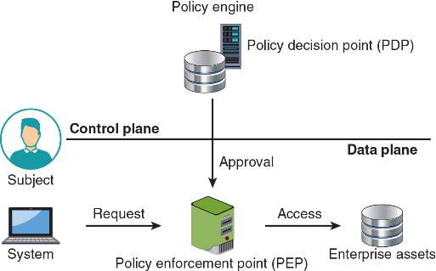
Conceptual ZTA

Slide 35
Access Technologies
Accessing a network infrastructure from a location other than the campus on which the organization is located is called remote access
Remote access always requires the connection be secure (secure communication)
  This involves selecting the best protocol to use (protocol selection) and opening the right ports on devices so communication can occur (port selection)
Two of the most common access technologies are virtual private network (VPN) and network access control (NAC)

Slide 36
Virtual Private Network (VPN)
A virtual private network (VPN) is a security technology that enables authorized users to use an unsecured public network (the Internet) as if it were a secure private network
There are two common types of VPNs: a remote access VPN and a site-to-site VPN
The most common protocol used for VPNs are IPsec and SSL
  The Layer 2 Tunneling Protocol (L2TP) is a VPN protocol that does not offer any encryption or protection, so it is usually paired with IPsec (L2TP/IPsec)

Slide 37
Network Access Control (NAC)
Network access control (NAC) examines the current state of an endpoint before it can connect to the network
  Devices that do not meet a specified set of criteria are denied access to the network, or given restricted access to computing resources, or connected to a “quarantine” network
Some NAC systems use software agents installed on endpoints to gather information
  Another alternative is when the NAC technology is embedded within a Microsoft Windows Active Directory domain controller

Slide 38
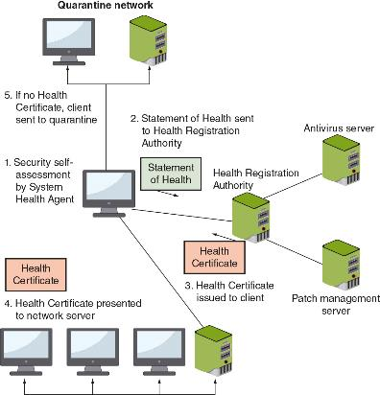
NAC Process

