Slide 1
Chapter 10 Wireless Network Attacks and Defenses

Slide 2
Wireless Attacks
The most common wireless technologies include the following:
  Cellular
  Bluetooth
  Near Field Communication (NFC)
  Radio frequency identification
  Wireless local area networks

Slide 3
Cellular Networks
Cellular networks are operated by telecommunication service providers and are the most widespread wireless networks
Faster 5G cellular service has allowed service providers to offer fixed wireless service for Internet connectivity
Telecommunication service providers own, maintain, and manage their own network equipment and facilities
  End users are not responsible for configuring or securing these cellular networks

Slide 4
Bluetooth Attacks
Bluetooth is a wireless technology that uses short-range radio frequency (RF) transmissions for communications over short distances
The primary type of Bluetooth network topology is a piconet
  It is established when two Bluetooth devices come within range of each other
  One device (leader) controls all wireless traffic
  The other device (follower) takes commands
    Active followers are sending transmissions
    Parked followers are connected but not actively participating

Slide 5

Bluetooth Piconets

Slide 6
Bluetooth Attacks
Bluejacking is an attack that sends unsolicited messages to Bluetooth-enabled devices
  Usually involves sending text messages, images, or sounds
Bluejacking is considered more annoying than harmful because no data is stolen
Bluesnarfing is an attack that accesses unauthorized information from a wireless device through a Bluetooth connection
  The attacker copies e-mails, contacts, pictures, or other data by connecting to the Bluetooth device without owner’s knowledge

Slide 7
Near Field Communication Attacks
Near field communication (NFC) is a set of standards used to establish communication between devices in close proximity
  Once devices are brought within 4 cm of each other or tapped together, two-way communication is established
Devices using NFC can be active or passive
  A passive NFC device contains information that other devices can read but does not read or receive any information (example, NFC tag)
  An active NFC device can read information as well as transmit data

Slide 8
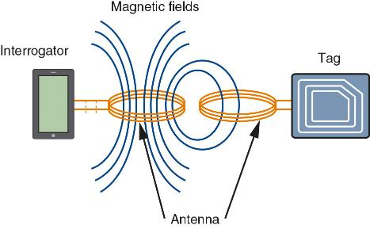
NFC Magnetic Induction

Slide 9
Near Field Communication Attacks
Vulnerability | Explanation | Defense
Eavesdropping | Unencrypted NFC communication between the device and terminal can be intercepted and viewed. | Because an attacker must be extremely close to pick up the signal, users should remain aware of their surroundings while making a payment.
Data theft | Attackers can “bump” a portable reader to a user’s smartphone in a crowd to make an NFC connection and steal payment information stored on the phone. | This can be prevented by turning off NFC while in a large crowd.
Man-in-the-middle attack | An attacker can intercept the NFC communications between devices and forge a fictitious response. | Devices can be configured in pairing so one device can only send while the other can only receive.
Device theft | The theft of a smartphone could allow an attacker to use that phone for purchases. | Smartphones should be protected with passwords or strong PINs.

Slide 10
Radio Frequency Identification Attacks
Radio frequency identification (RFID) is commonly used to transmit information between employee identification badges, inventory tags, book labels, and other paper-based tags that can be detected by a proximity reader
Most RFID tags are passive because they do not have their own power supply
  Because they do not require a power supply, they can be very small
RFID tags are susceptible to attacks such as unauthorized tag access, fake tags, eavesdropping, and RFID cloning

Slide 11
Wireless Local Area Network Attacks
A wireless local area network (WLAN) is designed to replace or supplement a wired local area network
It is important to know the following:
  The different versions of Wi-Fi
  The hardware necessary for a wireless network
  The different types of WLAN attacks directed at both the enterprise and consumers

Slide 12
Wireless Local Area Network Attacks
A wireless client network interface card (wireless adapter) performs the same functions as a wired adapter
  An antenna sends and receives signals through airwaves
An access point (AP) is a centrally located WLAN connection device that can send and receive wireless signals
  It acts as “base station” for the wireless network
  An AP acts as a bridge between wireless and wired networks because it can connect to a wired network by a cable

Slide 13
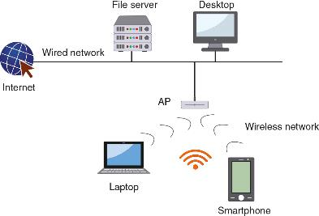
WLAN Setup

Slide 14
Wireless Local Area Network Attacks
Autonomous APs can manage wireless authentication, encryption, and other functions for wireless client devices
  These APs are sometimes called “fat APs”
APs that do not contain management and configuration functions are called “thin APs”
Controller APs can be managed through a dedicated wireless LAN controller (WLC)
A captive portal AP uses a standard web browser to provide information and allows the user to agree to a policy or present valid login credentials

Slide 15
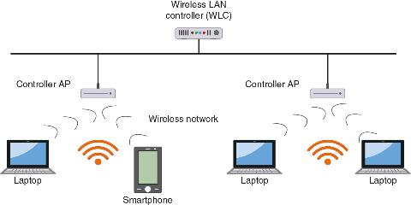
Controller APs with WLC

Slide 16
WLAN Enterprise Attacks
In a network, a well-defined boundary or “hard edge” protects data and resources
  There are two types of hard edges: a network hard edge and a second is made up of the walls and buildings that house the enterprise
The introduction of WLANs in enterprises has changed hard edges to “blurred edges”
There are several types of wireless attacks that can be directed at the enterprise

Slide 17
WLAN Enterprise Attacks
A rogue AP is an unauthorized access point that allows an attacker to bypass network security configurations
  It is usually set up by an insider (employee)
  It may be set up behind a firewall, opening the network to attacks
An evil twin is an AP set up by an attacker
  It attempts to mimic an authorized AP
  Attackers capture transmissions from users to the evil twin AP

Slide 18
WLAN Enterprise Attacks
Intercepting Wireless Data
  An attacker can pick up the RF signal from an open or misconfigured AP
Wireless Denial Attacks
  RF jamming occurs when attackers use intentional RF interference to flood the RF spectrum with enough interference to prevent a device from communicating with the AP
  An attacker can create false deauthentication or disassociation management frames that appear to come from another device, causing the client to disconnect from the AP (called a disassociation attack)

Slide 19
WLAN Enterprise Attacks
Wireless Consumer Attacks
  Most home users fail to configure any security on their home networks
  Attackers can:
    Steal data
    Read wireless transmissions
    Inject malware
    Download harmful content

Slide 20
Question
Jenny is investigating a security incident in which the smartphone of the CEO was compromised and confidential data was stolen. She suspects that it was an attack that used Bluetooth. Which attack would this be?

Slide 21
Answer
Jenny is investigating a security incident in which the smartphone of the CEO was compromised and confidential data was stolen. She suspects that it was an attack that used Bluetooth. Which attack would this be?
Bluesnarfing is an attack that accesses unauthorized information from a wireless device through a Bluetooth connection. In a bluesnarfing attack, the attacker copies emails, calendars, contact lists, cell phone pictures, or videos by connecting to the Bluetooth device without the owner’s knowledge or permission.

Slide 22
Wired Equivalent Privacy (WEP)
Wired Equivalent Privacy (WEP) is an IEEE 802.11 security protocol designed to ensure that only authorized parties can view transmissions
  WEP encrypts the transmission
A secret key is shared between the wireless client device and AP
WEP vulnerabilities include the following:
  WEP can use only a 64-bit or 128-bit number to encrypt
  WEP violates the cardinal rule of cryptography: avoid a detectable pattern

Slide 23
Wi-Fi Protected Setup (WPS)
Wi-Fi Protected Setup (WPS) – two common methods include the following:
  The PIN method utilizes a PIN printed on a sticker of the wireless router or displayed through a software wizard
  The push-button method is where a user pushes buttons and the security configuration takes place
Design and implementation flaws include the following:
  There is no lockout limit for entering PINs, the last PIN character is only a checksum, and the wireless router reports the validity of the first and second halves of the PIN separately

Slide 24
MAC Address Filtering
Media Access Control (MAC) address filtering is the most common type of wireless access control
  It permits or blocks device based on MAC address
Vulnerabilities of MAC address filtering include the following:
  MAC addresses are initially exchanged in an unencrypted format
    Attackers can see addresses of approved devices and substitute it on their own device
  Managing a large number of addresses is challenging

Slide 25
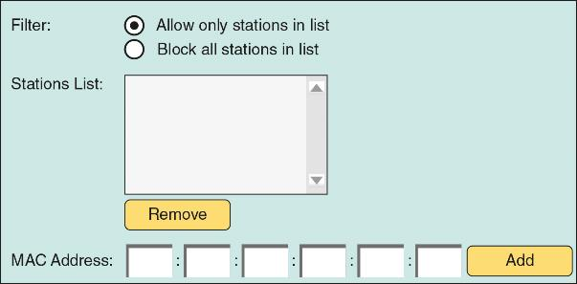
MAC Address Filtering

Slide 26
Wi-Fi Protected Access (WPA)
Wi-Fi Protected Access (WPA) was introduced by the Wi-Fi Alliance to fit into the existing WEP engine without requiring extensive hardware upgrades or replacements
There are two modes of WPA:
  WPA Personal
  WPA Enterprise
WPA addresses both encryption and authentication

Slide 27
Wi-Fi Protected Access (WPA)
Authentication for WPA Personal is accomplished using a preshared key (PSK)
  In a WLAN, a PSK is a secret value that is manually entered on both the AP and each wireless device
  Devices that have the secret key are automatically authenticated by the AP

Slide 28
Question
What is a vulnerability of MAC address filtering in a WLAN environment?

Slide 29
Answer
What is a vulnerability of MAC address filtering in a WLAN environment?
Filtering by MAC address has several vulnerabilities. MAC addresses are initially exchanged between wireless devices and the AP in an unencrypted format. An attacker monitoring the airwaves could easily see the MAC address of an approved device and then substitute it on their own device.

Slide 30
Wi-Fi Protected Access 2 (WPA2)
Wi-Fi Protected Access 2 (WPA2) is based on final IEEE 802.11i standard
The following are two modes of WPA2:
  WPA2-Personal
  WPA2-Enterprise
WPA2 addresses two major security areas of WLANs:
  Encryption
  Authentication

Slide 31
Wi-Fi Protected Access 2 (WPA2)
The encryption protocol used for WPA2 is the Counter Mode with Cipher Block Chaining Message Authentication Code Protocol (CCMP)
  It specifies the use of CCM with AES
The Cipher Block Chaining Message Authentication Code (CBC-MAC) component of CCMP provides data integrity and authentication
Authentication for the WPA2-Enterprise model uses the IEEE 802.1x standard
This standard provides greater degree of security by implementing port-based authentication

Slide 32
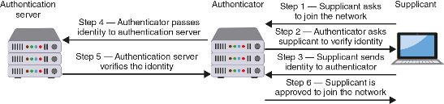
IEEE 802.1x Process

Slide 33
Wi-Fi Protected Access 2 (WPA2)
Extensible Authentication Protocol (EAP) is a framework for transporting authentication protocols
EAP defines message format and uses four types of packets
  Request, Response, Success, and Failure
A common EAP protocol is Protected EAP (PEAP)
  PEAP simplifies deployment of 802.1x by using Microsoft Windows logins and passwords
  It creates encrypted channel between client and authentication server

Slide 34
Wi-Fi Protected Access 2 (WPA2)
EAP name | Description
EAP-TLS | Uses digital certificates for authentication
EAP-TTLS | Security tunnels client password authentication within Transport Layer Security (TLS) records
EAP-FAST | Securely tunnels any credential form for authentication (such as a password or a token) using TLS

Slide 35
Wi-Fi Protected Access 3 (WPA3)
The next generation of Wi-Fi Protected Access (WPA) is known as WPA3
Security improvements of WPA3 include the following:
  WPA3 includes Simultaneous Authentication of Equals (SAE) which is designed to increase security at the time of the handshake when keys are being exchanged
  When using open or public Wi-Fi networks, WPA3 applies individual data encryption
  WPA3 has improved interaction capabilities with Internet of Things (IoT) devices

Slide 36
Additional Wireless Protections
Important considerations must be taken into account when installing a new WLAN for an organization:
  All areas of a building should have adequate wireless coverage
  All employees must have a reasonable amount of bandwidth
  A minimum amount of wireless signal should “bleed” outside the walls of the building
A site survey, which is an in-depth examination and analysis of a wireless LAN site, should be considered

Slide 37
Additional Wireless Protections
Some AP configuration settings are designed to limit the spread of the wireless RF signal so that a minimum amount of signal extends past the physical boundaries of the enterprise to be accessible to outsiders
Signal Strength Settings
  Some APs allow adjustment of the power level at which the LAN transmits
Spectrum Selection
  Some APs provide the ability to adjust frequency spectrum settings, including: frequency band, channel selection, and channel width

Slide 38
Additional Wireless Protections
Antenna Placement and Type
  APs should be located near the center of coverage area
  APs can be secured high on a wall to reduce signal obstructions and deter theft
  If possible, the AP and antenna should be positioned so that a minimal amount of signal reaches beyond the security perimeter of the building
    Another option is to use a type of antenna that focuses its signal in a concentrated direction toward authorized users instead of broadcasting it over a wide area

Slide 39
Rouge AP System Detection
Identifying rogue APs is known as rogue AP system detection
There are 4 types of wireless probes that can monitor airwaves for traffic:
  Wireless device probe
  Desktop probe
  Access point probe
  Dedicated probe
Once a suspicious signal is detected by a wireless probe:
  The information is sent to a centralized database where WLAN management system software compares it to a list of approved APs

