Slide 1
Chapter 11: Cloud and Virtualization Security

Slide 2
Introduction to Cloud Computing
Cloud computing is a model for enabling convenient, on-demand network access to a shared pool of configurable computing resources
  Entities that offer cloud computing are called cloud service providers
Cloud computing cost savings is due to the following factors:
  Elasticity and scalability
  Pay-per-use
  On demand
  Resiliency

Slide 3
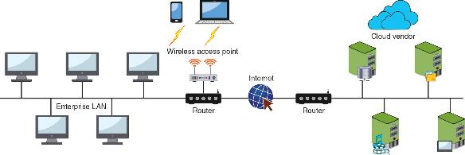
Cloud Computing

Slide 4
Introduction to Cloud Computing
Characteristic | Explanation
On-demand self-service | The consumer can make changes, such as increasing or decreasing computing resources, without requiring any human interaction from the service provider
Universal client support | Virtually any networked devices (desktop, laptop, smartphone, tablet, etc.) can access cloud computing resources
Invisible resource pooling | The physical and virtual computing resources are pooled together to serve multiple, simultaneous consumers that are dynamically assigned or reassigned based on the consumer’s needs; the customer has little or no control or knowledge of the physical location of the resources
Immediate elasticity | Computing resources can be increased or decreased quickly to meet demands
Metered services | Fees are based on the computing resources used

Slide 5
Types of Clouds
A public cloud is one in which the services and infrastructure are offered to all users with access provided remotely through the Internet
A community cloud is a cloud that is open only to specific organizations that have common concerns
A private cloud is created and maintained on a private network
A hybrid cloud is a combination of public and private clouds

Slide 6
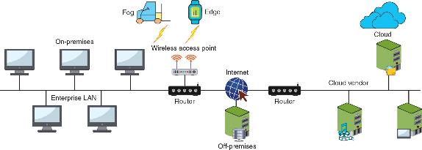
Cloud Locations
Instead of using a centralized model, cloud computing takes place in several different locations (a decentralized model)

Slide 7
Cloud Locations
Location | Description | Example
On-premises | Computing resources located on the campus of the organization (“on-prem”) | Desktop computer, local area network, data center
Off-premises | A computing resource hosted and supported by a third party | Remote backup facility
Fog | A decentralized computing infrastructure in which data, compute capabilities, storage, and applications are located between the data source and the cloud | Automated guided vehicles on an industrial shop floor
Edge | Computing that is performed at or very near to the source of data instead of relying on the cloud or on-prem for processing | Internet of Things device
Cloud | A remote facility for computing | Artificial intelligence processing engine

Slide 8
Cloud Architecture
A thin client is a computer that runs from resources stored on a central cloud server instead of a localized hard drive
A transit gateway is an Amazon Web Services (AWS) technology that allows organizations to connect all existing virtual private clouds (VPCs), physical data centers, remote offices, and remote gateways into a single managed source
A serverless infrastructure is one in which the capacity planning, installation, setup, and management are all invisible to the user because they are handled by the cloud provider

Slide 9
Cloud Models
Software as a Service (SaaS) – the vendor provides access to the vendor’s software applications running on a cloud infrastructure
Platform as a Service (PaaS) – consumers install and run their own specialized applications on the cloud computing network
Infrastructure as a Service (IaaS) – the vendor allows customers to deploy and run their own software, including OSs and applications
Anything as a Service (XaaS) – a broad category of subscription services related to cloud computing

Slide 10
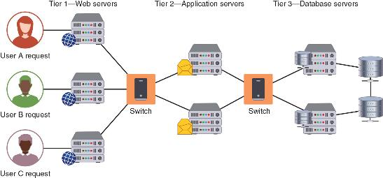
Three-Tier Architecture

Slide 11
Cloud Management
Cloud management can be conducted by the local organization performing the work itself or by contracting with a third-party management service provider
Services integration attempts to achieve a “boundary-less” approach
  It involves integrating all users across the enterprise who are using cloud computing

Slide 12
Cloud Management
When managing cloud computing locally, it is important to have written resource policies in place
A managed service provider (MSP) delivers services through ongoing and regular support as well as active administration of those resources
An MSP can manage on the customer’s premises, in the MSP’s own data center, in a third-party data center, or in a cloud computing environment
A managed security service provider (MSSP) can assist with or fully assume cybersecurity defenses

Slide 13
Cloud-Native Microservices
Traditional application design is often called “monolithic” because the entire program is developed as a single entity
The solution to monolithic application design is to divide it into smaller entities
  Each entity is a specialized part of the code (known as microservices)
A microservice architecture has smaller and more specialized elements, each of which manages its own database, generates its own logs, and handles user authentication (performed by microservices APIs)

Slide 14
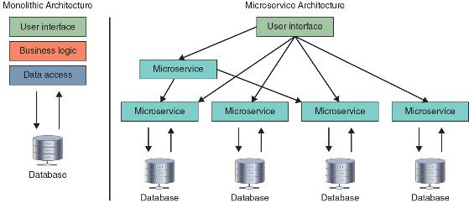
Monolithic vs Microservices

Slide 15
Question
Ash has been given a project to manage the development of a new company app. He wants to use a cloud model to facilitate the development and deployment. Which cloud model should he likely choose?

Slide 16
Answer
Ash has been given a project to manage the development of a new company app. He wants to use a cloud model to facilitate the development and deployment. Which cloud model should he likely choose?
Platform as a Service (PaaS) provides a software platform on which the enterprise or users can build their own applications and then host them on the PaaS provider’s infrastructure. The software platform can be used as a development framework to build and debug the app and then deploy it.

Slide 17
Cloud-Based Security
Virtual security devices can provide protection in a cloud computing environment
A cloud firewall is virtual software that functions in a similar manner to a physical security appliance by examining traffic into and out of the cloud
A secure web gateway (SWG) examines both incoming and outgoing traffic and performs basic URL and monitoring web applications
  A SWG also analyzes received traffic, performs data loss prevention (DLP), and provides alerts to a monitoring device like a SIEM appliance

Slide 18
Cloud-Based Security
A cloud access security broker (CASB) is a set of software tools or services that resides between an enterprise’s on-prem infrastructure and the cloud provider’s infrastructure
CASB acts as a “gatekeeper”, ensuring that the security policies of the enterprise extend to its data in the cloud
A secure access service edge (SASE) is the convergence of several security services into a single, cloud-delivered service model
  Various technologies that make up SASE include SWG, CASB, zero-trust architecture (ZTA), and WAN technologies

Slide 19
Cloud Vulnerabilities
Security issue | Description
Unauthorized access to data | Improper cloud security configurations can result in data being left exposed
Lack of visibility | Organizations have limited or no visibility into the security mechanisms of the cloud provider and thus cannot verify the effectiveness of security controls
Insecure APIs | While APIs help cloud customers customize their PaaS by providing data recognition, access, and effective encryption, threat actors can exploit a vulnerable API
Compliance regulations | Maintaining compliance requires that an organization know where their data is, who can access it, and how it is protected, but this can be difficult in an opaque cloud system where the transparency is lacking
System vulnerabilities | A cloud infrastructure is prone to system vulnerabilities due to complex networks and multiple third-party platforms

Slide 20
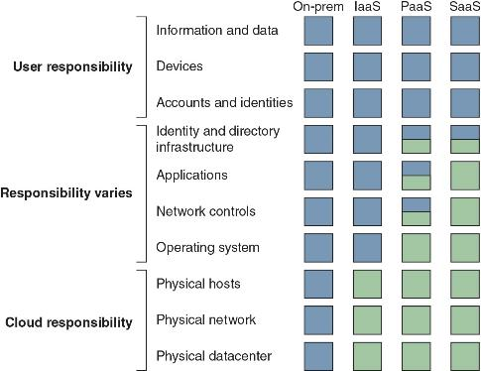
Responsibility Matrix
There needs to be clear understanding of who is responsible for each security element

Slide 21
Cloud Vulnerabilities
Physical networks use the Open Source Interconnection (OSI) seven-layer model to illustrate network functionality
With cloud computing, the OSI model is no longer as useful
The lack of a conceptual model like the OSI model makes selecting and managing security virtual devices more challenging
  Different cloud-based conceptual models are starting to be proposed
  However, no single model has been widely adapted

Slide 22
Cloud Security Controls
Securing cloud computing involves using controls such as the following:
  Conducting audits – a cloud security audit is an independent examination of cloud service controls
  Use Regions and Zones – reliability and resiliency are achieved through duplicating processes across one or more geographical areas (called high availability across zones)
  Secrets management – enables strong security and improved management of a microservices-based architecture, allowing the entire cloud infrastructure to remain flexible and scalable without sacrificing security

Slide 23
Cloud Security Controls
Hybrid clouds have special security challenges (called hybrid cloud considerations) due to their nature of spanning both public and private spaces

Slide 24
Cloud Security Controls
Best practices of hybrid clouds include the following:
  Encrypt sensitive data and data traffic between two clouds and inspect all encrypted traffic
  Monitor and audit configurations and use automation, rather than manual management
  Run regular scans to identify weak points
  Secure all endpoints
  Enforce zero-trust security

Slide 25
Defining Virtualization
Virtualization is a means of managing and presenting computer resources without regard to physical layout or location
Host virtualization is a type of virtualization in which an entire operating system environment is simulated
A virtual machine (VM) is a simulated software-based emulation of a computer
The “host system” runs a VM monitor program that supports one or more “guest systems”

Slide 26
Defining Virtualization
Virtualization is used to consolidate multiple physical servers into VMs that can run on a single physical computer
The VM monitor program is called a hypervisor, which manages the VM operating systems
There are two types of hypervisors:
  Type I – run directly on the computer’s hardware instead of the underlying OS
  Type II – run on the host OS, much like an application

Slide 27
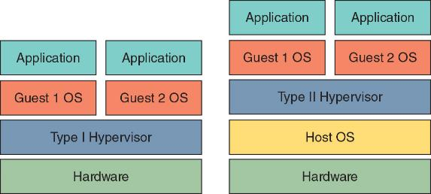
Type I and Type II Hypervisors

Slide 28
Defining Virtualization
A container holds only the necessary OS components that are needed for that specific application to run
  It reduces the necessary hard drive storage space and RAM needed
  It allows for containers to start more quickly because the OS does not have to be started
A common application of virtualization is virtual desktop infrastructure (VDI), which is the process of running a user desktop inside a remote VM that resides on a server

Slide 29
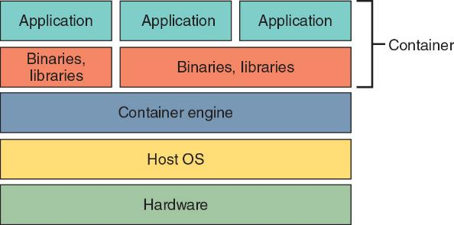
Containers

Slide 30
Advantages of Virtualization
New virtual server machines can be made available (host availability), and resources can easily be expanded or contracted as needed (host elasticity)
Virtualization can reduce costs
  Fewer physical computers must be purchased and maintained
It can provide uninterrupted server access to users
  Virtualization supports live migration, which allows a virtual machine to be moved to a different physical computer with no impact to users

Slide 31
Infrastructure as Code
A software-defined network (SDN) virtualizes parts of the physical network so that it can be more quickly and easily reconfigured
  This is accomplished by separating the control plane from the data plane
If traffic needs to flow through the network:
  It receives permission from the SDN controller, which verifies the communication is permitted by the network policy of the enterprise
  Once approved, the SDN controller computes a route for the flow to take and adds an entry for that flow in each of the switches along the path

Slide 32
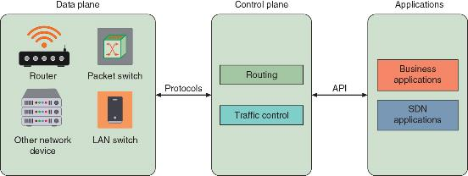
Software-Defined Network

Slide 33
Infrastructure as Code
A software-defined wide area network (SD-WAN) is a virtualized service that connects and extends enterprise WAN networks over large geographical distances
SD-WAN is designed to solve challenges associated with a traditional WAN, such as integrating connectivity between the service provider and the organization

Slide 34
Infrastructure as Code
A software-defined visibility (SDV) is a framework that allows users to create programs in which critical security functions can be automated
SDV allows network administrators to automate multiple functions in a network infrastructure including:
  Dynamic response to detected threat patterns
  Adjustments to traffic mode configurations for in-line security tools
  Additional IT operations-management functions and capabilities

Slide 35
Security Concerns for Virtualization
Security-related advantages of virtualization include:
  Test latest security updates by downloading on a virtual machine before installing on production computers
  A snapshot of a particular state of a virtual machine can be saved for later use
  Testing the existing security configuration (security control testing) can be performed using a simulated network environment
  VMs can promote security segregation and isolation

Slide 36
Security Concerns for Virtualization
Security-related advantages of virtualization include (continued):
  A suspicious program can be loaded into an isolated virtual machine and executed (sandboxing)
  If the program is malware, only the virtual machine will be impacted

Slide 37
Security Concerns for Virtualization
Security concerns for virtualized environments include:
  Not all hypervisors have the necessary security controls to keep out attackers
  Existing security tools were designed for single physical servers
  VMs must be protected from both outside networks and other VMs on the same physical computer
  VMs may be able to “break out” from the contained environment and directly interact with the host OS (called VM escape)
  It is important to have virtual machine escape protection

Slide 38
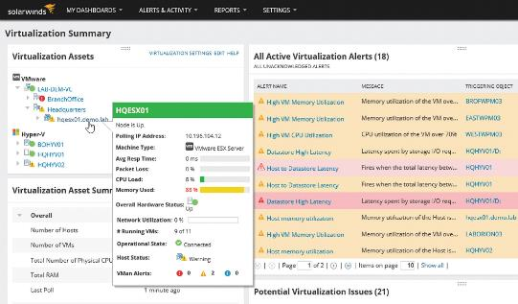
Virtual Machine Manager

