Slide 1
Chapter 14: Oversight & Operations

Slide 2
Governance
Governance refers to the structures, systems, and practices an organization has in place to do the following:
  Assign decision-making responsibilities, defining how decisions are to be made, and establishing the organization’s strategic direction
  Oversee the delivery of its services; the implementation of its policies, plans, programs, and projects; and the monitoring and mitigation of risks
  Report on performance toward achieving intended results and use performance information to drive ongoing improvements

Slide 3
Governance
Principle | Explanation
Accountability | The obligation of an individual, a group, or an organization to answer for a responsibility that has been conferred
Leadership | “Setting the tone,” which plays a crucial role in encouraging an organization’s personnel to embrace good governance practices
Integrity | Acting in a way that is impartial and ethical, reflected in part through compliance with legislation, regulations, and policies, as well as through the instilling of high standards of professionalism at all levels of an organization
Stewardship | The act of responsibly looking after resources on behalf of the organization and is demonstrated by maintaining or improving an organization’s capacity to serve the public interest over time
Transparency | Achieved when decisions and actions are open, meaning that stakeholders, including the public and employees, have access to full, accurate, and clear information on public matters

Slide 4
Governance
Governance bodies can be either internal to the organization or external
  Those that cover the immediate area are a local/regional body
  Those that cover an entire nation are a national body
  Those that are worldwide in scope are a global body
In a centralized body, all authority is vested into a single group
In a decentralized body, planning and decision making are distributed to smaller groups within it

Slide 5
Governance
Name | Scope | Description
Board | Internal | Composed of internal directors who approve strategic organizational goals and policies
Committee | Internal | The board of governance committee is a subset of the board of directors that manages governance issues
Government entity | External | National governments direct organizations through governance directives
Regulatory | External | Regulatory agencies are responsible for distributing and enforcing government directives
Legal | Internal | Internal corporate legal departments interpret internal and external governance policies
Industry | External | Different industries create and audit governance policies for organizations that make up that industry

Slide 6
Governance
Role | Description | Duties | Example
Data privacy officer (DPO) | Manager who oversees the data privacy compliance and manages data risk | Ensures the enterprise complies with data privacy laws and its own privacy policies | Decides that users can have permission to access the file SALARY.XLSX
Custodian/ Steward | Individual to whom day-to-day actions have been assigned by owner | Periodically reviews security settings and maintains records of access by end-users | Sets and reviews security settings on SALARY.XLSX
Owner | Person responsible for the information | Determines the level of security needed for the data and delegates security duties as required | Determines that the file SALARY.XLSX can be read only by department managers
Controller | Principal party for collecting the data | Acquire user’s consent, store the data, and manage consent or revoking access | Gathers data for SALARY.XLSX and identifies where it is stored
Processor | Proxy who acts on behalf of data controller | Person or agency that hold and processes personal data for a third party but does not make decisions about using the data and is not responsible for the data | Manages the SALARY.XLSX file on behalf of data controller

Slide 7
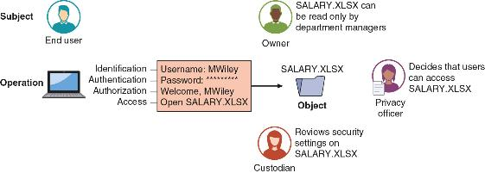
System and Data Roles

Slide 8
Governance
A policy is a formal statement that outlines specific requirements or rules that must be met based on a decision by a governing body
An acceptable-use policy (AUP) defines the actions users may perform while accessing systems and networking equipment
Other security policies include business continuity policies, disaster recovery policies, incident response policies, and a software development lifecycle (SDLC) policy

Slide 9
Governance
A procedure provides detailed mandatory steps that a user needs to follow to comply with a policy
An incident response playbook lists specific actions to take for threats
An example of a procedure is employee onboarding, or the tasks associated with hiring a new employee
Employee offboarding entails actions to be taken when an employee leaves an enterprise

Slide 10
Governance
A standard specifies the uniform uses of specific technologies or settings for secure configurations
An example of a standard is the Payment Card Industry Data Security Standard (PCI DSS)
  Other examples include password standards, access control standards, physical security standards, and encryption standards
A guideline provides general guidance and support for policies, standards, or procedures
  It is voluntary while policies, standards, and procedures are mandatory

Slide 11
Compliance
Compliance is the process of ensuring that an organization adheres to laws and regulations related to information security and user data privacy
It relies on penalties for noncompliance or not following compliance standards
  Penalties includes fines, sanctions, reputational damage, loss of license, or contractual impacts

Slide 12
Compliance
Compliance monitoring refers to the quality assurance tests that organizations perform to determine how well their business operations meet security regulations and standards
  It involves having a process to verify conformity and generating appropriate analysis
Compliance monitoring can be performed by the organization itself (internal compliance monitoring)
Automation compliance tools can generate an internal compliance report that can be provided to an auditor that verifies compliance

Slide 13
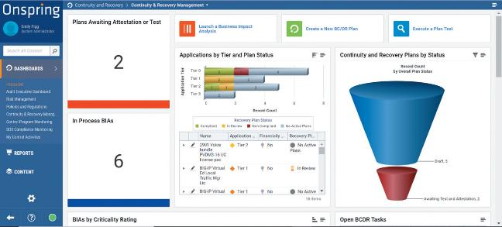
Automation Compliance Tool

Slide 14
Compliance
Compliance monitoring can also be performed by a professional third party (external compliance monitoring and reporting)
An external compliance report can serve as an official attestation of compliance monitoring
Reports typically require a statement of the acknowledgement of the organization’s responsibility for establishing and maintaining effective internal controls as they relate to compliance

Slide 15
Compliance
There are two types of data collections of user private data that occur:
  An overt and legitimate gathering of this data by an organization
  A concealed and questionable collection of user data
Many organizations today take advantage of the fact that every time a user interacts with technology, they leave behind a “data trail”
Data is predominantly collected by using tracking features (trackers) that are embedded in virtually every app on a smartphone

Slide 16
Compliance
Different legal protections are in place to protect data privacy
Currently there are no universal protections (global data protections) to which all nations adhere
  There are protections that apply to a country (national data protections)
In the US, ownership or legal possession and control of data has not been firmly established
  U.S. data protections primarily are those established as industry regulations that an organization follows to be in compliance

Slide 17
Security Operations
Information security defenders make up the security operations center (SOC)
Members of a SOC team are responsible for multiple tasks, including proactive monitoring, incident response and recovery, remediation activities, compliance, and coordination
Tools used by a SOC include:
  Automation, orchestration, threat hunting, and artificial intelligence

Slide 18
Automation
Information security has traditionally been more manual than automated for many years
In recent years, a shift has occurred in which more automation is becoming available to security personnel
This helps to streamline and speed up security processes to provide needed insights in a timely fashion

Slide 19
Benefits of Automation
Benefit | Explanation
Produce time efficiency | Automation can improve productivity by reducing the needed time to complete a task
Enforce baselines | Security automation can ensure that required baselines are imposed
Distribute standard infrastructure configurations | Unlike a technician who can easily miss a configuration setting when performing a task manually, automation can distribute infrastructure configurations to all devices
Securely scale | Adding additional appliances to scale operations can be performed more securely through automation
Improve staff retention | Due to the laborious nature of sifting through massive amounts of data, security automation can reduce the stress and “burnout” fatigue of workers and improve retention
Reduce reaction time | Automation can dramatically decrease the time needed to react to an attack
Generate workforce multiplier | Security automation gives staff the ability to be more productive

Slide 20
Use Cases for Security Automation
Security automation can be used to enhance software development to create more secure code
  Implementing an automated process can not only produce code more quickly, but the code will be more secure
Application programming interfaces (APIs) is a link provided by an operating system (OS), web browser, or other platform that allows a developer access to resources at a high level
  Use of APIs has led to what is called integration platform as a service (IPaaS)

Slide 21
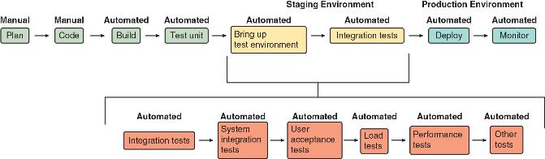
Use Cases for Security Automation
Continuous integration, continuous deployment, and continuous development

Slide 22
Use Cases for Security Automation
A script (snippet of code) is ideal for automation
  They often have features not found in formal programming languages
  These features include simple mechanisms for invoking other programs, less strict language requirements, and no requirement to declare variables
Security guardrails are “automations” that constantly watch cloud deployments, find deviations from desired baselines, and automatically remediate issues

Slide 23
Use Cases for Security Automation
Provisioning is the process of creating and setting up an IT infrastructure
  It includes the steps required to manage user and system access to various resources
Automated provisioning automatically grants and manages users’ access to the systems, applications, and resources of an organization
  Grants access based on employee positions and permission levels
  Can provision for individuals (user automation provisioning) or system (resource automation provisioning)

Slide 24
Use Cases for Security Automation
In cloud computing, automated security groups function like a virtual firewall that allows control over all inbound and outbound traffic to a particular cloud resource
Security groups are associated with network interfaces so that any changes are reflected immediately and automatically once the configuration is completed
  It can quickly deny ingress traffic from threat actors (disabling services and access)

Slide 25
Use Cases for Security Automation
The following are additional use cases for security automation:
  Escalation – Information security automation allows for the rapid detection of threat incident so that its importance can immediately be elevated
  Continuous integration and testing – Automation can help security personnel perform continuous integration and testing
  Ticket creation – A ticket is a special document or record that represents an incident, alert, request, or event that requires action
    Ticket creation can be automated

Slide 26
Orchestration
Security orchestration involves the automation and combination of many different individual tasks and processes
  This coordination involves hardware, software, middleware, and services
Security orchestration, automation, and response (SOAR) platform is a combination of software programs and tools that allow organization to synthesize and automate a range of security operations, threat intelligence, and incident response in a single platform

Slide 27
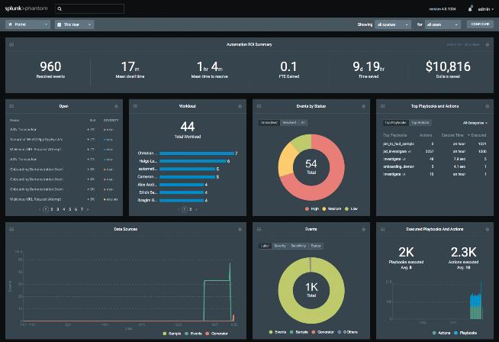
SOAR Dashboard

Slide 28
Threat Hunting
Threat hunting is an emergent activity that combines a proactive, repetitive (iterative), and predominantly human identification of a cyber invasion to an IT network or endpoints
Threat hunting assumes that the network is already infected, and attackers are not trying to enter form the outside but are currently inside

Slide 29
Threat Hunting
Title | Role | Goal | Task | Driving force | Timeframe
Incident responder | Reactive | Secure environment after alarm has been raised | Minimize impact of attack on the organization through formal process | Business continuity | Immediate
Penetration tester | Proactive | Secure environment through controlled offensive exercises | Mimic actions of threat actors to test and validate security posture | Uncover vulnerabilities | Soon
Threat hunter | Proactive | Identify suspicious activity before alarm has been raised | Seek evidence of malicious behavior | Prevent infection from spreading | Longer

Slide 30
Levels of Threat Hunting
Threat-hunting level | People | Processes | Tools
Initial (Level 1) | Existing SOC personnel | Ad-hoc hunts with little data collected | Standard SOC reactive tools with little automation
Managed (Level 2) | Threat hunting performed by volunteer | Uses basic threat feeds with indicators of compromise; hunts only occasionally | Searching for text strings and automatic matching of IoC
Defined (Level 3) | Dedicated threat hunter | Formal hunting process that occurs regularly with data collection from key areas | Uses statistical analysis techniques
Quantitatively Managed (Level 4) | SOC analysts rotated into threat hunting team | Hunts occur frequently with moderate data collection | Use of dashboards and visualization tools
Optimized (Level 5) | Threat-hunting teams integrated across a SOC with proper resources integration into process | Hunts occur continuously and data shared across security community | Takes advantage of machine learning

Slide 31
Threat Hunting Process & Tactics
The following are the steps in the process of threat hunting:
  Select the attack model
  Identify the most concerning threats
  Create a calendar
  Generate a hypothesis
  Investigate the hypothesis
  Act on results

Slide 32
Artificial Intelligence
Data analytics is a fixed process that examines large data sets to draw conclusions about the information they contain
A subset of data analytics is artificial intelligence (AI)
  Data analytics creates algorithms designed to learn patterns and correlations from data, which AI can then use to create predictive models
Machine learning (ML) is a subset of AI that uses statistical techniques to give computer systems the ability to “learn” or progressively improve their performance using data

Slide 33
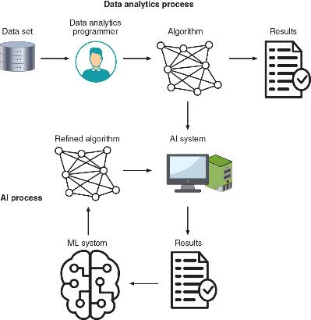
Data Analytics, AI, and ML

Slide 34
Artificial Intelligence
The following are three types of AI systems:
  Assisted intelligence – Improves what people and organizations are already doing
  Augmented intelligence – Enable people and organizations to do things they could not have done otherwise
  Autonomous intelligence – Features machines that act entirely on their own (self-driving vehicles)

Slide 35
Artificial Intelligence
The birth of AI can be traced back to the beginning of digital computers
AI exploded onto the scene with the release of ChatGPT in November 2022
Microsoft is now infusing its popular workplace software, Microsoft 365, with the technology behind ChatGPT, called Microsoft 365 Copilot

Slide 36
Artificial Intelligence
Organizations face many challenges relating to information security, such as:
  Hundreds, thousands, or hundreds of thousands of endpoint devices per organization
  Large numbers of daily vulnerabilities including unknown zero-day vulnerabilities
  Massive amounts of security-related data that is generated hourly
  A serious shortage of trained security personnel

Slide 37
Artificial Intelligence
The following are risks associated with using AI in security:
  AI needs huge volumes of high-quality data to function accurately
  AI tends to generate too many false positives
  It can be hard to “tune” an AI system for the specific needs of individual customers
  There is a lack of transparency in how AI systems make decisions
  The algorithmic models can degrade over time if they are not properly maintained by data analytics experts

Slide 38
Artificial Intelligence
Threat actors can attack AI systems and take advantage of AI
This is called adversarial artificial intelligence and includes the following:
  Compromise the algorithm
  Taint ML training data
  Use AI maliciously

