Slide 1
Chapter 15: Information Security Management

Slide 2
Asset Protection
Protecting assets is at the core of information security
Asset protection involves asset management and change management

Slide 3
Asset Management
An asset is any item that has a positive economic value
In an enterprise, assets have the following qualities:
  They provide value to the enterprise
  They cannot easily be replaced without a significant investment in expense, time, worker skill, and/or resources
  They can form part of the enterprise’s corporate identity

Slide 4
Asset Management
Asset | Description | Example | High value?
Data | Data that has been collected, classified, organized, and stored in various forms | Customer, personnel, production, sales, marketing, and finance databases | Yes: Extremely difficult to replace
Customized business software | Software that supports the business processes of the enterprise | Customized order transaction application | Yes: Unique and customized for the enterprise
System software | Software that provides the foundation for application software | Operating system | No: Can be easily replaced
Physical items | Computer equipment, communications equipment, storage media, furniture, and fixtures | Servers, routers, and power supplies | No: Can be easily replaced
Services | Outsourced computing services | Voice and data communications | No: Can be easily replaced

Slide 5
Asset Management
Asset management is the coordinated activity of an organization to realize value from its assets
To generate value from assets there must be a systematic approach to the governance of the assets and proper utilization of the assets in a cost-effective fashion

Slide 6
Asset Management
Cybersecurity asset management (CAM) is a process that combines asset management with information security
  CAM can identify assets on a continuous and real-time basis
  It can also identify the potential security risks or gaps that affect each asset through vulnerability scanners
CAM provides an up-to-date listing of assets that can immediately be reference in the event of an attack

Slide 7
Asset Management
An asset’s lifecycle begins when a need is first identified
From there, the asset is planned, created, or acquired
It is then operated and maintained, monitored, and replaced or upgrade when it reaches the end of its life
Costs associated with an asset are accumulated throughout its lifecycle and can vary depending on the current phase of the lifecycle of the asset

Slide 8
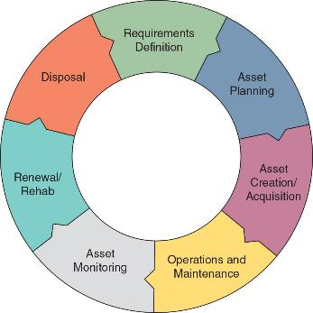
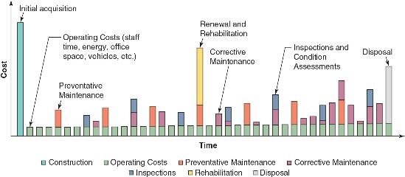
Asset Lifecycle & Cost

Slide 9
Selected Asset Management Tasks
Asset acquisition (also called asset procurement) is the process of identifying and then securing an asset to support a business goal
Once the asset has been identified, approved, and funded, most business use a bidding process to ask vendors to submit a qualified bid
There are two types of bidding processes:
  Standard bidding process
  E-bidding process

Slide 10
Selected Asset Management Tasks
Asset assignment/accounting is the process of determining and recording ownership (who owns the asset) and classification (into which category the asset belongs)
Assets are generally classified based on one of three factors:
  How easy it is to turn the asset into cash
  How the asset is used
  If the asset physically exists – a tangible asset is one that can be touched, and an intangible asset is one that has monetary value but no physical form

Slide 11
Selected Asset Management Tasks
Asset tracking is tracing the location of tangible assets
It is important to have a detailed tracking process as part of an asset management system for all assets
Inventory is the raw materials, works in progress, and finished goods that are available for sale that a business owns
Asset enumeration is a listing of the assets by a seller of those assets

Slide 12
Selected Asset Management Tasks
Disposal of assts typically involves a two-step process:
  The asset should be withdrawn from service (asset decommissioning)
  The asset should be physically removed (asset disposal)
Assets that contain valuable data should have that data transferred to a different device (data retention) before it is “scrubbed” clean of data (sanitization)
Paper media is usually destroyed by shredding

Slide 13

Micro-Cut Shredding

Slide 14
Change Management
Day-to-day business processes are called standard operating procedures, which can impact information security
Change management is a systematic approach to dealing with transformations (adjustments, replacements, etc.) within an organization
Change management policies are formal statements that outline specific rules that must be met
Change management procedures are detailed mandatory steps needed to comply with a policy

Slide 15
Change Management
Documentation is critical, both to maintain an audit trail and to ensure compliance with internal and external controls
Change management watches for any adjustments or variations to assets that could impact security
Change management tools can be as simple as spreadsheets and flowcharts
  In larger organizations, specialized change management software suites are used to maintain change logs digitally

Slide 16
Risk Management
Assets are continually under threat, which is a type of action that has the potential to cause harm
Organizations must determine the chance that a given threat will compromise an asset (called the likelihood of occurrence)
Risk is defined as a situation that involves exposure to some type of danger
Risk can also be described as a function of threats, consequences of those threats, and the resulting vulnerabilities

Slide 17
Risk Management
The following are different sources that can generate risk:
  Internal and external
  Legacy systems
  Multiparty
  Software compliance and licensing

Slide 18
Analyzing Risk
Risk analysis is a process to identify and assess the factors that may jeopardize the success of a project or reaching a stated goal (often called risk identification)
Following a methodology for performing a risk analysis is crucial
  These include a risk control self-assessment and a risk assessment
Risk Control Self-Assessment (RCSA) is an “empowering” methodology by which management and staff collectively work to identify and evaluate risks
  A reason identifying risk is difficult is unconscious human biases

Slide 19
Analyzing Risk
Bias | Explanation
Aggregate bias | Inferring something about an individual by using data that actually describes trends for the broader population
Anchoring bias | Holding on to a specific feature or set of features of information early in the decision-making process
Availability bias | Perceiving how likely an event is to occur given how frequently the event is heard of
Confirmation bias | Making a decision before investigating and then only looking for data that support the theory
Present bias | Trending to discount future risks and gains in favor of immediate gratification
Framing effect | Deciding on an option based on how the choices are worded
Fundamental attribution error | Viewing the failures or mistakes of others as part of their identity rather than attributing them to contextual or environmental influences

Slide 20
Analyzing Risk
Risk assessment can be performed by the following schedule:
  A scheduled assessment (one-time assessment)
  Whenever necessary (ad hoc assessment)
  On a calendar basis (recurring assessment)
  Year-round (continuous assessment)

Slide 21
Analyzing Risk
The frequency of conducting a risk assessment can be determined through the following two risk assessment approaches:
  Qualitative risk assessment uses an “educated guess” based on observation
    Typically assigns a numeric value (1-10) or label (High, Medium, or Low) that represents the risk
  Quantitative risk assessment attempts to create “hard” numbers associated with the risk of an element in a system by using historical data

Slide 22
Analyzing Risk
The following quantitative tools can be used to predict the likelihood of the risk:
  Mean Time Between Failure (MTBF)
  Mean Time To Recovery (MTTR)
  Mean Time To Failure (MTTF)
  Failure In Time (FIT)
Historical data can be used to determine the likelihood of a risk occurring within a year, known as Annualized Rate of Occurrence (ARO)

Slide 23
Analyzing Risk
Source | Explanation
Law enforcement agencies | Crime statistics on the area of facilities to determine the probability of vandalism, break-ins, or dangers potentially encountered by personnel
Insurance companies | Risks faced by other companies and the amounts paid out when these risks became reality
Computer incident monitoring organizations | Data regarding a variety of technology-related risks, failures, and attacks

Slide 24
Analyzing Risk
Risk impact involves comparing the monetary loss associated with an asset in order to determine the amount of money that would be lost if the risk occurred
The following formulas are used to calculate expected losses:
  Single Loss Expectancy (SLE) is the expected monetary loss every time a risk occurs
  Annualized Loss Expectancy (ALE) is the expected monetary loss that can be expected for an asset due to risk over a one-year period
  Risk exposure factor is the probability of a risk occurring multiplied by the total loss on the occurrence of the risk

Slide 25
Analyzing Risk
Risk register is a list of potential threats and associated risks
  It can help provide a clear snapshot of vulnerabilities and risks
  Risk registers may include key risk indicators (the primary risk factors), risk owners (those responsible for the asset), and the risk threshold (the maximum amount of risk that can be tolerated)
Risk matrix/heatmap is a visual color-coded tool that lists the impact and likelihood of risks

Slide 26
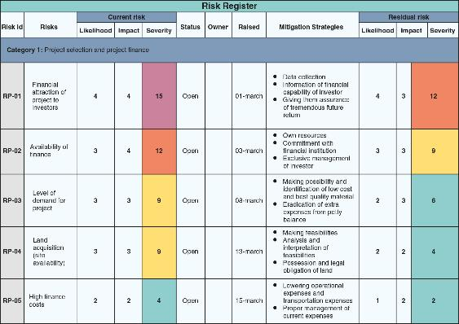
Risk Register

Slide 27
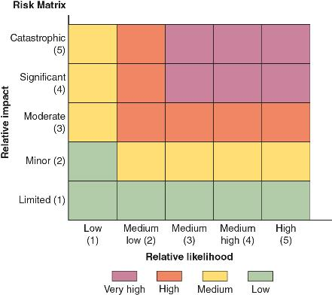
Risk Matrix/Heatmap

Slide 28
Managing Risk
Risk tolerance is the level of risk that an organization can accept per individual risk
Risk appetite is the total risk that the organization can bear in a given risk profile
  The risk appetite of an organization can be conservative (little tolerance for risk), expansionary (high tolerance for risk), or neutral (neither low nor high tolerance for risk)
Managing risk involves using specific strategies, addressing third-party risk, and applying awareness management

Slide 29
Managing Risk
There are four strategies for dealing with risks:
  Accept – risk is acknowledged but no steps are taken to address it
  Transfer – risk is transferred to a third-party
  Avoid – risk is identified but making the decision not to engage in the activity
  Mitigate – attempt to address risk by making the risk less serious

Slide 30
Managing Risk
A risk associated with using third parties is that it can be difficult to coordinate their diverse activities with the organization
Risks of third-party integration include the following:
  On-boarding and off-boarding
  Application and social media network sharing
  Privacy and risk awareness
  Data considerations

Slide 31
Managing Risk
Reducing risk with third-party vendors can be accomplished through requiring a close oversight of a vendor (vendor monitoring) and may include the following:
  Requiring completion of questionnaires about their supply-chain security protections
  Demand they perform regular penetration testing
  Requiring evidence of internal audits
  Create rules of engagement
  Demand third parties follow due diligence

Slide 32
Managing Risk
Vender agreement examples include the following:
  Service-level agreement (SLA)
  Business partnership agreement (BPA)
  Memorandum of understanding (MOU)
  Nondisclosure agreement (NDA)
  Measurement system analysis (MSA)
  Memorandum of agreement (MDA)
  Work order (WO)/statement of work (SOW)

Slide 33
Managing Risk
Security awareness management (risk awareness) is the raising of understanding to all employees of what risks exist, their potential impacts, and how they are managed
The goal of this training is to help users achieve anomalous behavior recognition
Training should help users be able to determine that which is unexpected, unintentional, and as such it becomes risky
  This is known as situation awareness

Slide 34
Managing Risk
Different techniques employed for user training include the following:
  Computer-based training (CBT)
  Role-based awareness training
  Gamification
  Phishing simulations

Slide 35
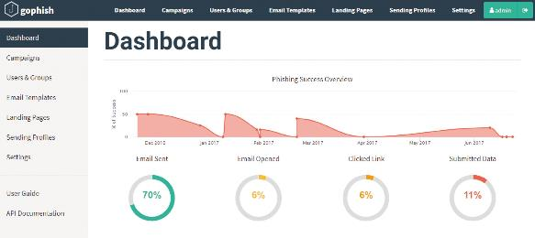
Phishing Simulation Dashboard

