Slide 1
Chapter 4: Advanced Cryptography

Slide 2
Defining Digital Certificates
A digital signature is used to prove a document originated from a valid sender
There is a weakness with a digital signature: it can only prove that the private key of the sender was used to encrypt the digital signature
  An imposter could post a public key under a sender’s name
A trusted third party can be used to help solve the problem of verifying identity
A digital certificate is a technology used to associate a user’s identity to a public key that has been “digitally signed” by a trusted third party

Slide 3
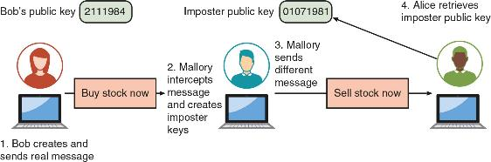
Imposter Public Key

Slide 4
Managing Digital Certificates
Entities and technologies used to manage digital certificates include:
  Certificate authorities (CAs) and tools for managing certificates
If a user wants a digital certificate, after generating a public and private key, the user must complete a request
  The user electronically signs it by affixing their public key and sends it to a registration authority that is responsible for verifying the authenticity of the user
  Once verified, it is transferred to an intermediate certificate authority where the request is processed and a digital certificate is issued (a process known as certificate signing request (CSR) generation)

Slide 5
Managing Digital Certificates
Intermediate CAs are subordinate entities designed to handle specific CA tasks such as processing certificate requests and verifying the identity of the individual
The person requesting a digital certificate can be authenticated by the following methods:
  Email, documents, in person
A certificate repository (CR) is a publicly accessible centralized directory of digital certificates used to view certificate status
  This directory can be managed locally by setting it up as a storage area connected to the CA server

Slide 6
Managing Digital Certificates
Some circumstances might cause a certificate to be revoked, such as the following:
  Certificate is no longer used
  Details of the certificate have changed, such as the user’s address
  Private key has been lost or exposed (or suspected lost or exposed)
A Certificate Revocation List (CRL) is a list of digital certificates that have been revoked

Slide 7
Managing Digital Certificates
The Online Certificate Status Protocol (OCSP) performs a real-time lookup of a certificate’s status
  The browser sends the certificate’s information to a trusted entity known as an OCSP Responder
  The OCSP Responder provides immediate revocation information on that certificate
OCSP stapling is a variation of OCSP where web servers send queries to the OCSP Responder server at regular intervals to receive a signed time-stamped response

Slide 8
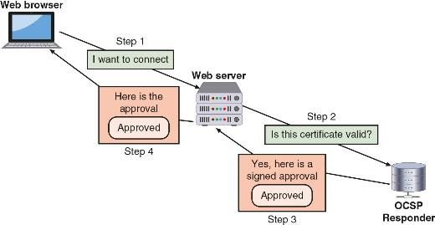
OSCP Stapling

Slide 9
Types of Digital Certificates
The most common categories of digital certificates are root certificates, domain certificates, and hardware/software certificates
The process of verifying a digital certificate is genuine depends upon certificate chaining
  The beginning point of the chain is known as a root digital certificate and is created and verified by a CA
  They are self-signed and do not depend upon any higher-level authority
  The endpoint of the chain is the user digital certificate itself

Slide 10
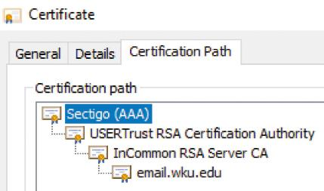
Example of Certificate Chaining

Slide 11
Types of Digital Certificates
Most digital certificates are web server digital certificates
Web server digital certificates perform two primary functions:
  Ensure the authenticity of the web server to the client
  Ensure the authenticity of the cryptographic connection to the web server
There are several types of domain digital certificates: domain validation digital certificates, extended validation (EV) digital certificates, wildcard digital certificates, and subject alternative name (SAN) digital certificates

Slide 12
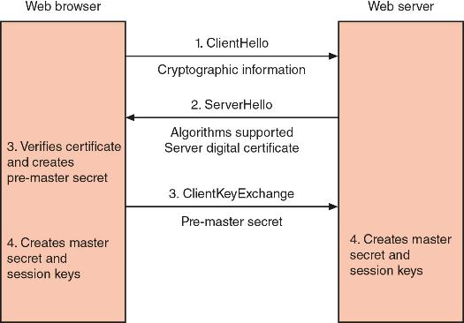
Key Exchange

Slide 13
Types of Digital Certificates
Hardware and Software Digital Certificates
More specific digital certificates relate to hardware and software:
  Machine/computer digital certificate
  Code signing digital certificate
  Email digital certificate

Slide 14
Types of Digital Certificates
Digital Certificate Attributes and Formats
  The standard format for digital certificates is X.509 Version 3
  Several certificate attributes make up an X.509 digital certificate including the following:
    The certificate validity period
    End-host identity information
    Encryption keys that will be used for secure communications
    The signature of the issuing CA
    The common name (CN) of the device being protected

Slide 15
Question?
What is a technology used to associate a user’s identity to a public key and has been digitally signed by a trusted third party?

Slide 16
Answer
What is a technology used to associate a user’s identity to a public key and has been digitally signed by a trusted third party?
A digital certificate is a technology used to associate a user’s identity to a public key and has been digitally signed by a trusted third party.

Slide 17
What is Public Key Infrastructure?
There is a need for a consistent means to manage digital certificates
Public key infrastructure (PKI) is a framework for all entities involved in digital certificates
It is the set of software, hardware, processes, procedures, and policies that are needed to create, manage, distribute, use, store, and revoke digital certificates across large user populations

Slide 18
Trust Models
Trust is defined as confidence in or reliance on another person/entity
A trust model refers to the type of trust relationship that can exist between individuals and entities
Direct trust is a type of trust model where one person knows the other person
Third-party trust refers to a situation where two individuals trust each other because each trusts a third party
The web of trust model is based on direct trust, where each user signs a digital certificate then exchanges certificates with all other users

Slide 19
Trust Models
The hierarchical trust model assigns a single hierarchy with one master CA called the root
  The root signs all digital certificate authorities with a single key
The distributed trust model has multiple CAs that sign digital certificates
  It eliminates limitations of hierarchical trust model
The bridge trust model is similar to the distributed trust model
  One CA acts as a facilitator to interconnect all other CAs
  Allows different models to be linked together

Slide 20
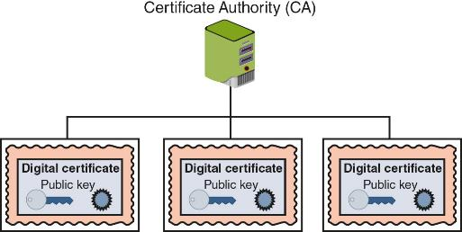
Hierarchical Trust Model

Slide 21
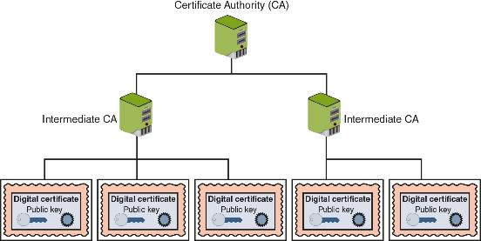
Distributed Trust Model

Slide 22
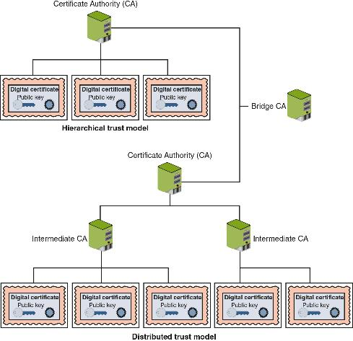
Bridge Trust Model

Slide 23
Managing PKI
A certificate policy (CP) is a published set of rules that govern operation of a PKI
  The CP provides recommended baseline security requirements for the use and operation of CA, RA, and other PKI components
A certificate practice statement is a technical document that describes in detail how the CA uses and manages certificates
  It also covers how to register for a digital certificate, how to issue them, when to revoke them, procedural controls and key pair management

Slide 24
Managing PKI
The life cycle of a certificate is typically divided into the following four parts:
  Creation
  Suspension
  Revocation
  Expiration

Slide 25
Key Management
Public keys can be stored by embedding them within digital certificates
Private keys can be stored on the user’s local system
  Software-based storage may expose keys to attackers
  An alternative is to store keys in hardware on smart-cards or tokens
Multiple pairs of dual keys can be created
  One pair is used to encrypt information and the public key can be backed up to another location
  The second pair would be used only for digital signatures and the public key in that pair would never be backed up

Slide 26
Key Management
The following procedures can help ensure keys are handled properly:
  Escrow
  Expiration
  Renewal
  Revocation
  Recovery
  Suspension
  Destruction

Slide 27
Question?
Dag wants to set up a trust model in which he only will serve as a CA. Which trust model will he choose?

Slide 28
Answer
Dag wants to set up a trust model in which he only will serve as a CA. Which trust model will he choose?
A hierarchical trust model can be used in an organization where one CA is responsible for only the digital certificates for that organization.

Slide 29
Secure Communication
Cryptographic algorithms are used to protect data in transit (transport/communication encryption)
There are different secure communication and transport protocols based on cryptographic algorithms for protecting data in transit
  These protocols typically rely on “encapsulating” or enveloping the data to be transmitted inside something else (tunneling)
The following protocols use tunneling:
  Transport Layer Security (TLS) and IP Security (IPSec)

Slide 30
Transport Layer Security (TLS)
Transport Layer Security (TLS) is a replacement for Secure Sockets Layer (SSL) and provides a higher degree of protection
  The current version is TLS v1.3
A cipher suite is a named combination of the encryption, authentication, and message authentication code (MAC) algorithms that is used with TLS

Slide 31
IP Security (IPSec)
IPSec is a protocol suite for securing IP communications
IPSec is considered to be a transparent security protocol
  Transparent to applications, users, and software
IPSec provides three areas of protection that correspond to three IPSec protocols:
  Authentication, confidentiality, and key management
IPSec supports two encryption modes:
  Transport mode and tunnel mode

Slide 32
Other Protocols
The secure version of HTTP is actually “plain” HTTP sent over TLS and is called Hypertext Transport Protocol Secure (HTTPS)
  HTTPS uses port 443 instead of HTTP’s port 80
Secure Shell (SSH) is an encrypted alternative to the Telnet protocol used to access remote computers
Secure/Multipurpose Internet Mail Extensions (S/MIME) is a protocol for securing email messages
Secure Real-time Transport Protocol (SRTP) is a secure extension protecting transmission using the Real-Time Transport Protocol (RPT)

Slide 33
Implementing Cryptography
Cryptography that is improperly applied can lead to vulnerabilities
It is essential to understand the different options that relate to cryptography
Implementing cryptography includes understanding the following:
  Key strength
  Secret algorithms
  Block cipher modes of operation

Slide 34
Key Strength
A cryptographic key is a value that serves as input to an algorithm
  It transforms plaintext into ciphertext (and vice versa for decryption)
The following are primary characteristics that determine the resiliency of the key to attacks (called key strength):
  Randomness
  Cryptoperiod – length of time for which a key is authorized for use
  Length of the key

Slide 35
Secret Algorithms
Keys must be kept secret, so does the same apply to algorithms?
Would a secret algorithm enhance security in the same way as keeping a key or password secret?
  No
For a cryptography to be useful it needs to be widespread:
  A military force that uses cryptography must allow many users to know of its existence to use it

Slide 36
Block Cipher Modes of Operation
A block cipher manipulates an entire block of plaintext at one time
  Each block is encrypted independently
A block cipher mode of operation specifies how block ciphers should handle these blocks
Some of the most common modes:
  Electronic Code Book (ECB)
  Cipher Block Chaining (CBC)
  Counter (CTR)
  Galois/Counter (GCM)

