Slide 1
Chapter 5: Endpoint Vulnerabilities, Attacks, and Defenses

Slide 2
Malware Attacks
Malware is a word that describes software designed to interfere with a computer’s normal functions and can be used to commit an unwanted and harmful action
One attempt at classifying the diverse types of malware can be to examine the primary action that the malware performs, such as kidnap, eavesdrop, masquerade, and launch

Slide 3
Kidnap
Ransomware is malicious software designed to extort money from victims in exchange for their endpoint device to be restored to its normal working state
Blocking ransomware blocks the user from using their computer in a normal fashion
  The ransomware infects the computer and then manipulates its OS in such a way as to block all normal access to the device
Locking ransomware encrypts some or all of the files on the device so that they cannot be opened

Slide 4
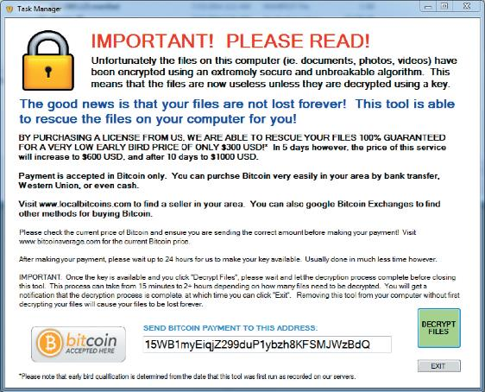
Locking Ransomware Message

Slide 5
Kidnap
Attackers have also encrypted all files on any network or storage device that is connected to a device
Attackers may also publicly release the stolen information
Ransomware is considered to be the most serious malware threat for the following reasons:
  Low barrier to entry
  Pervasive attacks
  High impact

Slide 6
Eavesdrop
Two types of eavesdropping malware are spyware and keyloggers
A keylogger silently captures and stores each keystroke that a user types on the computer’s keyboard
  The threat actor can then search the captured text for any useful information such as passwords, credit card numbers, or personal information
  A keylogger can be a software program or a small hardware device
Spyware is tracking software that is deployed without the consent or control of the user

Slide 7
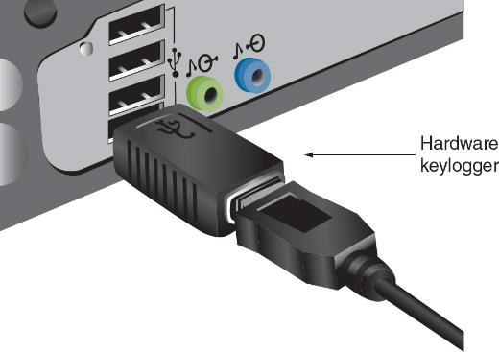
Hardware Keylogger

Slide 8
Masquerade
Some malware can hide its true intentions
A computer Trojan is an executable program that masquerades as performing a benign activity but also does something malicious
A remote access Trojan (RAT) has the basic functionality of a Trojan but also gives the threat agent unauthorized remote access to the victim’s computer by using specially configured communication protocols
  This creates an opening to the victim’s computer allowing the threat agent unrestricted access

Slide 9
Launch
Malware that infects a computer to launch attacks on other computers includes a virus, worm, bloatware, and bot
There are two types of viruses: a file-based virus and a fileless virus
  A file-based virus is malicious code that is attached to a file that reproduces itself on the same computer without any human intervention
  The virus first unloads a payload to perform a malicious action, then the virus replicates itself by inserting its code into another file (on the same computer)

Slide 10
Launch
A fileless virus does not attach itself to a file but instead takes advantage of native services and processes that are part of the OS to avoid detection and carry out its attacks
  It does not infect a file, instead the code is loaded directly in the computer’s random access memory (RAM)
Advantages of a fileless virus over a file-based virus include the following:
  Easy to infect, extensive control, persistent, difficult to detect, difficult to defend against

Slide 11
Launch
A worm is a malicious program that uses a computer network to replicate (sometimes called a network virus)
  It is designed to enter a computer through the network and then take advantage of a vulnerability in an application or an OS on the host computer
Actions that worms have performed include deleting files on the computer or allowing the computer to be remotely controlled by an attacker

Slide 12
Launch
Bloatware is software that is installed on a device without the user requesting it
  It could contain malware or it could become a platform for other malware to exploit if the bloatware contains a vulnerability
A category of bloatware is software that comes preinstalled on a new device
Another category is software that a user does not intend to install but is installed as the result of overlooking the default installation options

Slide 13
Launch
Another type of malware allows the infected computer to be placed under the remote control of an attacker for the purpose of launching attacks
  The infected robot computer is known as a bot or zombie
  When hundreds, thousands, or even millions of bot computers are gathered into a logical computer network, they create a botnet under the control of a bot herder
Infected bot computers receive instructions through a command and control (C&C) structure from the bot herders

Slide 14
Sidestep
A logic bomb is computer code that is typically added to a legitimate program but lies dormant and evades detection until a specific logical event triggers it
A rootkit is malware that can hide its presence and the presence of other malware on the device
  It does this by accessing “lower layers” of the OS to make alterations
A backdoor gives access to a computer, program, or service that circumvents any normal security protections

Slide 15
Indicator of Attack (IoA)
Indicator | Description
Account lockout | A user account that is inaccessible through a normal login attempt can be an indication the account has been taken over by an attacker and is locking out a legitimate user.
Concurrent session usage | An indicator of attack in which both a legitimate user and an attacker are logged into the same account.
Blocked content | Data that is no longer accessible can be an IoA.
Impossible travel | Impossible travel is accessing a resource that is not possible due to geography; for example, a user who checks email from New York and then downloads a file from Los Angeles five minutes later is an example of impossible travel.
Resource consumption | System resources such as memory or processing capabilities that are suddenly depleted could indicate an attack.
Resource inaccessibility | A large-scale attack can block system resources from being accessed.
Out-of-cycle logging | Log records that do not correspond to actual events that have occurred can be an IoA.
Published/documented | Evidence from external sources of a current attack can be used to identify an attack.
Missing logs | Log files that have mysteriously been deleted is an indication of an ongoing attack taking place.

Slide 16
Question?
Finn’s team leader has just texted him that an employee, who violated company policy by bringing in a file on a USB flash drive, has just reported that their computer is infected with locking ransomware. Why would Finn consider this a serious situation?

Slide 17
Answer
Finn’s team leader has just texted him that an employee, who violated company policy by bringing in a file on a USB flash drive, has just reported that their computer is infected with locking ransomware. Why would Finn consider this a serious situation?
It can encrypt all files on any network that is connected to the employee’s computer. In addition to encrypting files on the device’s local drive, new variants of locking ransomware encrypt all files on any network or attached device that is connected to that device. This includes secondary drives, USB drives, network-attached storage devices, network servers, and even cloud-based data repositories.

Slide 18
Application Vulnerabilities and Attacks
Application attacks look for vulnerabilities in the application or manipulate the application in order to compromise it
Application attacks frequently result in privilege escalation, which allows the attacker to gain illicit access of elevated rights or privileges beyond what is entitled for a user

Slide 19
Application Vulnerabilities
A buffer overflow attack occurs when a process attempts to store data in RAM beyond the boundaries of a fixed-length storage buffer
  This extra data overflows into the adjacent memory locations
These attacks are called injections or memory injections since they introduce something into RAM
Some attacks are the result of poor coding on the part of software developers
  Software that allows the user to enter data but has improper input handling features does not filter or validate user input to prevent a malicious action

Slide 20
Application Vulnerabilities
Another improper handling situation is a NULL pointer/object dereference
  When an application dereferences a pointer that has a value of NULL, it typically will cause a program to crash or exit
A NULL pointer/object dereference can also be the result of a race condition
  A race condition in software occurs when two concurrent threads of execution access a shared resource simultaneously

Slide 21
Application Attacks
A common type of attack is an application attack directed at programs running on Internet web servers, known as web-based attacks
A web server provides services that are implemented as “web applications” through software applications running on the server
Web-based attacks frequently result in directory traversal
  This type of attack takes advantage of a vulnerability so that a user can move from the root directory to other restricted directories

Slide 22
Application Attacks
In a cross-site scripting (XSS) attack, a website that accepts user input without validating it and uses that input in a response can be exploited
An attacker can take advantage in an XSS attack by tricking a valid website into feeding a malicious script to another user’s web browser
One of the most common injection attacks (SQL injection) inserts statements to manipulate a database server
  SQL stands for Structured Query Language
By entering crafted SQL statements as user input, information from the database can be extracted or the existing can be manipulated

Slide 23
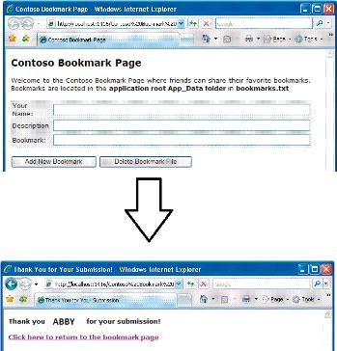
Bookmark Page Accepts User Input

Slide 24
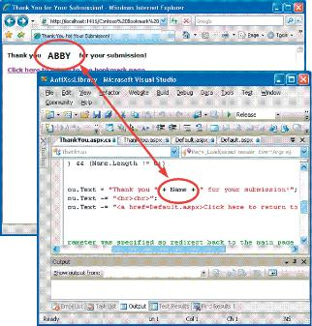
Input Used in Response

Slide 25
Application Attacks
Request forgery is a request that has been fabricated
There are two types of request forgeries: cross-site request forgery (CSFR) and a server-site request forgery (SSRF)
A cross-site request forgery (CSRF) takes advantage of an authentication “token” that a website sends to a user’s web browser
  If a user is currently authenticated on a website and is tricked into loading another webpage, the new page inherits the identity and privileges of the victim, who may then perform an undesired function on the attacker’s behalf

Slide 26
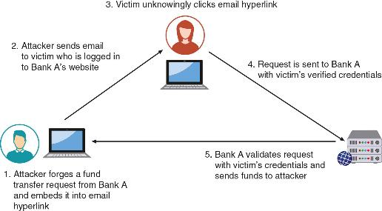
Cross-Site Request Forgery

Slide 27
Application Attacks
A server-site request forgery (SSRF) takes advantage of a trusting relationship between web servers
  SSRF attacks exploit how a web server processes external information received from another server
  Some web applications are designed to read information from or write information to a specific URL
  If an attacker can modify that target URL, they can potentially extract sensitive information from the application or inject untrusted input into it

Slide 28
Application Attacks
Replay attacks are commonly used against digital identities
  After intercepting and copying data, the threat actor retransmits selected and edited portions of the copied communications later to impersonate the legitimate user
Many digital identity replay attacks are between a user and an authentication server

Slide 29
Question?
What type of attacks is based on website accepting user input without sanitizing it?

Slide 30
Answer
What type of attacks is based on website accepting user input without sanitizing it?
XSS. In a cross-site scripting (XSS) attack, a website that accepts user input without validating it (called “sanitizing”) and uses that input in a response can be exploited.

Slide 31
Protecting Endpoints
Protection on computer endpoints can be accomplished through software installed on the endpoint, such as the following:
  Antivirus, web browser protections, and monitoring and response systems
Antivirus (AV) software can examine a computer for file-based virus infections and monitor computer activity and scan new documents that might contain a virus
  Log files created by AV products can provide info regarding attacks
  Older AV products use signature-based monitoring, called static analysis
  A newer approach to AV is heuristic monitoring, called dynamic analysis

Slide 32
Protecting Endpoints
Web browsers offer the following security on endpoint computers:
  Secure cookies are sent to a web server with an encrypted request over the secure HTTPS protocol
    This prevents an unauthorized person from intercepting a cookie that is being transmitted between the browser and the web server
  HTTP Response Headers are headers that tell the browser how to behave while communicating with the website

Slide 33
Protecting Endpoints
There are three types of monitoring and response systems for endpoint computers:
  Host Intrusion Detection Systems (HIDS) is a software-based application that runs on an endpoint computer and can detect an attack has occurred
  Host Intrusion Prevention Systems (HIPS) monitor endpoint activity to immediately block a malicious attack by following specific rules
  Endpoint Detection and Response (EDR) tools are considered more robust than HIDS and HIPS

Slide 34
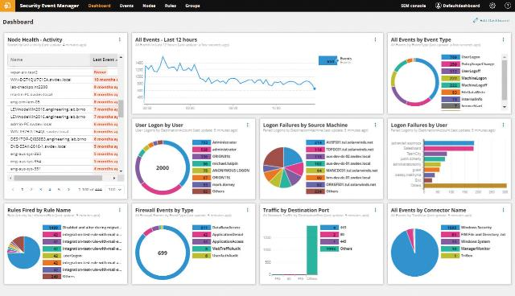
HIDS Dashboard

Slide 35
Protecting Endpoints
Endpoint detection and response (EDR) tools can aggregate data from multiple endpoint computers to a centralized database so that security professionals can further investigate and gain a better picture of events
EDR tools can perform more sophisticated analytics that identify patters and detect anomalies
  This can help detect unusual or unrecognized activities by performing baseline comparisons of normal behavior

Slide 36
Hardening Endpoints
Hardening endpoints involves patch management and OS protections
Effective patch management involves two types of patch management tools to administer patches
  Patch distribution using automated patch management tools
  Patch reception in Microsoft Windows 11 can be delayed from one to five weeks
    After that, the updates will resume
    Users can set a time range when the computer will restart after an update has been installed

Slide 37
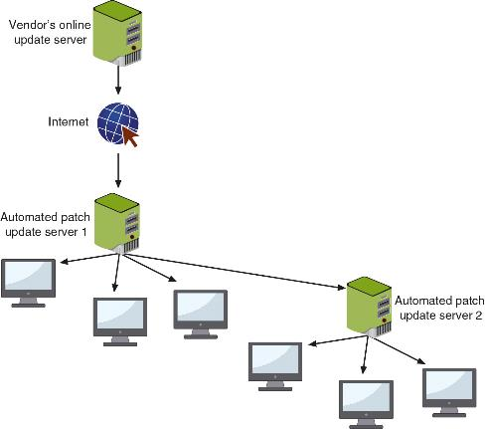
Automated Patch Update Service

Slide 38
Hardening Endpoints
Protections at the OS level include the following:
  Disabling unnecessary ports and protocols
  Application allow list – a list of approved applications to run on the OS so that any item not approved will not function
  Sandbox – a “container” in which an application can be run so that it does not impact the underlying OS

