Slide 1
Chapter 7: Identity and Access Management

Slide 2
Types of Authentication Credentials
Element | Description | Scenario
Somewhere you are | Restricted location | Restricted military base
Something you are | Unique biological characteristic that cannot be changed | Fingerprint reader to enter building
Something you have | Possession of an item that nobody else has | Riker’s RFID card
Someone you know | Validated by another person | Li knows Peyton
Something you exhibit | Genetically determined characteristic | Peyton’s flaming red hair
Something you can do | Perform an activity that cannot be exactly copied | Paolo’s signature
Something you know | Knowledge that nobody else possesses | Combination to unlock locker

Slide 3
Something You Know: Passwords
Passwords are the most common type of IAM authentication today
Passwords provide weak protection and are constantly under attack
Password Weaknesses
  Weakness of passwords is linked to human memory
  Long, complex passwords are most effective
  Users must remember passwords for many different accounts
  Each account password should be unique
  Many security policies mandate that passwords must expire

Slide 4
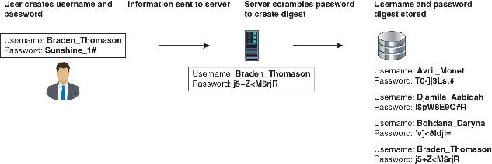
Creating a Password

Slide 5
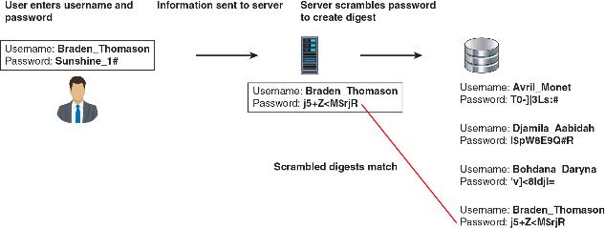
Retrieving a Password

Slide 6
Something You Know: Passwords
In a brute force attack, every possible combination of letters, numbers, and characters is combined to attempt to determine the user’s password
A password spraying attack selects one or a few common passwords and then enters the same password when trying to login to several user accounts
Attackers work to steal the file of password digests
  They can also load that file onto their own computers and then use a sophisticated password cracker, which is software designed to break passwords

Slide 7
Something You Know: Passwords
An offline brute force attacks uses a stolen digest file
  The attacker then uses password cracking software to create candidate digests of every possible combination of letters, numbers, and characters that are then matched against those in a stolen digest file
In a dictionary attack, the attacker creates digests of common dictionary words and compares against a stolen digest file
Credential stuffing occurs when an attacker injects stolen username and password credentials across multiple websites

Slide 8
Something You Know: Passwords
A rule attack conducts a statistical analysis on the stolen passwords that is used to create a mask to break the largest number of passwords
  There are three basic steps in a rule attacks:
  1. A small sample of the stolen password plaintext file is obtained
  2. Statistical analysis is performed on the sample to determine the length and character sets of the passwords
  3. A series of masks is generated that will be most successful in cracking the highest percentage of passwords

Slide 9
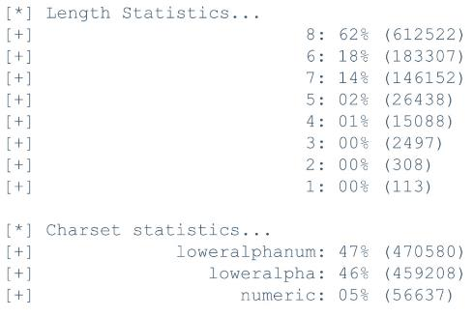
Rule Attack Statistical Analysis

Slide 10
Rule Attack Generated Masks

Slide 11
Something You Have: Tokens & Keys
The most common items used for “something you have” authentication are tokens, security keys, and smart cards
A token is a type of object that can be hardware or software
  One type of hardware token is a windowed token that displays a dynamic value called a one-time password (OTP)
  A software OTP is generated through an app on a user’s smartphone
Multifactor authentication (MFA) is a type of authentication where a user is using more than one type of authentication credential
  Example: what a user knows and what a user has could be used together for authentication

Slide 12
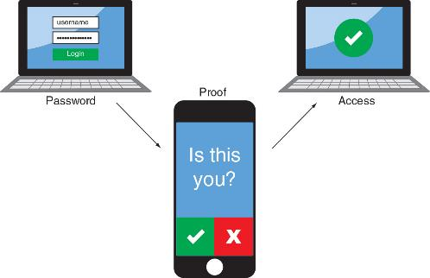
Authentication App

Slide 13
Something You Have: Tokens & Keys
A more secure option is using a dedicated token key, known as a security key
One feature of security keys is attestation, which is a key pair that is “burned” into the security key during manufacturing time and is specific to a device model
A smart card is a credit-card-sized plastic card that can hold information to be used as part of the authentication process
  A smart card standard covering all U.S. government employees is called the Personal Identity Verification (PIV) standard

Slide 14
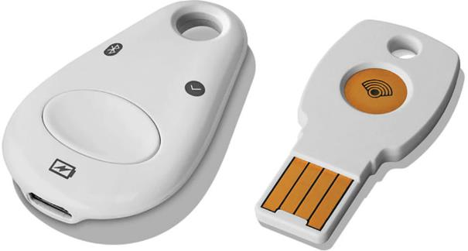
Security Keys

Slide 15
Something You Are: Biometrics
Physiological biometrics uses a person’s unique physical characteristics for authentication
  Several unique characteristics of a person’s body can used to authenticate
Specialized Biometric Scanners
  A retinal scanner uses the human retina as a biometric identifier
  It maps the unique patterns of a retina by directing a beam of low-energy infrared light (IR) into a person’s eye

Slide 16
Something You Are: Biometrics
The following are two basic types of fingerprint scanners:
  A static fingerprint scanner takes a picture and compares with image on file
  A dynamic fingerprint scanner uses a small slit or opening
Other human characteristics that can be used for authentication include:
  A person’s vein can be identified through a vein-scanning tablet
  A person’s gait or manner of walking

Slide 17
Something You Are: Biometrics
Standard Input Devices
  Voice recognition uses a standard computer microphone to identify users based on the unique characteristics of a person’s voice
  An iris scanner uses a standard webcam to identify the unique characteristics of the iris
  Facial recognition uses landmarks called nodal points on human faces for authentication

Slide 18
Something You Are: Biometrics
Biometric Disadvantages
  The cost of specialized hardware scanning devices
  Readers have some amount of error
  Biometric systems can be “tricked”
  A final concern with biometrics is the efficacy rate (which is the benefit achieved)

Slide 19
Something You Are: Biometrics
Cognitive biometrics relates to perception, thought process, and understanding of the user
  It is considered easier for the user to remember because it is based on user’s life experiences
  Cognitive biometrics is also called knowledge-based authentication
  Picture Password was introduced by Microsoft for Windows 10 touch-enabled devices
    Users select a picture to use for which there should be at least 10 “points of interest” that could serve as “landmarks” or places to touch

Slide 20
Something You Are: Behavioral Bio
Behavioral biometrics authenticates by normal actions the user performs
A type of behavioral biometrics is keystroke dynamics, which recognizes a user’s typing rhythm
  Keystroke dynamics uses the following unique typing variables
    Dwell time, which is the time it takes to press and release a key
    Flight time is the time between keystrokes
  Keystroke dynamics holds a great amount of potential because it requires no specialized hardware

Slide 21
Securing Passwords
One method of protecting password digests is called salting, which consists of a random string that is used in hash algorithms
  Passwords can be protected by adding a random string to the user’s cleartext password before it is hashed
  Salts make dictionary attacks and brute force attacks much slower and limit the impact of rainbow tables
Another strategy is called peppering where a message digest is created as normal but then encrypted with a symmetrical encryption key before being stored

Slide 22
Securing Passwords
A more secure approach for creating password digests is to use key stretching
  Key stretching is a specialized password hash algorithm that is intentionally designed to be slower
  Three key stretching algorithms are bcrypt, PBKDF2, and Argon2

Slide 23
Securing Passwords
Solutions for managing passwords include the following:
  Password vaulting, user password managers, hardware password keys, and using password best practices
Password vaulting stores user password credentials in a highly protected database (vault) that is stored on the organization’s network
A user password manager is a software application or online website that stores user passwords along with login information
A hardware password key often serves as a hardware-based password manager

Slide 24
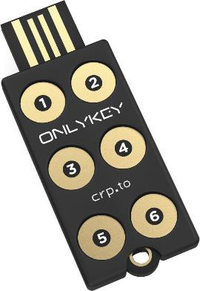
Password Key

Slide 25
Securing Passwords
Password best practices include the following:
  Default passwords should be changed
  Password reuse should be prohibited
  Password expiration should not be utilized
  Password age should be set to at least 1
  Provisioning (initially setting up user accounts) should include policies that address password best practices
  De-provisioning should have policies such as suspending accounts when an employee leaves an organization

Slide 26
Secure Authentication Technologies
Single-Sign On
  Identity management is using a single authentication credential shared across multiple networks
  Federation (sometimes called federated identity management or FIM) when networks are owned by different organizations
  Single sign-on (SSO) uses one authentication credential to access multiple accounts or applications
Technologies for SSO include Security Assertion Markup Language (SAML) and Lightweight Directory Access Protocol (LADP)

Slide 27
Secure Authentication Technologies
Security Assertion Markup Language (SAML) is an XML standard that allows secure web domains to exchange user authentication and authorization data
  SAML allows a user’s login credentials to be stored with a single identity provider instead of being stored on each web service provider’s server
Lightweight Directory Access Protocol (LDAP) makes it possible for almost any application to obtain directory information
  Developers use LDAP to allow SSO if a single login were to grant access to all databases, apps, and devices on that server

Slide 28
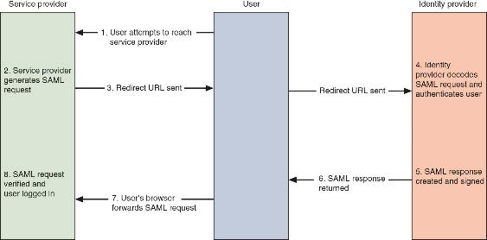
SAML Transaction

Slide 29
Secure Authentication Technologies
Name | Description | Explanation
OAuth (Open Authorization) | Open-source federation framework | OAuth 2.0 is a framework to support the development of authorization protocols
OpenID | Open standard decentralized authentication protocol | Authentication protocol that can be used in OAuth 2.0 as a standard means to obtain a user identity
Shibboleth | Open-source software package for designing SSO | Uses federation standards to provide SSO and exchanging attributes

Slide 30
Secure Authentication Technologies
Passkeys refer to various methods for storing authenticating information in hardware
Passkeys do not rely on passwords
  They combine multiple authentication factors into a single package that is managed by the device’s OS
Passkeys are also “discoverable,” which means an enrolled device can automatically push a passkey through an encrypted tunnel to another device that is attempting to sign in

Slide 31
Access Control Schemes
An access control scheme is a predefined framework, embedded in the software and hardware, that administrators can use for controlling access
The Discretionary Access Control (DAC) scheme is the least restrictive, where every object has an owner, who has total control over that object
Two weaknesses of DAC include the following:
  DAC relies on decisions by the user to set security
  Permission will be inherited by any programs the subject executes

Slide 32
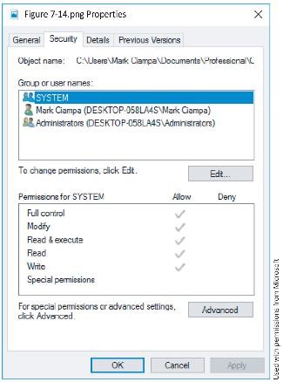
Windows DAC

Slide 33
Access Control Schemes
Mandatory Access Control (MAC) assigns users’ access controls strictly according to the custodian’s desires
The following are two key elements to MAC:
  Labels – every entity is assigned a classification label
  Levels – a hierarchy based on the labels is used for objects and subjects
Microsoft Windows uses Mandatory Integrity Control (MIC) that ensures data integrity by controlling access using a security identifier (SID)

Slide 34
Access Control Schemes
Role-Based Access Control (RBAC) is based on a user’s job function within an organization
  The RBAC scheme assigns permissions to particular roles and then assigns users to those roles
Rule-Based Access Control is used for managing user access to one or more systems, where business changes may change access rules
Attribute-Based Access Control (ABAC) uses more flexible policies that can combine attributes

Slide 35
Access Control Schemes
Name | Explanation | Description
Mandatory Access Control (MAC) | End-user cannot set controls | Most restrictive scheme
Discretionary Access Control (DAC) | Subject has total control over objects | Least restrictive scheme
Role-Based Access Control (RBAC) | Assigns permissions to particular roles in the organization and then users are assigned to roles | Considered a more “real-world” approach
Rule-Based Access Control | Dynamically assigns roles to subjects based on a set of rules defined by a custodian | Used for managing user access to one or more systems
Attribute-Based Access Control (ABAC) | Uses policies that can combine attributes | Most flexible scheme

Slide 36
Access Control Lists (ACLs)
An access control list (ACL) is a set of permissions (authorizations) that is attached to an object
  The list specifies who are allowed to access an object and what operations they can perform on it
ACLs provide filesystem permissions for protecting files managed by the OS
Some disadvantages of ACLs includes inefficiency and difficulty to manage in an enterprise setting

