Slide 1
Chapter 1: Introduction to Information Security

Slide 2
Understanding Security
Security is the state of being free from danger, which is the goal of security
  It is also defined as the “measures taken to ensure safety”, which is the process of security
As security is increased, convenience is often decreased
  The more secure something is, the less convenient it may become to use

Slide 3
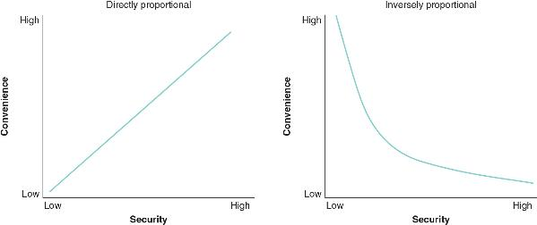
Understanding Security

Slide 4
Principles of Security
The following are three types of security protections (CIA):
  Confidentiality ensures that only approved individuals may access information
  Integrity ensures that information is correct and unaltered
  Availability ensures that information is accessible to authorized users

Slide 5
Principles of Security
Another security principle involves controlling access to information and involves authentication, authorization, and accounting
  Authentication is the act of ensuring a user’s credentials as authentic
  Authorization grants permission for a user to take a particular action
  Accounting creates a record that is preserved of who accessed the network, what resources they accessed, and when they disconnected from the network

Slide 6
Principles of Security
A security control is a safeguard that is employed within an enterprise to protect the CIA of information and can include the following:
  Deterrent controls
  Preventive controls
  Detective controls
  Compensating controls
  Corrective controls
  Directive controls

Slide 7
Cybersecurity vs Information Security
Cybersecurity usually involves a range of practices, processes, and technologies intended to protect devices, networks, and programs that process and store data in an electronic form
Information security protects “processed data” that is essential in an enterprise environment

Slide 8
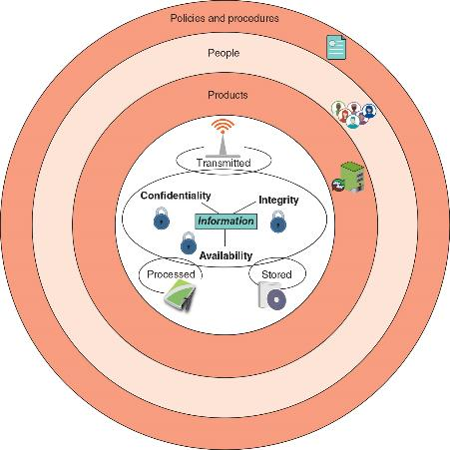
Defining Information Security

Slide 9
Question?
Serafina is studying to take the Security+ certification exam. Which of the following of the CIA elements ensures that only authorized parties can view protected information?

Slide 10
Answer
Serafina is studying to take the Security+ certification exam. Which of the following of the CIA elements ensures that only authorized parties can view protected information?
Confidentiality ensures that only authorized parties can view the information. Providing confidentiality can involve several different security tools, ranging from software to encrypt the credit card number stored on the web server to door locks to prevent access to those servers.

Slide 11
Threat Actors and Their Movements
A threat actor is an individual or entity responsible for attacks
  The generic term attacker is also commonly used
Financial crime is often divided into three categories based on targets:
  Individual users
  Enterprises
  Governments
Threat actors can be categorized as unskilled attackers, shadow IT, organized crime, insiders, hacktivists, nation-state actors, and others

Slide 12
Unskilled Attackers
Individuals who want to perform attacks yet lack the technical knowledge to carry them out are sometimes called unskilled attackers
Easy-to-use attacks tools are freely available or can be purchased at a low cost to perform sophisticated attacks
Unskilled attackers use these types of tools to carry out their attacks
Their motivation is usually data exfiltration or service disruption

Slide 13
Shadow IT
The process of bypassing corporate approval for technology purchases is known as shadow IT
The employee’s motivation is often ethical, but it often weakens security

Slide 14
Organized Crime
Organized crime is a close-knit group of highly-centralized enterprises set up for the purpose of engaging in illegal activities
In recent years, organized crime has moved into cyberattacks
They consider this to be less risky and more rewarding than traditional crime
The motivation is generally financial gain

Slide 15
Insider Threats
Another threat comes from a company’s own employees, contractors, and business partners, called insiders
Motivation could be revenge or blackmail
Attacks from insider threats are hard to recognize

Slide 16
Hacktivists
Groups or individuals that are strongly motivated by ideology (for the sake of their principles or beliefs) are hacktivists
The types of attacks by hacktivists often involve breaking into a website and changing its contents as a means of a political statement
Other attacks are retaliatory:
  Hacktivists have disabled a bank’s website that didn’t allow online payments deposited into accounts belonging to groups supported by hacktivists
The motivation is to cause disruption/chaos

Slide 17
Nation-State Actors
Governments are increasingly employing their own state-sponsored attackers for launching cyberattacks against their foes
  These attackers are known as nation-state actors
Nation-state actors are often involved in multiyear intrusion campaigns targeting highly sensitive economic, proprietary, or national security information
A new class of attacks called advanced persistent threat (APT) use innovative attack tools that silently extract data over an extended period of time

Slide 18
Other Threat Actors
Threat actor | Description | Explanation
Competitors | Launch attack against an opponent’s system to steal classified information | Competitors may steal new product research or a list of current customers to gain a competitive advantage
Brokers | Sell their knowledge of a weakness to other attackers or governments | Individuals who uncover weaknesses do not report them to the software vendor but instead sell them to the highest bidder, who are willing to pay a high price for the unknown weakness
Cyberterrorists | Attack a nation’s network and computer infrastructure to cause disruption and panic among citizens | Targets may include a small group of computers or networks that can affect the largest number of users, such as the computers that control the electrical power grid of a state or region

Slide 19
Question?
What is the motivation of an employee who practices shadow IT?

Slide 20
Answer
What is the motivation of an employee who practices shadow IT?
The process of bypassing corporate approval for technology purchases is known as shadow IT. The employee’s motivation is often ethical (it has sound moral principles) but nevertheless weakens security.

Slide 21
Threat Vectors and Attacks Surfaces
An attack surface (threat vector) is a digital platform that threat actors target for their exploits
Some attack surfaces can be considered mainstream for several reasons:
  They have been the primary targets of threat actors
  These attack surfaces are found in all technology settings
  They continue to bear the brunt of attacks today

Slide 22
Threat Vectors and Attacks Surfaces
Other threat vectors are more specialized and can be divided into categories such as communications and supply chain
The most common communication tools are message-based and include email, texts, instant messages, and voice calls
A supply chain is a network that moves a product from its creation to the end-user
  Each link in a supply chain can be a potential threat vector
  Malware can be injected into a product during its manufacturing, storage, and distribution (called supply chain infections)

Slide 23
Threat Vectors and Attacks Surfaces
Software supply chains have recently been the target of attackers
An alarming type of supply chain infection targets open-source software, which is software where the source code is available for anyone to freely use without restrictions
  Threat actors add their malicious code to an open-source project, which is then downloaded and installed by unsuspecting victims

Slide 24
Categories of Vulnerabilities
A vulnerability is the state of being exposed to the possibility of being attacked or harmed
Cybersecurity vulnerabilities can be categorized into software, hardware, misconfigurations, and zero-day vulnerabilities
Software
  Vulnerabilities are predominately found in software, with OS software being the chief culprit
  Attacks may include a malicious update

Slide 25
Categories of Vulnerabilities
Hardware
  The following hardware vulnerabilities can lead to a successful attack:
    Difficulty patching firmware, legacy platforms, and end-of-life (EOL) hardware
Misconfigurations
  Often configuration settings are not properly implemented, resulting in misconfigurations that can then result in vulnerabilities

Slide 26
Categories of Vulnerabilities
Zero-day vulnerabilities
  Vulnerabilities can be exploited by attackers before anyone else even knows it exists
  This type of vulnerability is called a zero-day because it provides zero days of warning
  Zero-day vulnerabilities are considered extremely serious

Slide 27
Impacts of Attacks
A successful attack always results in several negative impacts
These impacts can be classified as the following:
  Data impacts (see Table 1-8 on the following slide)
  Overall effects
    The attack may make systems inaccessible (availability loss), which results in lost productivity (financial loss)
    Attacks may affect the public perception of the enterprise (reputation)

Slide 28
Impacts of Attacks
Impact | Description | Example
Data loss | The destruction of data so that it cannot be recovered | Maliciously erasing patient data used for cancer research
Data exfiltration | Stealing data to distribute it to other parties | Taking a list of current customers and selling it to a competitor
Data breach | Stealing data to disclose it in an unauthorized fashion | Theft of credit card numbers to sell to other threat actors
Identity theft | Taking personally identifiable information to impersonate someone | Stealing a Social Security number to secure a bank loan in the victim’s name

Slide 29
Information Security Resources
Defenders have the following external cybersecurity resources to help ward off attacks:
  Frameworks
  Regulations
  Legislation
  Standards
  Benchmarks/secure configuration guides
  Information sources

Slide 30
Frameworks
An information security framework is a series of documented processes used to define policies and procedures for implementation and management of security controls in an enterprise environment
The National Institute of Standards and Technology (NIST) frameworks are divided into three basic parts:
  Framework core
  Implementation tiers
  Profiles

Slide 31
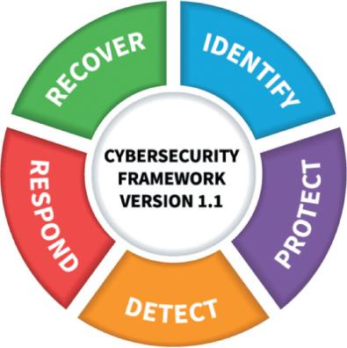
Frameworks

Slide 32
Regulations
The process of adhering to regulations is called regulatory compliance
Most organizations must follow multiple regulations from different regulatory bodies
For information security, there are the following:
  Broadly applicable regulations
  Industry-specific-regulations
  U.S. state regulations
  International regulations

Slide 33
Legislation
Specific legislation or laws can be enacted by governing bodies that can provide an information security resource
  These include national, territorial, and state laws
With the number of different entities involved in passing multiple legislation, this often leads to a “hodge-podge” of legislation and is not always a good cybersecurity resource

Slide 34
Standards
A standard is a document approved through consensus by a recognized standardization body
  It provides for frameworks, rules, guidelines, or characteristics for products or related processes and production methods
One information security compliance standard is the Payment Card Industry Data Security Standard (PCI DSS)

Slide 35
Benchmarks/Secure Configurations
Benchmarks/secure configuration guides are usually distributed by hardware manufacturers and software developers
  They serve as a guideline for configuring a device or software so that it is resilient to attacks
Usually these are platform-/vendor-specific guides that only apply to specific products

Slide 36
Information Sources
Requests for comments (RFCs) are document “white papers” that are authored by technology bodies employing specialists, engineers, and scientists who are experts in those areas
Data feeds are continually maintained databases of the latest cybersecurity incidences
Common cybersecurity data feeds include vulnerability feeds that provide information on the latest vulnerabilities
The adversary tactics, techniques, and procedures (TTP) is a database of the behavior of threat actors and how they manage attacks

Slide 37
Question?
What is another name for “attack surface”?

Slide 38
Answer
What is another name for “attack surface”?
An attack surface, also called a threat vector, is a digital platform that threat actors target for their exploits.

