Slide 1
Fundamentals of Cryptography

Slide 2
Steganography: Hiding the Message
Steganography hides the existence of data
An image, audio, or video file can contain hidden messages embedded in the file
  It is achieved by dividing data and hiding in unused portions of the file
A common scheme is to hide data in the file header fields that describe the file, between sections of the metadata (data used to describe the content or structure of the actual data)

Slide 3
Cryptography: Hiding the Meaning
Cryptography is the practice of transforming (“scrambling”) information so that its meaning cannot be understood by unauthorized parties
  One method is transposition, in which each letter of the message is rearranged
  Another method is substitution, where one letter is substituted for another letter

Slide 4
Cryptography: Hiding the Meaning
The process of changing the original text into a scrambled message is known as encryption (the reverse process is decryption)
The following terminology applies to cryptography:
  Plaintext is unencrypted data that is input for encryption or is the output of decryption
  Ciphertext is the scrambled and unreadable output of encryption
  Cleartext is unencrypted data that is not intended to be encrypted

Slide 5
Cryptography: Hiding the Meaning
Plaintext data is input into a cryptographic algorithm (also called a cipher), which consists of procedures based on a mathematical formula used to encrypt and decrypt the data
A key is a mathematical value entered into the algorithm to produce ciphertext
  The reverse process uses the key to decrypt the message
The critical factor in cryptography is that one or more elements must be kept secret at all costs
  The key for the algorithm must always be kept secret

Slide 6
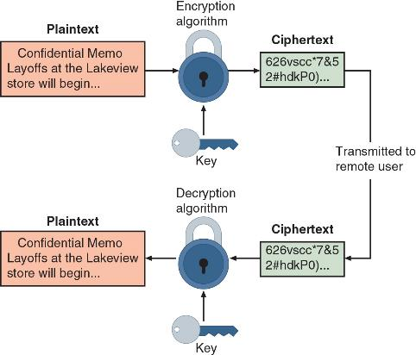
Cryptography: Hiding the Meaning

Slide 7
Benefits of Cryptography
Cryptography can provide the following security protections:
  Confidentiality ensures only authorized parties can view it
  Integrity ensures information is correct and unaltered
  Authentication ensures sender can be verified through cryptography
  Nonrepudiation proves that a user performed an action
  Obfuscation is making something obscure or unclear
Security through obscurity is an approach in security where virtually any system can be made secure as long as outsiders are unaware of it or how it functions

Slide 8
Question?
Layla has encrypted a document so that it can only be viewed by those who have been provided the key. What protection has she given to this document?

Slide 9
Answer
Layla has encrypted a document so that it can only be viewed by those who have been provided the key. What protection has she given to this document?
Confidentiality ensures that only authorized parties can view the information. Encrypted information that can only be viewed by those who have been provided the key is an example of confidentiality.

Slide 10
Cryptographic Algorithms
The three categories of cryptographic algorithms include the following:
  Hash algorithms
  Symmetric cryptographic algorithms
  Asymmetric cryptographic algorithms

Slide 11
Variations of Algorithms
A secure cryptographic algorithm that is hand-calculated is a one-time pad (OTP) that combines plaintext with a random key
  A pad is a long sequence of random letters
  To decipher the message, the recipient must have a copy of the pad
A stream cipher takes one character and replaces it with another
A block cipher manipulates an entire block of plaintext at one time
A sponge function takes as input a string of any length and returns a string of any requested variable length

Slide 12
Hash Algorithms
A hash algorithm creates a unique “digital fingerprint” of a set of data and is commonly called hashing
  This fingerprint, called a digest (sometimes called a message digest or hash), represents the contents
  It is primarily used for comparison purposes
Hashing is intended to be one way in that its digest cannot be reversed to reveal the original set of data
A hashing algorithm is considered secure if it has a fixed size, is unique, is original, and is secure (hash cannot be reversed to determine original plaintext)

Slide 13
Hash Algorithms
The following are considered to be secure hash algorithms:
  Secure Hash Algorithm (SHA)
  RipeMD
  Whirlpool
Hashing is often used as a check to verify that the original contents of an item have not been changed

Slide 14
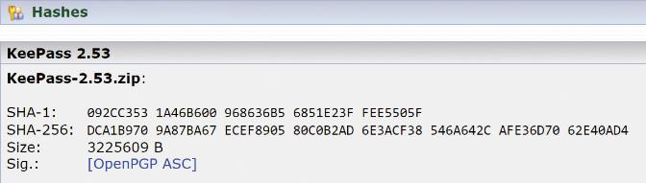
Hash Algorithms

Slide 15
Symmetric Cryptographic Algorithms
Symmetric cryptographic algorithms use the same key to encrypt and decrypt data
  It is also called private key cryptography because the key is kept private between the sender and receiver
Symmetric cryptography can provide strong encryption if the key is kept secure between the sender and the recipient
Some strong symmetric cryptographic algorithms include:
  Advanced Encryption Standard (AES)
  Blowfish and Twofish

Slide 16
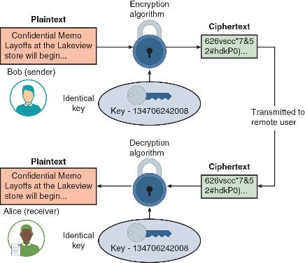
Symmetric Cryptographic Algorithms

Slide 17
Asymmetric Cryptographic Algorithms
The primary weakness of symmetric algorithms is that distributing and maintaining a secure key among multiple users poses challenges
  Asymmetric cryptographic algorithms use two mathematically related keys known as the public key and the private key
  It is also known as public key cryptography
The public key is available to everyone and is freely distributed
The private key is known only to the individual to whom it belongs

Slide 18
Asymmetric Cryptographic Algorithms
The following are some important principles regarding asymmetric cryptography:
  Key pairs
  Public key
  Private key
  Both directions - keys can work in both directions

Slide 19
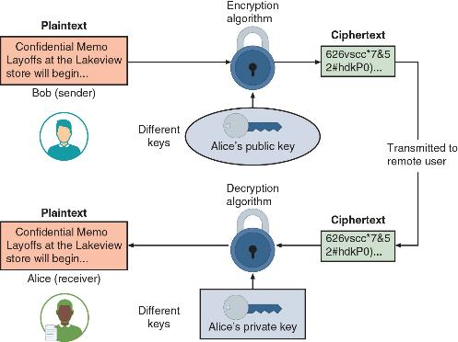
Asymmetric Cryptographic Algorithms

Slide 20
Asymmetric Cryptographic Algorithms
RSA asymmetric algorithm was published in 1977
  It multiplies two large prime numbers
  The basis of RSA encryption security is factoring
With elliptic curve cryptography (ECC), users share one elliptic curve and one point on the curve
  It uses less computing power than prime number-based asymmetric cryptography because the key sizes are smaller
  All modern OSs and web browsers rely on ECC

Slide 21
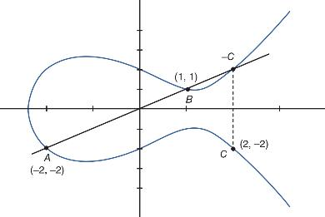
Asymmetric Cryptographic Algorithms

Slide 22
Asymmetric Cryptographic Algorithms
Digital Signature Algorithm (DSA) creates a digital signature which can do the following:
  Verify the sender, prevent the sender from disowning the message, and prove message integrity
Key Exchange
  There are different solutions for a key exchange that occurs within the normal communications channel (in-band) of cryptography:
    Diffie-Hellman (DH), Diffie-Hellman Ephemeral (DHE), Elliptic Curve Diffie-Hellman (ECDH), and Perfect forward secrecy

Slide 23
Question?
Which algorithm uses the same key to both encrypt and decrypt data?

Slide 24
Answer
Which algorithm uses the same key to both encrypt and decrypt data?
Symmetric cryptographic algorithms use the same key to encrypt and decrypt the data.

Slide 25
Encryption through Software
File and File System Cryptography
  Encryption software can be used to encrypt or decrypt files one-by-one (file-level encryption)
  Protecting groups of files can take advantage of the OS’s file system
  Third-party software tools available for encryption include GNU Privacy Guard (GnuPG), AxCrypt, Folder Lock, and VeraCrypt
  Microsoft Windows Encrypting File System (EFS) is a cryptography system for Windows that is tightly integrated with the file system
  Encryption and decryption are transparent to the user

Slide 26
Encryption through Software
Disk Encryption
  Full-disk encryption (FDE) protects all data on a hard drive
  An example: BitLocker drive encryption software that is included in Microsoft Windows
  BitLocker encrypts the entire disk, including the Windows Registry
  Volume-level encryption protects a volume, which is a section of a drive that is accessible by a user and has a file system associated with it

Slide 27
Encryption through Software
Database Encryption
  Database-level encryption occurs in one of two ways
  The plug-in method requires attaching an encryption module onto the DBMS
  Transparent data encryption (TDE) executes encryption and decryption within the database engine itself
  TDE does not require any additional packages or code modification of the database, engine, or DBMS and is easier to manage

Slide 28
Hardware Encryption
Cryptography can be embedded in hardware, which provides a higher degree of security
  It can be applied to USB devices and standard hard drives
Cryptographic features can be built into the hardware of a USB device which allows for all data written to be automatically encrypted
Some hardware-based USBs allow administrators to remotely prohibit accessing the data, lock out a user, or even instruct the drive to initiate a self-destruct sequence to destroy all data

Slide 29
Hardware Encryption
Self-encrypting drives (SEDs) are drives that can protect all data written to them
  The drive and host device perform authentication process during initial power up
  If authentication fails, the drive can be configured to deny access or even delete encryption keys so all data is permanently unreadable
A hardware security model (HSM) is a removable external cryptographic device that includes an onboard key generator and key storage facility
  It performs accelerated symmetric and asymmetric encryption

Slide 30
Hardware Encryption
A trusted execution environment (TEE) is a secure cryptoprocessor that is internal to the computer itself
  It protects the confidentiality and integrity of the code and data stored on it
The Trusted Platform Module (TPM) is an international standard for cryptoprocessors that provides cryptographic services
A TPM includes a random number generator and full support for asymmetric encryption and can also generate public and private keys
  On Apple and Android devices it is called a secure enclave

Slide 31
Blockchain
A blockchain is a shared, immutable ledger that facilitates the process of recording transactions and tracking assets in a business network
Blockchain technology allows a network of computers to agree at regular intervals on the true state of a distributed ledger
A public blockchain (open public ledger) is a blockchain network that anyone can join and become a part of
A private blockchain operates in a closed network
A federated blockchain (consortium blockchain) is typically used when organizations need both a public and private blockchain

Slide 32
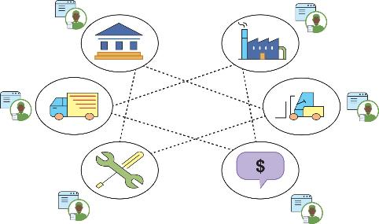
Blockchain

Slide 33
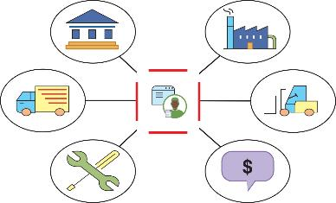
Blockchain

Slide 34
Limitations of Cryptography
Cryptography is a necessary feature to add to protect low-power devices and applications with fast response times to make them secure
Adding cryptography to low-power devices or those that have fast response times can be difficult
  Cryptographic algorithms require both time and energy, which results in a resource versus security constraint

Slide 35
Attacks on Cryptography
Two of the most common cryptography attacks are algorithm attacks and collision attacks
Methods attackers can use to circumvent strong algorithms include known ciphertext attacks and downgrade attacks
  Statistical tools can be used to attempt to discover a pattern in the ciphertexts, which can then be used to reveal the plaintext or key
  In a downgrade attack, an attacker forces the system to abandon the current higher security mode of operation and instead “fall back” to implementing an older and less secure mode

Slide 36
Attacks on Cryptography
A collision attack is an attempt to find two input strings of a hash function that produce the same hash result
  When two files have the same digest this is known as a collision
A birthday attack is based on the birthday paradox, which says that for there to be a 50 percent chance that someone in a given room shares your birthday, 253 people would need to be in the room

Slide 37
Attacks on Cryptography
Quantum computing relies on quantum physics using atomic-scale units (qubits) that can be both 0 and 1 at the same time
  It is possible for one qubit to carry out two separate streams of calculations simultaneously
Quantum computing also has a drawback for cybersecurity
  A single quantum computer could perform factoring by using hundreds of atoms in parallel to quickly factor huge numbers, rendering all current asymmetric cryptographic algorithms useless
Post-quantum cryptography algorithms are secure against an attack by a quantum computer

