Slide 1
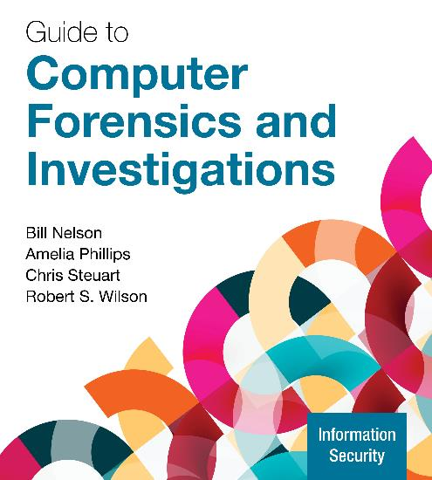
Guide to Computer Forensics and Investigations, 7e
Module 1: Understanding the Digital Forensics Profession and Investigations
Nelson/Phillips/Steuart/Wilson, Guide to Computer Forensics and Investigations, 7th Edition. ©2025 Cengage Learning, Inc. All Rights Reserved. May not be scanned, copied or duplicated, or posted to a publicly accessible website, in whole or in part.

Slide 2
Module Objectives (1 of 2)
By the end of this module, you should be able to:
Describe the field of digital forensics
Explain how to prepare computer investigations and summarize the difference between public-sector and private-sector investigations
Explain the importance of maintaining professional conduct
Describe how to prepare a digital forensics investigation by taking a systematic approach
Describe procedures for private-sector digital investigations

Slide 3
Module Objectives (2 of 2)
By the end of this module, you should be able to (continued):
Explain requirements for data recovery workstations and software
Summarize how to conduct an investigation, including critiquing a case

Slide 4
An Overview of Digital Forensics (1 of 2)
Digital forensics is defined as the application of computer science and investigative procedures for a legal purpose involving the analysis of digital evidence after proper search authority, chain of custody, validation with mathematics, use of validated tools, repeatability, reporting, and possible expert presentation
In October 2012, an ISO standard for digital forensics was ratified
It defines the personnel and methods for acquiring and preserving digital evidence

Slide 5
An Overview of Digital Forensics (2 of 2)
The Federal Rules of Evidence (FRE) was created to ensure consistency in federal proceedings
It was signed into law in 1973 and many states’ rules map to it
The Fourth Amendment to the U.S. Constitution protects everyone’s right to be secure from search and seizure
Separate search warrants might not be necessary for digital evidence
Every U.S. jurisdiction has case law related to the admissibility of evidence recovered from computers and other digital devices

Slide 6
Digital Forensics and Other Related Disciplines (1 of 3)
Investigating digital devices includes the following:
Collecting data securely
Examining suspect data to determine details such as origin and content
Presenting digital information to courts
Applying laws to digital device practices
Digital forensics is different from data recovery, which involves retrieving information that was deleted by mistake or lost during a power surge or server crash
In data recovery, you typically know what you are looking for

Slide 7
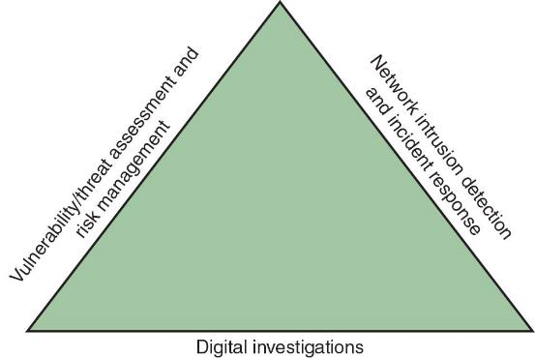
Digital Forensics and Other Related Disciplines (2 of 3)
Figure 1-1 Investigations triad
Forensics investigators often work as part of a team, known as the investigations triad

Slide 8
Digital Forensics and Other Related Disciplines (3 of 3)
Vulnerability/threat assessment and risk management tests and verifies the integrity of stand-alone workstations and network servers
Network intrusion detection and incident response detects intruder attacks by using automated tools and monitoring network firewall logs
Digital investigations manages investigations and conducts forensics analysis of systems suspected of containing evidence

Slide 9
A Brief History of Digital Forensics Tools
By the early 1990s, the International Association of Computer Investigative Specialists (IACIS) introduced training on software for digital forensics
IRS created search-warrant programs
ASR Data created Expert Witness for Macintosh
ILook is currently maintained by the IRS Criminal Investigation Division
AccessData Forensic Toolkit (FTK) is a popular commercial product

Slide 10
Understanding Case Law
Existing laws can’t keep up with the rate of technological change
When statutes don’t exist, case law is used
It allows legal counsel to apply previous similar cases to current ones in an effort to address ambiguity in laws
Examiners must be familiar with recent court rulings on search and seizure in the electronic environment

Slide 11
Developing Digital Forensics Resources
To supplement your knowledge, consider the following:
Be familiar with Linux, macOS, and current Windows platforms
Develop and maintain contact with computing, network, and investigative professionals
Join computer user groups in both the pubic and private sectors
Example: Computer Technology Investigators Network (CTIN) meets to discuss problems with digital forensics examiners
Consult outside experts

Slide 12
Preparing for Digital Investigations
Public-sector investigations involve government agencies responsible for criminal investigations and prosecution
The Fourth Amendment to the U.S. Constitution restricts government search and seizure
The Department of Justice (DOJ) updates information on computer search and seizure regularly
Private-sector investigations focus more on policy violations

Slide 13
Understanding Public-Sector Investigations (1 of 2)
When conducting public-sector investigations, you must understand laws on computer-related crimes including:
Standard legal processes
Guidelines on search and seizure
How to build a criminal case
A criminal investigation usually begins when someone finds evidence of or witnesses a crime
The witness or victim makes an allegation to the police

Slide 14
Understanding Public-Sector Investigations (2 of 2)
A Digital Evidence First Responder (DEFR) arrives on an incident scene, assesses the situation, and takes precautions to acquire and preserve evidence
A Digital Evidence Specialist (DES) has the skill to analyze the data and determine when another specialist should be called in to assist
An affidavit is a sworn statement of support of facts about or evidence of a crime
It must include exhibits that support the allegation

Slide 15
Understanding Private-Sector Investigations (1 of 5)
Private-sector investigations involve private companies and lawyers who address company policy violations and litigation disputes
An example would be wrongful termination
Private-sector crimes can involve the following:
Email harassment, gender and age discrimination, and white-collar crimes such as falsification of data embezzlement, sabotage, and industrial espionage

Slide 16
Understanding Private-Sector Investigations (2 of 5)
Most important policies define rules for using the company’s computers and networks and is known as an “Acceptable use policy”
A line of authority states who has the legal right to initiate an investigation, who can take possession of evidence, and who can have access to evidence
Business can avoid litigation by displaying a warning banner on computer screens

Slide 17
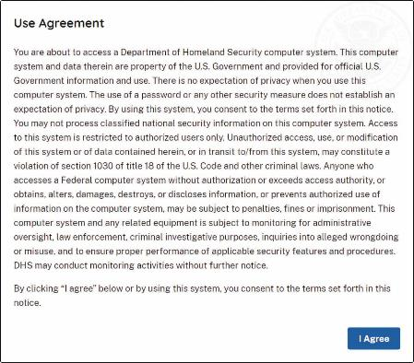
Understanding Private-Sector Investigations (3 of 5)
Figure 1-8 A sample warning banner

Slide 18
Understanding Private-Sector Investigations (4 of 5)
Businesses are advised to specify an authorized requester who has the power to initiate investigations
During private investigations, you search for evidence to support allegations of violations of a company’s rules or an attack on its assets
Three types of situations are common:
Abuse or misuse of computing assets
Email abuse
Internet abuse
A private-sector investigator’s job is to minimize risk to the company

Slide 19
Understanding Private-Sector Investigations (5 of 5)
The distinction between personal and company computer property can be difficult with cell phones, smartphones, personal notebooks, and tablet computers
In today’s bring your own device (BYOD) environment, some companies state that if you connect a personal device to the business network, it falls under the same rules as company property

Slide 20
Knowledge Check Activity 1-1
Digital forensics differs from data recovery because ___________.
digital forensics is dealing with the unknown
in data recovery, you typically know what you are looking for
digital forensics may be conducted in criminal or civil cases
data recovery is easier

Slide 21
Knowledge Check Activity 1-1: Answer
Digital forensics differs from data recovery because ___________.
Answer: b. in data recovery, you typically know what you are looking for
In digital forensics, you are doing an investigation and are looking for clues or evidence that applies to the case. As the answer states, in data recovery, you typically know what you are looking for.

Slide 22
Maintaining Professional Conduct
Professional conduct includes ethics, morals, and standards of behavior
An investigator must exhibit the highest level of professional behavior at all times by doing the following
Maintaining objectivity
Maintaining credibility by maintaining confidentiality
Investigators should also attend training to stay current with the latest technical changes in computer hardware and software, networking, and forensic tools

Slide 23
Maintaining a Digital Forensics Investigation
The role of a digital forensics professional is to gather evidence to prove that a suspect committed a crime or violated a company policy
Collect evidence that can be offered in court or at a corporate inquiry
Investigate the suspect’s computer
Preserve the evidence on a different computer
Chain of custody is the route the evidence takes from the time you find it until the case is closed or goes to court

Slide 24
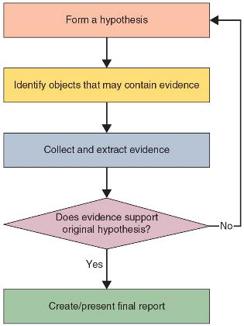
Five Steps of an Investigation
Figure 1-9 Five steps of an investigation

Slide 25
An Overview of a Computer Crime
Computers can contain information that helps law enforcement determine:
Chain of events leading to a crime
Evidence that can lead to a conviction
Law enforcement officers should follow proper procedure when acquiring the evidence
After your preliminary assessment, you identify the potential challenges, then you can begin the actual investigation and data retrieval

Slide 26
Taking a Systematic Approach (1 of 7)
Steps for problem-solving include the following:
Make an initial assessment about the type of case you are investigating
Determine a preliminary design or approach to the case
Create a detailed checklist
Determine the resources you need
Obtain and copy an evidence drive
Identify the risks

Slide 27
Taking a Systematic Approach (2 of 7)
Steps for problem-solving include the following (continued):
Mitigate or minimize the risks
Test the design
Analyze and recover the digital evidence
Investigate the data you recover
Complete the case report
Critique the case

Slide 28
Taking a Systematic Approach (3 of 7)
Assess the case by outlining the case details as follows:
Situation
Nature of the case
Specifics of the case
Type of evidence
Known disk format
Location of evidence
Based on these details, you can determine the case requirements

Slide 29
Taking a Systematic Approach (4 of 7)
A basic investigation plan should include the following activities:
Acquire the evidence
Complete an evidence form and establish a chain of custody
Transport the evidence to a computer forensics lab
Secure evidence in an approved secure container
Prepare your forensics workstation
Retrieve the evidence from the secure container

Slide 30
Taking a Systematic Approach (5 of 7)
A basic investigation plan should include the following activities (continued):
Make a forensic copy of the evidence
Return the evidence to the secure container
Process the copied evidence with computer forensics tools

Slide 31
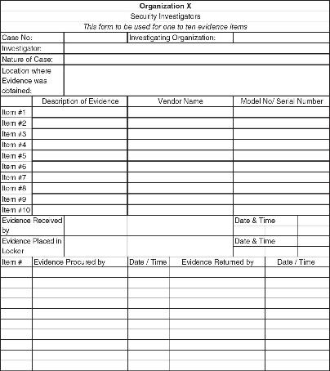
Taking a Systematic Approach (6 of 7)
Figure 1-12 A sample multi-evidence form used in a private-sector environment

Slide 32
Taking a Systematic Approach (7 of 7)
Secure your evidence by doing the following:
Use evidence bags to secure and catalog the evidence
Use computer safe products when collecting computer evidence such as antistatic bags and antistatic pads
Use well padded containers
Use evidence tape to seal all openings
You should write your initials on the tape before applying it to the evidence

Slide 33
Procedures for Private-Sector High-Tech Investigations
Employee Termination Cases
The majority of investigative work for termination cases involves employee abuse of corporate assets
Incidents that create a hostile work environment are the predominant types of cases investigated
Viewing pornography in the workplace and sending inappropriate emails are examples
Organizations must have appropriate policies in place

Slide 34
Internet Abuse Investigations
The following are recommended steps when processing Internet abuse:
Use standard forensic analysis techniques and procedures
Use appropriate tools to extract all webpage URL information
Contact the network firewall administrator and request a proxy server log
Compare the data recovered from forensic analysis to the proxy server log
Continue analyzing the computer’s disk drive data

Slide 35
Email Abuse Investigations
The following steps outline the recommended procedure for email investigations:
For computer-based email files, use the standard forensic analysis techniques and procedures
For server-based email data files, obtain an electronic copy of the suspect’s and victim’s email folder or data
For web-based email investigations, search for Internet keywords to extract all related email address information
Examine header data of all messages of interest to the investigation

Slide 36
Attorney-Client Privilege Investigations (1 of 2)
Under attorney-client privilege (ACP) rules for an attorney, you must keep all findings confidential
Steps for conducting an ACP case include the following:
Request a memo from the attorney directing you to start the investigation
Request a list of keywords of interest to the investigation
Initiate the investigation and analysis
For disk drive examinations, make two bit-stream images using different tools for each image
Compare hash signatures on all files on the original and re-created disks

Slide 37
Attorney-Client Privilege Investigations (2 of 2)
Steps for conducting an ACP case include the following (continued):
Methodically examine every portion of the disk drive and extract all data
Run keyword searches on allocated and unallocated disk space
For Windows OSs, use specialty tools to analyze and extract data from the Registry
For binary data files such as CAD drawings, locate the correct software product
For unallocated data recovery, use a tool that removes or replaces nonprintable data

Slide 38
Industrial Espionage Investigations
Steps to conducting an industrial espionage case include the following:
Gather all personnel assigned to the investigation and brief them on plans
Gather resources needed to conduct the investigation
Place surveillance systems at key locations
Discreetly gather any additional evidence
Collect all log data from networks and email servers
Report regularly to management and corporate attorneys
Review the investigation’s scope with management and corporate attorneys

Slide 39
Interviews and Interrogations in High-Tech Investigations
An interview is usually conducted to collect information from a witness or suspect about specific facts related to an investigation
An interrogation is the process of trying to get a suspect to confess
A digital investigator should instruct the investigator conducting the interview on what questions to ask and what the answers should be
Ingredients for a successful interview or interrogation
Being patient throughout the session
Repeating or rephrasing questions to zero in on specific facts
Being tenacious

Slide 40
Understanding Data Recovery Workstations and Software
A forensic workstation is a specifically configured computer loaded with additional bays and forensics software
Write-blockers devices enable you to boot to Windows without writing data to the evidence drive
There are hardware write-blockers as well as software write-blockers
Windows products are being developed that make performing disk forensics easier

Slide 41
Setting Up Your Workstation for Digital Forensics (1 of 2)
Basic requirements include the following:
A workstation running Windows 10 or later
A write-blocker device
Digital forensics acquisition tool
Digital forensics analysis tool
Target drive to receive the source or suspect disk data
Spare PATA or SATA ports
USB ports

Slide 42
Setting Up Your Workstation for Digital Forensics (2 of 2)
Additional useful items include the following:
Network interface card (NIC)
Extra USB ports
FireWire 400/800 ports
SCSI card
Disk-editor tool
Text-editor tool
Graphics viewer program and other specialized viewing tools
Other specialized viewing tools

Slide 43
Conducting an Investigation
Gather resources identified in investigation plan including the following:
Original storage media
Evidence custody form
Evidence container for the storage media
Bit-stream imaging tool
Forensic workstation to copy and examine your evidence
Securable evidence locker, cabinet, or safe

Slide 44
Gathering the Evidence
Perform the following steps:
Meet the IT manager to interview him
Fill out the evidence form, have the IT manager sign
Place the evidence in an evidence bag
Carry the evidence to the computer forensics lab
Complete the evidence custody form
Secure evidence by locking the container

Slide 45
Understanding Bit-Stream Copies
A bit-stream copy is a bit-by-bit copy of the original storage medium
It is different from a simple backup copy
Backup software can only copy known files and cannot copy deleted files, email messages or recover file fragments
A bit-stream image is the file containing the bit-stream copy of all data on a disk or partition
It is usually referred to as “image” or “image file”
Copy the image file to a target disk that matches the original disk’s manufacturer, size and model

Slide 46
Analyzing Your Digital Evidence (1 of 4)
When analyzing digital evidence, your job is to recover data
Deleted files linger on the disk until new data is saved on the same physical location
Forensic tools such as Autopsy can be used to retrieve deleted files for use as evidence

Slide 47
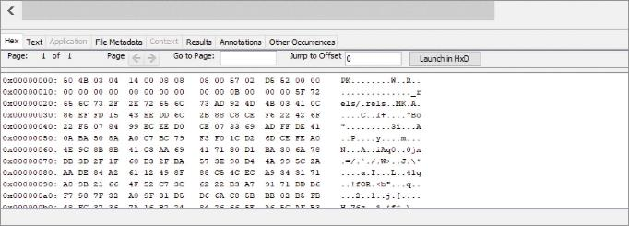
Analyzing Your Digital Evidence (2 of 4)
Figure 1-20 Hex tab in Content Viewer of Autopsy

Slide 48
Analyzing Your Digital Evidence (3 of 4)
Completing the Case
You need to produce a final report stating what you did and what you found
Repeatable findings means being able to repeat the steps and produce the same result
If necessary, use a template
Your report should show conclusive evidence
Include an Autopsy report to document your work

Slide 49
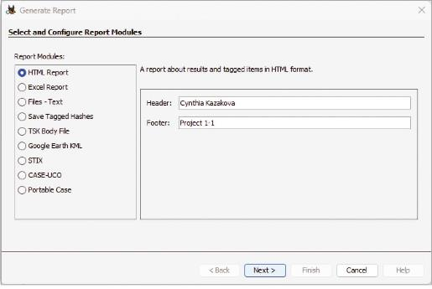
Analyzing Your Digital Evidence (4 of 4)
Figure 1-21 Generate Report window of Autopsy

Slide 50
Critiquing the Case
Ask yourself the following questions:
How could you improve your performance in the case?
Did you expect the results you found? Did the case develop in ways you did not expect?
Was the documentation as thorough as it could have been?
What feedback has been received from the requesting source?
Did you discover any new problems? If so, what are they?
Did you use new techniques during the case or during research?

Slide 51
Knowledge Check Activity 1-2
Digital forensics workstations must have _________. (Choose all that apply.)
a data-acquisition tool
a write-blocker
FireWire
an SCSI card

Slide 52
Knowledge Check Activity 1-2: Answer
Digital forensics workstations must have _________. (Choose all that apply.
Answer: a. a data-acquisition tool, b. a write-blocker
A digital forensics workstation must have a data-acquisition tool to be able to connect to a device and retrieve the data. They also must have a physical or validated software write-blocker to guarantee the data is not altered during acquisition.

Slide 53
Self Assessment
Describe the five steps in planning an investigation.
What are three things you should do when conducting an internal corporate investigation?

Slide 54
Summary (1 of 2)
Now that the lesson has ended, you should be able to:
Describe the field of digital forensics
Explain how to prepare computer investigations and summarize the difference between public-sector and private-sector investigations
Explain the importance of maintaining professional conduct
Describe how to prepare a digital forensics investigation by taking a systematic approach
Describe procedures for private-sector digital investigations

Slide 55
Summary (2 of 2)
Now that the lesson has ended, you should be able to (continued):
Explain requirements for data recovery workstations and software
Summarize how to conduct an investigation, including critiquing a case

