Slide 1
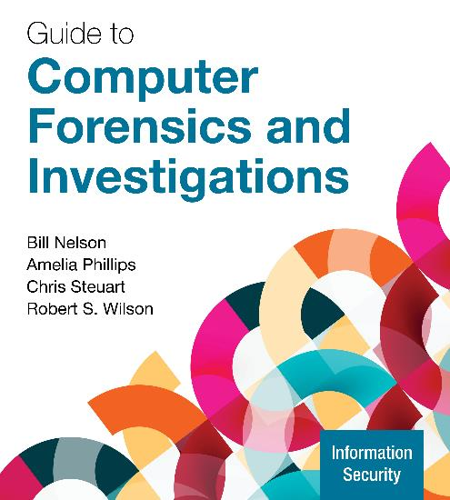
Guide to Computer Forensics and Investigations, 7e
Module 2: Report Writing and Testimony for Digital Investigations
Nelson/Phillips/Steuart/Wilson, Guide to Computer Forensics and Investigations, 7th Edition. ©2025 Cengage Learning, Inc. All Rights Reserved. May not be scanned, copied or duplicated, or posted to a publicly accessible website, in whole or in part.

Slide 2
Module Objectives
By the end of this module, you should be able to:
Explain the importance of reports and testimony and preparing to testify
Describe guidelines for writing reports
Describe procedures for generating report findings and writing a digital forensics report
Explain the preparation necessary for testifying as a fact witness or an expert witness
Describe guidelines for testifying in court and in depositions

Slide 3
Understanding the Importance of Reports with a View to Testifying
Forensic reports can accomplish the following:
Provide justification for collecting more evidence
Be used at a probable cause hearing
Communicate expert opinion
Keep a copy of any deposition notice or subpoena so that you can include the following:
Jurisdiction
Style of the case
Cause number
Date and location of the deposition

Slide 4
Limiting a Report to Specifics
All reports to clients should start with the job mission or goal, which usually consists of the following:
Find information on a specific subject
Recover certain important documents
Recover certain types of files with specific dates and times
Before you begin writing, identify your audience and the purpose of the report

Slide 5
Types of Reports (1 of 3)
A verbal report is often a preliminary to written reports and addresses the following:
Tests that have not been concluded
Interrogatories
Document production
Who should be deposed and the plan for deposing them
A written report may be an affidavit or a declaration

Slide 6
Types of Reports (2 of 3)
An examination plan serves as a guide to know what questions to expect when testifying
The attorney uses the examination plan to guide you in your testimony
You can propose changes to clarify or define information
Your contribution helps your attorney learn the terms and functions used in computer forensics

Slide 7
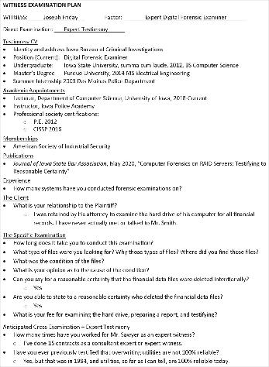
Types of Reports (3 of 3)
Figure 2-1 A sample examination plan

Slide 8
Guidelines for Writing Reports
An expert responds to hypothetical questions based on factual evidence
An expert witness may testify to an opinion or conclusion, if four basic conditions are met:
Opinion, inferences, or conclusions depend on special knowledge, skills, or training
Witness should qualify as a true expert in the field
Witness must testify to a reasonable degree of certainty
Experts must know facts on which their opinions are based, or they must testify to a hypothetical question

Slide 9
What to Include in Written Preliminary Reports (1 of 2)
Discovery is the process of opposing attorneys seeking information from each other
Written preliminary reports are considered high-risk documents
It’s better if there’s no written report to provide
Destroying the report could be considered destroying or concealing evidence (spoliation)

Slide 10
What to Include in Written Preliminary Reports (2 of 2)
Include the same information as in verbal reports
Additional items to include in your report include the following:
A summary of your billing to date and estimated costs
Examiner notes
The tentative conclusion
Areas that require further investigation
A request for confirmation from the attorney on the scope of your examination

Slide 11
Report Structure
A complex report usually includes the following sections:
Abstract (summary)
Table of contents
Body of report
Conclusion
Appendices
Glossary
References
Acknowledgements

Slide 12
Writing Reports Clearly (1 of 2)
Consider the following when writing reports:
Communicative quality
Ideas and organization
Grammar and vocabulary
Punctuation and spelling
Lay out ideas in logical order
Build arguments piece by piece
Group related ideas and sentences into paragraphs

Slide 13
Writing Reports Clearly (2 of 2)
Considering writing style
Use a natural language style
Avoid repetition, vague language, and generalizations
Use active rather than passive voice
Avoid presenting too many details and personal observations
Be objective
Including signposts
Draw reader’s attention to a point

Slide 14
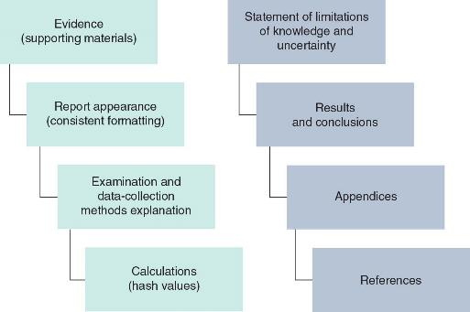
Designing the Layout and Presentation of Reports (1 of 4)
Figure 2-2 Digital forensics report elements

Slide 15
Designing the Layout and Presentation of Reports (2 of 4)
Evidence – Supporting Material
Use material such as figures, tables, data, and equations to help tell the story as it unfolds
Report Appearance – Consistent Formatting
How you format text is less important than being consistent
Examination and Data-Collection Methods Explanation
Explain how you studied the problem, which should follow logically from the report’s purpose

Slide 16
Designing the Layout and Presentation of Reports (3 of 4)
Calculations – Hash Values
If you use any hashing algorithms, be sure to give the common name
Statement of Limitations of Knowledge and Uncertainty
Protect your credibility
Results and Conclusions
Explain your findings, using subheadings to divide the discussion into logical parts
Save broader generalizations and summaries for the conclusion

Slide 17
Designing the Layout and Presentation of Reports (4 of 4)
Appendices
You can include appendices containing material such as raw data, figures not used in the body of the report, and anticipated exhibits
Arrange them in the order referred to in the report
References
Cite references by author’s last name and year of publication
Follow a standard format

Slide 18
Generating Report Findings and Writing the Digital Forensics Report
Digital forensics tools generate reports when performing analysis
It is still the digital forensics examiner’s responsibility to explain the significance of the evidence
Reports are typically in a text format such as the following:
Word processing document
HTML file
Spreadsheet

Slide 19
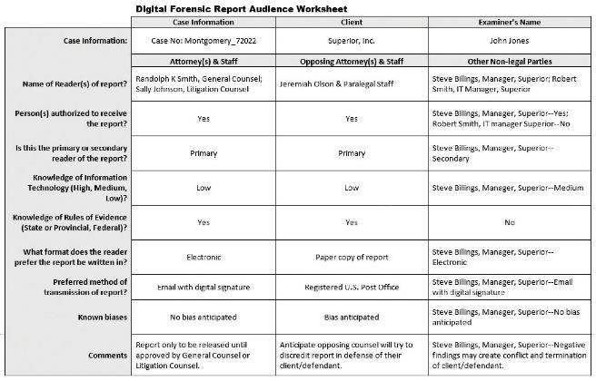
Determine Who Will Read the Report
Figure 2-3 Digital forensic report audience worksheet

Slide 20
Putting the Digital Forensics Report Together
The report-writing process should be completed in the following order:
Analyze the data and review the examiner notes
Write the first draft
Revise the draft and create the final report
Use Autopsy to complete Activity 2-1

Slide 21
Knowledge Check Activity 2-1
For verbal reports between the expert witness and the hiring attorney, what areas of an investigation are typically discussed? (Choose all that apply.)
All testing of findings that haven’t been completed
Interrogatories that need to be addressed to other parties
Requested document production
Identification of people who might need to be deposed

Slide 22
Knowledge Check Activity 2-1: Answer
For verbal reports between the expert witness and the hiring attorney, what areas of an investigation are typically discussed? (Choose all that apply.)
Answer: a. All testing of findings that haven’t been completed; b. Interrogatories that need to be addressed to other parties; c. Requested document production; d. Identification of people who might need to be deposed
All of the answer options presented in this question are correct.

Slide 23
Preparing for Testimony (1 of 2)
A fact witness provides facts found in an investigation
They explain what the evidence is and how it was obtained
They do not offer conclusions, only facts
An expert witness has opinions based on observations
Opinions are formed from experience and deductive reasoning
Opinions make the witness an expert

Slide 24
Preparing for Testimony (2 of 2)
When preparing your testimony review the following questions:
What is the client’s overall theory of the case?
What is my story of the case?
What can I say with confidence?
How does my opinion fit into the theory of the case?
What is the scope of the case? Have I gone too far?
Have I identified the client’s needs for how my testimony fits into the overall theory of the case?

Slide 25
Documenting and Preparing Evidence (1 of 3)
Document your steps to prove them repeatable
Validate your tools and verify evidence with hash algorithms
Do not use a formal checklist
Collect evidence and document employed tools
Maintain chain of custody
Collect the right amount of information
Note the date and time of your forensic workstation when starting your analysis

Slide 26
Documenting and Preparing Evidence (2 of 3)
Keep only successful output
Search for keywords using well-defined parameters
Keep your notes simple
List only relevant evidence on your report
Define any procedures you use to conduct your analysis as scientific

Slide 27
Documenting and Preparing Evidence (3 of 3)
Reviewing Your Role as a Consulting Expert or an Expert Witness
Do not record conversations or telephone calls
Federal Rules of Civil Procedure requires the following are provided:
Other cases in which the expert has testified in the last four years
Ten years of any published writings
Previous compensations for testifying
Evaluate the court’s expert
Brief your attorney on your findings and opinion of the court’s expert

Slide 28
Creating and Maintaining Your CV
Your curriculum vitae (CV) lists your education, training, and professional experience and is used to qualify your testimony
List any training, teaching, and experience
Detail specific accomplishments
List basic and advanced skills
Include a testimony log

Slide 29
Preparing Technical Definitions
Prepare definitions of technical concepts using your own words
Examples of definitions to prepare ahead of time include the following:
Digital forensics or computer forensics
Hashing algorithms
Image files and bit-stream copies
File slack and unallocated space
File timestamps
Computer log files

Slide 30
Preparing to Deal with the News Media
Some legal actions generate interest from the news media
Reasons to avoid contact with news media include the following:
Your comments could harm the case and create a record that can be used against you
You have no control over the context of the information a journalist publishes
You can’t rely on a journalist’s promises of confidentiality

Slide 31
Testifying in Court and Depositions
Procedures during a trial
Your attorney presents you as a competent expert
Opposing attorney might attempt to discredit you
Your attorney guides you through your testimony
Opposing attorney cross-examines you
Your attorney might have an opportunity for redirect examination of material addressed in cross-examination
You could be called later as a rebuttal witness

Slide 32
Understanding the Trial Process
The typical order of trial is as follows:
Motions in limine
Impaneling the jury
Opening statements
Plaintiff
Defense
Rebuttal
Closing arguments
Jury instructions

Slide 33
Providing Qualifications for Your Testimony
Your attorney asks questions to elicit qualifications that make you an expert witness
This qualification phase is called voir dire
The attorney will ask the court to accept you as an expert on digital forensics
Opposing counsel might object and is allowed to examine you
This typically happens only if the opposing attorney thinks there is something to gain from it

Slide 34
General Guidelines on Testifying (1 of 5)
Be professional and polite
Be conscious of the jury, judge, and attorneys
If asked something you cannot answer, say one of the following:
That is beyond the scope of my expertise
I was not asked to investigate that
Avoid overstating opinions

Slide 35
General Guidelines on Testifying (2 of 5)
The following are questions you should prepare for:
How is data (or evidence) stored on a hard drive?
What is an image or a bit-stream copy of a drive?
How is deleted data recovered from a drive?
What are Windows temporary files, and how are they related to data or evidence?
What are system or network log files?

Slide 36
General Guidelines on Testifying (3 of 5)
Using Graphics During Testimony
Graphical exhibits illustrate and clarify your findings
Your exhibits must be clear and easy to understand
Graphics should be big, bold, and simple
The goal of using graphics is to provide information the jury needs to know
Review all graphics with your attorney before trial
Make sure the jury can see your graphics, and face the jury during your presentation

Slide 37
General Guidelines on Testifying (4 of 5)
Avoiding Testimony Problems
Recognize when conflict-of-interest issues apply to your case
Conflicting out is an attempt by opposing attorneys to prevent you from serving on an important case
Avoid agreeing to review a case unless you’re under contract with that person
Avoid conversations with opposing attorneys
You should receive payment before testifying
Don’t talk to anyone during court recess

Slide 38
General Guidelines on Testifying (5 of 5)
Understanding Prosecutorial Misconduct
If you have found exculpatory evidence, you have an obligation to ensure that the evidence isn’t concealed
Initially, you should report the evidence to the prosecutor handling the case and be sure you document the communication
If this information isn’t disclosed to the defense attorney in a reasonable time, you can report it to the judge

Slide 39
Testifying During Direct Examination (1 of 2)
Keep the following guidelines and techniques in mind:
Work with your attorney to get the right language
Be wary of your inclination to be helpful
Review the examination plan your attorney has prepared
Provide a clear overview of your findings
Use a systematic easy-to-follow plan for describing your methods
Practice testifying
Use your own words when answering questions

Slide 40
Testifying During Direct Examination (2 of 2)
Keep the following guidelines and techniques in mind (continued):
Make sure you know the following terms before giving testimony:
Independent recollection
Customary practice
Documentation of the case
Present your background and qualifications
Avoid vagueness
When using graphics in a presentation, make sure the jury understands your explanations

Slide 41
Testifying During Cross-Examination (1 of 2)
Keep the following in mind during cross-examination:
Use your own words and keep in mind that certain words have additional meanings
Be aware of leading questions
Never guess when you do not have an answer
Most jurisdictions now allow the judge and jurors to ask questions
Avoid feeling stressed and losing control
Never have unrealistically high self-expectations when testifying; everyone makes mistakes

Slide 42
Testifying During Cross-Examination (2 of 2)
Avoid the following behaviors:
Being argumentative when being badgered by the opposing attorney
Having poor listening skills or using defensive body language
Being too talkative or talking too fast
Being too technical for the jury to understand
Acting surprised and unprepared to respond when presented with unknown or new information

Slide 43
Preparing for a Deposition Hearing (1 of 3)
A deposition differs from trial testimony because there is no jury or judge
A discovery deposition is part of the discovery process for a trial
A testimony preservation deposition may be requested by your client to preserve your testimony in case of schedule conflicts or health problems

Slide 44
Preparing for a Deposition Hearing (2 of 3)
Some guidelines for testifying at depositions include the following:
Stay calm, relaxed, and confident and maintain a professional demeanor
Use name of attorneys when answering
Keep eye contact with attorneys and be assertive in your responses
Be professional and polite
Use facts when describing your opinion
Being deposed in a discovery deposition is an unnatural process

Slide 45
Preparing for a Deposition Hearing (3 of 3)
Recognizing Deposition Problems
Avoid omitting information
Answer only the questions you are asked
Be professional and polite when giving opinions about opposite experts
To respond to difficult questions that could jeopardize your client’s case, pause before answering
Keep in mind that you can correct any minor errors you make during your examination
Discovery deposition testimony often doesn’t make it to the jury

Slide 46
Guidelines for Testifying at Hearings
Testifying at a hearing is generally comparable to testifying at a trial
A hearing can be before an administrative agency or a legislative body or in a court
Often administrative or legislative hearings are related to events that resulted in litigation
A judicial hearing is held in court to determine the admissibility of certain evidence before trial
No jury is present

Slide 47
Knowledge Check Activity 2-2
During your cross-examination, you should do which of the following? (Choose all that apply.)
a. Maintain eye contact with the jury.
b. Pay close attention to what your attorney is objecting to.
c. Help the attorneys, judge, and jury understand the case, even if you have to go a bit beyond the scope of your expertise.
d. Pay close attention to opposing counsel’s questions.
e. Answer opposing counsel’s questions as briefly as is practical

Slide 48
Knowledge Check Activity 2-2: Answer
During your cross-examination, you should do which of the following? (Choose all that apply.)
Answer: a. Maintain eye contact with the jury; b. Pay close attention to what your attorney is objecting to; d. Pay close attention to opposing counsel’s questions; e. Answer opposing counsel’s questions as briefly as is practical
During a jury trial, keep a comfortable level of eye contact with the jury. You might find yourself competing with the opposing attorney, but do your best to keep the jury’s attention on you during your testimony.

Slide 49
Self Assessment
For verbal reports between the expert witness and the hiring attorney, what areas of an investigation are typically discussed?
Describe fact witness testimony.

Slide 50
Summary
Now that the lesson has ended, you should be able to:
Explain the importance of reports and testimony and preparing to testify
Describe guidelines for writing reports
Describe procedures for generating report findings and writing a digital forensics report
Explain the preparation necessary for testifying as a fact witness or an expert witness
Describe guidelines for testifying in court and in depositions

