Slide 1
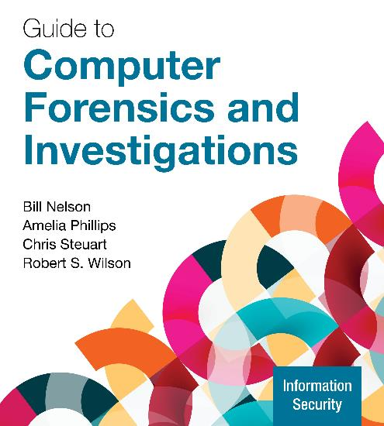
Guide to Computer Forensics and Investigations, 7e
Module 3: The Investigator’s Laboratory and Digital Forensics Tools
Nelson/Phillips/Steuart/Wilson, Guide to Computer Forensics and Investigations, 7th Edition. ©2025 Cengage Learning, Inc. All Rights Reserved. May not be scanned, copied or duplicated, or posted to a publicly accessible website, in whole or in part.

Slide 2
Module Objectives (1 of 2)
By the end of this module, you should be able to:
Describe certification requirements for digital forensics labs
List physical requirements for a digital forensics lab
Explain the criteria for selecting a basic forensic workstation
Describe components used to build a business case for developing a forensics lab

Slide 3
Module Objectives (2 of 2)
By the end of this module, you should be able to (continued):
Explain how to evaluate needs for digital forensics tools
Describe available digital forensics software tools
List some considerations for digital forensics hardware tools
Describe methods for validating and testing forensics tools

Slide 4
Understanding Forensics Lab Accreditation Requirements
A digital forensics lab is where you conduct investigations, store evidence, and do most of your work
The ANSI-ASQ National Accreditation Board (ANAB) provides accreditation of crime and forensics labs worldwide
This accreditation includes forensics labs that analyze digital evidence
ANAB audits lab functions and procedures

Slide 5
Identifying Duties of the Lab Manager and Staff
Some lab manager duties include the following:
Set up processes for managing cases
Promote group consensus in decision making
Maintain fiscal responsibility for lab needs
Enforce ethical standards among lab staff members
Plan updates for the lab
Establish and promote quality-assurance processes
Set reasonable production schedules
Estimate how many cases an investigator can handle

Slide 6
Lab Budget Planning (1 of 2)
Expenses for a lab include the following:
Hardware, software, facility space, travel costs, and personnel training
Estimate the number of cases your lab expects to examine
Identify types of computers you’re likely to examine
Take into account changes in technology
Use statistics to determine what kind of computer crimes are more likely to occur and use that to plan your equipment purchases

Slide 7
Lab Budget Planning (2 of 2)
Check statistics from the Uniform Crime Report
Identify crimes committed with specialized software
When setting up a lab for a private company, check:
Hardware and software inventory
Problems reported last year
Future developments in digital technology
Time management is a major issue when choosing software and hardware to purchase

Slide 8
Acquiring Certification and Training (1 of 2)
Update your skills through appropriate training
Thoroughly research the requirements, cost, and acceptability in your area of employment
International Association of Computer Investigative Specialists (IACIS)
Candidates who complete the IACIS test are designated as a Certified Forensic Computer Examiner (CFCE)
High-Tech Crime Network (HTCN)
Certified Computer Crime Investigator, Basic and Advanced Level
Certified Computer Forensic Technician, Basic and Advanced Level

Slide 9
Acquiring Certification and Training (2 of 2)
EnCase Certified Examiner (EnCE) Certification
Open to the public and private sectors and is specific to use and mastery of EnCase forensics analysis software
Exterro Forensic Certification
Formerly AccessData
Exterro Ace (AccessData Certified Examiner)
Exterro Ace for Enterprise
Many other training and certifications are available

Slide 10
Determining the Physical Requirements for a Digital Forensics Lab
Your lab facility must be secure so that evidence is not lost, corrupted, or destroyed
Provide a safe and secure physical environment
Keep inventory control of your assets
Know when to order more supplies

Slide 11
Access and Security
The lab should function and be treated as an evidence locker, making it a secure facility
The following are minimum requirements for a lab:
A room with true floor-to-ceiling walls
Door access with a locking mechanism
Secure container, such as a safe or heavy-duty file cabinet
Visitor’s log
Brief your staff about security policy

Slide 12
Security for High-Risk Investigations
High-risk investigations demand more security than the minimum lab requirements
TEMPEST qualified lab requires lining the walls, ceiling, floor, and doors with specially grounded conductive metal sheets
Electromagnetic Radiation (EMR) proofed
TEMPEST facilities are very expensive and requires routine inspection and testing
You can use low-emanation workstations instead, which are less expensive than a TEMPEST lab

Slide 13
Evidence Storage Containers (1 of 2)
Evidence storage containers are also known as evidence lockers
They must be secure so that no unauthorized person can easily access your evidence
Recommendations for securing storage containers are as follows:
Locate them in a restricted area
Limit the number of authorized people who access the container
Maintain records on who is authorized to access each container
Containers should remain locked when not in use

Slide 14
Evidence Storage Containers (2 of 2)
The container should be made of steel with an internal cabinet lock or external padlock
If possible, purchase a media safe
When possible, build an evidence storage room in your lab
Maintain an evidence log listing every time an evidence container is opened and closed

Slide 15
Facility Maintenance
Immediately repair physical damages
Escort cleaning crews as they work
Minimize the risk of static electricity by using antistatic pads
Clean floor and carpets
Maintain two separate trash containers
Materials unrelated to an investigation
Sensitive materials
When possible, hire specialized companies for disposing sensitive materials

Slide 16
Auditing a Digital Forensics Lab
Auditing ensures proper enforcing of policies
Audits should include inspecting the following facility components and practices:
Ceiling, floor, roof, and exterior walls of the lab
Doors and locks
Visitor logs
Evidence container logs
At the end of every workday, secure any evidence that’s not being processed in a forensic workstation

Slide 17
Floor Plans for Digital Forensics Labs (1 of 4)
How you configure the work area will depend on the following:
Your budget
The amount of available floor space
The number of computers you assign to each computing investigator
An ideal configuration will have:
Two forensic workstations plus one non-forensic workstation with Internet access

Slide 18
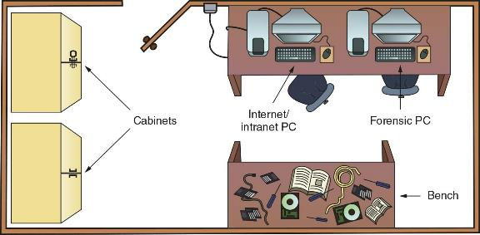
Floor Plans for Digital Forensics Labs (2 of 4)
Figure 3-2 Small or home-based lab

Slide 19
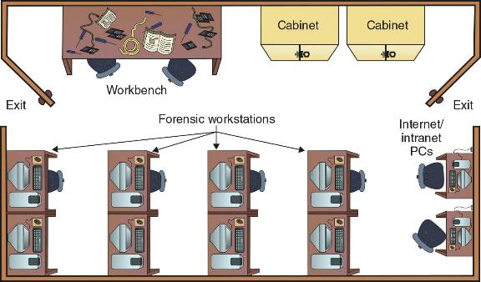
Floor Plans for Digital Forensics Labs (3 of 4)
Figure 3-3 Mid-size digital forensics lab

Slide 20
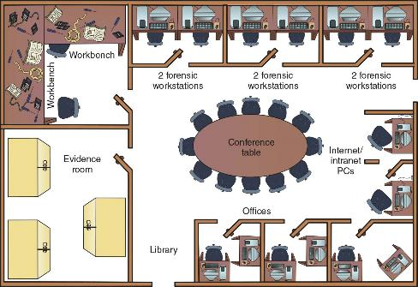
Floor Plans for Digital Forensics Labs (4 of 4)
Figure 3-4 Regional digital forensics lab

Slide 21
Selecting Workstations for a Lab
Police labs have the most diverse set of requirements for digital investigation tools
A lab might need legacy systems and software to match what’s used in the community
A small, local police department might have one multipurpose forensic workstation with one or two basic workstations or high-end laptops
You can now use a laptop PC with USB 3.0/4.0 SATA, or SSD hard disks to create a lightweight, mobile forensic workstation

Slide 22
Selecting Workstations for Private-Sector Labs
Commercial businesses providing forensics analysis can tailor their services to specific markets
Their equipment needs depend on their specialty, if any; for general forensics facilities, a multipurpose workstation is sufficient
For companies doing internal investigations, their forensic workstations will be based on the types of computers they use internally
With some digital forensics programs you can work from a Windows PC and examine both Windows and Mac disk drives

Slide 23
Stocking Hardware Peripherals (1 of 2)
Consider stocking your lab with the following:
Digital camera
Assorted antistatic bags
External CD/DVD drive
IDE cables
Ribbon cables for floppy disks
Extra USB 3.0 or newer cables and SATA cards
SCSI cards, preferably ultrawide
Graphics cards, both PCI and AGP types

Slide 24
Stocking Hardware Peripherals (2 of 2)
Consider stocking your lab with the following (continued):
Assorted FireWire and USB adapters
Hard disk drives and USB drives
At least two 2.5-inch Notebook IDE hard drives to standard IDE/ATA or SATA adapter
Computer hand tools

Slide 25
Maintaining Operating Systems and Software Inventories
Maintain licensed copies of software such as the following:
Microsoft Office (current and older version)
Hexadecimal editor
Programming languages (Visual Studio, Perl, or Python)
Specialized viewers (ACDSee, Thumbsplus, or IrfanView)
WPS Office, and a third-party or open-source office suite
Quicken and QuickBooks accounting applications

Slide 26
Using a Disaster Recovery Plan
A disaster recovery plan ensures that you can restore your workstation and investigation files to their original condition
Includes backup tools such as Paragon Backup & Recovery
Keep track of software updates to your workstation as part of change management or configuration management
For labs using high-end RAID servers or a private cloud:
You must consider methods for restoring large data sets
Large servers must have adequate data backup systems in case of a major failure of more than one drive

Slide 27
Planning for Equipment Upgrades
Risk management involves assessing risks and determining how much risk is acceptable for any process or operation
Identify equipment your lab depends on so it can be periodically replaced
Identify equipment you can replace when it fails
Computing components last 18 to 36 months under normal conditions
Schedule upgrades at least every 18 months
Preferably every 12 months

Slide 28
Preparing a Business Case for a Digital Forensics Lab (1 of 5)
A business case provides justification for establishing or upgrading a lab and its equipment
Investigators must plan ahead to ensure that money is available for facilities, tools, supplies, and training for your forensics lab
Justification
You need to justify to the person controlling the budget the reason a lab is needed
Requires constant efforts to market the lab’s services to previous, current, and future customers and clients

Slide 29
Preparing a Business Case for a Digital Forensics Lab (2 of 5)
Budget Development – The proposed budget needs to include:
Facility costs
Hardware requirements
Software requirements
Miscellaneous budget needs

Slide 30
Preparing a Business Case for a Digital Forensics Lab (3 of 5)
Approval and acquisition
You must present a business case with a budget to upper management for approval
Implementation
As part of your business case, describe how implementation of all approved items will be processed
A timeline showing expected delivery or installation dates and expected completion dates must be included
Make sure you schedule inspection dates

Slide 31
Preparing a Business Case for a Digital Forensics Lab (4 of 5)
Acceptance Testing - consider the following tasks:
Inspect the facility to make sure it meets security criteria for containing and controlling digital evidence
Test all communications
Test all hardware to verify it is operational
Install and start all software tools

Slide 32
Preparing a Business Case for a Digital Forensics Lab (5 of 5)
Correction for Acceptance
Your business case must anticipate problems that can cause delays in lab production
Production
After all essential corrections have been made the lab can go into production
Implement lab operations procedures

Slide 33
Knowledge Check Activity 3-1
A digital forensics lab manager is responsible for which of the following? (Choose all that apply.)
Quality assurance processes
Case activities and scheduling
Process and procedures related to securing evidence
Review of casework by digital forensics examiners

Slide 34
Knowledge Check Activity 3-1: Answer
A digital forensics lab manager is responsible for which of the following? (Choose all that apply.)
Answer: a. Quality assurance processes; b. Case activities and scheduling; c. Process and procedures related to securing evidence; d. Review of casework by digital forensics examiners
To maintain a lab’s ANAB accreditation, lab managers are required to ensure that policies, procedures, and quality processes, case activities and schedules, secure evidence storage, and review of casework by digital forensics examiners are consistent for all investigations.

Slide 35
Evaluating Digital Forensic Tools
Consider open-source tools; the best value for as many features as possible
Some questions to ask when evaluating tools include the following:
On which OS does the forensics tool run?
Is the tool versatile?
Can the tool analyze more than one file system?
Can a scripting language be used with the tool to automate repetitive functions and tasks?
Does it have automated features?
What is the vendor’s reputation for providing product support?

Slide 36
Types of Digital Forensics Tools
Hardware forensic tools range from simple, single-purpose components to complete computer systems and servers
Software forensic tools can be grouped into the following:
Command-line applications
GUI applications
Software tools are commonly used to copy data from a suspect’s disk drive to an image file

Slide 37
Tasks Performed by Digital Forensics Tools (1 of 6)
Acquisition involves making a copy of the original drive
Two types of data-copying methods are used in software acquisitions:
Physical copying of the entire drive
Logical copying of a disk partition
The formats for disk acquisitions vary from raw data to vendor-specific proprietary
You can view a raw image file’s contents with any hexadecimal editor

Slide 38
Tasks Performed by Digital Forensics Tools (2 of 6)
Validation is the process of confirming that a tool is functioning as intended
Verification proves that two sets of data are identical by calculating hash values or using another similar method
A related process is filtering, which involves sorting and searching through investigation findings to separate good data and suspicious data
Many forensics programs include a list of common header values
With this information, you can see whether a file extension is incorrect for the file type

Slide 39
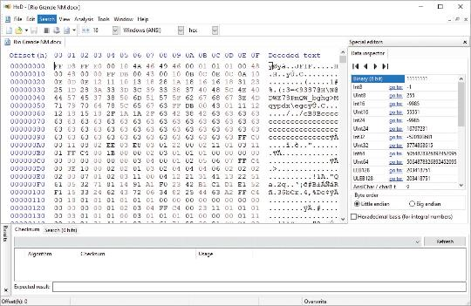
Tasks Performed by Digital Forensics Tools (3 of 6)
Figure 3-7 The file header indicates a .jpeg file

Slide 40
Tasks Performed by Digital Forensics Tools (4 of 6)
Extraction is the recovery task in a digital investigation and is the most challenging of all tasks to master
Recovering data is the first step in analyzing an investigation’s data
From an investigation perspective, encrypted files and systems are a problem
Many password recovery tools have a feature for generating potential password lists for a password dictionary attack
If a password dictionary attack fails, you can run a brute-force attack

Slide 41
Tasks Performed by Digital Forensics Tools (5 of 6)
Reconstruction is to re-create a suspect drive to show what happened during a crime or an incident
Methods of reconstruction include the following:
Disk-to-disk copy
Partition-to-partition copy
Image-to-disk copy
Image-to-partition copy
Disk-to-image copy
Rebuilding files from data runs and carving

Slide 42
Tasks Performed by Digital Forensics Tools (6 of 6)
Reporting
To perform a forensics disk analysis and examination, you need to create a report
Subfunctions of reporting
Bookmarking or tagging
Log reports
Timelines
Report generator
Use this information when producing a final report for your investigation

Slide 43
Command-Line Forensics Tools
The first tools that analyzed and extracted data from floppy disks and hard disks were MS-DOS tools for IBM PC file systems
Norton DiskEdit was one of the first MS-DOS tools used for computer investigations
Command-line tools require few system resources and are designed to run in minimal configurations

Slide 44
Linux Forensics Tools
UNIX has been mostly replaced by Linux, however, you might still encounter systems running UNIX
Kali Linux, formerly known as BackTrack, includes a variety of tools and has an easy-to-use KDE interface
Autopsy and Sleuth Kit
Sleuth Kit is a Linux forensics tool
Autopsy was the browser interface used to access Sleuth Kit’s tools

Slide 45
Other GUI Forensics Tools
GUI forensics tools can simplify digital forensics investigations and have also simplified training for beginning examiners
Most of them are put together as suites of tools
Advantages include the following:
Ease of use, multitasking, and no need to learn older OSs
Disadvantages include the following:
Excessive resource requirements, inconsistent results, and they create tool dependencies

Slide 46
Forensic Workstations (1 of 2)
Forensic workstations are divided into the following categories:
Stationary workstation
Portable workstation
Lightweight workstation
Balance what you need and what your system can handle
Remember that RAM and storage need updates as technology advances

Slide 47
Forensic Workstations (2 of 2)
Advantages of building your own workstation include the following:
You can customize to your needs and save money
Disadvantages include:
It can be hard to find support for problems and it can become expensive if careless
Also need to identify what you intend to analyze

Slide 48
Using a Write-Blocker
Write-blockers prevents data from being written to a hard disk
Software-enabled blockers have been developed to change the Windows Registry so that selected disk drives connected to a workstation are set to read-only
Hardware write-blockers act as a bridge between the suspect drive and the forensic workstation
They are ideal for GUI forensic tools

Slide 49
Recommendations for a Forensic Workstation
Determine where data acquisitions will take place
With Firewire and USB write-blocking devices you can acquire data easily with Tableau write-blocker and a laptop
If you want to reduce hardware to carry, consider WiebeTech Forensic UltraDock or the Logicube Talon
If you have a limited budget, one option for outfitting your lab is to use high-end game PCs

Slide 50
Using National Institute of Standards and Technology Tools (1 of 2)
NIST publishes articles, provides tools, and creates procedures for testing/validating forensics software
The Computer Forensics Tool Testing (CFTT) project manages research on forensics tools
NIST has created criteria for testing forensics tools based on:
Standard testing methods
ISO 17025 criteria for testing items that have no current standards

Slide 51
Using National Institute of Standards and Technology Tools (2 of 2)
Your lab must meet the following criteria
Establish categories for digital forensics tools
Identify forensics category requirements
Develop test assertions
Identify test cases
Establish a test method
Report test results
ISO 5725 specifies results must be repeatable and reproducible

Slide 52
Using Validation Protocols (1 of 2)
Always verify your results by performing the same tasks with other similar forensics tools
Use at least two tools to verify your work
One way to compare results and verify a new tool is by using a disk editor, such as HxD, Hex Workshop, or WinHex
Digital Forensics Examination Protocol
Conduct the investigation with a GUI tool
Perform the same investigation with a disk editor for verification
Compare hash values obtained with both tools

Slide 53
Using Validation Protocols (2 of 2)
Digital Forensics Tool Upgrade Protocol
You should test all new releases and OS patches and upgrades
If you find a problem, report it to forensics tool vendor
Do not use the forensics tool until the problem has been fixed
Use a test hard disk for validation purposes
Check the Web for new editions, updates, patches, and validation tests for your tools

Slide 54
Knowledge Check Activity 3-2
What are the features and limitations of command-line digital forensics tools? (Choose all that apply.)
a. They can only be run from a Windows GUI booted computer.
b. They work with any desktop, laptop, or mobile computing device.
c. They only work with Linux computers.
d. They are compact and require very few resources on a suspect’s computer.

Slide 55
Knowledge Check Activity 3-2: Answer
What are the features and limitations of command-line digital forensics tools? (Choose all that apply.)
Answer: d. They are compact and require very few resources on a suspect’s computer.
Command-line tools require few system resources because they are designed to run in minimal configurations. Most tools fit on bootable media (USB drives, CDs, and DVDs). These tools work well for conducting an initial inquiry for a suspect’s computer. The digital forensics examiner can boot a suspect’s computer and access its data drives in read-only mode. The examiner can easily copy data from a suspect’s computer to an externally mounted USB drive for follow-up examination.

Slide 56
Self Assessment
Why is configuration management important?
Where can you go to learn more about validation methods for digital forensics tools?

Slide 57
Summary (1 of 2)
Now that the lesson has ended, you should be able to:
Describe certification requirements for digital forensics labs
List physical requirements for a digital forensics lab
Explain the criteria for selecting a basic forensic workstation
Describe components used to build a business case for developing a forensics lab

Slide 58
Summary (2 of 2)
Now that the lesson has ended, you should be able to (continued):
Explain how to evaluate needs for digital forensics tools
Describe available digital forensics software tools
List some considerations for digital forensics hardware tools
Describe methods for validating and testing forensics tools

