Slide 1
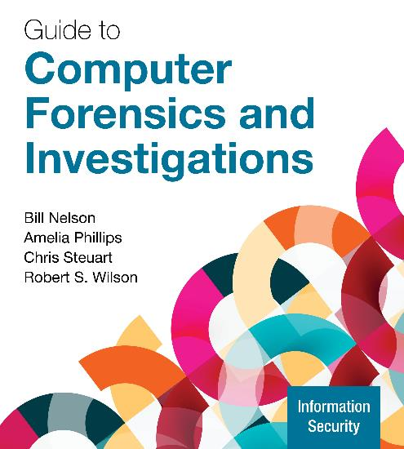
Guide to Computer Forensics and Investigations, 7e
Module 4: Data Acquisition
Nelson/Phillips/Steuart/Wilson, Guide to Computer Forensics and Investigations, 7th Edition. ©2025 Cengage Learning, Inc. All Rights Reserved. May not be scanned, copied or duplicated, or posted to a publicly accessible website, in whole or in part.

Slide 2
Module Objectives (1 of 2)
By the end of this module, you should be able to:
Describe digital evidence storage formats
Understand how to plan for a digital forensics acquisition
Describe contingency planning for data acquisitions
Explain how to use acquisition tools
Describe how to validate data acquisitions

Slide 3
Module Objectives (2 of 2)
By the end of this module, you should be able to (continued):
Describe RAID acquisition methods
List other forensic tools available for data acquisitions

Slide 4
Understanding Storage Formats for Digital Evidence
Data in a forensics acquisition tool is stored as an image file
The following are possible storage formats:
Open-source
Advanced Forensics Format (AFF)
Proprietary formats

Slide 5
Open-Source Imaging Formats (1 of 2)
Raw Format
Advantages
Fast data transfers
Ignores minor data read errors on source drive
Most computer forensics tools can read raw format
Disadvantages
Requires as much storage as original disk or data
Some tools might not collect marginal (bad) sectors

Slide 6
Open-Source Imaging Formats (2 of 2)
Advanced Forensic Format
AFF has the following design goals
Provides compressed or uncompressed image files
No size restriction for disk-to-image files
Space in the image file or segmented files for metadata
Simple design with extensibility
Open source for multiple platforms and Oss
Internal consistency checks for self-authentication
File extensions include .afd for segmented image files and .afm for AFF metadata

Slide 7
Proprietary Formats
Most forensics tools have their own formats for collecting evidence
The following are some features offered by proprietary formats:
The option to compress or not compress image files
The capability to split an image into smaller segmented files
It can integrate metadata into the image file
Disadvantages
Inability to share an image between different tools
File size limitation for each segmented volume

Slide 8
Developing an Acquisition Action Plan
Create a general action plan and include the following:
Resources required
An outline showing how the acquisition will be executed
Preservation of the evidence
Security of the evidence before, during, and after the acquisition
Review any available technical specification about a disk drive’s data storage media before you arrive

Slide 9
Determining the Best Acquisition Method (1 of 4)
There are two types of acquisitions: static acquisitions and live acquisitions
For both static and live, there are four methods of data collection:
Creating a physical disk-to-image file
Creating a physical disk-to-disk copy
Creating a partition-to-partition copy
Creating a partition-to-data file (a simple file or folder copy)
Determining the best method depends on the circumstances of the investigation

Slide 10
Determining the Best Acquisition Method (2 of 4)
Creating a physical disk-to-image file is the most common method and offers most flexibility
You can make more than one copy
Copies are bit-for-bit replications of the original drive
Compatible with many commercial forensics tools
You might have to create a disk-to-disk copy when a disk-to-image copy is not possible
Tools include EnCase, X-Ways Forensics for Windows systems, and Guymager for Linux systems

Slide 11
Determining the Best Acquisition Method (3 of 4)
If your time is limited, consider using a logical acquisition or a sparse acquisition data copy method
A logical acquisition captures only specific files of interest to the case
A sparse acquisition collects fragments of unallocated (deleted) data
Use this method only when you don’t need to examine the entire drive

Slide 12
Determining the Best Acquisition Method (4 of 4)
To determine which acquisition method to use for an investigation, consider the following:
Size of the source (suspect) disk
Whether you can retain the source disk as evidence
How much time you have to perform the acquisition
Where the evidence is located

Slide 13
Calculating Acquisition Times
The time to transfer data from one device to an image file or other device can vary based on the following factors:
Source drive’s data transfer read speed
Controller interface speed, such as a SATA and a USB controllers
Target drive’s data transfer write speed
Other variables of influence include CPU speed, the number of threads available to transfer data simultaneously on the motherboard, and the quality and reliability of the cables connecting the devices

Slide 14
Contingency Planning for Image Acquisitions
You should create a duplicate copy of your evidence image file
Make at least two images of digital evidence
Use different tools or techniques
Some tools don’t copy host protected area (HPA)
The HPA is an area of a disk drive that is reserved for booting utilities and diagnostic programs
The whole disk encryption feature in Windows called BitLocker makes static acquisitions more difficult

Slide 15
Using Acquisition Tools
Acquisition tools for Windows and Linux have an advantage of acquiring evidence from a suspect drive more convenient
Especially when used with hot-swappable devices
You must protect acquired data with a well-tested write-blocking hardware device or software application
Some countries haven’t accepted the use of write-blocking devices for data acquisitions

Slide 16
Using Linux Live CD/DVD and USB Distributions (1 of 3)
A few Linux ISO images are specifically designed for digital forensics
They contain additional utilities that typically aren’t installed in normal Linux distributions
Some are configured not to mount or to mount as read-only
When using a shell command to mount a drive, type mount –help at the shell prompt to learn what options are available
Linux can copy data from a physical device without having to mount it

Slide 17
Using Linux Live CD/DVD and USB Distributions (2 of 3)
The following are some well-designed Linux Live CDs for digital forensics:
CAINE
Kali Linux
Knoppix
SANS Investigative Forensic Toolkit (SIFT)
You can download these ISO images to any computer, including a Windows system

Slide 18
Using Linux Live CD/DVD and USB Distributions (3 of 3)
After creating a Linux Live CD/DVD or USB drive, test it on your workstation
Check your workstation’s BIOS to see whether it boots first from the CD or DVD in the system
Place it in the CD or DVD drive and reboot your system
If successful, Linux loads into your computer’s memory, and a common GUI for Linux is typically displayed
If you have problems with the Linux GUI display, try another computer with a different video card

Slide 19
Mini-WinFE Boot CDs and USB Drives
Mini-WinFE enables you to build a Windows forensic boot CD/DVD or USB drive so that connected drives are mounted as read-only
It can access the suspect’s Windows Registry files
Before booting a suspect’s computer, connect your target drive, such as a larger USB drive
After Mini-WinFE is booted, it can list all connected drives and alter your target USB drive to read-write mode so you can run an acquisition program

Slide 20
Kali Linux Live Features
Kali Linux comes in several ISO configurations ranging from a light version, which is only 856 MB, to a full-featured version
It comes in 32-bit, 64-bit, ARM, Mobile, Apple MI, and virtual machine versions
It is designed for penetration testing and contains many network security assessment and forensics acquisition tools, along with the Linux version of Autopsy
When Kali Live is started, it displays a boot menu that includes a forensic mode option

Slide 21
FTK Imager Features
Exterro’s FTK Imager can perform a bit-by-bit acquisition of storage media devices or copy selected files and folders from most media devices
It calculates the MD-5 and SHA-1 hashes of the original source drives and then verifies the image files to see if they match as it performs the acquisition
FTK Imager easily fits on a CD or flash drive and can be integrated into a Mini-WinFE boot CD or flash drive
It requires a hardware write-blocker to perform static acquisitions

Slide 22
Preparing a Target Drive for a Forensic Acquisition (1 of 2)
Take the following steps to prepare a target drive:
Use only new or freshly wiped and formatted drives
Record drive information, serial number, manufacturer, size in bytes, and partition label names
Secure the prepared target drive so that it remains ready for use in an investigation
The following commands can wipe data from partitions and drives:
format with the /p:nth switch
Diskpart with the clean all function

Slide 23
Preparing a Target Drive for a Forensic Acquisition (2 of 2)
Create a journal to keep track of the following information:
Type of media
Media manufacturer name, model name or number, and serial #
Size of media
Purpose
Number of partitions and the file system format of partition(s)
Forensic boot media
Disposition of media

Slide 24
Understanding the Boot Sequence (1 of 2)
To avoid contamination of data on a suspect’s system, you must know how to access and modify CMOS, BIOS, EFI, and UEFI settings
A computer stores system configuration and date and time information in the CMOS when power is off
To access a computer’s CMOS, watch for which key or keys to press and when to press them from the display while computer is booting
You will be able to change the computer’s boot sequence from the CMOS setup screen

Slide 25
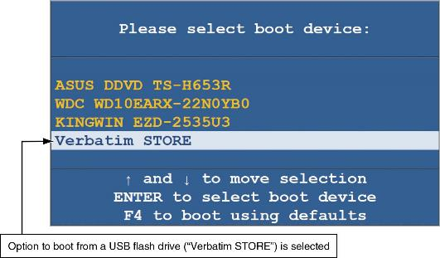
Understanding the Boot Sequence (2 of 2)
Figure 4-1 CMOS boot menu

Slide 26
Using xcopy to Collect Evidence
Table 4-1 xcopy command features
Switch | Description
/a | Copies only files that have the attribute set on.
/d:date | Copies only files last updated on and after the date specified.
/e | If errors are encountered, it continues to copy data.
/f | Lists file name source and its destination name.
/h | Copies all files that have the hidden attribute set.
/s | Copies all folders that contain data and ignores empty folders.
/u | Updates existing files from the source in the destination folders.

Slide 27
Using robocopy to Collect Evidence
Feature | Description
/bytes | Displays the number of bytes copied
/ia:[RASHCNETO] | Copies only files with a specific attribute set, such as r for read-only files or c for compressed file
/fp | Displays the full pathname of files
/v | Creates a verbose output showing files that have been skipped
/r:n | If a file is locked by another user, it retries n number of time
/tee | Creates a status report that is sent to the console and to a log file
/w:n | If a file is locked by another user, it waits n value of seconds before retrying; the default is 30 seconds
/xa: [RASHCNETO] | Excludes files with a specific attribute, such as r for read-only files or c for compressed file
/xc | Excludes files that have changed
/xd <directory> [...] | Excludes specific paths
/xf <filename> [...] | Excludes specific files and paths

Slide 28
Knowledge Check Activity 4-1
Which acquisition method would be appropriate for collecting only fragments of unallocated data?
Physical acquisition
Logical acquisition
Sparse acquisition
Partition acquisition

Slide 29
Knowledge Check Activity 4-1: Answer
Which acquisition method would be appropriate for collecting only fragments of unallocated data?
Answer: c. Sparse acquisition
A sparse acquisition, besides collecting allocated data, is capable of collecting the fragments of unallocated or deleted data.

Slide 30
Validating Data Acquisitions
Validating evidence may be the most critical aspect of computer forensics
It requires using a hashing algorithm utility
Validation techniques include the following:
CRC-32, MD5, and SHA-1 to SHA-512

Slide 31
Linux Validation Methods
You can run md5sum or sha1sum utilities on all suspect disks and volumes or segmented volumes
The dd command will perform a bit-stream copy of a file, folder, partition, or disk into a raw file
The split command can be added to the dd command with the pipe function to split the raw file into segmented volumes
The dcfldd command was designed to create raw forensic binary files
The dc3dd command has the same features as dcfldd with added improvements

Slide 32
Windows Validation Methods
Windows PowerShell version 2.0 has the get-filehash hashing algorithm command
It can generate MD5, SHA-1, SHA-256, SHA-384, and SHA-512 hashes
Third-party hashing tools can be cataloged into two groups:
The first group includes tools that provide hashing features as part of their product
The second group includes tools that are stand-alone and only perform hashing

Slide 33
Solid-State Drive Concerns
Modern solid-state drive (SSD) devices use NAND flash memory chips to store data
NAND memory is more complicated than magnetic media
The erasing of memory makes it harder to recover deleted data from SSDs
The erasing of unallocated space will alter the SSD’s hash values
Before securing SSDs into evidence, it might be worth disabling the TRIM function to preserve the data and to ensure that the drive’s hash value doesn’t change

Slide 34
Media Failure Concerns
There may be an occasion where mismatched hashes from the original data to the copied data
This could indicate that the original media is faulty
All media storage devices have a mean time to failure (MTTF), which is typically defined in the number of hours before a device will most likely fail
Another source of failure is cables and connectors
When replacing a cable, use new ones when possible

Slide 35
Using Compare Functions to Validate Data (1 of 3)
The DOS command comp will compare two files and display information about the differences between the files
The fc command has a few more features than the comp command
The PowerShell cmdlet compare-object combined with get-content can compare files similar to the DOS commands
The Linux command diff is similar to the DOS fc command, with some unique features not available in the DOS and PowerShell commands

Slide 36
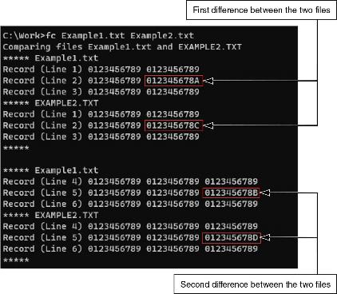
Using Compare Functions to Validate Data (2 of 3)
Figure 4-4 The fc command showing the difference between two files

Slide 37
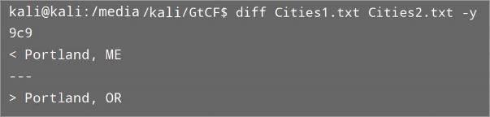
Using Compare Functions to Validate Data (3 of 3)
Figure 4-7 The Linux diff command

Slide 38
Understanding RAID (1 of 4)
Redundant array of independent disks (RAID) is a computer configuration involving two or more physical disks
Originally developed as a hardware-redundancy measure
RAID 0 provides rapid access and increased storage
Two disks become one large volume
Biggest disadvantage is lack of redundancy
RAID 1 is designed for data recovery
The content of two disks is identical (mirroring)

Slide 39
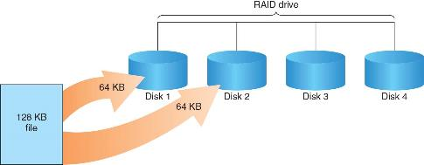

Understanding RAID (2 of 4)
Figure 4-10 RAID 0: Striping
Figure 4-11 RAID 1: Mirroring

Slide 40
Understanding RAID (3 of 4)
RAID 2 is similar to RAID 1 except data is written to a disk on a bit level
Has better data integrity checking than RAID 0
RAID 3 uses data stripping and dedicated parity
It requires at least three disks
RAID 5 is similar to RAIDs 0 and 3
It places parity recovery data on each disk

Slide 41
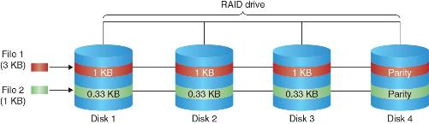
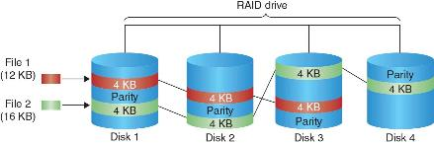
Understanding RAID (4 of 4)
Figure 4-12 RAID 2: Striping (bit level)
Figure 4-13 RAID 5: Block-level striping with distributed parity

Slide 42
Acquiring RAID Disks (1 of 2)
You need to address the following concerns:
How much data storage is needed?
What type of RAID is used?
Do you need to have all drives connected?
Do you have the right acquisition tool?
Can the tool read a forensically copied RAID image?
Can the tool read split data saves of each RAID disk?
Copying small RAID systems to one large disk is possible

Slide 43
Acquiring RAID Disks (2 of 2)
Vendors offering RAID acquisition functions include Runtime Software and R-Tools Technologies
Occasionally, a RAID system is too large for a static acquisition
Retrieve only the data relevant to the investigation with the sparse or logical acquisition method

Slide 44
Using Other Forensics Acquisition Tools (1 of 2)
ASR Data SMART is a Linux forensics analysis tool that can make image files of a suspect drive
Capabilities include the following:
Robust data reading of bad sectors
Mounting of drives in write-protected mode
Mounting of target drives in read/write mode
Compression schemes to speed up acquisition or reduce amount of storage needed

Slide 45
Using Other Forensics Acquisition Tools (2 of 2)
IxImager runs from a bootable floppy or CD and is designed to work only with ILookIX
PassMark Software offers a bootable ISO image named OSFClone, which can create raw, Expert Witness, and AFF acquisitions
Runtime Software offers compact shareware programs for data acquisition and recovery including DiskExplorer for FAT and NTFS
ForensicSoft SAFE Boot Disk is a bootable Windows CD or USB drive
X-Ways Imager is a digital forensics acquisition application

Slide 46
Knowledge Check Activity 4-2
Which acquisition method would be most appropriate for collecting email files from a server that uses a RAID storage array?
Physical acquisition
Logical acquisition
Tape archive
Sparse acquisition

Slide 47
Knowledge Check Activity 4-2: Answer
Which acquisition method would be most appropriate for collecting email files from a server that uses a RAID storage array?
Answer: b. Logical acquisition
To perform an acquisition of a RAID will require as much or almost as much disk storage as the size of the RAID. Since it is only email that is needed, forensically imaging an entire RAID is impractical and of no use for an investigation. In addition, it will take too much resources, such as a target disk drive, and time to collect the data. As such, a logical acquisition of just the email data would be ideal for this scenario.

Slide 48
Self Assessment
Which acquisition method would be appropriate for collecting data from a SAN?
Which file system(s) could be used to store acquired forensic images on a target drive?

Slide 49
Summary (1 of 2)
Now that the lesson has ended, you should be able to:
Describe digital evidence storage formats
Understand how to plan for a digital forensics acquisition
Describe contingency planning for data acquisitions
Explain how to use acquisition tools
Describe how to validate data acquisitions

Slide 50
Summary (2 of 2)
Now that the lesson has ended, you should be able to (continued):
Describe RAID acquisition methods
List other forensic tools available for data acquisitions

