Slide 1
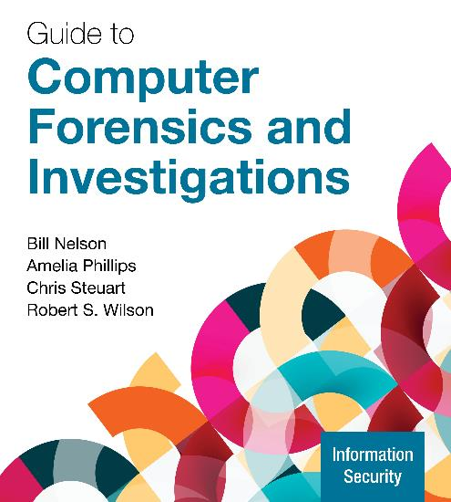
Guide to Computer Forensics and Investigations, 7e
Module 6: Working with Microsoft File Systems and the Windows Registry
Nelson/Phillips/Steuart/Wilson, Guide to Computer Forensics and Investigations, 7th Edition. ©2025 Cengage Learning, Inc. All Rights Reserved. May not be scanned, copied or duplicated, or posted to a publicly accessible website, in whole or in part.

Slide 2
Module Objectives
By the end of this module, you should be able to:
Explain the purpose and structure of file systems
Describe Microsoft file structures
Explain the structure of FAT disks
Explain the structure of NTFS disks
Describe whole disk encryption
Explain how the Windows Registry works
Identify Windows artifacts

Slide 3
Understanding File Systems
A file system provides an OS a road map to data on a disk
The type of file system an OS uses determines how data is stored on the disk
When you need to access a suspect’s computer to acquire or inspect data, you should be familiar with both the computer’s OS and file systems

Slide 4
Understanding Disk Drives (1 of 4)
Disk drives are made up of one or more platters coated with magnetic material
Disk drive components include the following
Geometry – refers to a disk’s logical structure
Head
Tracks
Cylinders
Sectors

Slide 5
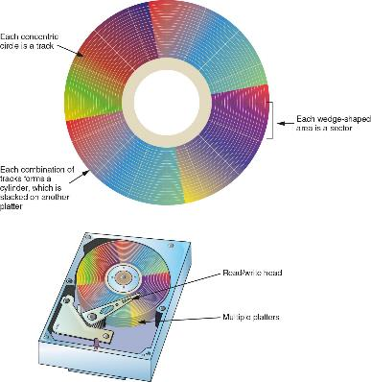
Understanding Disk Drives (2 of 4)
Figure 6-1 Components of a disk drive

Slide 6
Understanding Disk Drives (3 of 4)
Properties handled at the drive’s hardware or firmware level include the following:
Zone bit recording (ZBR) is how most manufacturers deal with the fact that a platter’s inner tracks have a smaller circumference
Track density is the space between each track
Areal density is the number of bits in one square inch of a disk platter
Head and cylinder skew are used to improve disk performance

Slide 7
Understanding Disk Drives (4 of 4)
The Master Boot Record (MBR) and GUID Partition Table (GPT) are two file system programs that define the logical partition volume
Both are located in sector 0 of a disk drive
GPT-formatted drives convert the CHS addressing scheme into logical block addresses
A logical block address (LBA) is the physical sector on a GPT drive that is typically 4096 bytes
Can be used on drives larger than 2.2 TB

Slide 8
Exploring Microsoft File Structures
In Microsoft file structures, sectors are grouped to form clusters
Which is storage allocation units of one or more sectors
Clusters are numbered sequentially starting at 0 in NTFS and 2 in FAT
The OS assigns each cluster a number, called logical addresses
Sector numbers are called physical addresses
Clusters and their addresses are specific to a logical disk drive, which is a disk partition

Slide 9
Disk Partitions (1 of 4)
Someone who wants to hide data can create hidden partitions between partitions on a disk drive
On disk drives with multiple partitions, there are small unused spaces between partitions called the partition gap
Data can also be hidden at the end of a disk by declaring a smaller number of bytes than the actual drive size
To access a hidden partition or the ending section of a drive, a disk editor can activate the hidden partition by updating the partition table

Slide 10
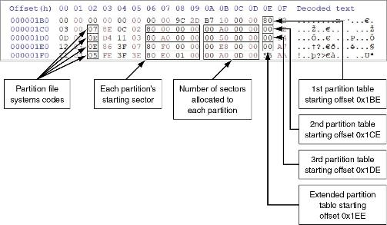
Disk Partitions (2 of 4)
Figure 6-4 A closeup of the partition table section of the MBR

Slide 11
Disk Partitions (3 of 4)
The GUID GPT utility was developed to replace the MBR
A GPT drive can access up to 18 EB per partition
The partition boot sector 0 is the first sector of the first cluster, which consists of one or more sectors of the partition
In sector 0 of the boot partition’s cluster 0 is information that contains the number of bytes per sector, how many sectors are assigned to a cluster, and the number of sectors allotted to the partition

Slide 12
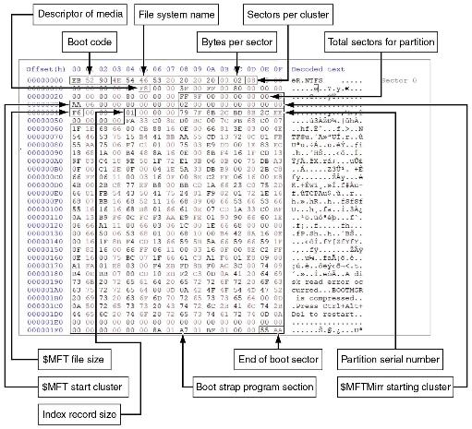
Disk Partitions (4 of 4)
Figure 6-9 NTFS partition boot sector

Slide 13
Examining FAT Disks
The File Allocation Table (FAT) is the file structure database that Microsoft originally designed for floppy disks
The FAT database is typically written to a disk’s outermost track and contains file names, directory names, date and time stamps, the starting cluster number, and file attributes
There are three current FAT versions
FAT16, FAT32, and exFAT (used for mobile personal storage devices)
Cluster sizes vary according to the hard disk size and file system

Slide 14
Drive Slack Space
Microsoft OSs allocate disk space for files by clusters, resulting in drive slack
Drive slack is unused space in a cluster between the end of an active file’s content and the end of the cluster
Drive slack includes the following:
RAM slack – in newer Windows OSs, before data is written to disk, the RAM slack is zeroed out and contains no data
File slack – the remaining sectors within the last disk cluster beyond RAM slack is referred to as a file slack

Slide 15
File Fragmentation
An unintentional side effect of FAT16 allowing large clusters was that it reduced fragmentation as cluster size increased
When you run out of room for an allocated cluster, the OS allocates another cluster for your file
As files grow and require more disk space, assigned clusters are chained together
As some files are created and deleted, the chain can be broken or fragmented

Slide 16
Deleting FAT Files
In a FAT file system, when a file is deleted, the OS inserts a HEX E5 value replacing the first letter of the filename
This value tells the OS that the file is no longer available and a new file can be written to the same cluster location
Data in the file remains on the disk drive
The area of the disk where the deleted file resides becomes unallocated disk space
It is now available to receive new data from newly created files or other files needing more space

Slide 17
Knowledge Check Activity 6-1
How many bytes per sector are there typically found on a 4 TB disk drive?
256
512
784
4096

Slide 18
Knowledge Check Activity 6-1: Answer
How many bytes per sector are there typically found on a 4 TB disk drive?
Answer: d. 4096
Drives over 2 TB typically can only be formatted as GPT drives and have 4096 bytes per sector. Smaller drives typically have 512 bytes per sector.

Slide 19
Exploring NTFS Disks (1 of 2)
NT File System (NTFS) was introduced with Windows NT
It is still the primary file system for Windows 10 and 11
Improvements over FAT file systems include the following:
NTFS provides more information about a file
NTFS gives more control over files and folders
NTFS was Microsoft’s move toward a journaling file system
It records a transaction before the system carries it out

Slide 20
Exploring NTFS Disks (2 of 2)
In NTFS, everything written to the disk is considered a file
On an NTFS disk, the first data set is the Partition Boot Sector
Next is Master File Table (MFT) also referred to as $MFT
NTFS results in much less file slack space
Clusters are smaller for smaller disk drives
NTFS also uses Unicode, which is an international data format

Slide 21
NTFS System Files (1 of 3)
$MFT contains information about all files on the disk, including the system files the OS uses
In the $MFT, the first 15 records are reserved for system files
Records in the $MFT are called metadata
In the NTFS $MFT, all files and folders are stored in separate records of 1024 bytes each
Each record contains file or folder information
A field within $MFT is referred to as an attribute ID

Slide 22
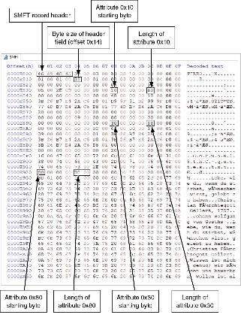
NTFS System Files (2 of 3)
Figure 6-13 Attribute ID locations in the $MFT record

Slide 23
NTFS System Files (3 of 3)
File or folder information is typically stored in one of two ways in an $MFT record: resident and nonresident
Each cluster on a partition has its own unique address
In NTFS, each address is called a logical cluster number (LCN)
LCNs are sequentially numbered from the beginning of a partition to the last cluster of the partition
Once the first LCN address is written to the $DATA attribute, it becomes the file’s virtual cluster number (VCN)

Slide 24
MFT Structures for File Data (1 of 3)
For the header of all $MFT records, the record fields of interest are as follows:
At offset 0x00 - the $MFT record identifier FILE
At offset 0x1C to 0x1F - size of the $MFT record
At offset 0x14 - length of the header (indicates where the next attribute starts)
At offset 0x32 and 0x33 - the update sequence array, which stores the last 2 bytes of the first sector of the $MFT record

Slide 25
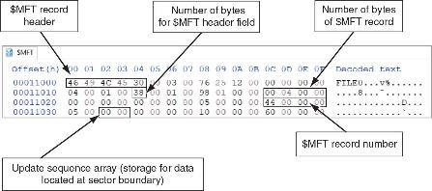
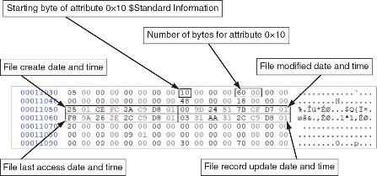
MFT Structures for File Data (2 of 3)
Figure 6-17 A $MFT header
Figure 6-18 Attribute 0x10: Standard Information

Slide 26
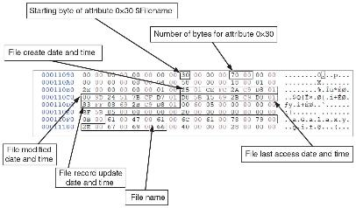
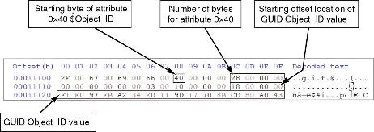
MFT Structures for File Data (3 of 3)
Figure 6-19 Attribute 0x30: $Filename
Figure 6-20 Attribute 0x40: $Object_ID

Slide 27
Interpreting Data Runs (1 of 2)
Data runs have the following components:
The first component declares how many bytes in the attribute field are needed to store the values for the second and third components
The second component stores the number of clusters assigned to the data run
The third component contains the starting cluster address value, VCN(0)

Slide 28
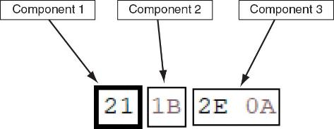
Interpreting Data Runs (2 of 2)
Figure 6-24 Data run components

Slide 29
The $I30 System File
When the number of new files or subfolders increases in a folder, Windows creates an $I30 file to store the additional new files’ or folders’ information
The $I30 files contain useful artifacts for an investigation
The $I30 file may contain residual information of its name, byte size, and date-time values for a deleted file
Listings for deleted files are relocated to the end of the $I30 file
Deleted files are labeled as index slack (INDX slack)

Slide 30
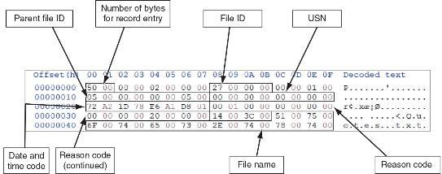
$UsnJrnl System File
The Update Sequence Number Journal ($UsnJrnl) provides a log of actions performed on a file
Figure 6-31 Hexadecimal view of a $J file

Slide 31
Prefetch (1 of 2)
To help reduce the time it takes to load an application into memory in Windows, Microsoft has implemented the Prefetch function
The first time an application is run, the OS will create a prefetch file for it
The next time the application is run, Windows preloads the necessary links to other data or executable files into memory
The contents of a prefetch file can reveal the following:
When an application was installed, how many times the application had been run, dates and time it was run, and data that was accessed by the application

Slide 32
Prefetch (2 of 2)
To examine the contents of a prefetch file, download the PECmd.exe tool
PECmd.exe will display the following information:
Source file path, creation, modified, and last access date and time
Source file’s executable name and hash
Byte size of the source file
Windows OS version of the computer
The number of times and when the application has run
Volume information

Slide 33
NTFS Alternate Data Streams (1 of 2)
Alternate data streams are methods by which data can be appended to existing files
They can obscure valuable evidentiary data, intentionally or by coincidence
In NTFS, an alternate data stream becomes an additional file attribute
It allows the file to be associated with different applications
You can only tell whether a file has a data stream attached by examining that file’s MFT entry

Slide 34
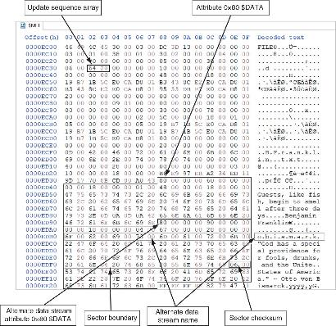
NTFS Alternate Data Streams (2 of 2)
Figure 6-32 A resident text alternate data stream

Slide 35
NTFS Compressed Files
NTFS provides compression similar to FAT DriveSpace 3 (a Windows 98 compression utility)
With NTFS, files, folders, or entire volumes can be compressed
Most forensics tools can uncompress and analyze compressed Windows data
Forensics tools might have difficulty with third-party compression utilities, such as the .rar format

Slide 36
NTFS Encrypting File System (1 of 2)
Encrypting File System (EFS) was introduced with Windows 2000
Uses public key and private key methods of encrypting files, folders, or disk volumes
When EFS is used in Windows 2000 and later, a recovery certificate is generated and sent to the local Windows administrator account
Users can apply EFS to files stored on their local workstations or a remote server

Slide 37
NTFS Encrypting File System (2 of 2)
The recovery Key Agent implements the recovery certificate, which is in the Windows administrator account
Windows administrators can recover a key in two ways: through Windows or from a command prompt
Commands available from a command prompt include the following:
cipher
copy

Slide 38
Deleting NTFS Files
When a file is deleted in Windows NT and later, the OS renames it and moves it to the Recycle Bin
You can restore it from the Recycle Bin
You can also use the del (delete) MS-DOS command
This method eliminates the file from the MFT listing in the same way FAT does

Slide 39
Resilient File System Overview
Resilient File System (ReFS) is designed to address very large data storage needs, such as the cloud
The following features are incorporated into ReFS’s design:
Maximized data availability
Improved data integrity
Designed for scalability
ReFS uses disk structures similar to the MFT in NTFS

Slide 40
Understanding Whole Disk Encryption
Personal identity information (PII) and trade secrets caused by computer theft has become more of a concern
Whole disk encryption tools offer the following features:
Preboot authentication
Full or partial disk encryption with secure hibernation
Advanced encryption algorithms
Key management function
To examine an encrypted drive, decrypt it first

Slide 41
Examining Microsoft BitLocker
BitLocker is Microsoft’s utility for protecting drive data
Hardware and software requirements are as follows:
A computer capable of running Windows Vista or later
The TPM microchip, version 1.2 or newer
A computer BIOS compliant with Trusted Computing Group (TCG)
Two NTFS partitions
The BIOS configured so that the hard drive boots first before checking other bootable peripherals

Slide 42
Examining Third-Party Disk Encryption Tools
BitLocker can only encrypt NTFS drives
If you want to encrypt a FAT drive, you need a third-party solution
Available third-party WDE utilities include the following:
BROADCOM
Endpoint Encryption
Jetico BestCrypt Volume Encryption

Slide 43
Understanding the Windows Registry
Registry is a database that stores hardware and software configuration information, network connections, user preferences, and setup information
The Registry can contain valuable evidence for an investigation
Viewing the Registry files from a static acquisition requires special tools such as FTK Registry Viewer or forensics applications such as Autopsy, X-Ways Forensics, and others

Slide 44
Data Types in the Registry
The Registry is a hierarchical structured database that contains the following data types:
Keys that are like folders on a disk partition
Subkeys that contain values like data and reference to files
The data types found in keys and subkeys are shown in Table 6-11 in the text

Slide 45
Exploring the Organization of the Windows Registry (1 of 2)
Table 6-12 Registry file locations and purposes
File name and location | Purpose of file
Users\user-account\Ntuser.dat | User-protected storage area; contains the list of most recently used files and desktop configuration settings
Windows\system32\config\Default.dat | Contains the computer’s system settings
Windows\system32\config\SAM.dat | Contains user account management and security settings
Windows\system32\config\Security.dat | Contains the computer’s security settings
Windows\system32\config\Software.dat | Contains installed programs’ settings and associated usernames and passwords
Windows\system32\config\System.dat | Contains additional computer system settings
Windows\system32\config\systemprofile | Contains additional ntuser information

Slide 46
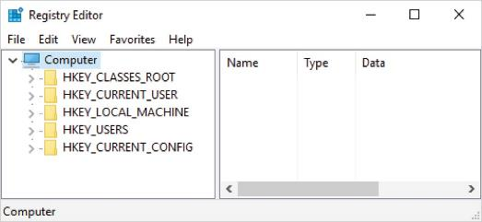
Exploring the Organization of the Windows Registry (2 of 2)
Figure 6-34 Viewing HKEYs in Registry Editor

Slide 47
Windows Forensics Artifacts (1 of 3)
In addition to the $I30, $MFT, $UsnJrnl, and Prefetch files used by Windows, the following are other data files that might contain digital evidence:
hiberfile.sys – where Windows stores volatile data (RAM) when Windows is suspended
Internet history files
pagefile.sys – similar to hiberfile.sys in that it also stores RAM data
Recycle.Bin

Slide 48
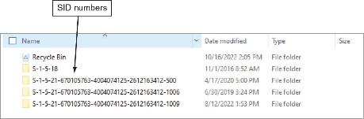
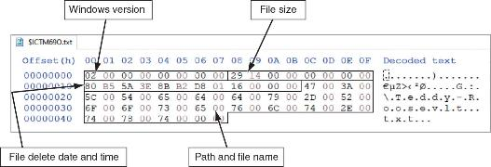
Windows Forensics Artifacts (2 of 3)
Figure 6-35 $SMFT record of Recycle Bin file
Figure 6-36 $Recycle.Bin metadata record

Slide 49
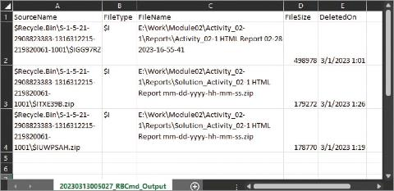
Windows Forensics Artifacts (3 of 3)
Figure 6-37 RBCmd.exe metadata output

Slide 50
Knowledge Check Activity 6-2
What type of data is stored in Ntuser.dat?
Account management and security settings
A list of the most recently used files
Security setting for the OS
A list of installed programs and associated user account information

Slide 51
Knowledge Check Activity 6-2: Answer
What type of data is stored in Ntuser.dat?
Answer: b. A list of the most recently used files.
Ntuser.dat contains the list of the most recently used files and desktop configuration settings.

Slide 52
Self Assessment
What are the differences between a resident and nonresident record in an $MFT file?
Which data files contain RAM data?

Slide 53
Summary
Now that the lesson has ended, you should be able to:
Explain the purpose and structure of file systems
Describe Microsoft file structures
Explain the structure of FAT disks
Explain the structure of NTFS disks
Describe whole disk encryption
Explain how the Windows Registry works
Identify Windows artifacts

