Slide 1

Guide to Computer Forensics and Investigations, 7e
Module 7: Linux and Macintosh File Systems
Nelson/Phillips/Steuart/Wilson, Guide to Computer Forensics and Investigations, 7th Edition. ©2025 Cengage Learning, Inc. All Rights Reserved. May not be scanned, copied or duplicated, or posted to a publicly accessible website, in whole or in part.

Slide 2
Module Objectives
By the end of this module, you should be able to:
Describe Linux file structures
Describe Macintosh file structures
Use Linux forensics tools

Slide 3
Examining Linux File Structures (1 of 2)
UNIX distributions
Silicon Graphics, Inc. (SGI) IRIX, Santa Cruz Operation (SCO) UnixWare, Sun Solaris, IBM AIX, and HP-UX
Linux distributions
Ubuntu, CentOS, Mint, Fedora, and Gentoo
Linux is only the core of the OS
All UNIX-like OSs have a kernel
So do all Windows OSs

Slide 4
Examining Linux File Structures (2 of 2)
Remember that UNIX and Linux commands are case sensitive
The wrong capitalization can mean your commands are rejected as incorrect or interpreted as something different
Review some Linux commands by working through the activity on pages 327-332

Slide 5
File Structures in ext4 (1 of 3)
The early file system standard was Second Extended File System (Ext2)
Third Extended File System (Ext3) replaced Ext2 in most Linux distributions
Fourth Extended File System (Ext4) is backward compatible with ext2/ext3
It improved management of large files and offered more flexibility
It is now considered the standard file system for most distributions

Slide 6
File Structures in ext4 (2 of 3)
Advantages of the ext4 file system include the following:
The Linux system ext4 will automatically mount an ext3 drive
The ext4 file system allows for larger file sizes, longer file names, and unlimited subdirectories
The ext4 file system got rid of the indirect pointers and a new method utilizing extents was introduced
Flexible group blocks allow several block groups to be one logical group

Slide 7
File Structures in ext4 (3 of 3)
UNIX/Linux file system consists of the following four components:
The boot block contains the bootstrap code
A UNIX/Linux computer has only one boot block, located on the main hard disk
The superblock specifies disk geometry, available space, and keeps track of all inodes and manages the file system
An inode block contains the first data after the superblock
The data block is where directories and files are stored on a disk drive

Slide 8
Inodes (1 of 5)
An inode contains file and directory metadata and provides a mechanism for linking data stored in data blocks
An assigned inode contains the following information:
Mode and type of file or directory
Number of links to a file or directory
UID and GID of the file’s or directory’s owner
Number of bytes in the file or directory
File’s or directory’s last access time and last modified time
Inode’s last file status change time

Slide 9
Inodes (2 of 5)
An assigned inode contains the following information (continued):
Block address for the file data
Indirect, double-indirect, and triple-indirect block addresses for the file data
Current usage status of the inode
Number of actual blocks assigned to a file
File generation number of version number
The continuation inode’s link

Slide 10
Inodes (3 of 5)
An assigned inode has 13 pointers that link to data blocks and other pointers where files are stored
As the file grows, the OS provides up to three layers of inode pointers
Each of the first 10 pointers is called an indirect pointer
Each pointer in the second layer is called a double-indirect pointer
Each pointer in the third layer is called a triple-indirect pointer

Slide 11
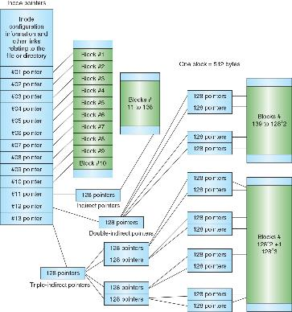
Inodes (4 of 5)
Figure 7-5 Inode pointers in the Linux file system

Slide 12
Inodes (5 of 5)
A bad block inode keeps track of bad sectors
To find bad blocks on a Linux computer, use the badblocks command – you must log in as root to use
Linux includes two other commands that supply bad block information:
mke2fs and e2fsck – they include safeguards that prevent them from overwriting important information

Slide 13
Hard Links and Symbolic Links (1 of 2)
A hard link is a pointer that allows accessing the same file by different file names
Use the ln command to create a hard link
A link count is a field inside each inode that specifies the number of hard links
A symbolic link is a pointer to another file, and they aren’t included in the link count
Also known as soft links or symlinks
Can point to items on other drives or other parts of the network

Slide 14
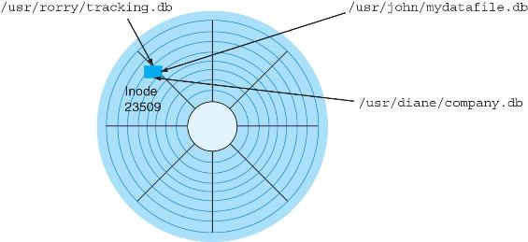
Hard Links and Symbolic Links (2 of 2)
Figure 7-8 Hard linked files with different file names

Slide 15
Knowledge Check Activity 7-1
Inodes contain everything except which of the following?
UID and GID
Node number
Name of the file and its path
Access time and change time

Slide 16
Knowledge Check Activity 7-1: Answer
Inodes contain everything except which of the following?
Answer: c. Name of the file and its path
Inodes in the Linux file system contain extensive information, including the GID, UID, the number of links, access time, created time, change time, and other information. The only items not stored in the inode are the name of the file and its path.

Slide 17
Understanding Macintosh File Structures (1 of 2)
At the time of this writing, the current OS for Apple laptops and desktops is macOS 12 Monterey
With OS X, Macintosh moved to the Intel processor and become UNIX based
In 2020, Apple released macOS 11 Big Sur, which provided support for Apple’s native silicon, the M1 processor

Slide 18
Understanding Macintosh File Structures (2 of 2)
Before OS X, the Hierarchical File System (HFS) was used
In HFS, files are stored in nested directories (folders)
The Mac O Extended Format (HFS+) file system was introduced with Mac OS 8.1
HFS+ supports smaller file sizes on larger volumes, resulting in more efficient disk use
Apple File System (APFS) was introduced in macOS 10.13 High Sierra
Users can still mount HFS+ drives with macOS Monterey

Slide 19
An Overview of Mac File Structures (1 of 8)
In older versions of macOS, a file consists of two parts:
Data fork and resource fork
The data fork typically contains data the user creates, such as text or spreadsheets
Applications also read and write to the data fork
When working with an application file, the resource block contains additional information
Such as menus and dialog boxes

Slide 20
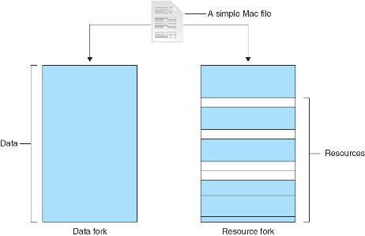
An Overview of Mac File Structures (2 of 8)
Figure 7-10 The resource fork and data fork in a macOS file

Slide 21
An Overview of Mac File Structures (3 of 8)
A volume is any storage medium used to store files
It can be all or part of the storage media for hard disks
Volumes have allocation and logical blocks
A logical block is a fundamental unit of storage that can hold up to 512 bytes of data
An allocation block is a group of consecutive logical blocks

Slide 22
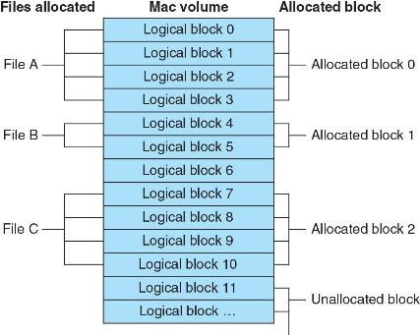
An Overview of Mac File Structures (4 of 8)
Figure 7-11 Logical and allocation block structures

Slide 23
An Overview of Mac File Structures (5 of 8)
The HFS and HFS+ file systems have two end of file (EOF) descriptors
The logical EOF is the actual ending of the file
The physical EOF is the number of bytes allotted on the volume for a file
A clump is a group of contiguous allocation blocks
Volume fragmentation is kept to a minimum by adding more clumps to larger files

Slide 24
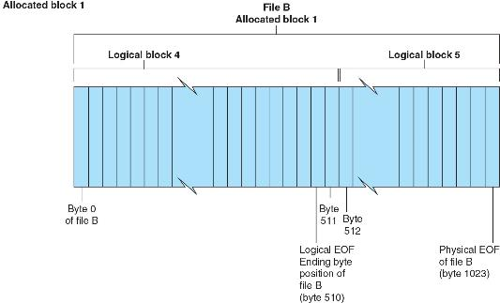
An Overview of Mac File Structures (6 of 8)
Figure 7-12 Logical EOF and physical EOF

Slide 25
An Overview of Mac File Structures (7 of 8)
Older Macintosh OSs use the Master Directory Block (MDB) for HFS, which is the Volume Information Block (VIB) in HFS+
All information about a volume is stored in the MDB
When the OS mounts a volume, some information from the MDB is written to a Volume Control Block (VCB)
The extents overflow file is used to store any file information not in the MDB or a VCB

Slide 26
An Overview of Mac File Structures (8 of 8)
The catalog is a listing of all files and directories on the volume
Maintains relationships between files and directories
Apple file systems utilize a B-tree file system
Files are nodes containing file data and are called leaf nodes
The B-tree also has the following nodes that handle file information:
The header node stores information about the B-tree file
The index node stores link information to previous and next nodes
The map node stores a node descriptor and map record

Slide 27
Apple File System (1 of 2)
APFS has the following characteristics and features:
A 64-bit file system
Improved timestamp resolution
Encryption to protect data from unauthorized access
A snapshot features that takes a “picture” of the file system at a particular point in time for data recovery purposes
File cloning, which allows users to make identical copies of files without incurring significant storage penalties

Slide 28
Apple File System (2 of 2)
APFS has the following characteristics and features (continued):
Efficient space utilization of the storage device with multiple user volumes
Optimization for flash memory or SSDs
Copies of metadata that are made when any data is written
APFS provides additional useful digital forensics artifacts that can be used to establish a timeline of what was occurring on a computer

Slide 29
Forensics Procedures in macOS (1 of 3)
There are some differences between Linux and macOS file systems
Linux has the /home/username and /root directories
In macOS, the folders are /users/username and /private/var/root
The /home directory exists in the macOS but it is empty
macOS users have limited access to other user accounts’ files and the guest account is disabled by default

Slide 30
Forensics Procedures in macOS (2 of 3)
For forensics procedures in macOS, you must know where file system components are located and how both files and file components are stored
Application settings are in three formats:
Plaintext, plist files, and the SQLite database
Plist files are preference files for installed applications on a system
FileVault is used to encrypt and decrypt a user’s /users directory

Slide 31
Forensics Procedures in macOS (3 of 3)
Since Mac OS 8.6, Keychain Access has been used to manage passwords for applications, websites, and other system files
You can restore passwords using the Mac application Keychain Access or System Preferences/Passwords
Deleted files are in the Trash folder
If a file is deleted at the command line, however, it doesn’t show up in the trash

Slide 32
Acquisition Methods in macOS (1 of 2)
To examine a macOS computer, you need to make an image of the drive
Attempting to take apart these devices without Apple factory training could damage the computer
You need a macOS-compatible forensic boot disk to make a forensics image, which then must be written to an external drive or USB drive
Collect the custodian’s name, username, and password as well as the system administrator username and password

Slide 33
Acquisition Methods in macOS (2 of 2)
When using the macOS Recovery mode, you can disable secure boot or boot to an external device to conduct the acquisition
After making an acquisition, examine the image of the file system
The tool you use depends on the image file format
Cellebrite Digital Collector and Sumuri Recon ITR have a function for disabling and enabling Disk Arbitration
Disk Arbitration is a macOS feature for disabling and enabling automatic mounting when a drive is connected via a USB or FireWire device

Slide 34
Using Linux Forensics Tools
Most commercial computer forensics tools can analyze Linux Ext2, Ext3, Ext4, ReiserFS, and Reiser4 file systems
Freeware tools include Sleuth Kit and its web browser interface, Autopsy Forensic Browser
Foremost is a freeware carving tool that can read many image file formats
It has a configuration file, foremost.conf, which lists the most common file headers, footers, and data structures
Paladin Edge is an Ubuntu-based forensics tool

Slide 35
Using the dc3dd Command (1 of 2)
The dc3dd utility is a command-line method to acquire a disk image
To install dc3dd on a Kali Linux, start a terminal shell window and type the following command:
dc3dd --help
This command will return a message that it is not installed and will ask if you would like to install, type y to initiate the installation
After dc3dd is installed, type dc3dd -- help again to review its options

Slide 36
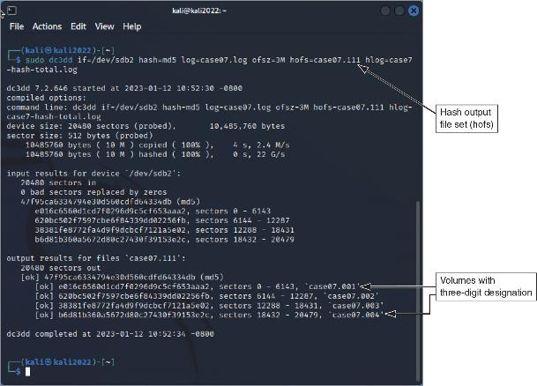
Using the dc3dd Command (2 of 2)
Figure 7-14 dc3dd acquisition

Slide 37
Using the Kali Linux Forensics Tools (1 of 2)
To access the forensics tools in Kali Linux, when you launch the Kali VM, click the Kali image in the upper-left corner
In the pane on the left, select “11 - Forensics”
Some notable tools include the following:
Forensics Carving Tools, Forensics Imaging Tools, PDF Forensics Tools, the Sleuth Kit Suite, Autopsy, binwalk, bulk-extractor, and hashdeep

Slide 38
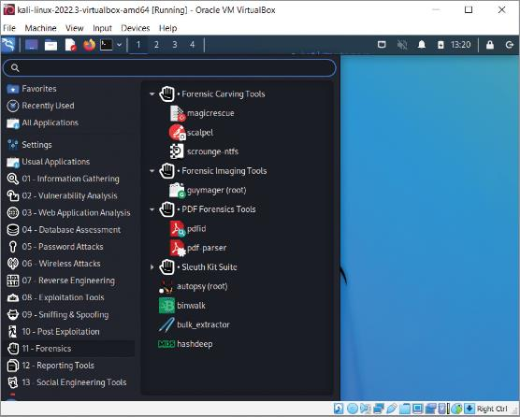
Using the Kali Linux Forensics Tools (2 of 2)
Figure 7-15 Kali Linux forensics tools

Slide 39
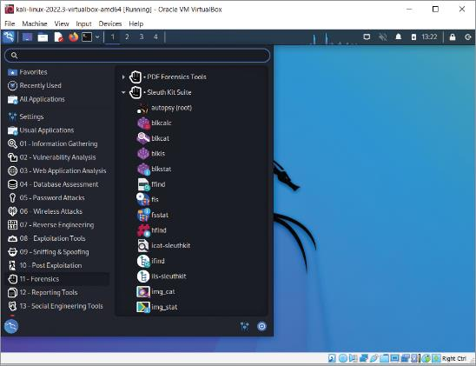
Exploring Sleuth Kit
Figure 7-16 Kali Linux Sleuth Kit Suite

Slide 40
Knowledge Check Activity 7-2
Which mode does a macOS device need to be in to set up the computer for acquisition?
macOS Rescue mode
macOS Recovery mode
macOS Regenerate mode
macOS Restore mode

Slide 41
Knowledge Check Activity 7-2: Answer
Which mode does a macOS device need to be in to set up the computer for acquisition?
Answer: b. macOS Recovery mode
When conducting an acquisition, the digital forensics examiner may need to boot up into macOS Recovery mode to adjust system settings, such as disabling secure boot, or booting to external media, to conduct the acquisition of the Mac device. Refer to Apple’s documentation to set the computer in macOS Recovery mode.

Slide 42
Self Assessment
How does macOS reduce file fragmentation?
What is the Disk Arbitration feature used for in macOS?

Slide 43
Summary
Now that the lesson has ended, you should be able to:
Describe Linux file structures
Describe Macintosh file structures
Use Linux forensics tools

