Slide 1
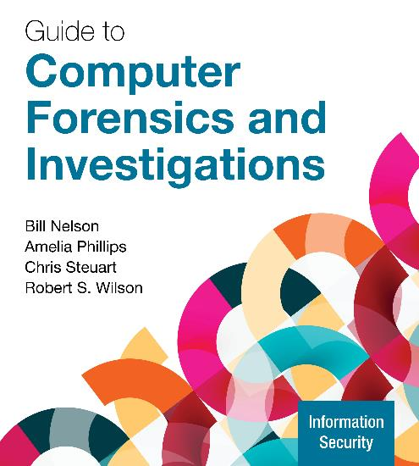
Guide to Computer Forensics and Investigations, 7e
Module 8: Media Files and Digital Forensics
Nelson/Phillips/Steuart/Wilson, Guide to Computer Forensics and Investigations, 7th Edition. ©2025 Cengage Learning, Inc. All Rights Reserved. May not be scanned, copied or duplicated, or posted to a publicly accessible website, in whole or in part.

Slide 2
Module Objectives
By the end of this module, you should be able to:
Identify different types of media files
Summarize data compression and obfuscation
Define data-hiding techniques
Explain how to locate and recover media files
Explain digital evidence validation and discrimination techniques
Describe an examination plan

Slide 3
Understanding Digital Photograph File Formats (1 of 5)
Knowing how digital photos are created and how they store unique information can contribute to your credibility when presenting evidence
The raw file format is typically used on higher-end digital cameras
A disadvantage of this format is that it’s proprietary and not all image viewers can display these formats
The process of converting raw picture data to another format is called demosaicing

Slide 4
Understanding Digital Photograph File Formats (2 of 5)
The Exchangeable Image File (Exif) format stores data about digital photos
When a picture is taken, information such as model, make, serial number are stored in the graphics file
If the device has GPS capability, the latitude and longitude location (geolocation) data might be recorded in the Exif section of the file
Exif is an enhancement to JPEG and TIF formats
It modifies the beginning of a JPEG or TIF so that metadata can be inserted

Slide 5
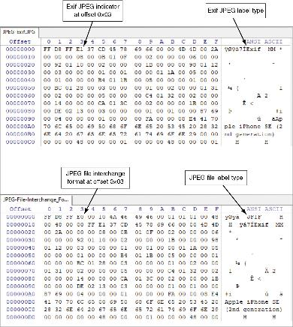
Understanding Digital Photograph File Formats (3 of 5)
Figure 8-2 Differences in Exif and JPEG file header information

Slide 6
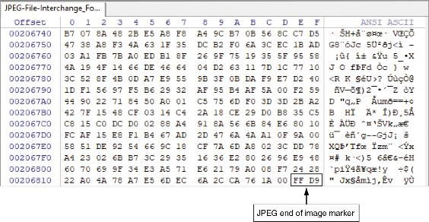
Understanding Digital Photograph File Formats (4 of 5)
Figure 8-3 End of image (EOI) marker FFD9 for all JPEG files

Slide 7
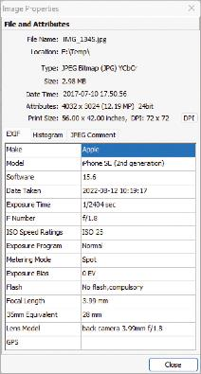
Understanding Digital Photograph File Formats (5 of 5)
With tools such as Autopsy, Exif Reader, and FastStone Image Viewer, you can extract metadata as evidence for your case.
Figure 8-4 FastStone Image Viewer displaying metadata from an Exif JPEG file

Slide 8
Understanding Bitmap and Raster Images
A bitmap image stores graphics information as a grid of individual pixels
A raster image is also a collection of pixels, but those pixels are stored in rows to make images easy to print
Image quality is governed by resolution which determines the amount of detail that is displayed
Software contributes to image quality with the use of drivers
The number of color bits used per pixel also affects image quality

Slide 9
Understanding Vector Graphics
A vector graphic uses lines instead of dots to make up an image
Other characteristics of vector files include the following:
Store only the calculations for drawing lines and shapes
Smaller than bitmap files
Preserves quality when an image is enlarged
CorelDRAW and Adobe Illustrator are examples of graphics programs

Slide 10
Understanding Metafile Graphics Files
Metafile graphics combine raster and vector graphics and can have the characteristics of both file types
For example, you scan a photo (bitmap image) and then add text or arrows (vector drawings)
Share advantages and disadvantages of both types
When enlarged, the bitmap part loses quality

Slide 11
Graphics File Formats (1 of 2)
Standard graphics file formats include the following:
Bitmap file formats
Portable Network Graphic (.png)
Graphic Interchange Format (.gif)
Joint Photographic Experts Group (.jpeg, .jpg)
Tagged Image File Format (.tiff, .tif)
Window Bitmap (.bmp)
Vector file formats
Hewlett Packard Graphics Language (.hpgl)
Autocad (.dxf)

Slide 12
Graphics File Formats (2 of 2)
Nonstandard graphics file formats include the following:
Paintbrush (.pcx)
Raster Transfer Language (.rtl)
Adobe Photoshop (.psd) and Illustrator (.ai)
Freehand (.fh11)
Scalable Vector Graphics (.svg)
Targa (.tga)
Search the web for software to manipulate unknown image formats

Slide 13
Audio and Video File Formats
Audio and video files come in many different formats
The most common current audio and video file formats include:
Apple QuickTime Movie (.mov)
Audio Video Interleave (.avi)
Motion Picture Expert Group (MPEG)

Slide 14
Viewing and Examining Media Files (1 of 4)
In addition to Windows Photos, other media viewing programs include the following:
FastPictureViewer Pro
FastStone
Irfanview Graphic Viewer
VLC Media Player
When working with Windows OSs, the digital forensics examiner may find additional evidence by examining the content of thumbnail (thumb.db) files

Slide 15
Viewing and Examining Media Files (2 of 4)
On digital cameras and smartphones, photo and video files are typically stored in a Digital Camera Image (DCIM) folder
DCIM is part of the Design Rule for Camera Format system (DCF)
The DCF folder and file structure recommendations are as follows:
Subfolder names have three numbers followed by five letters
Graphic file names have three letters with four numbers followed by the file type extension

Slide 16
Viewing and Examining Media Files (3 of 4)
The changing of a file’s header and its extension is a method to hide incriminating evidence because digital forensics tools will assume it is an unknown file
When encountering an unknown file, you will need to examine its contents in a hexadecimal viewer
An example of an unknown file might have an XIF extension
The XIF format is old, and little information is available about it
The first 3 bytes of an XIF file are the same as a TIF file
Build your own header search string

Slide 17
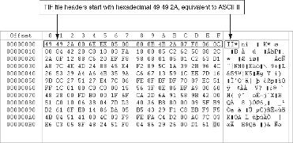
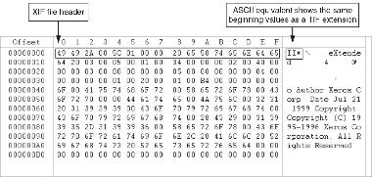
Viewing and Examining Media Files (4 of 4)
Figure 8-5 A TIF file viewed in a hex editor
Figure 8-6 An XIF file viewed in a hex editor

Slide 18
Understanding Data Compression (1 of 2)
Data compression is the process of coding data from a larger form to a smaller form
Graphics files and most compression tools use one of two data compression schemes: lossless or lossy
Lossless compression techniques reduce file size without removing data
Based on Huffman or Lempel-Ziv-Welch coding which uses a code to represent redundant bits of data
Utilities: WinZip, PKZip, StuffIt, 7zip, and FreeZip

Slide 19
Understanding Data Compression (2 of 2)
Lossy compression compresses data by permanently discarding bits of information
Vector quantization (VQ) is a form of lossy compression that uses complex algorithms to determine what data to discard based on vectors in the graphics file
Utility: Lzip
Lossless compression produces an exact replica of the original data after it has been uncompressed
Lossy compression typically produces an altered replica of the data

Slide 20
Steganography in Graphics Files (1 of 5)
Steganography hides information inside image files
The term for detecting and analyzing steganography files is steganalysis
Two major forms of steganography are insertion and substitution
Insertion places data from the secret file into the host file
Hidden data is not displayed when viewing host file in its associated program
You need to analyze the data structure carefully

Slide 21
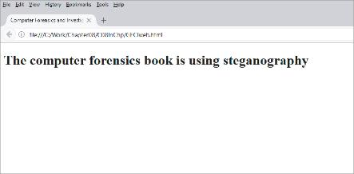
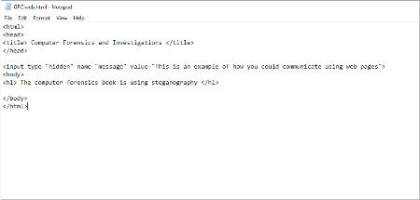
Steganography in Graphics Files (2 of 5)
Figure 8-7 A simple webpage displayed in a web browser
Figure 8-8 The HTML code reveals hidden text

Slide 22
Steganography in Graphics Files (3 of 5)
Substitution replaces bits of the host file with other bits of data
Graphics files such as .bmp files are ideal for storing steganography secret messages
You should inspect all files for evidence of steganography
Clues to look for include the following:
Duplicate files with different hash values
Steganography programs installed on the suspect’s drive

Slide 23
Steganography in Graphics Files (4 of 5)
Steganalysis Methods
Stego-only attack – used when only the file containing the possible steganography content is available for analysis
Known cover attack – used when the cover-media and the stego-media are available for analysis
Known message attack – used when the hidden message is revealed later, allowing further analysis of new messages
Chosen stego attack – used when a steganography tool and stego-media were used to hide the message content
Chosen message attack – used to identify patterns used in stego-media

Slide 24
Steganography in Graphics Files (5 of 5)
Use steganalysis tools (also called “steg tools”) to detect, decode, and record hidden data
A steg tool can also detect variations of the graphic image
When done correctly you cannot detect hidden data in most cases unless you compare the altered file with the original file
Check to see whether the file size, image quality, or file extensions have changed

Slide 25
Understanding Copyright Issues with Graphics
Steganography has been used to protect copyrighted material
By inserting digital watermarks into a file
Digital investigators need to be aware of copyright laws
Copyright laws for the Internet are not clear
There is no international copyright law
Check the U.S. Copyright Office
U.S. Copyright Office identifies what can and can’t be covered under copyright law in U.S.

Slide 26
Knowledge Check Activity 8-1
Which compression format creates an altered replica of the original data when it is decompressed?
Lossless
Lossy or vector quantization
LZMA2
LZ77

Slide 27
Knowledge Check Activity 8-1: Answer
Which compression format creates an altered replica of the original data when it is decompressed?
Answer: b. Lossy or vector quantization
Files compressed using lossy or vector quantization reduce the original data into mathematical values. These mathematical values are only a simulation of the original data.

Slide 28
Bit-Shifting
Bit-shifting is the process of shifting one or more digits in a binary number to the left or right to produce a different value
It changes data from readable code to data that looks like binary executable code
WinHex and Hex Workshop includes a feature for shifting bits
Some antivirus tools will run hashes on suspect files, but some advanced malware uses bit-shifting to hide its malicious code
When analyzing data that might involve bit-shifting, consider getting training in assembly language and higher-level programming languages

Slide 29
Encrypted Files
Encrypted files are encoded to prevent unauthorized access
To decode, users supply a password or passphrase
Many commercial encryption programs use a technology called key escrow, which is designed to recover encrypted data if users forget their passphrases or if the user key is corrupted
If you do encounter encrypted data in an investigation, try to persuade the suspect to reveal the encryption passphrase

Slide 30
Hiding Data (1 of 4)
One of the first techniques to hide data was changing file extensions
Advanced digital forensics tools check file headers
Compare the file extension to verify that it’s correct
If there’s a discrepancy, the tool flags the file as a possible altered file
Another hiding technique is selecting the Hidden attribute in a file’s Properties dialog box
Always select the option to view hidden files, folders, and drives

Slide 31
Hiding Data (2 of 4)
By using the Windows diskpart remove letter command
You can unassign the partition’s letter, which hides it from view in File Explorer
To unhide, use the diskpart assign letter command
To detect whether a partition has been hidden:
Account for all disk space when examining an evidence drive
Analyze any disk areas containing space you can’t account for
Many digital forensics tools can detect and view a hidden partition

Slide 32
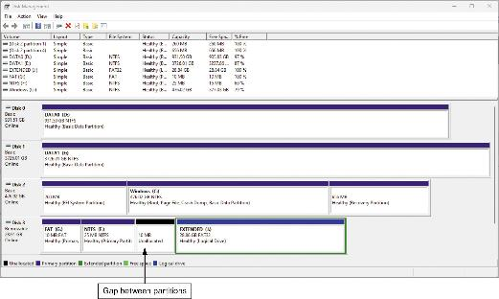
Hiding Data (3 of 4)
Figure 8-11 The Disk Management window showing a gap between partitions

Slide 33
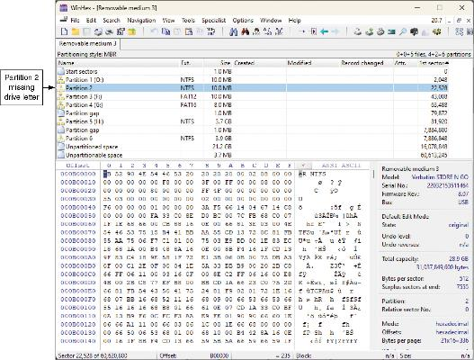
Hiding Data (4 of 4)
Figure 8-12 Viewing a hidden partition in WinHex

Slide 34
Marking Bad Clusters in FAT
A data-hiding technique used in FAT file systems is placing sensitive or incriminating data in free or slack space on disk partition clusters
It involves using old utilities such as Norton DiskEdit
You can mark good clusters as bad clusters in the FAT table so the OS considers them unusable
Only way they can be accessed from the OS is by changing them to good clusters with a disk editor
DiskEdit runs only in MS-DOS and can access only FAT-formatted disk media

Slide 35
Using Passwords to Protect Files (1 of 3)
Password-cracking tools are available for handling password-protected data or systems
Some are integrated into digital forensics tools
Stand-alone tools include the following:
Last Bit, AccessData PRTK, ophcrack, John the Ripper, and Passware
These tools use a dictionary attack or brute-force attack to crack passwords

Slide 36
Using Passwords to Protect Files (2 of 3)
Brute-force attacks use every possible letter, number, and character found on a keyboard
This method can require a lot of time and processing power
In a dictionary attack, the program uses common words found in the dictionary and tries them as passwords
Most use a variety of languages
With many programs, you can build profiles of a suspect to help determine their password

Slide 37
Using Passwords to Protect Files (3 of 3)
Rainbow table is a file containing the hash values for every possible password that can be generated from a computer’s keyboard
No conversion necessary, so it is faster than a brute-force or dictionary attack
Salting passwords is a technique that alters hash values and makes cracking passwords more difficult
When attempting to crack a password, research the encryption method used by the application or OS

Slide 38
Identifying Media File Fragments
Recovering any type of file fragments is called carving, also known as salvaging outside North America
Many digital forensics programs can carve from file slack and free space
Helps identify image files fragments and put them together

Slide 39
Determining Unknown File Formats
As part of your investigation, you may need to research both old and new file types to better understand the purpose of each file type and how it stores data
The Internet is the best source for learning more about file formats and their extensions
The website File.org provides information on applications capable of viewing a particular file format

Slide 40
Repairing Damaged Headers
When examining recovered fragments from files in slack or free space, you might find data that appears to be a header
If header data is partially overwritten, you must reconstruct the header to make it readable
Compare the hexadecimal values of known media file formats with the pattern of the file header you found
Each graphics file has a unique header value
Example: A JPEG file has the hexadecimal header value FFD8, followed by the label JFIF for a standard JPEG or Exif file at offset 0x06

Slide 41
Searching for and Carving Data
Complete Activity 8-1 to search for JPEG files with altered headers and then extract them for follow-up examination and reconstruction

Slide 42
Rebuilding File Headers (1 of 2)
The process of rebuilding file headers requires knowing what hexadecimal code values are needed for the specific file format
The first step in rebuilding a file’s header is to determine what the expected hexadecimal values are for the specific file format
Update the altered headers to their correct hexadecimal values
Complete Activity 8-2 to correct the altered header hexadecimal codes and preserve the original file

Slide 43
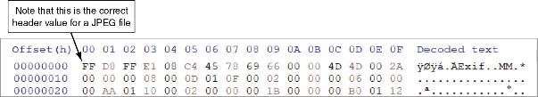
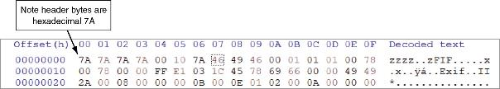
Rebuilding File Headers (2 of 2)
Figure 8-22 Unaltered JPEG file
Figure 8-23 Altered JPEG file

Slide 44
Reconstructing File Fragments (1 of 2)
To reconstruct file fragments, follow these steps:
Locate and export all clusters of the fragmented file
Determine the starting and ending cluster numbers for each fragmented group of sectors
If using HxD, convert starting and ending cluster addresses to the offset byte positions
Copy each fragmented group of sectors in their correct sequence to a recovery file
Add the appropriate extension to the recovered file

Slide 45
Reconstructing File Fragments (2 of 2)
To reconstruct file fragments, follow these steps (continued):
Rebuild the file’s header to make it readable in a graphics viewer
Test the recovered file to see if the reconstruction was successful

Slide 46
Digital Evidence Validation and Discrimination
Ensuring the integrity of data collected is essential for presenting evidence in court
Most forensic tools offer hashing of image files
Using advanced hexadecimal editors ensures data integrity

Slide 47
Using Hash Values to Discriminate Data
AccessData has its own hashing database, Known File Filter (KFF), which is available only with FTK
KFF filters known program files from view and contains the hash values of known illegal files
The advantage of recording hash values is that you can determine whether data has changed
An advantage of using hashes of sectors is that you can look for known file fragments, a process called block-wise hashing

Slide 48
Preparing for the Examination (1 of 3)
The first task is to preserve all evidence
After data is properly preserved, the next step is to write down the objective of the examination
The objective should reflect what was asked for by the requestor or in the complaint
After the objective is documented, you can determine the resources needed to acquire the flash drive’s data
Decide which tools you will use to recover the evidence

Slide 49
Preparing for the Examination (2 of 3)
Follow these basic steps for all forensics examination:
Use recently wiped media that have been reformatted and inspected for viruses
Inventory the hardware on the suspect computer and note the condition of the computer when seized
For static acquisitions, remove the original drive from the computer and check the date and time values in the suspect computer CMOS
Record how you acquired data from the suspect drive
Process data methodically and logically

Slide 50
Preparing for the Examination (3 of 3)
Follow these basic steps for all forensics examination (continued):
List all folders and files on the image or drive
Examine the contents of all data files in all folders
For password-protected files, make your best effort to recover their contents
Identify the function of every executable file that doesn’t match known hash values
Maintain security of the evidence and your work area by limiting access to only authorized persons

Slide 51
Planning the Examination
Processes for examining digital evidence depend on the nature of the investigation
Investigations can result in scope creep, in which an investigation expands beyond the original description because of unexpected evidence you find
Scope creep has become more common because criminal investigations require more detailed examination of evidence just before trial to help prosecutors

Slide 52
Performing the Examination
The steps to perform an examination are divided into three stages:
Stage 1: Preparing for the examination
Stage 2: Conducting the examination
Stage 3: Report findings from the examination

Slide 53
Knowledge Check Activity 8-2
What is the term for the process of making readable code to appear as binary code?
Shifty bits
Trim bits
Bit-shifting
Bit-trimming

Slide 54
Knowledge Check Activity 8-2: Answer
What is the term for the process of making readable code to appear as binary code?
Answer: c. bit-shifting
Bit-shifting, a data obfuscation method, can make readable code appear as binary executable when viewed through a hexadecimal analysis tool, such as WinHex or HexWorkshop.

Slide 55
Self Assessment
How is vector graphic data stored in a picture file?
What is the first task to complete when planning a digital forensics examination?

Slide 56
Summary
Now that the lesson has ended, you should be able to:
Identify different types of media files
Summarize data compression and obfuscation
Define data-hiding techniques
Explain how to locate and recover media files
Explain digital evidence validation and discrimination techniques
Describe an examination plan

